Slide 1
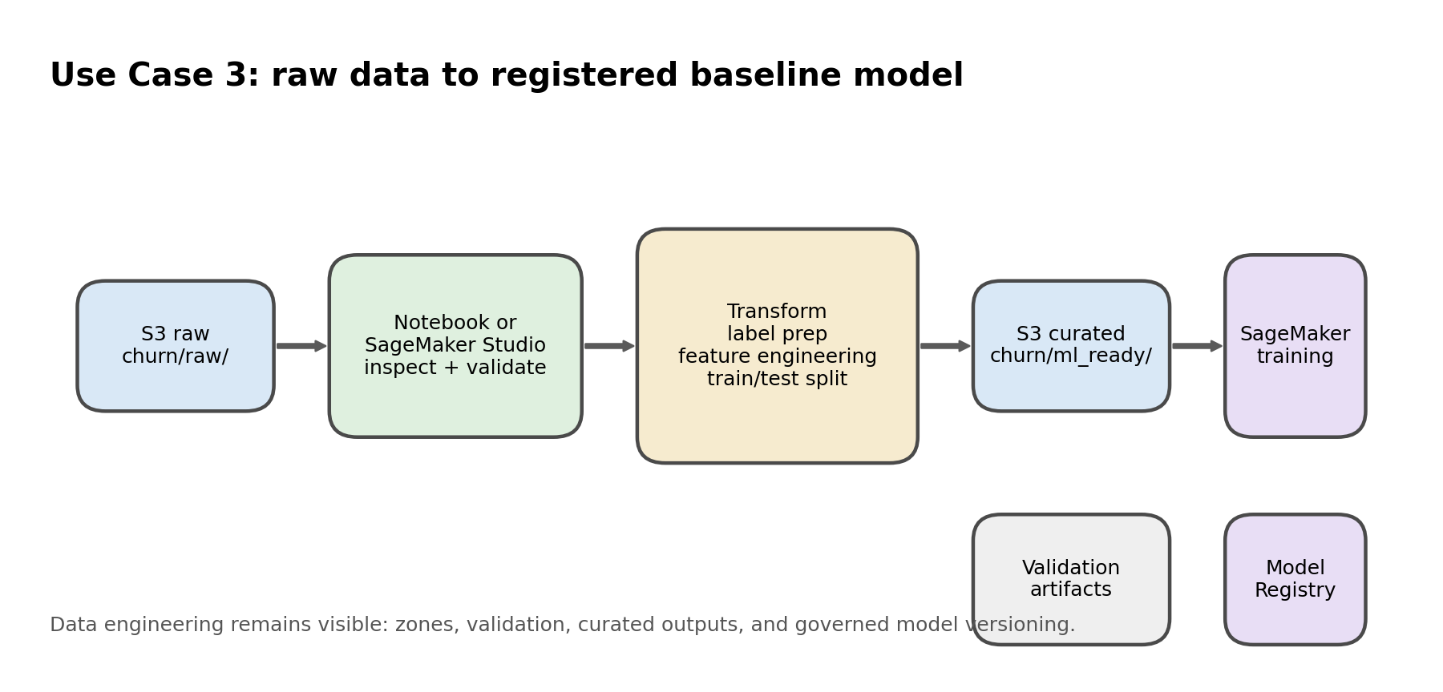
Session 2 - Use Case 3
ETL for ML Preparation on AWS
10-15 min overview deck, then 45-50 min live lab using S3, notebook ETL, and SageMaker.
Business goal
ETL promise
AWS services
Live demo stance
Predict telecom churn while keeping the data-engineering layer visible.
Extract raw churn data, transform and validate it, then publish curated ML-ready outputs.
Amazon S3, notebook, optional Glue bridge, SageMaker, Model Registry.
Because credentials are available, show bucket paths and service screens live.
What learners will hear
• Raw data does not go straight to ML. • Validation and curated publish points come before training. • The model is a downstream consumer of ETL output. • Model Registry is the governed publish step for the model artifact.
Key line: raw -> validate -> transform -> publish -> train -> register
Notes:
[Sources] - AWS Data Engineering Hands-on Labs proposal (user upload) - Generated image: use_case_3_flow.png

Slide 2
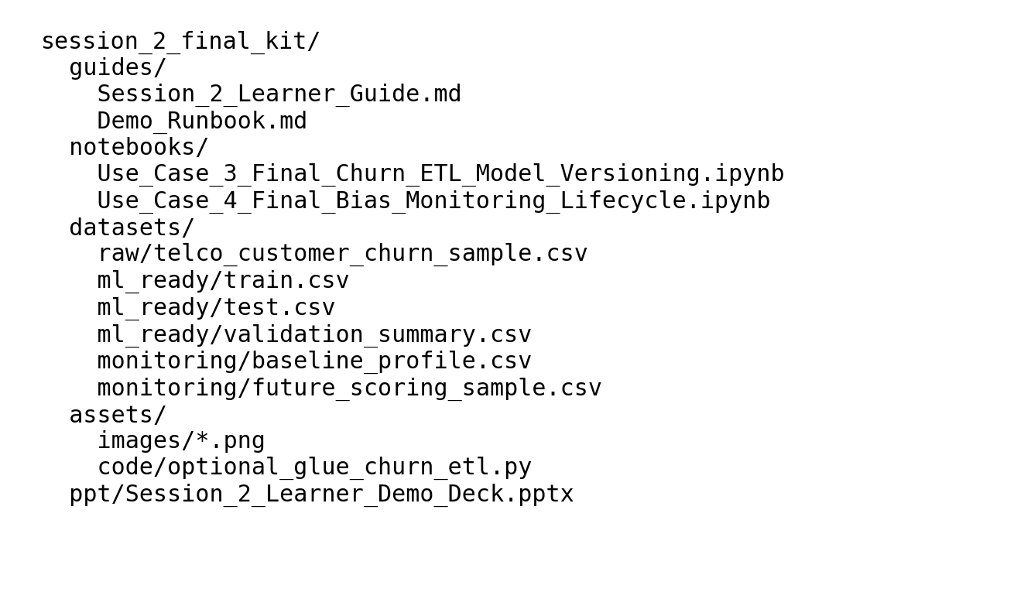
Use Case 3 service map
AWS services and ETL responsibilities
Keep the language anchored on ETL jobs, zones, validation, and publish points.
Amazon S3
Notebook / SageMaker Studio
AWS Glue bridge
SageMaker + Registry
Stores the raw churn file, curated train/test outputs, and validation artifacts.
Runs profiling, standardization, feature engineering, and validation checks.
Optional production story: convert the notebook logic into a repeatable PySpark ETL job.
Train the baseline model, then register the model version for approval and traceability.
Presenter cue
• S3 is the zone system. • The notebook shows ETL logic step by step. • Glue is the productionization workaround. • SageMaker consumes curated data and publishes the model version.
Do not describe Use Case 3 as ML instead of ETL. Describe it as ETL for ML preparation.
Notes:
[Sources] - AWS Data Engineering Hands-on Labs proposal (user upload) - Generated image: folder_map.png

Slide 3
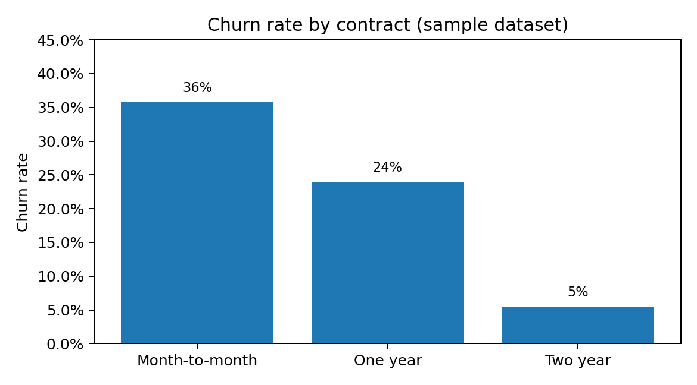
Use Case 3 hands-on flow
What to do in the 45-50 minute lab
Move quickly from explanation to the notebook and S3 bucket paths.
1
1. Land raw data
Show churn/raw/ in S3 and explain why a raw zone matters.
2
2. Profile
Run schema, null, blank, duplicate, and label checks.
3
3. Transform
Clean TotalCharges, create label, and engineer features.
4
4. Validate
Capture validation_summary so quality checks become a stored artifact.
5
5. Publish
Write train.csv and test.csv into churn/ml_ready/.
6
6. Train and register
Train baseline model and explain Model Registry as the governed publish step.
Keep the model discussion brief. Spend most of the time on raw, curated, and artifact-producing ETL steps.
Notes:
[Sources] - AWS Data Engineering Hands-on Labs proposal (user upload) - Generated image: churn_by_contract.png

Slide 4
Use Case 3 outputs
What learners should leave with
Focus on the concrete files and why they exist.
Curated datasets
Best management-facing line
train.csv and test.csv are the ETL publish outputs that feed SageMaker training.
Use Case 3 shows ETL for ML preparation: raw churn data is extracted from S3, transformed and validated in a notebook, loaded into a curated path, then consumed by SageMaker for training and governed model versioning.
Validation artifacts
validation_summary.csv proves that quality checks were run before publish.
Governed model outputs
evaluation_summary.json and model_registry_manifest.json turn the model into a reviewable product.
This is the slide to use when management asks how ETL remains visible in Session 2.
Notes:
[Sources] - AWS Data Engineering Hands-on Labs proposal (user upload)

Slide 5
Use Case 3 workarounds
How to keep the demo smooth in a 1-hour slot
Use live AWS screens where helpful, but do not let heavy jobs take over the session.
• If a managed training job would take too long, run the ETL notebook and train locally for speed while still explaining the SageMaker path. • Show the S3 prefixes and the curated outputs even if you do not wait for every AWS screen to complete. • Use the optional Glue script to explain how the notebook ETL becomes a repeatable job later. • Close with the simple summary: S3 lands it, notebook shapes it, Glue can productionize it, SageMaker trains it, Registry governs it.
Optional production add-ons
Step Functions for orchestration, EventBridge for scheduling, CloudWatch for logs and alerts.
What not to lose
The raw -> curated -> artifact story matters more than showing every SageMaker screen in full.
Closing line
Good models start with strong ETL discipline and clean published datasets.
Allocate roughly 12 minutes to slides and the rest to the notebook plus S3 walkthrough.
Notes:
[Sources] - AWS Data Engineering Hands-on Labs proposal (user upload)

