Slide 1
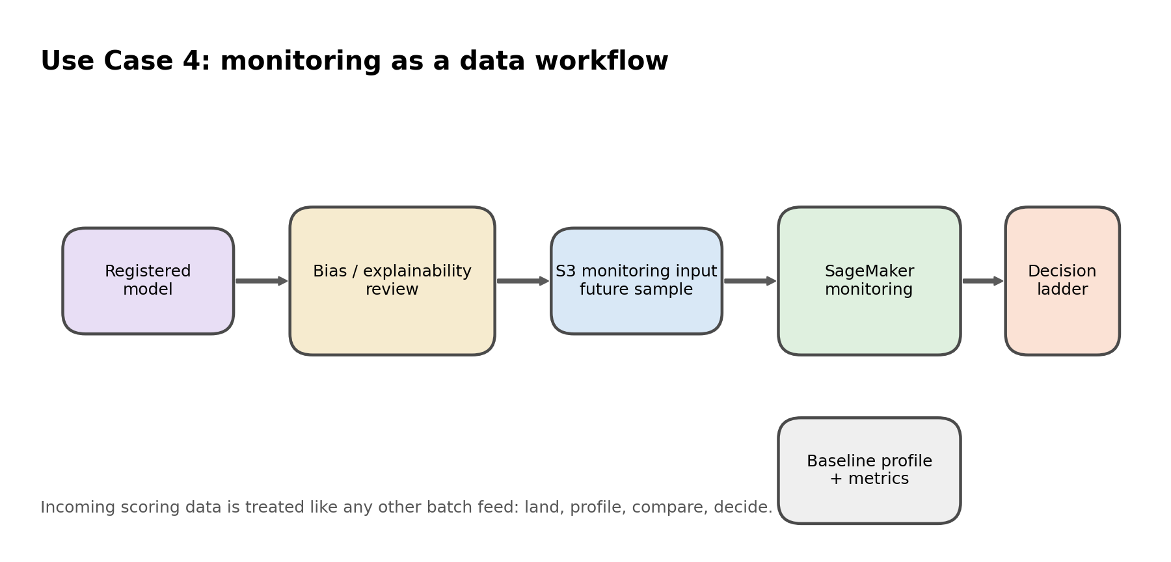
Session 2 - Use Case 4
ETL for Monitoring and Model Review on AWS
10-15 min overview deck, then 45-50 min live lab using baseline artifacts, incoming batches, and SageMaker concepts.
Business goal
ETL promise
AWS services
Live demo stance
Keep the churn model trustworthy when new production data arrives.
Treat monitoring as another batch workflow: land, profile, compare, decide.
Amazon S3, notebook, optional Glue bridge, SageMaker monitoring and review.
Use live S3 paths and explain how SageMaker operationalizes the review logic.
What learners will hear
• Monitoring is still data engineering. • Incoming scoring files are just another managed batch input. • Bias and explainability checks complement drift checks. • Lifecycle decisions come from stored findings and review artifacts.
Key line: baseline -> incoming batch -> compare -> review -> decide
Notes:
[Sources] - AWS Data Engineering Hands-on Labs proposal (user upload) - Generated image: use_case_4_flow.png

Slide 2
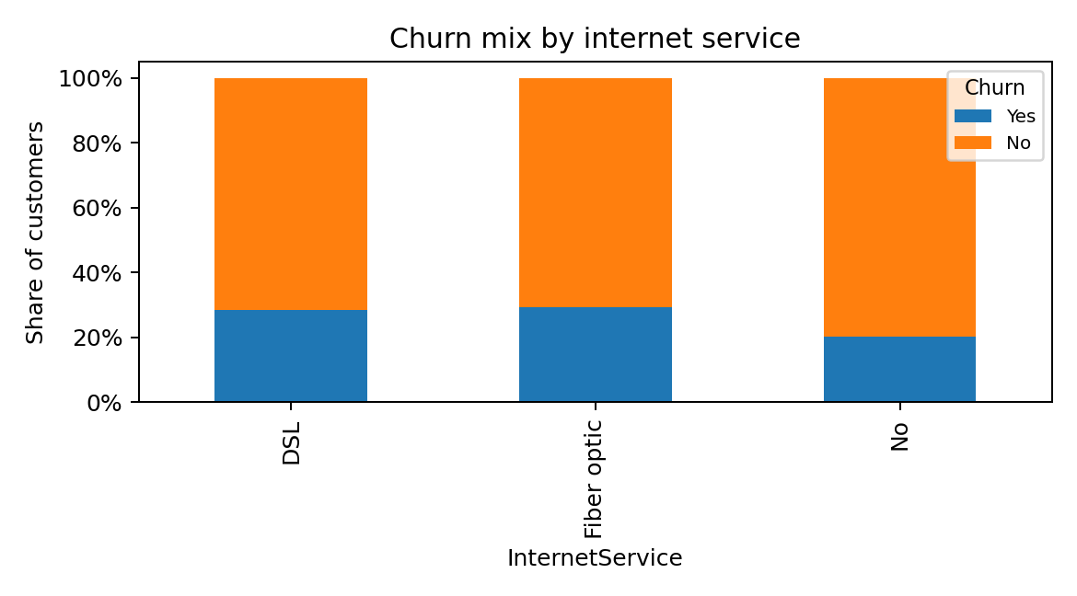
Use Case 4 service map
AWS services and ETL responsibilities
Use the phrase “monitoring data workflow” repeatedly.
Amazon S3
Notebook / SageMaker Studio
AWS Glue bridge
SageMaker review
Stores baseline datasets, incoming scoring files, and monitoring outputs.
Builds baseline profiles, compares incoming batches, and explains findings.
Optional production story: recurring profile and comparison jobs.
Bias / explainability review, monitoring concepts, and controlled model decisions.
Presenter cue
• The baseline is a stored artifact from Use Case 3. • The future scoring sample is another S3 landing pattern. • Glue is the ETL job workaround for recurring profile generation. • SageMaker turns these review steps into operational model governance.
Describe the model as under review, not as a static finished asset.
Notes:
[Sources] - AWS Data Engineering Hands-on Labs proposal (user upload) - Generated image: churn_mix_by_internet.png

Slide 3
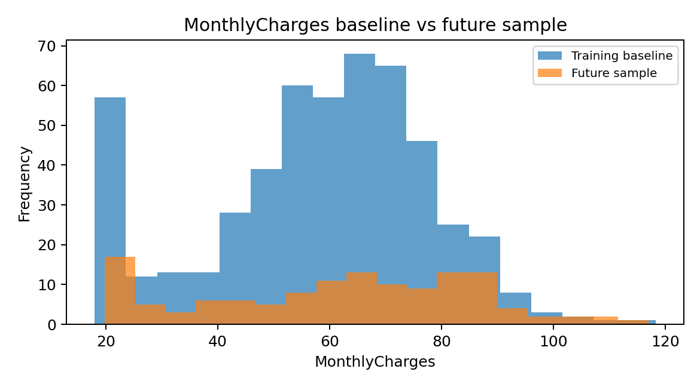
Use Case 4 hands-on flow
What to do in the 45-50 minute lab
The lab should feel like data observability and review, not abstract theory.
1
1. Load baseline
Re-use the curated training baseline from Use Case 3.
2
2. Build profile
Create or load the baseline profile artifact.
3
3. Land incoming batch
Show future_scoring_sample.csv as a new S3 batch input.
4
4. Compare
Run mean-shift and category-shift checks against the baseline.
5
5. Review
Discuss bias or explainability using customer segments.
6
6. Decide
Use the decision ladder: retain, review, retrain, or rollback.
Use the graph only as a visual hook. The main teaching point is the comparison process and the stored findings.
Notes:
[Sources] - AWS Data Engineering Hands-on Labs proposal (user upload) - Generated image: monthlycharges_baseline_vs_future.png

Slide 4
Use Case 4 outputs
What learners should leave with
Focus on the evidence trail that supports the lifecycle decision.
Monitoring inputs
Best management-facing line
baseline_profile.csv and future_scoring_sample.csv make the review reproducible.
Use Case 4 shows ETL for monitoring: baseline artifacts and incoming scoring data are extracted from S3, transformed into comparable profiles, reviewed for drift and explainability, then published as findings that drive a controlled model decision.
Review artifacts
drift_findings.csv and segment_churn_summary.csv turn observations into evidence.
Lifecycle artifact
monitoring_decision_manifest.json captures the retain / review / retrain / rollback narrative.
This is the slide to use when management asks how ETL remains visible after training.
Notes:
[Sources] - AWS Data Engineering Hands-on Labs proposal (user upload)

Slide 5
Use Case 4 workarounds
How to keep the demo smooth in a 1-hour slot
Do not let monitoring tooling complexity hide the simple batch workflow story.
• If full managed monitoring would take too long, run the notebook comparison locally and explain how SageMaker Model Monitor or Clarify operationalize the same logic. • Show the S3 monitoring prefix and the stored findings even if you do not wait for heavy managed jobs to complete. • Use the optional Glue script to explain recurring profile-generation jobs. • Close with the simple summary: S3 lands it, notebook or Glue profiles it, SageMaker reviews it, findings drive lifecycle action.
Optional production add-ons
Step Functions for orchestration, EventBridge for schedules, CloudWatch for alarms and job visibility.
What not to lose
The core lesson is not a SageMaker feature tour. It is a monitoring ETL process with stored outputs.
Closing line
Production ML depends on continuous data engineering controls.
Allocate roughly 12 minutes to slides and the rest to the notebook plus S3 walkthrough.
Notes:
[Sources] - AWS Data Engineering Hands-on Labs proposal (user upload)

