Slide 1
ML – Project Predicting Employee Attrition & Estimating Financial
Team Members: [SE23UCSE_005_006_022_075_096]
Course Name: [Machine Learning]
Instructor: [Om Prakash]
Date: [2/5/25]

Slide 2
Problem Statement
• Predict employee attrition (classification)
• Predict future salaries for likely-to-stay employees (regression)
• Estimate financial loss from attrition
• Real-world value: HR planning, retention, cost forecasting

Slide 3
Dataset Overview
• Dataset: IBM HR Analytics Employee Attrition
• Features: Age, Gender, JobRole, MonthlyIncome, YearsAtCompany, PerformanceRating, etc.
• Source: Kaggle
• Type: Tabular data

Slide 4
Data Cleaning & Preprocessing
• Handle missing values
• Encode categorical variables
• Normalize numerical values (for SVM/SVR)
• Drop redundant columns
• Split data into train-test sets

Slide 5
Part 1 – Attrition Prediction (Classification)
• Models: Logistic Regression, Decision Tree, SVM
• Metrics: F1-score, AUC-ROC
• Output: Binary prediction of employee attrition

Slide 6
Part 2 – Salary Simulation (Data Augmentation)
• Approach:
- Fixed Growth: FutureSalary = MonthlyIncome × 1.08
- Performance-based increment using rating
• Creates ground truth for regression

Slide 7
Part 3 – Salary Prediction (Regression)
• Models: Random Forest, Ridge
• Metrics: R² Score, RMSE
• Goal: Predict future salary based on employee features

Slide 8
Part 4 – Identifying Likely-to-Stay Employees
• Use P_stay = 1 - P_leave
• Threshold: e.g., P_stay > 0.6
• Apply regression only on filtered employees

Slide 9
Part 5 – Estimating Expected Financial Loss
• Expected Loss = P_leave × FutureSalary
• Sum over all employees
• Helps quantify cost of attrition

Slide 10
Code & GitHub Integration
• Languages: Python (pandas, scikit-learn, matplotlib)
• GitHub: [https://github.com/ar-five5/mL_Project/tree/main]
• Includes: Jupyter notebooks, graphs, model evaluations

Slide 11
Key Takeaways & Future Work
• Predict attrition and quantify its cost
• Support HR decision-making
• Future: Add time-series trends, use real salary datasets

Slide 12
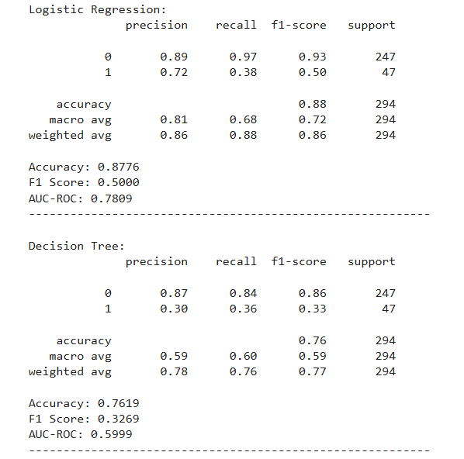
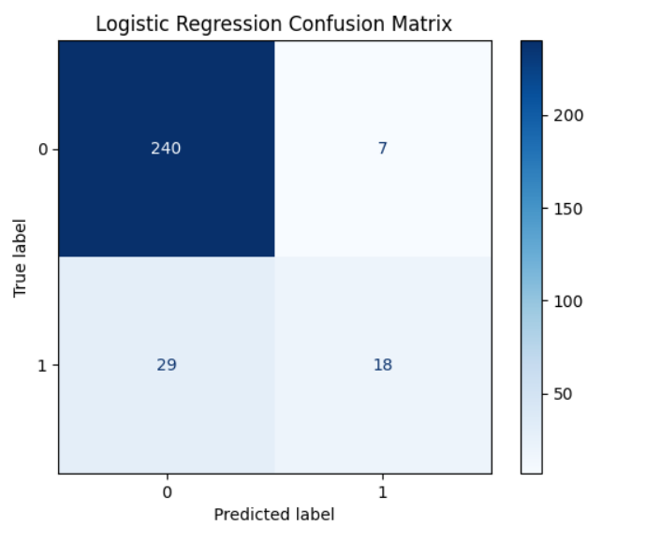
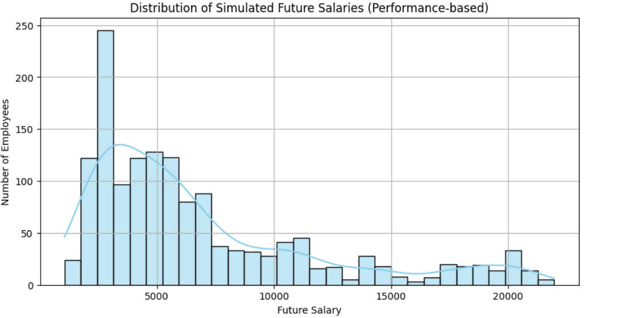
Graphs and Results

Slide 13
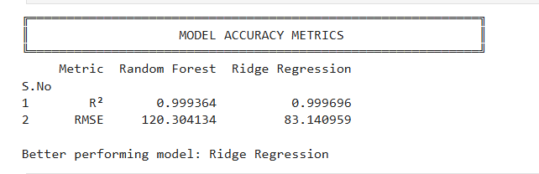
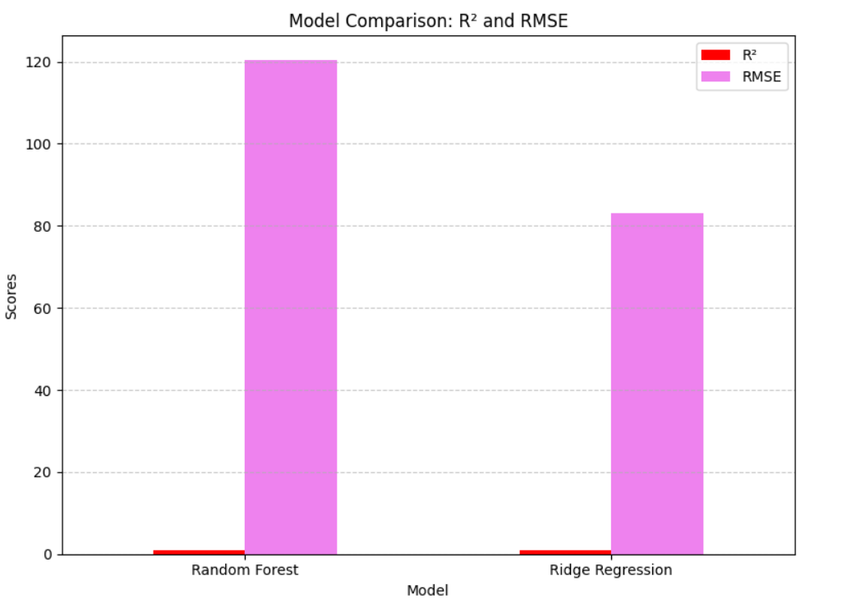
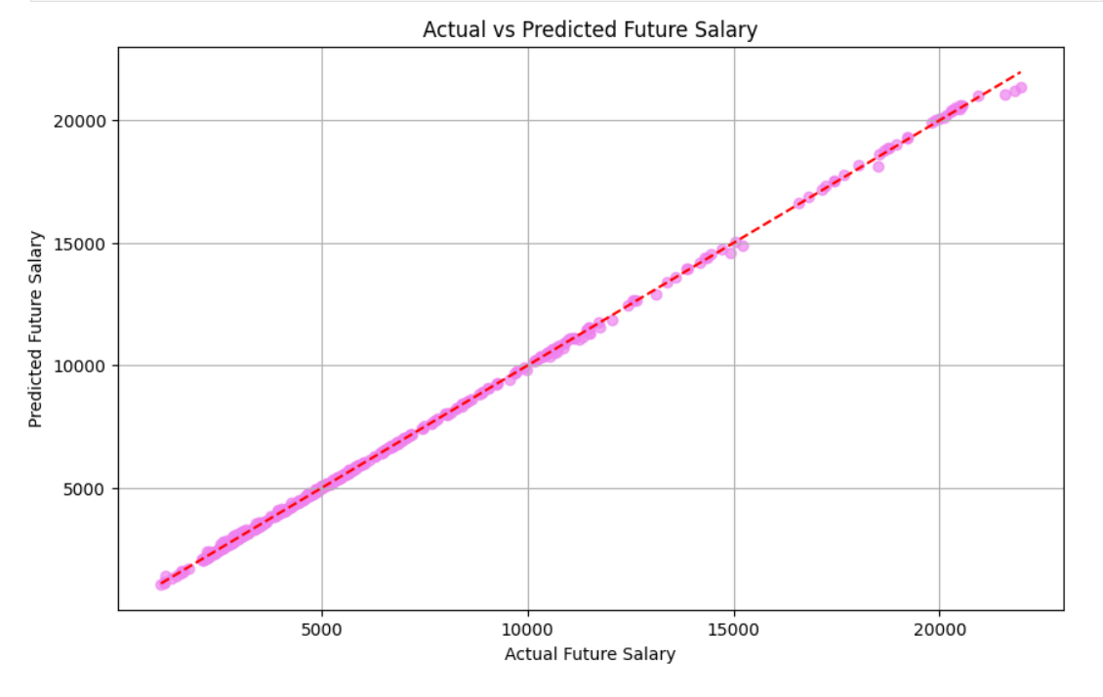
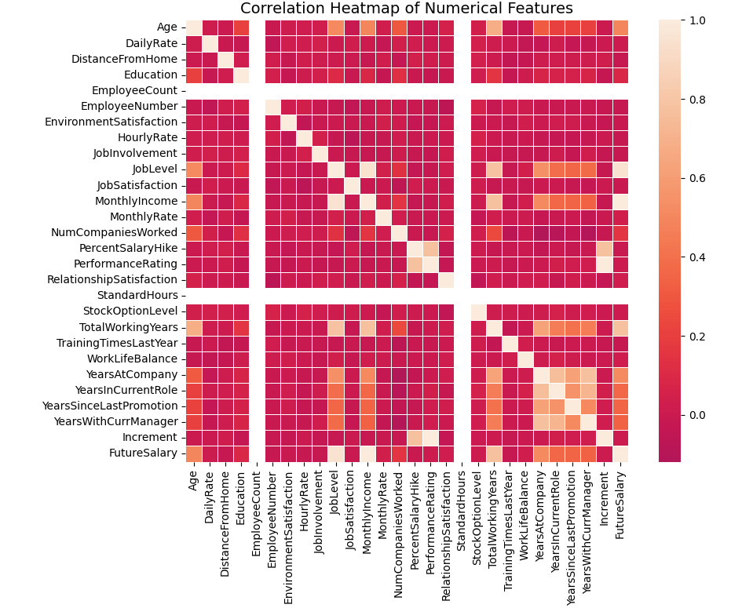

Slide 14
Thank You!

