Slide 1

AGODA · SUPPLY ANALYTICS CASE STUDY
THE URGENCY MESSAGE
Do hotel prices really rise as check-in approaches & where should an urgency nudge be?
49,061
5 cities
~ 0
ABHISHEK RAJ
Bookings Analyzed
Q4 | Oct-Dec 2016, 880 hotels
Real price trend to check-in
Notes:
This case study asked whether hotel prices genuinely rise as check-in approaches, and where Agoda should surface an urgency nudge. I'll give you the answer upfront, then show you the full journey in the data.

Slide 2





EXECUTIVE SUMMARY
The answer, before the journey
What I found, what it means, and what to do about it.
Bottom line: Hotel prices do not systematically rise as the check-in date approaches, the apparent 39.5% move is selection bias. So, urgency messaging should be honest and targeted : price-rise only where the data backs it.
What I tested
What's true
The opportunity
What to do
Across 49K bookings, how the price paid moves as the check-in date approaches.
Within the same room-night the trend is ~0 (p=0.88). Prices are volatile, not directional.
City D + Weekend + 4-5 star rises 82% of the time - a genuine, honest target
Reserve price-rise for proven segments; A/B test before scaling.
Notes:
Bottom line: the price-rise claim is false on average. The apparent 39.5% move is selection bias - I'll show you exactly what causes it. Once I hold everything else constant and compare the same room-night to itself, the effect is statistically zero, p equals 0.88.
But the opportunity isn't dead. It moves from 'all guests' to where prices genuinely do rise — and in one segment that's 82% of the time. So the recommendation is targeted, honest messaging, not a blanket claim.

Slide 3


THE BRIEF & MY APPROACH
From a tempting trend to a causal answer
The Product Owner wants an urgency message. First, I had to check if its premise is even true.
Step 1 Explore
The premise to test
Profile 49064 bookings; map how price behaves as the check-in date approaches, fix incorrect accommodation type name & remove
check-in date < booking date cases (3 cases).
"Prices have been rising, book now to lock in your rate."
Step 2 Control for mix
Hold star rating, chain, city & weekend constant, then compare each hotel to itself : strips out which hotels book when, not just which prices move.
If true, urgency messaging is justified. If not, I'd be misleading customers - a trust and compliance risk. The data must decide.
Step 3 Isolate the signal
Narrow to the same hotel on the same night, booked at different times : the clean test, where only timing varies.
Step 4 Translate
Turn the finding into a targeted, honest recommendation where the message is true, where it misleads, and what to do.
Notes:
The Product Owner wants an urgency message. Before I could design it, I had to verify its premise. A false claim is a trust and compliance risk — not just an analytics problem.
My four steps: explore the data and fix data quality issues; add observable controls to see how much the timing effect shrinks; then compare each hotel to itself to remove all hotel-level confounding; and finally narrow to the same room-night at different booking times — that's the cleanest possible test, where only timing varies. The conclusion flows directly from that progression."

Slide 4
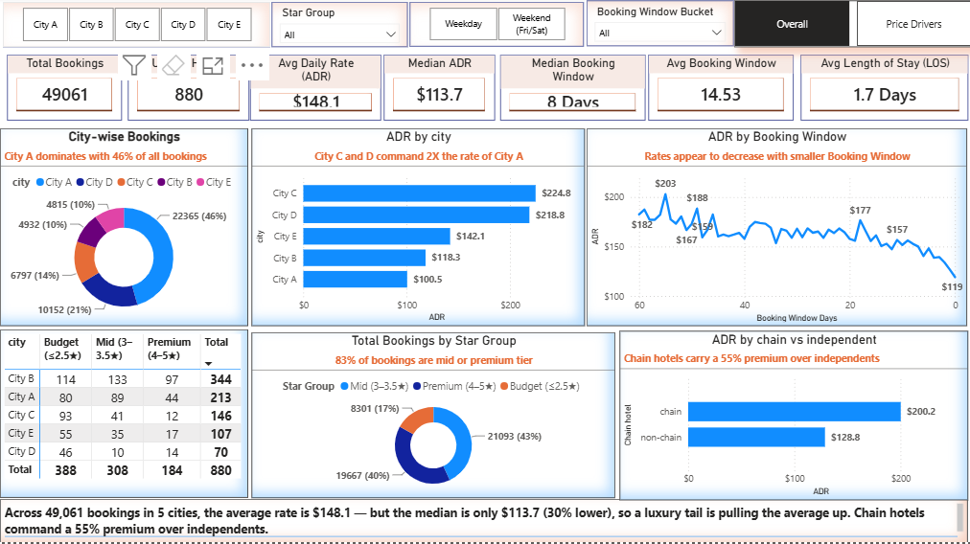
01 · THE DATA
A clean, well-behaved sample : with one telling detail in the averages.
Live & Interactive Dashboard : Executive Overview
Median over mean : $148 avg vs $114 median - a luxury tail inflates the average.
High intent, late funnel : 47.9%
book within 8 days of check-in date
Length of Stay : 1.7 Days is the average stay length of the bookings
Late-funnel : Half of all bookings happen within 8 days of check-in.
Concentrated : City C & D command ~2x the rate of City A; chain hotels carry a 55% premium.
Notes:
49,061 clean bookings across 5 cities, 880 hotels, Q4 2016. Three data quality fixes: corrected a misspelled accommodation-type column, removed 3 rows where check-in predates booking — logically impossible. Everything else was clean.
Two things to flag from the EDA: half of all bookings happen within 8 days of check-in — this is a late-funnel, high-intent dataset. And mean ADR is $148 versus a $114 median — a luxury tail inflates the average, so I'll use median where appropriate. I'll also pause on that 47.9% late-funnel number later — it has direct implications for where to place the nudge.
Before I touched booking window at all, I wanted to understand what genuinely drives price. Star rating dominates — 5-star rooms average $281 versus roughly $50 for budget. That's a 5x gap. Weekend adds 16%, chain adds 55%. These are the structural drivers. Booking timing, as you'll see, is almost irrelevant by comparison

Slide 5
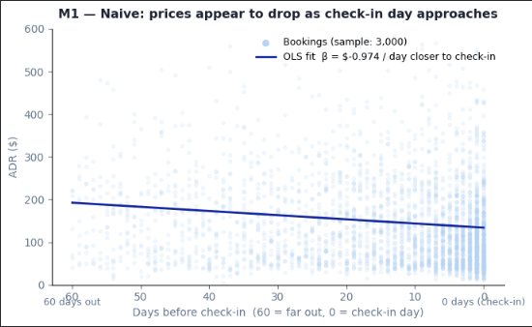
02 · THE NAIVE VIEW
The tempting first look : prices appear to drop toward check-in
ADR appears ~39.5% higher far out and lower toward check-in : the apparent case for urgency.
M1 : ADR vs booking window (every booking)
-$0.974 / day × 60 days = −$58 swing (−39.5%)
Implied ADR move across 60 to 0 days before check-in
The trap: This compares different bookings for different hotels. Reading 60 days out down to check-in, the raw line slopes down, so prices look lower near check-in : so “prices are rising” is already wrong for the average guest.
R² = 0.013. Booking Window explains barely 1% of price. Something structural is doing the real work.
Notes:
Here's the tempting first look. Plot average daily rate against booking window — 60 days out down to zero — and I got an apparent 39.5% price drop as check-in approaches. That's a minus $58 swing. It looks like prices are rising as you book early and falling near the check-in date date.
But notice R-squared is 0.013. Booking window explains barely 1% of price variation. Something structural is doing the real work — and that R-squared is the tell. What M1 is actually doing is comparing expensive hotels that book early against cheap hotels that book late. It's a hotel-mix comparison masquerading as a time trend. The naive reading would have us show a price-rise message that's actually driven by selection, not timing.

Slide 6
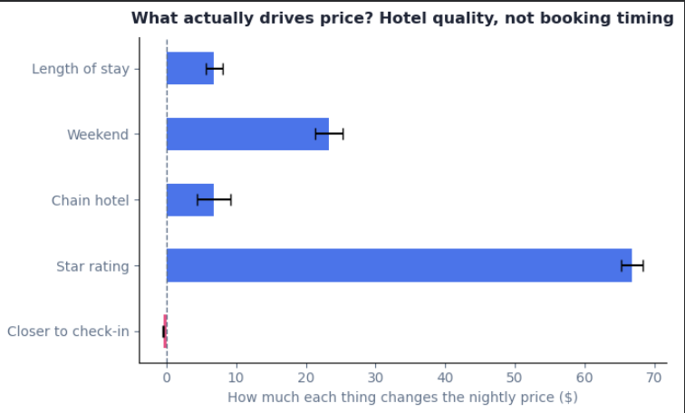
03 · CONTROL FOR MIX
Model 2 : Hold hotel quality and season constant
Add star rating, chain, weekend, length of stay, city and month. The timing effect shrinks toward zero ( -17%).
-$0.974 → -$0.423 / day
the per-day effect (closer to check-in) after observable controls
Star rating dominates. A star upgrade is worth ~$67, it dwarfs every other driver and is exactly what M1 ignored.
Timing is tiny. The "closer to check-in" bar is barely visible next to quality : when you book matters far less than what the hotel is.
R² jumps to 0.41. Quality, city and season explain 41% of price, versus 1% for timing alone.
Still mixes different hotels together : M3 compares each hotel only to itself.
Notes:
Model 2 adds the structural controls: star rating, chain status, weekend, length of stay, city, and month. The per-day timing effect shrinks from minus 97 cents to minus 42 cents — a 57% reduction just by holding observable quality constant. R-squared jumps from 1% to 41%. Star rating alone is worth about $67 per tier — it utterly dwarfs the timing effect.
M2 is better than M1. But it still mixes different hotels. What if there are unobserved quality differences — boutique feel, location within the city — that we can't capture with star rating? That's what M3 fixes.

Slide 7
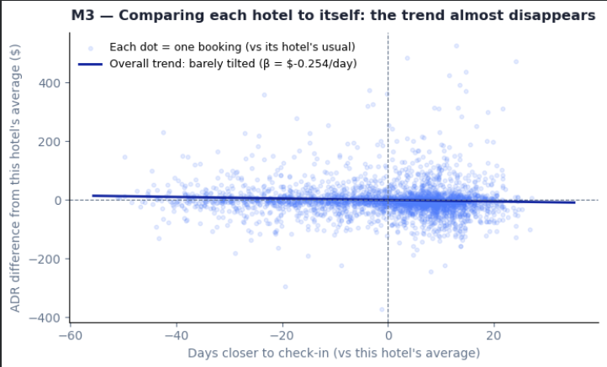
04 · COMPARE LIKE WITH LIKE
Model 3 : Compare each hotel to itself
Subtract each hotel's own averages : only within-hotel variation remains. The effect shrinks further (-10%).
-$0.423 → -$0.254 / day
Booked later than usual
ADR higher than usual
within-hotel effect, clustered by hotel
Booked earlier than usual
ADR higher than usual
The mix is gone. Each hotel is compared only to itself, so hotel-quality bias is removed by construction.
The line goes flat. Across a -$400 to +$500 spread the slope barely tilts - timing is nearly irrelevant within a hotel.
A third still vanished. The shrink from -$0.42 to -$0.25 was unobserved quality that star rating alone could not capture.
Booked earlier than usual
ADR lower than usual
Booked later than usual
ADR lower than usual
Within a hotel, room types still differ : M4 compares the same room-night to itself.
Notes:
Model 3 compares each hotel to itself. I subtract each hotel's own average price and its own average booking window — what remains is purely within-hotel variation. No hotel can confound itself. The timing effect shrinks again, from minus 42 to minus 25 cents per day.
Look at the scatter. Across a $400-to-$500 price spread, the regression line is nearly flat. The quadrant labels tell the story: bookings sit in all four corners — booked earlier and priced higher, booked later and priced higher, and both opposites. There's no consistent pattern. The remaining minus-25-cent effect is tiny, and another chunk of it still vanished moving from M2 to M3 — that was unobserved quality that star rating couldn't capture. But are room-types within a hotel comparable? M4 solves that.

Slide 8
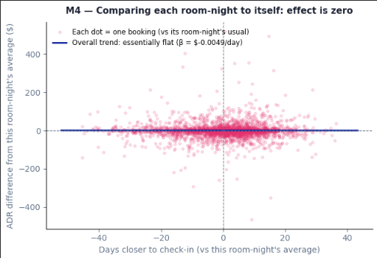
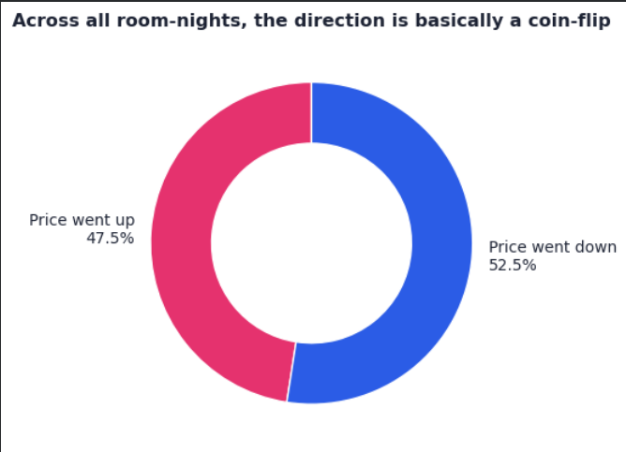
05 · THE CLEAN TEST
Model 4 : Same room-night, and the coin-flip
Compare the same hotel on the same night at different booking windows. The effect is statistically zero.
Why the average is zero
47.5% rise / 52.5% fall
For any given room-night the price is as likely to fall as to rise : a coin-flip. The rises and falls cancel out, which is why the model average lands at zero. Most slopes sit very close to zero, with only thin tails of dramatic movement.
-$0.005 / day (p = 0.88)
95% CI [-0.06, +0.07] crosses zero : indistinguishable from no effect.
Notes:
Model 4 is the cleanest test possible. I group by hotel-and-check-in-date — I call these stay-nights — so I'm literally comparing the same room on the same night booked at different points in time. The only thing varying is timing. The coefficient is minus half a cent per day. P equals 0.88. The 95% confidence interval runs from minus 6 cents to plus 7 cents — it crosses zero comfortably. This is indistinguishable from no effect.
But is the average zero because nothing is happening, or because rises and falls cancel? The coin-flip analysis answers that. For every stay-night with five-plus observations, I fit a per-stay slope. Result: 47.5% rising, 52.5% falling. Nearly exactly a coin-flip. The rises and falls genuinely cancel. Prices are volatile, not directional — and that volatility is where the opportunity lives.

Slide 9



06 · THE VERDICT
It's selection bias : not a price trend
Premium inventory sells early; cheaper and distressed rooms remain near the date. That mix created the illusion.
“Prices rising”
47.5% / 52.5%
Honest by need
A factual price claim. My analysis shows it is false on average and only true in narrow segments, so use it sparingly and only where proven.
For any given room-night, price is as likely to fall as rise : a coin-flip.
A blanket “prices are rising” claim would mislead ~half of guests ; layer the price-rise message only on proven >50% segments.
The myth is debunked but the opportunity isn't dead. It just moves from whether prices rise to where they genuinely do.
Notes:
The four-model collapse tells one coherent story. Minus 97 cents naive. Minus 42 cents after controls. Minus 25 cents comparing each hotel to itself. Minus half a cent for the same room-night — statistically zero.
The 39.5% was selection bias, pure and simple. Premium inventory fills early at high prices. Cheaper and distressed rooms linger near the date. That composition shift is what the raw data was capturing — not a real price trend.
What does this mean for messaging? A blanket 'prices are rising' claim would mislead roughly half of guests. That's a trust risk and potentially a compliance risk. But — and this is important — the finding doesn't kill the opportunity. It redirects it from 'do prices rise on average?' to 'where do prices genuinely rise?' That's the segmentation question.

Slide 10
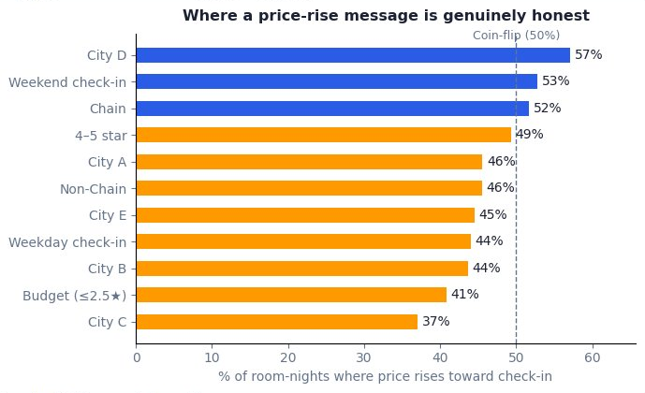
07 · THE OPPORTUNITY
Where the message is genuinely honest ?
HERO TARGET
City D + Weekend + 4-5 star
82%
of room-nights genuinely rise toward check-in : here the message is accurate, not a guess.
Rule: price-rise wording only above the 50% line; target the top 3 segments & their combinations.
Notes:
The average is zero. But the distribution is not. Some segments genuinely and consistently see prices rise toward check-in. The hero target I found: City D, weekend, 4-5 star hotels. 82% of room-nights in this segment show rising prices. That's not noise — that's a real signal.
My rule: use price-rise wording only above the 50% threshold — only where the message is more likely true than false. Below that, default to scarcity. The 82% segment is where I'd concentrate the price-rise message first. And I'd layer it on the property page and booking form — the high-intent funnel stages where 47.9% of bookings already sit.

Slide 11
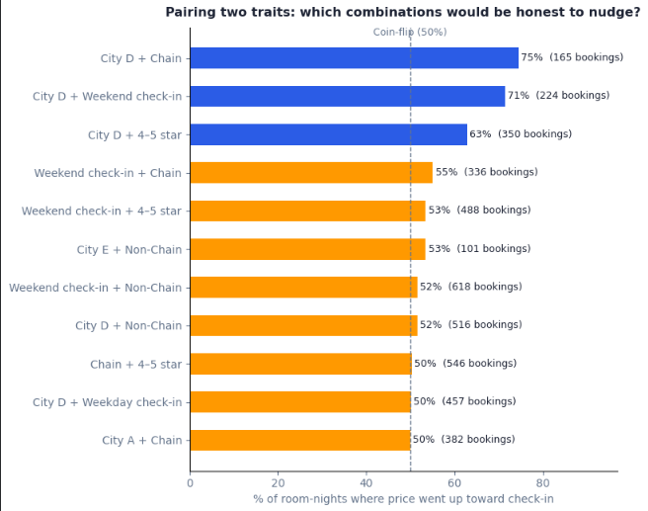
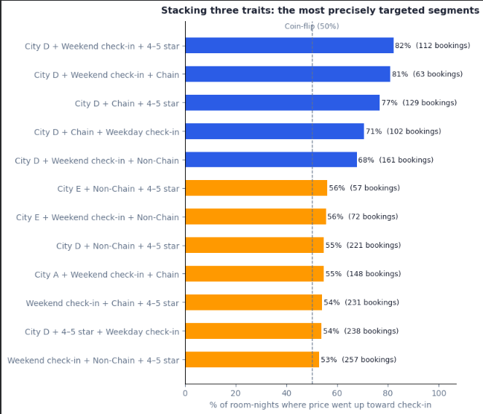
08 · WHERE IT'S REAL
The average is flat : the segments are not
Stacking honest signals : the more aligned the segment, the more often prices genuinely rise.
Top 2-way combinations
Top 3-way combinations
Notes:
This slide shows the full segmentation: 2-way, and 3-way combinations filtered to at least 50 observations. The pattern is consistent — stacking the right signals compounds the rising-price probability. City D alone is moderate. Add weekend, it climbs. Add 4-5 star, you're at 82%. The more aligned the segment, the more honest and accurate the message. This is also the targeting logic for the A/B test — you'd start with the hero segment and test outward.

Slide 12




09 · RECOMMENDATIONS
Recommendations to the Product Owner
Targeted, honest, and proven before scaling.
Default to scarcity
Use availability-based prompts ("limited rooms left") that hold true regardless of price direction.
Reserve price-rise for proof
Show “prices may rise” only on City D + Weekend + 4-5 star (82%) and other >50% segments.
Place at high intent
Property page & booking form : closest to conversion, where a nudge converts without annoying browsers.
Keep it honest by design
Tie wording to live price & inventory signals : never a fake countdown. Protects trust and compliance.
Notes:
Four recommendations for the PO. First: default to scarcity. Availability-based prompts — 'limited rooms left' — are always true and never require a price direction assumption. They're the safe baseline.
Second: reserve price-rise language for proven segments — City D, weekend, 4-5 star at 82%, and other segments above the 50% threshold. The wording should be tied to live pricing signals, not hardcoded.
Third: placement at high-intent funnel stages — property page and booking form. The EDA showed 47.9% of bookings happen within 8 days. You're reaching guests who are already close to converting. A nudge there converts; on search results pages it mostly annoys.
Fourth: never fake urgency. No static countdowns. Tie every signal to live data — real inventory, real price movement. This protects trust and keeps you on the right side of consumer protection regulation

Slide 13



10 · IMPACT & VALIDATION
Sizing the prize : and proving it safely
Illustrative, driven by conversion uplift on targeted segments.
Conservative
Base case
Optimistic
per 1M eligible sessions
avg booking value ≈ $252 (mean ADR $148 × LOS 1.7)
+0.5% conversion
+1.0% conversion
+2.0% conversion
≈ $1.3M
≈ $2.5M
≈ $5.1M
How I'd validate before scaling
A/B test
Guardrails
Truth audit
Backtest
Property-page split: scarcity vs price-rise vs control. Primary metric = conversion.
Track cancellations, refunds, NPS. Auto-kill if trust metrics regress.
Fire the price-rise claim only where it proves ≥70% accurate.
Re-check segment targeting on a fresh quarter before widening.
Notes:
I sized the opportunity on illustrative assumptions — conversion uplifts of 0.5%, 1%, and 2% on eligible sessions, with average booking value of $252. Conservative case is $1.3M; base case $2.5M; optimistic $5.1M per million eligible sessions. These are directional, not a revenue forecast.
The validation path matters more than the sizing.
First: an A/B test — property page split between scarcity, price-rise, and control, with conversion as the primary metric.
Second: guardrails on cancellations, refunds, and NPS — if trust metrics regress, auto-kill the treatment.
Third: a truth audit — fire the price-rise claim only where it proves accurate above 70% in real-time data.
Fourth: backtest on fresh data before widening beyond the hero segment

Slide 14
11 · RIGOUR & CANDOUR
Assumptions, limitations & what's next
Stated up front : every conclusion rests on these, and each is testable.
Assumptions I made
Limitations of the data
Data that would sharpen it
Fri & Sat are considered as weekend days due to price increase.
ADR is a fair proxy for the price a shopper saw.
Bookings imply the room was available at that price and time.
Within a hotel+date, room-nights are comparable enough to compare.
An urgency nudge can measurably shift conversion.
Realised bookings only : no quoted prices or un-booked sessions.
No room type, rate plan or cancellation policy in the data.
No occupancy or competitor pricing : can't see demand pressure.
One quarter, 5 cities, up to 3-night stays, 2016 vintage.
Daily price quotes per room-night : a true price-over-time panel.
Funnel events: impressions, clicks, conversion by step.
Real-time occupancy / inventory remaining per property.
Competitor rates and demand/event signals; customer segment.
Validating the assumptions: the A/B test confirms the conversion assumption; a daily price-quote feed would directly test the ADR-as-signal and availability assumptions before any rollout.
Notes:
I want to be upfront about what I assumed and what I couldn't test. On assumptions: I defined weekends as Friday and Saturday based on the pricing premium in the data. I used ADR as a proxy for the price a shopper actually saw - that's reasonable but imperfect. I assumed bookings mean the room was available at that price. And I assumed a nudge can measurably shift conversion - that's the A/B test's job to confirm.
On limitations: this is realised-bookings data only. I have no quoted prices, no unbooked sessions, no room type or rate plan, no occupancy or competitor rates. It's one quarter, five cities, 2016. The data that would sharpen everything: daily price quotes per room-night, which would give me a true price-over-time panel; funnel events to measure where in the journey urgency nudges move the needle; and real-time inventory signals. Those gaps are testable — none of them invalidate the core finding, but they'd let us act with more precision.

Slide 15
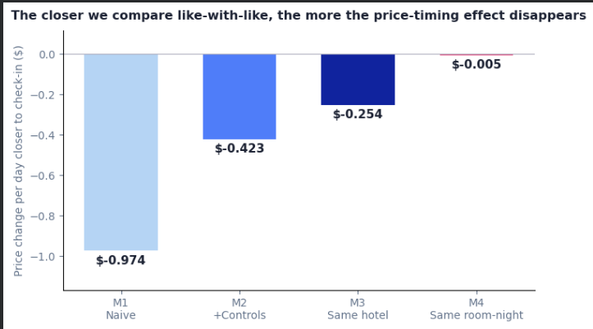
APPENDIX · PYTHON
How I proved it : the statistical test
OLS with progressively tighter controls; the timing effect collapses to zero.
Read the collapse
Naive: -$0.97/day
+ Controls: -$0.42/day
Hotel fixed effects: -$0.25/day
Same room-night: -$0.005/day (p=0.88)
Comparing the same room-night to itself, the effect is statistically zero. The 39.5% was confounding : selection bias, not real price movement. Chain status adds ~$7 and is absorbed by hotel fixed effects.
Notes:
That's the full picture. The price-rise premise is false on average, the opportunity is real in targeted segments, and I've outlined a path to prove it commercially before scaling. Happy to dig into any part of this - the model choices, the segmentation logic, the A/B design, or the data assumptions.

