Slide 1
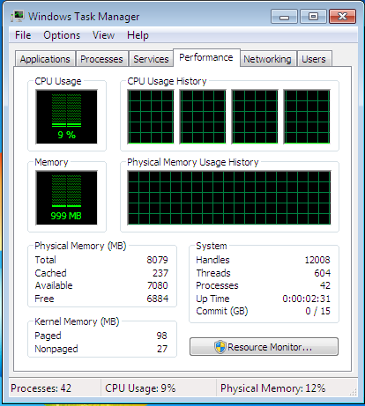
PRESENTATION ON DEVICE MANAGER AND TASK MANAGER
By ABDUR RAZZAK
ID: 1204149
Batch: ID-NT/ACSL-01M/R28/01
Date: 03/02/2016

Slide 2
Device Manager
What is Device Manager?
The Device Manager is a Control Panel applet in Microsoft Windows operating systems.
It allows users to view and control the hardware attached to the computer.
When a piece of hardware is not working, the offending hardware is highlighted for the user to deal with.

Slide 3
Where is Device Manager?
We can use Device Manager to see the devices installed on our PC,
update driver software for our devices,
check to see if hardware is working properly,
and change hardware settings.

Slide 4
History of Device Manager
Device Manager was first introduced in Windows 95.
Device Manager is available in Microsoft Windows 95, 98, ME, 2000, 2003, XP, Vista, 7, 8, and 10.
In NT-based versions, it is included as a Microsoft Management Console snap-in.

Slide 5
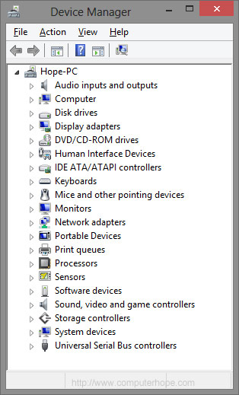
For each device, users can:
Supply device drivers
Enable or disable devices
Tell Windows to ignore malfunctioning devices
View other technical properties

Slide 6
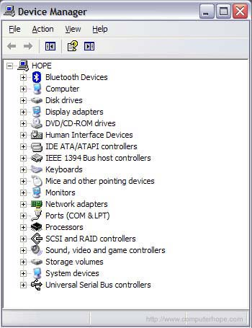
Identifying problems in Windows Device Manager
When opening the Device Manager, we should see a screen similar to the example picture to the right.
All categories should have +'s or arrows pointing to the right next to each of the device categories with no "Other devices" or "Unknown devices" listed.

Slide 7
TASK MANAGER
What is Task Manager?
Task Manager, previously known as Windows Task Manager is a task manager, system monitor and startup manager included with Microsoft Windows systems.
Task Manager provides limited information about computer performance and running applications, processes and CPU usage, commit charge and memory information, network activity and statistics, logged-in users, and system services

Slide 8
History of Task Manager
Windows Task Manager was introduced with Windows NT 4.0.
Previous versions of Windows NT included the Task List application, which had far fewer features.

Slide 9
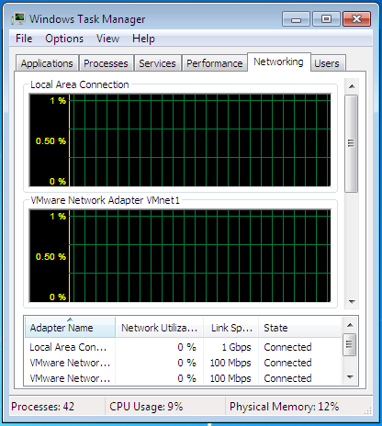
How to use Task Manager?
Open Task Manager using any of the following methods:
Press Ctrl-Shift-Esc.
Right-click an empty area of the taskbar, and then click Task Manager.
Press Ctrl-Alt-Delete, and then click Task Manager.

Slide 10
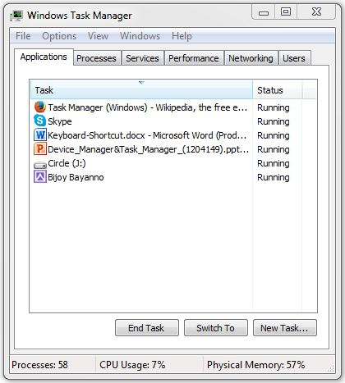
Functionality of Task Manager
Applications
Processes
Performance
Networking
And Users
Thanks for all…

