Slide 1
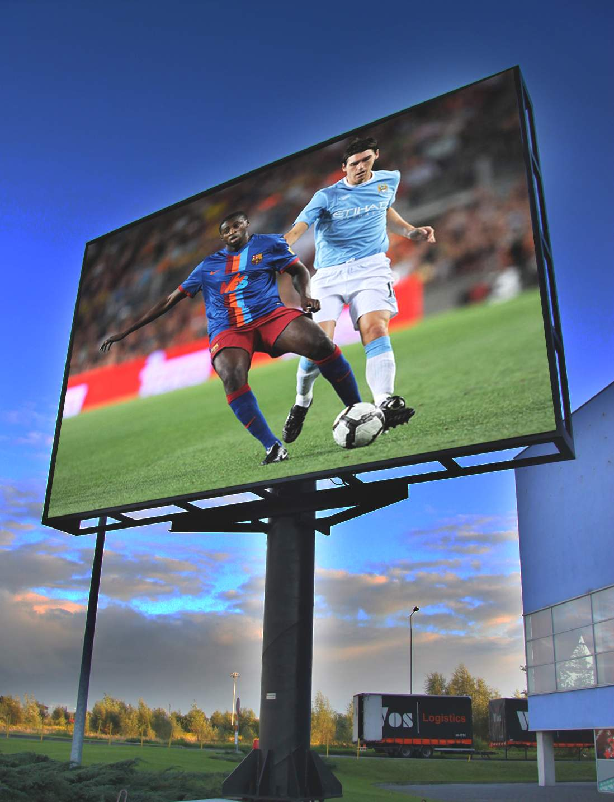
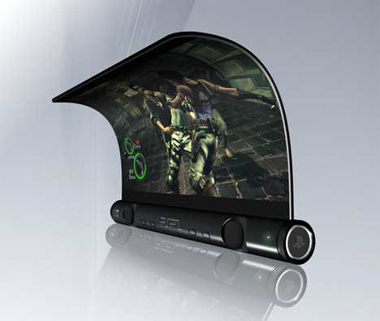
Presentation on LED & OLED Displays
Abdur Razzak
Round: 28, ID: 1204149
Date: 14/01/2016

Slide 2

LED Display
An light-emitting diode (LED) display is a flat panel display, which uses an array of light-emitting diodes as pixels for a video display.
Their brightness allows them to be used outdoors in store signs and billboards, and in recent years they have also become commonly used in destination signs on public transport vehicles.
LED displays are capable of providing general illumination in addition to visual display, as when used for stage lighting or other decorative purposes.

Slide 3
Brief History of LED Display
The first true all-LED flat panel television screen was possibly developed, demonstrated and documented by James P. Mitchell in 1977.
The modular, scalable display was initially designed with hundreds of MV50 LEDs and a newly available transistor-transistor logic memory addressing circuit from Texas Instruments.
The ¼-inch thin flat panel prototype and the scientific paper were displayed at the 29th ISEF expo in Washington D.C. in May 1978. It received awards by NASA and General Motors Corporation

Slide 4

OLED Display
An organic light-emitting diode (OLED) is a light-emitting diode (LED) in which the emissive electroluminescent layer is a film of organic compound that emits light in response to an electric current.
This layer of organic semiconductor is situated between two electrodes; typically, at least one of these electrodes is transparent.
OLEDs are used to create digital displays in devices such as television screens, computer monitors; portable systems such as mobile phones, handheld game consoles and PDAs. A major area of research is the development of white OLED devices for use in solid-state lighting applications

Slide 5
Brief History of OLED Display
André Bernanose and co-workers at the Nancy-Université in France made the first observations of electroluminescence in organic materials in the early 1950s.
In 1960 Martin Pope and some of his co-workers at New York University developed ohmic dark-injecting electrode contacts to organic crystals. These contacts are the basis of charge injection in all modern OLED devices.
Ching W. Tang and Steven Van Slyke at Eastman Kodak reported the first OLED device in 1987.

Slide 6
Comparison between LED and OLED Display
The main difference between an LED display and an OLED displsy that the pixels of an OLED are self illuminating, whereas the LEDs in an LED display are used to light an LCD display.
LED displays are currently less expensive than OLED displays, though eventually experts expect OLED displays to drop significantly in price.
Thank you for watching this presentation.

