Slide 1
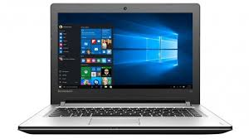
Presentation on Laptops
By ABDUR RAZZAK
ID: 1204149
Batch: ID-NT/ACSL-01M/R28/01
Date: 20/01/2016

Slide 2
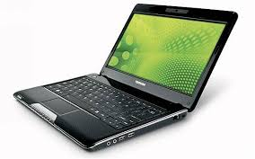
What is Laptop?
Laptop is portable and compact personal computer with the same capabilities as a desktop computer.
Laptop computers have an L-shape design and the screen can be lowered and closed to allow for easy transportation of the machine.
The primary feature that attracts users to laptops over desktops is their portability.
Laptop computers provide users the ability to run the machine using an internal battery or an outside power adaptor

Slide 3
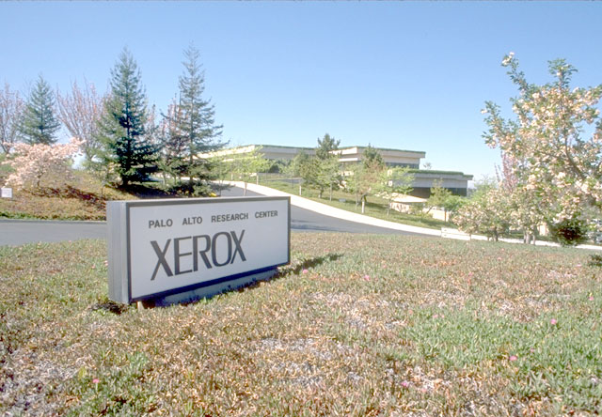
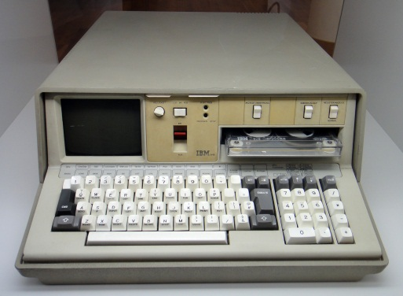
History of Laptops
A "personal, portable information manipulator" was imagined by Alan Kay at Xerox PARC in 1968, and described in 1972 his paper as the "Dynabook".
The IBM Special Computer APL Machine Portable (SCAMP), was demonstrated in 1973. This prototype was based on the IBM PALM processor.
The IBM 5100, the first commercially available portable computer, appeared in September 1975, and was based on the SCAMP prototype.

Slide 4
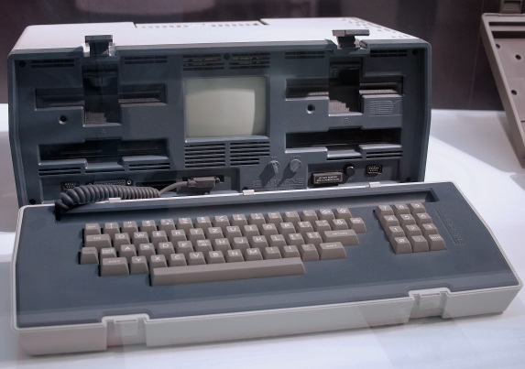
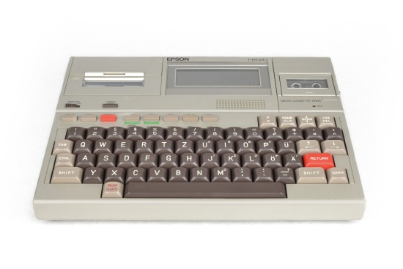
History of Laptop
The Osborne 1, released in 1981, used the Zilog Z80 and weighed 23.6 pounds (10.7 kg). It had no battery, a 5 in (13 cm) CRT screen, and dual 5.25 in (13.3 cm) single-density floppy drives.
In the same year the first laptop-sized portable computer, the Epson HX-20, was announced. The Epson had a LCD screen, a rechargeable battery, and a calculator-size printer in a 1.6 kg (3.5 lb) chassis.
Both Tandy/RadioShack and HP also produced portable computers of varying designs during this period.

Slide 5
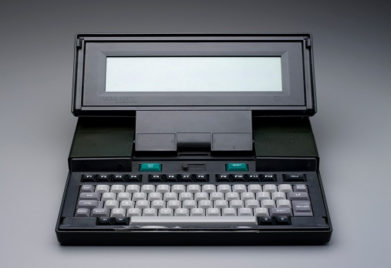
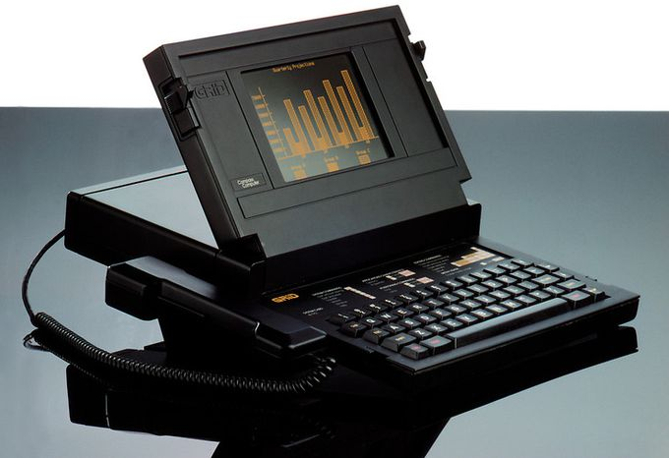
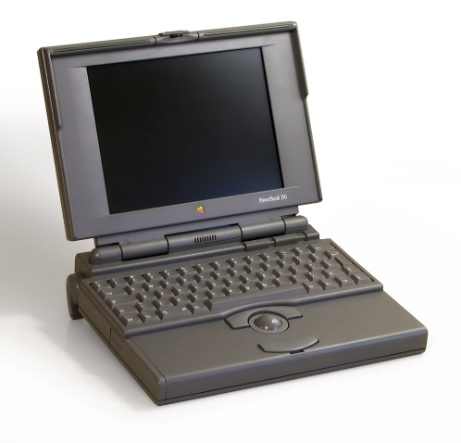
History of Laptop
The Dulmont Magnum was released in Australia in 1981–82, but was not marketed internationally until 1984–85.
GRiD Compass 1100, released in 1982, was used at NASA and by the military among others.
The Gavilan SC, released in 1983, was the first computer described as a "laptop" by its manufacturer. From 1983 onward, several new input techniques were developed and included in laptops, including the touchpad (Gavilan SC, 1983), the pointing stick (IBM ThinkPad 700, 1992) and handwriting recognition (Linus Write-Top, 1987).

Slide 6
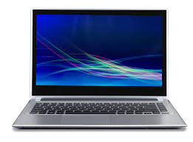
Traditional laptop
The form of a traditional laptop computer is a clamshell, with a screen on one of its inner sides and a keyboard on the opposite. It can be easily folded to conserve space while traveling.
The screen and keyboard are inaccessible while closed.
Devices of this form are commonly called a 'traditional laptop' or notebook, particularly if they have a screen size of 13 to 17 inches measured diagonally and run a full-featured operating system like Windows 10, OS X or Linux.

Slide 7
Advantages and Disadvantages
Advantages | Disadvantages
Accessibility: Users can access information and files in diverse locations. | Performance: Laptops do not offer the same computing power as desktops, largely due to scaling.
Consolidated internal memory: Data can be saved to one hard drive and accessed at will. | Service life: Some laptop components cannot be interchanged as more advanced versions become available.
Connectivity: Wi-Fi and mobile data networks provide laptops with near-constant internet connections. | Health effects: Laptops are not as ergonomically compatible as a decentralized desktop computer.
Power requirements: Laptops are more power efficient than desktop computers. | Durability: Generally speaking, laptop components deteriorate more quickly than desktop equipment.
Noise: Laptop PCs are optimized to be quieter than desktop models. | Security: Laptops are valuable items which are frequent targets of theft. Utilizing public networks increases the risk of hacking and theft.

Slide 8
Thanks for all
for watching presentation.

