Slide 1
IDB-BISEW IT Scholarship Project
Presentation on Networking Technologies Course
By A.F.M. Bakabillah
Show & Tell Consulting Ltd

Slide 2
Course Details
Networking Technologies
Course Hours: 868 Hrs.

Slide 3
Module Details
Module 1: Hardware Fundamentals
Module 2: Data Communication Systems
Module 3: Administering and Configuring Microsoft Windows 8
Module 4: Installing and Configuring Windows Server 2012
Module 5: Administering and Managing Windows Server 2012
Module 6: Configuring Advanced Windows Server 2012 Services
Module 7: Configuring Windows Server 2008 Applications Infrastructure
Module 8: Red Hat Enterprise Linux System Administration I
Module 9: Red Hat Enterprise Linux System Administration II
Module 10: Red Hat Enterprise Linux System Administration III

Slide 4
Module | Description | Course Duration
 |  | Contact Hours | Hands-on Hours | Total Hours
I | Hardware Fundamentals | 50 | 50 | 100
II | Data Communication Systems | 50 | 50 | 100
III | Administering and Configuring Microsoft Windows 8. | 44 | 44 | 88
IV | Installing and Configuring Windows Server 2012 | 44 | 44 | 88
V | Administering and Managing Windows Server 2012 | 46 | 46 | 92
VI | Configuring Advanced Windows Server 2012 Services | 40 | 40 | 80
VII | Configuring Windows Server 2008 Applications Infrastructure | 40 | 40 | 80
VIII | Red Hat Enterprise Linux System Administration I | 40 | 40 | 80
IX | Red Hat Enterprise Linux System Administration II | 40 | 40 | 80
X | Red Hat Enterprise Linux System Administration III | 40 | 40 | 80
Full Course Duration: |  |  |  | 868

Slide 5
Exam System
Exam# | Time | Question Type | No. of Ques. | Marks / Ques. | Total Marks | Pass Marks
External | 90 min. | MCQ | 35 | 2 | 70 | ^{*1}
 |  | Descriptive | 15 | 2 | 30 | 15
 | Total |  | 50 | 2 | 100 | 70
Evidence | 45 min. |  | 3 - 5^{*2} | ^{*3} | 50 | 30
^{*1} Pass Marks in MCQ = 70 – Marks Obtained in Descriptive.
^{*2} It Depends on Syllabus & Work Size.
^{*3} It depends on number of question & work size.

Slide 6
Exam System
Exam will be preceded by a pre-exam trainee Feedback Session. No Schedule class will be held on that day.
External exam will be preceded by a minimum of 1 (one) Review class (more if needed based on pre-exam feedback).
No review class before Evidence by Assessor (unless instructed otherwise by concerned Consultant). Classes will be held on the day of Evidence exam.

Slide 7
Feedback Session
Review class
External Exam
Evidence Exam

Slide 8
Technologies Taught in the Course
Hardware Fundamentals :
PC Hardware Fundamentals
OS Installation and Configuration
Maintaining and Troubleshooting PC Hardware
Installing and Maintaining Printers
Understanding Portable Computing
Basic Networking

Slide 9
Technologies Taught in the Course
Data Communication System
Network Concepts
Network Installation and Configuration
Network Media and Topologies
Network Management
Network Security

Slide 10
Technologies Taught in the Course
Administering and Configuring Microsoft Windows 8
Install and upgrade to Windows 8.1
Configure hardware and applications
Configure network connectivity
Configure access to resources
Configure remote access and mobility
Monitor and maintain Windows clients
Configure system and data recovery options

Slide 11
Technologies Taught in the Course
Installing and Configuring Windows Server 2012
Install and configure servers
Configure server roles and features
Configure Hyper-V
Deploy and configure core network services
Install and administer Active Directory
Create and manage Group Policy

Slide 12
Technologies Taught in the Course
Administering Windows Server 2012
Deploy, manage and maintain servers
Configure File and Print Services
Configure network services and access
Configure a Network Policy Servers (NPS) infrastructure
Configure and manage Active Directory
Configure and manage Group Policy

Slide 13
Technologies Taught in the Course
Configuring Advanced Windows Server 2012 Services
Configure and manage high availability
Configure file and storage solutions
Implement business continuity and disaster recovery
Configure Network Services
Configure the Active Directory infrastructure
Configure and Access Solutions

Slide 14
Technologies Taught in the Course
Configuring Windows Server 2008 Applications Infrastructure
Deploy images by using Windows Deployment Services
Configure Windows Server Hyper-V and virtual machines
Configure Windows Server 2008 Terminal Services RemoteApp (TS RemoteApp)
Configure Web applications
Manage Internet Information Services (IIS), Configure SSL security, Configure Web site authentication and permissions
Configure a File Transfer Protocol (FTP)
Configure Simple mail Transfer protocol (SMTP)
Configure Digital Rights Management (DRM), SharePoint Services, Windows Media server

Slide 15
Technologies Taught in the Course
Red Hat Enterprise Linux System Administration I
Introduction to the command line
Managing physical storage
Learning how to install and configure software components and services
Establishing network connections and firewall access
Monitoring and managing processes
Managing and securing files
Administering users and groups
Accessing Linux file systems
Installing and using virtualized systems
Reviewing the system log files and journal

Slide 16
Technologies Taught in the Course
Red Hat Enterprise Linux System Administration II
Installation using Kickstart
Manage filesystems and logical volumes
Manage scheduled jobs
Access network filesystems
Manage SELinux
Control firewalling
Troubleshooting

Slide 17
Technologies Taught in the Course
Red Hat Enterprise Linux System Administration III
Deploying and managing network servers
Caching only DNS
Apache HTTPD
Postfix SMTP
Network file sharing with NFS and SMB
iSCSI initiators and targets
Advanced networking and firewall configurations
Bash shell scripting
Troubleshooting the system

Slide 18
Professional work scenario
Entry level positions:
Desktop Support Technician
Support Executive
System Support Executive
Positions at mid-level:
System Administrator
Sr. IT Officer
System Engineer
Continue

Slide 19
Professional work scenario
Salary Ranges:
Entry Level : TK. 10000/- to TK.15000/-
Mid Level: TK. 15000/- to above
Types of organizations who employ graduates of this course:
Telecom company
Network Support Firm
Internet Service Provider
Multinational company
National company
Group of Companies
Bank/Garments/ Pharmaceuticals and many more…..

Slide 20
Vendor Certification and Benefits
Vendor certification is a reliable indicator that certified persons excel at the subject for which they are certified. Realistically, the answer lies somewhere in between. Becoming certified means you have a certain amount of product knowledge. It does not necessarily make you a better Network Admin. It does demonstrate motivation, initiative, and perseverance — all good traits for a Network Admin to possess. Once you’ve achieved certification, you can congratulate yourself on a job well done — many people fall by the wayside during the certification process.
Certifications:
MCP
MCSA: Windows Server 2012

Slide 21
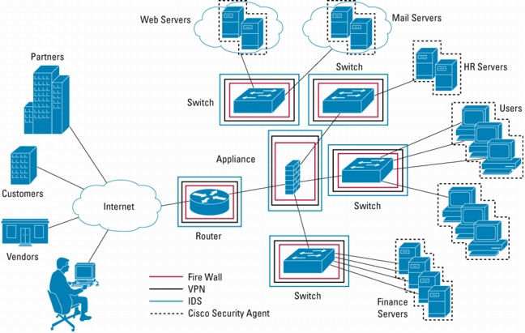
Thank you………
Thank You…………

