Slide 1
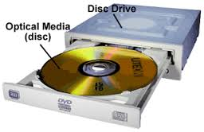
Optical Storage Drives
Abdur Razzak
Round-28, ID-1204149
Date: 12/01/2016
Optical storage is a storage method in which data is written and read with an optical beam(laser).

Slide 2
Brief History of Optical Storage Drive
The first popular system was the Compact Disc, introduced in 1982, adapted from audio (CD-DA) to data storage (the CD-ROM format) with the 1985 Yellow Book, and re-adapted as the first mass market optical storage medium with CD-R and CD-RW in 1988.
Compact Disc is still the de facto standard for audio recordings, although its place for other multimedia recordings and optical data storage has largely been superseded by DVD.
DVD (initially an initialism abbreviation of "Digital Video Disc," then modified to "Digital Versatile Disc," then officially just "DVD") was rolled out in 1996, again initially for video and audio.
DVD recordable formats developed some time later: DVD-R in late 1997 and DVD+R in 2002.
HD(high-definition) DVD and Blu-ray Disc, based upon a switch from red to blue-violet laser and tighter engineering tolerances. After suffering a number of significant losses to Blu-ray, Toshiba announced their withdrawal from HD DVD on 19 February 2008.
As of 2007, future development beyond Blu-ray Disc appear to be based upon one or more of the following technologies, all in varying stages of development:

Slide 3
Types of Optical Storage Drive
CD-ROMs
DVD-ROMs
BD-ROMs

Slide 4
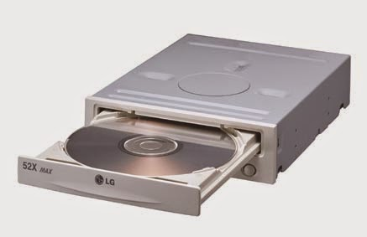

CD-ROMs
CD-ROM (Compact Disc, read-only-memory) is an adaptation of the CD that is designed to store computer data in the form of text and graphics, as well as hi-fi stereo sound.
A CD-ROM stores around 700MB of data.

Slide 5
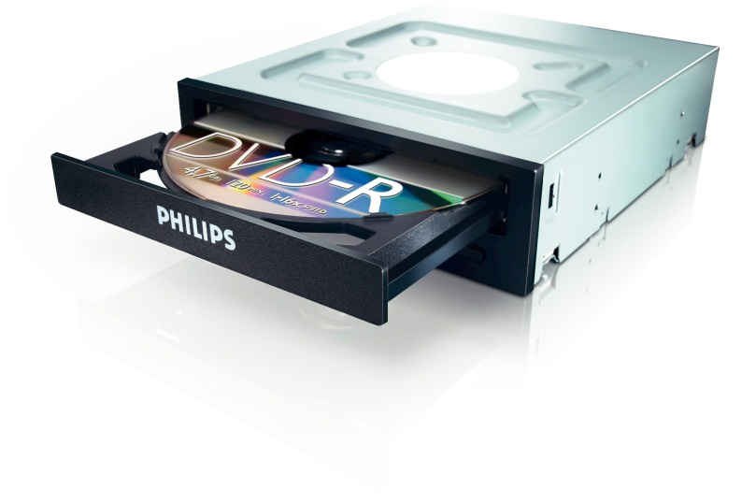

DVD-ROMs
Digital versatile disc-read only memory (DVD-ROM) is a read-only digital versatile disc (DVD) commonly used for storing large software applications. It is similar to a compact disk-read only memory (CD-ROM) but has a larger capacity.
A DVD-ROM stores around 4.7GB of data.

Slide 6
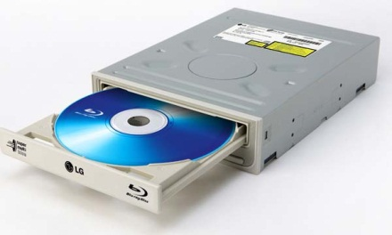

BD-ROMs
BD-ROM (Blu-ray disc, read only memory) is a high definition optical disc storage format of the Blu-ray family that consists of pre-recorded data. BD-ROM can only read audio and video information.
A BD-ROM stores around 100GB of data.
Thank you….

