Slide 1





Population pharmacogenomics for precision medicine in Colombia
Aroon Chande
Jordan Lab | Georgia Institute of Technology
Applied Bioinformatics Laboratory

Slide 2
Pharmacogenomics
The study of the relationship between genetic variations and how our body responds to medications
Because of genetic variation, not all people will respond the same way to the same medication, even if they are the same age, size and gender
Pharmacogenomic testing gives an insight into how an individual patient may respond to a medicine
Text taken from PharmGKB: https://www.pharmgkb.org/whatIsPharmacogenomics

Slide 3
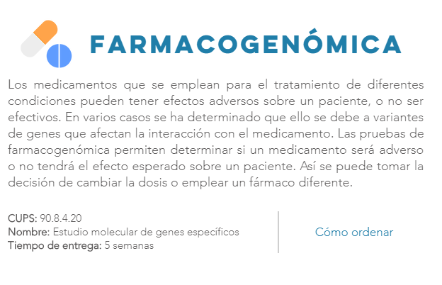
GenomaCES and pharmacogenomics

Slide 4
Questions
Do pharmacogenomic SNPs carry information about genetic ancestry, i.e. are they ancestry-informative markers?
Are there pharmaSNPs with population-specific frequency differences in Colombia – Antioquia versus Chocó?
Are Colombian population-specific differences in pharmaSNP frequencies related to genetic ancestry?

Slide 5
Questions
Do pharmacogenomic SNPs carry information about genetic ancestry, i.e. are they ancestry-informative markers?
Are there pharmaSNPs with population-specific frequency differences in Colombia – Antioquia versus Chocó?
Are Colombian population-specific differences in pharmaSNP frequencies related to genetic ancestry?

Slide 6
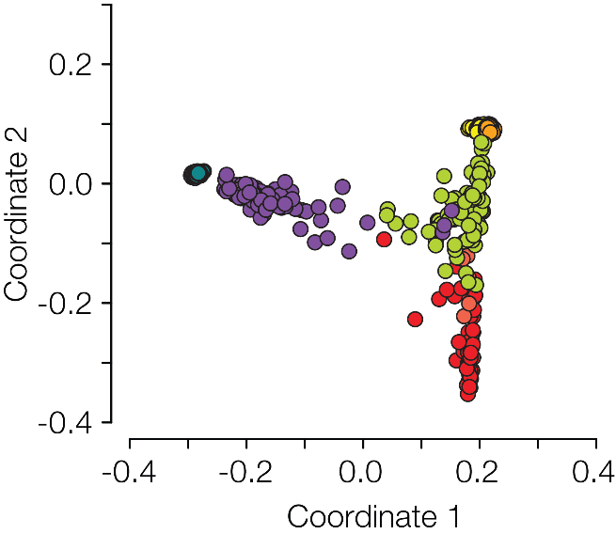
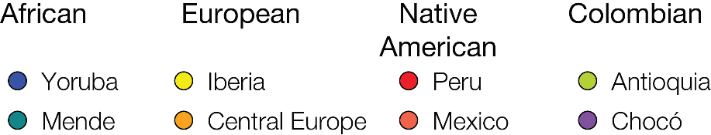
Ancestry informativeness of genome-wide SNPs
n=28,137,656

Slide 7
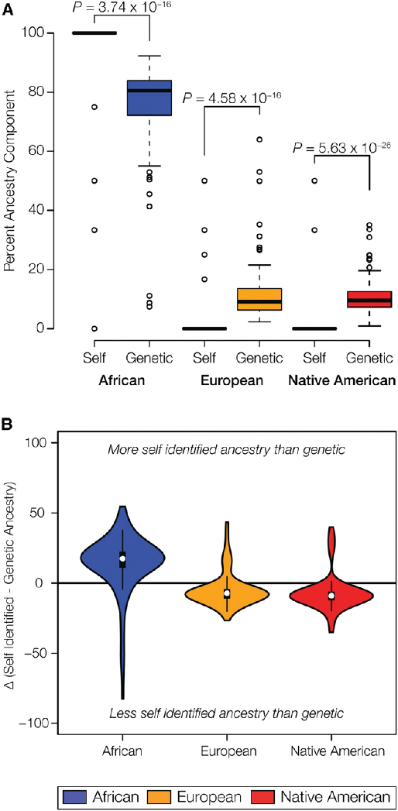
Self-reported ancestry is often wrong

Slide 8
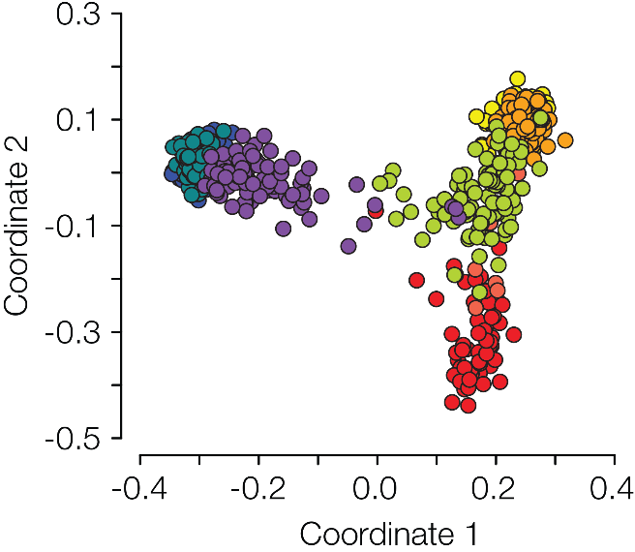
Ancestry informativeness of pharmaSNPs
n=1,995
A relatively small number of PharmaSNPs can recapitulate known evolutionary relationships among human populations

Slide 9
Questions
Do pharmacogenomic SNPs carry information about genetic ancestry, i.e. are they ancestry-informative markers?
Are there pharmaSNPs with population-specific frequency differences in Colombia – Antioquia versus Chocó?
Are Colombian population-specific differences in pharmaSNP frequencies related to genetic ancestry?

Slide 10
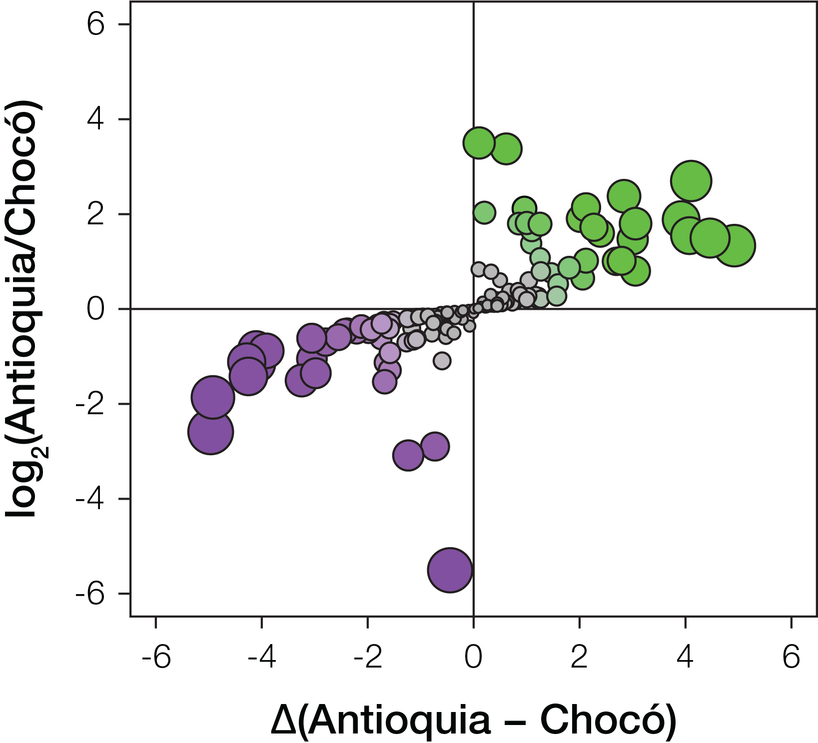
PharmaSNP frequency differences in Colombia
Higher in Antioquia
To look at differences in effect allele frequencies between populations, we consider both the ratio of frequency differences (y-axis) and the magnitude of frequency differences (x-axis).
Note: ratios will be greater at low allele frequencies, whereas magnitudes will be greater at high allele frequencies.
Higher in Chocó

Slide 11
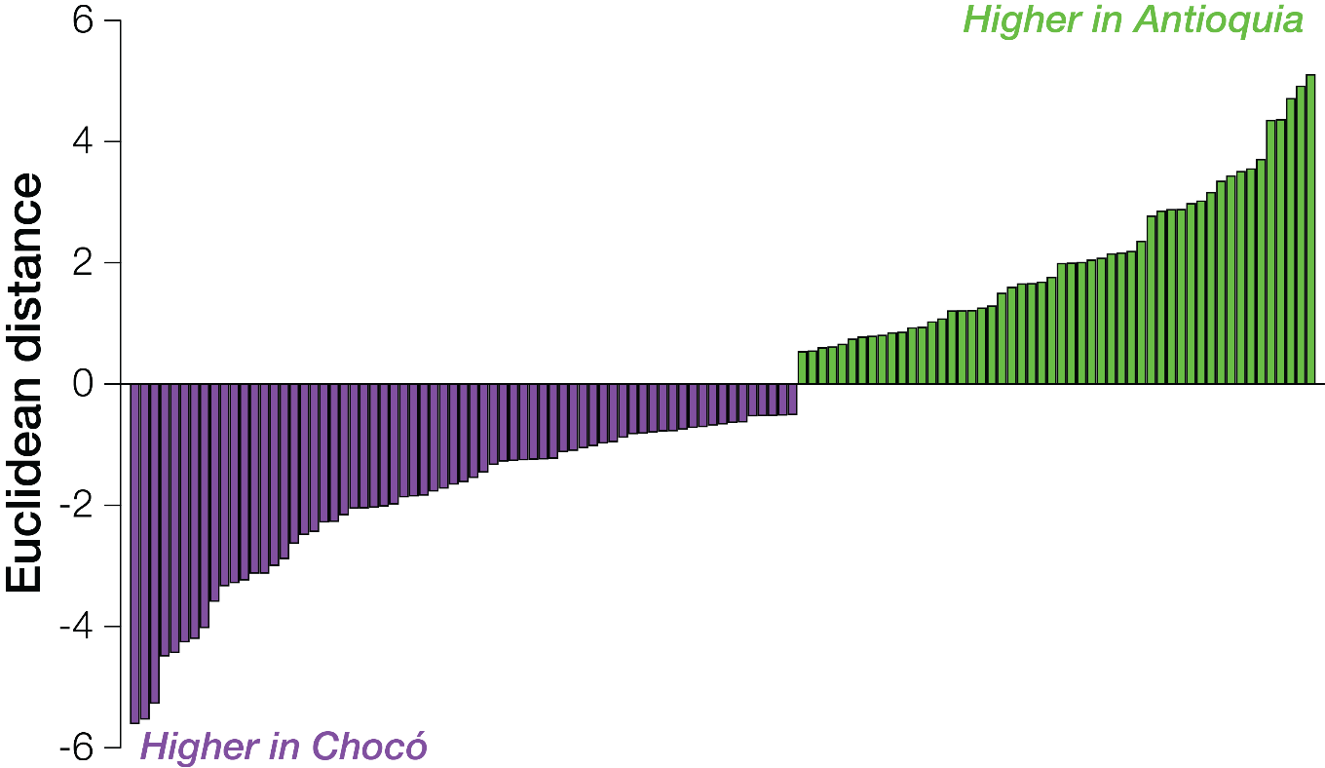
PharmaSNP frequency differences in Colombia
Effect allele frequency differences*
*Jointly considers both the ratio and magnitude of the effect allele differences between populations as the Euclidean distance from the origin on the previous plot

Slide 12
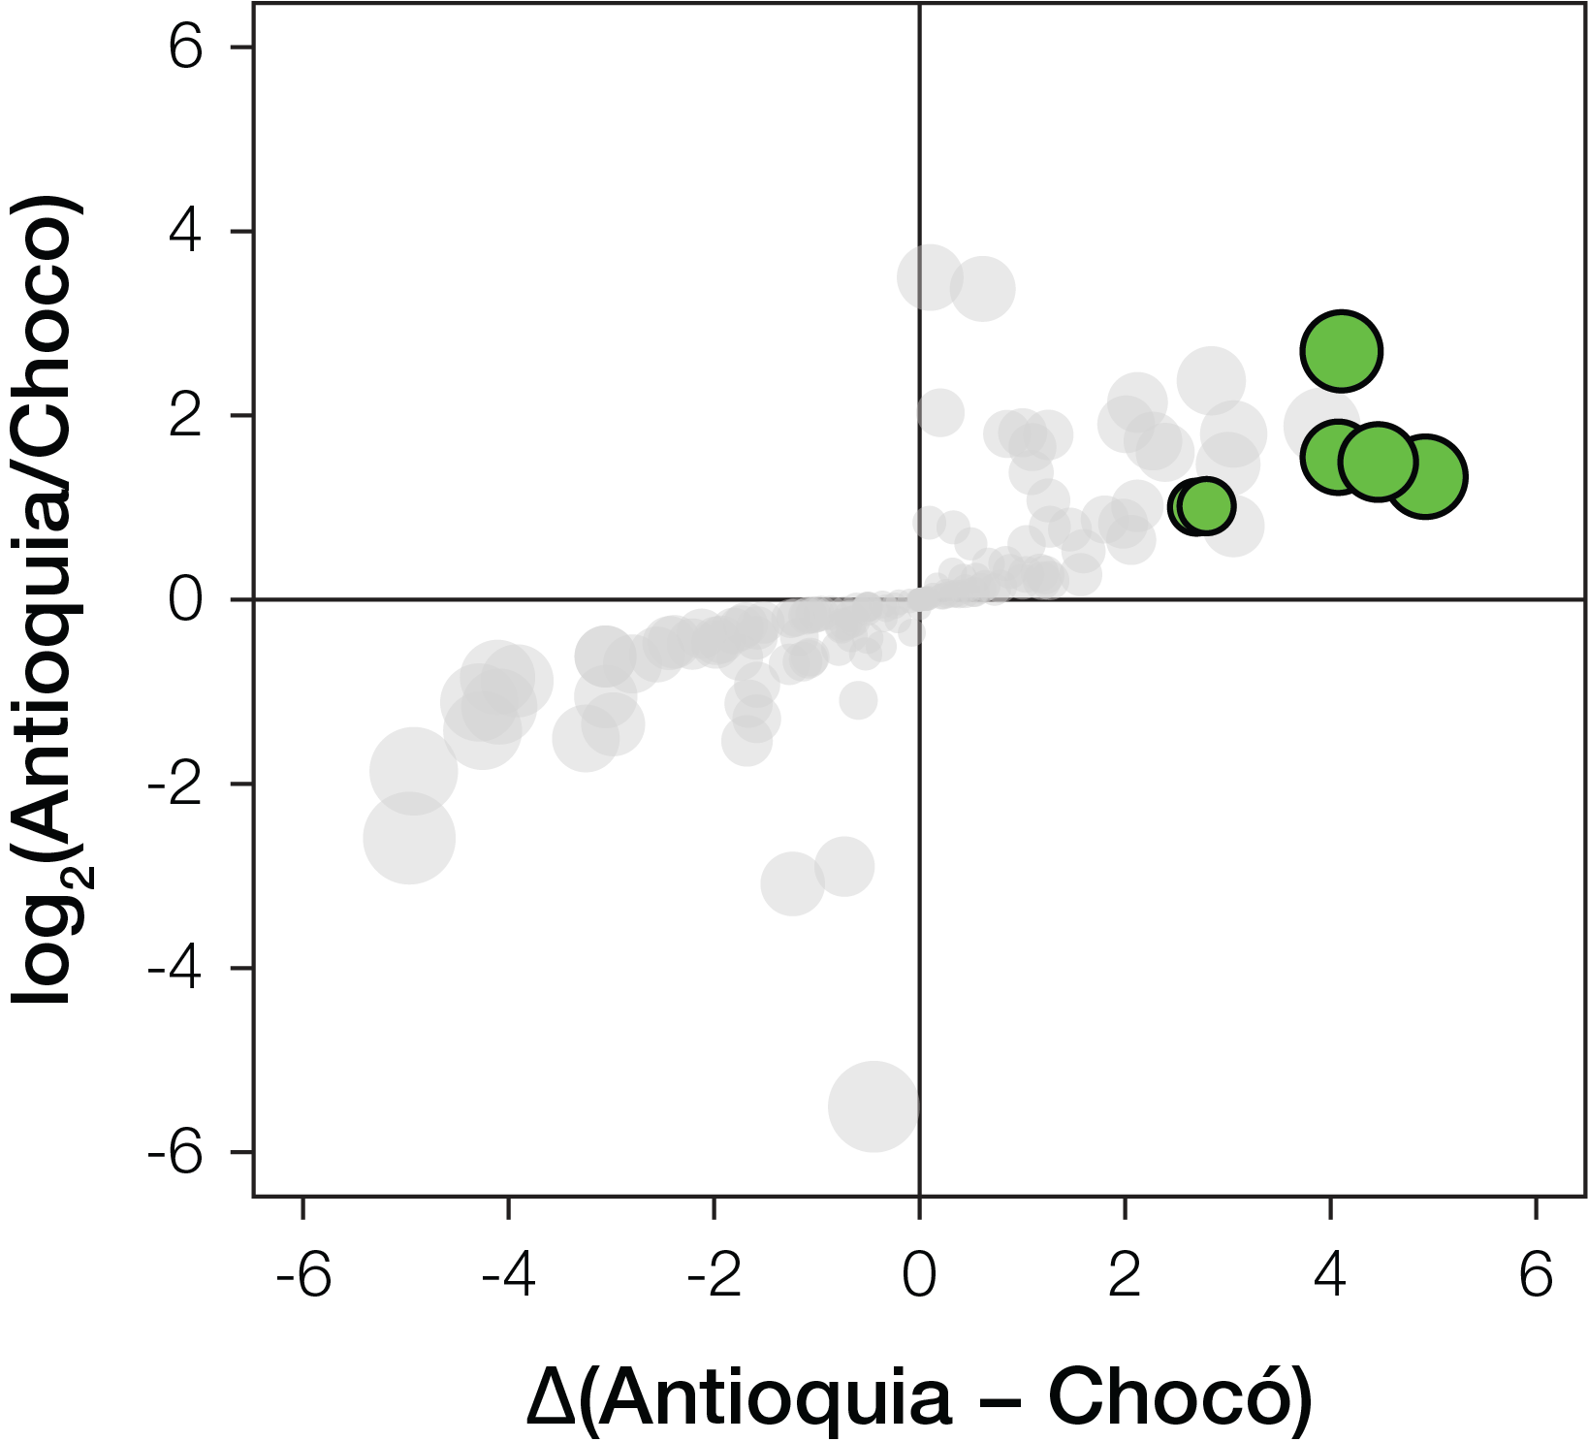
PharmaSNP frequency differences in Colombia
Higher in Antioquia
Higher in Chocó

Slide 13
Antioquia-specific pharmaSNPs
Higher in Antioquia
rs1954787
Antidepressant efficacy
rs11615
Platin efficacy/toxicity
rs3812718
Antiepileptic dosage/efficacy
rs776746
Tacrolimus hypermetabolism
rs1719247
Simvastatin ADR
rs7793837
Salbutamol efficacy
Higher in Chocó

Slide 14
PharmaSNP frequency differences in Colombia
Higher in Antioquia
Higher in Chocó

Slide 15
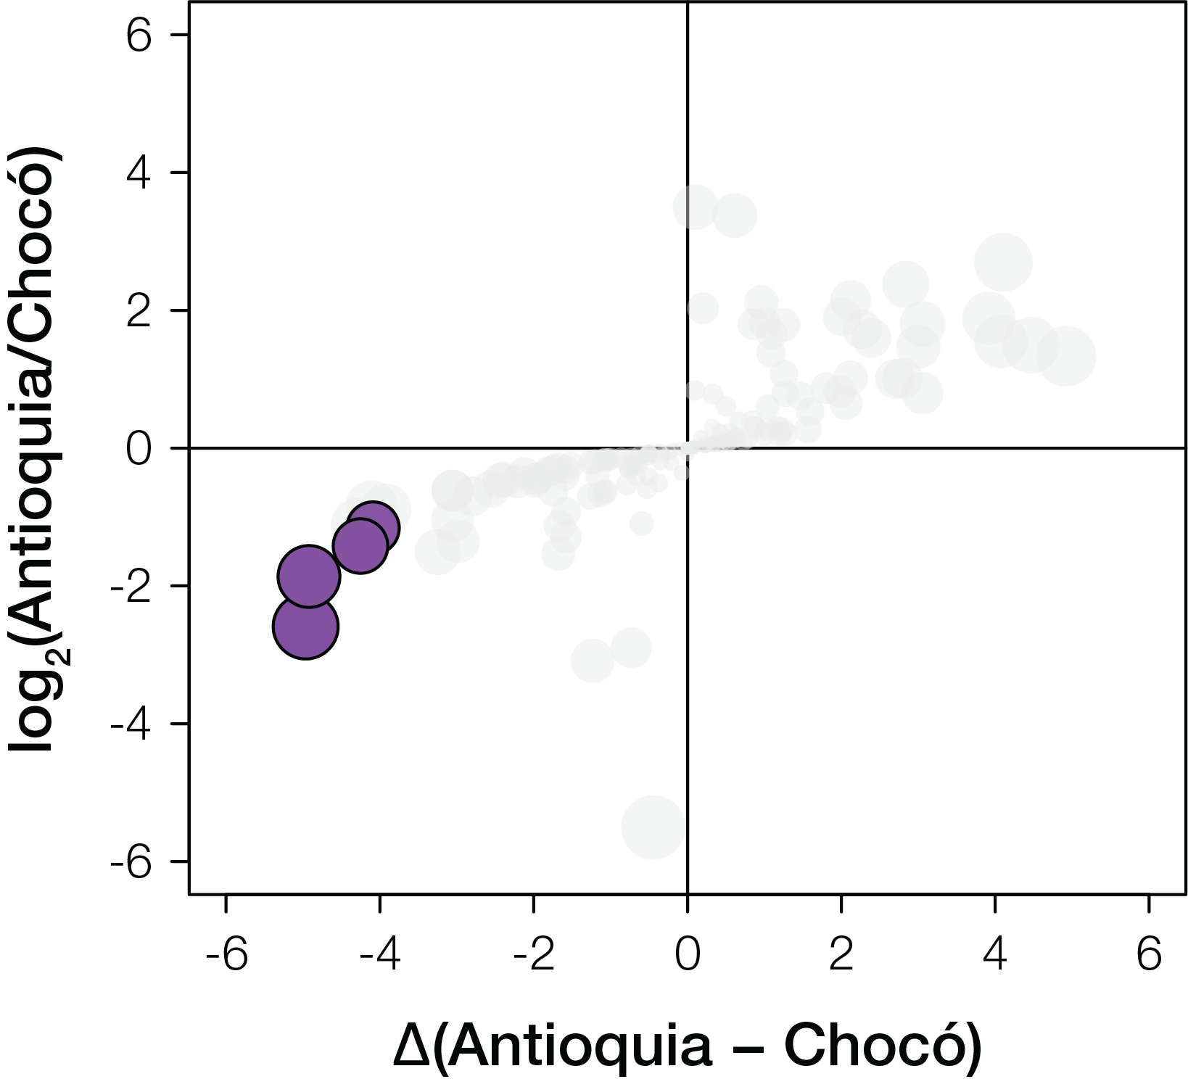
Chocó-specific pharmaSNPs
rs11212617
Metformin efficacy
rs776746
Tacrolimus metabolism
rs6977820
Antipsychotic drug toxicity
rs2740574
Tacrolimus metabolism

Slide 16
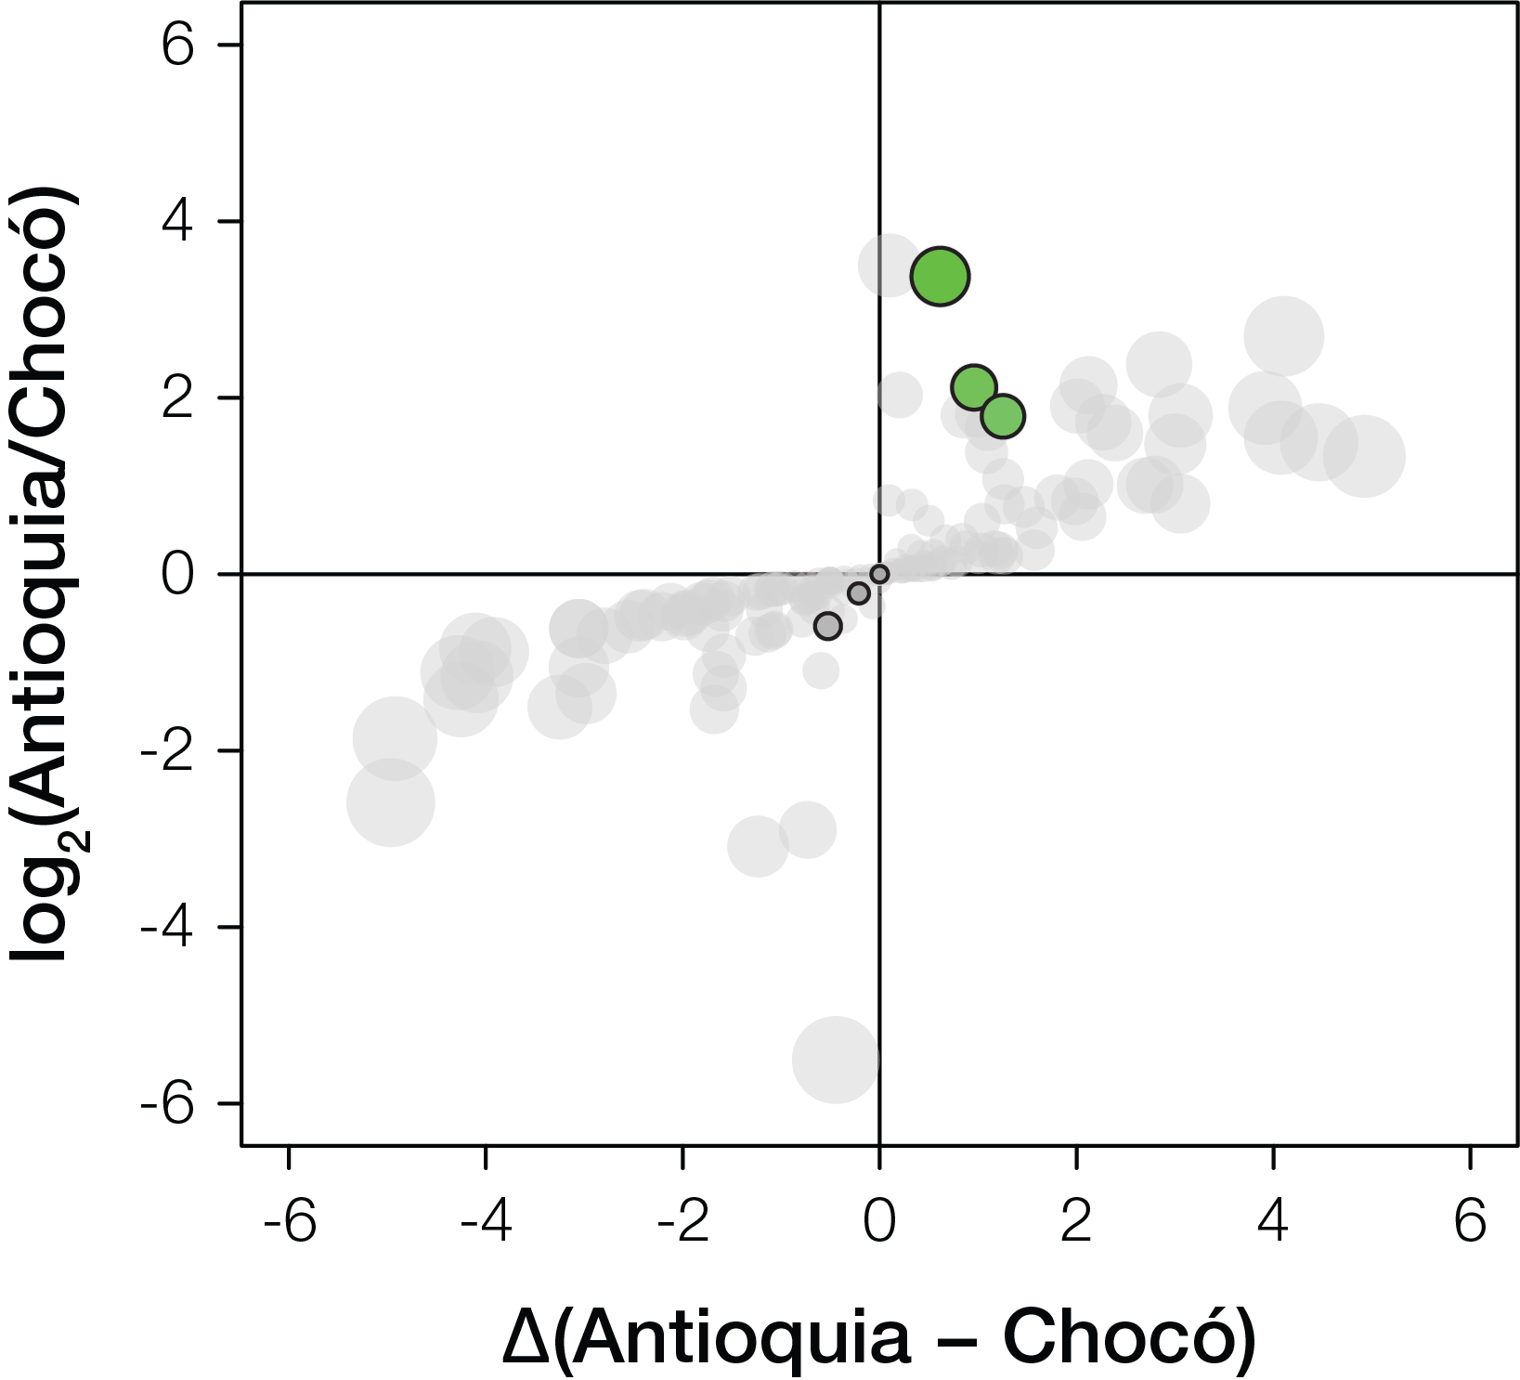
Low cost genetic testing by allele specific PCR
rs1057910
Warfarin
Higher in Antioquia
GenomaCES SNPs n=6
rs4986893
Clopidogrel
rs1799853
Warfarin
rs12248560
Clopidogrel
rs4149056
Statins
rs4244285
Clopidogrel
Higher in Chocó

Slide 17
Questions
Do pharmacogenomic SNPs carry information about genetic ancestry, i.e. are they ancestry-informative markers?
Are there pharmaSNPs with population-specific frequency differences in Colombia – Antioquia versus Chocó?
Are Colombian population-specific differences in pharmaSNP frequencies related to genetic ancestry?

Slide 18
rs4149056 – Simvastatin toxicity (1A)
Simvastatin is a lipid-lowering medication (Statin)
It is used along with exercise, diet, and weight loss to decrease elevated lipid levels
It is also used to decrease the risk of heart problems in those at high risk
C allele is associated with increased risk of toxicity

Slide 19
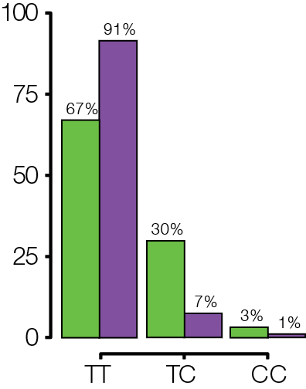

rs4149056 – Simvastatin toxicity (1A)
Simvastatin is a lipid-lowering medication (Statin)
C allele is associated with increased risk of toxicity
C allele containing genotypes are more common in Antioquia
Genotype Percentage
Genotype

Slide 20
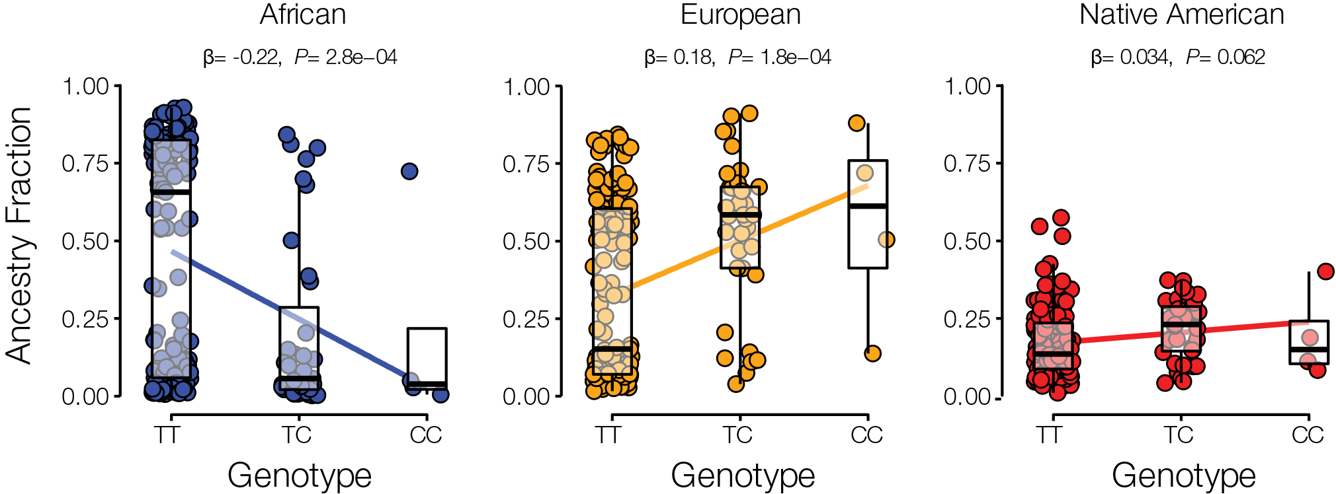
PharmaSNP ancestry associations
We evaluate whether pharmaSNPs of interest are associated with genetic ancestry by comparing individuals’ ancestry fractions – African, European, and Native American – to their genotypes for SNPs of interest
This is done for all individuals from Antioquia and Chocó, and the strength of ancestry associations are measured by the linear trend in the data, quantified by the Beta (β) value and the P-value significance level
In this example, the effect allele A is negatively correlated (β=-0.22) with African ancestry, and the association is highly significant P=7.1e-05

Slide 21
rs4149056 – Simvastatin toxicity (1A)
C allele is associated with increased risk of toxicity
C allele is negatively associated with African ancestry and positively associated with both European (strong) and Native American (marginal) ancestry

Slide 22
rs9923231 – Warfarin dosage (1A)
Warfarin is a medication that is used as an anticoagulant (blood thinner).
It is commonly used to treat blood clots such as deep vein thrombosis and pulmonary embolism and to prevent stroke in people who have atrial fibrillation, valvular heart disease or artificial heart valves.
C allele is associated with the likelihood of requiring a higher dosage

Slide 23
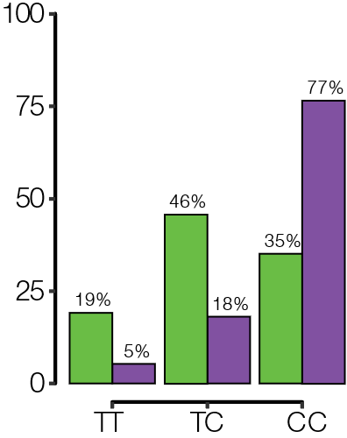
rs9923231 – Warfarin dosage (1A)
C allele is associated with the likelihood of requiring a higher dosage
C allele containing genotypes are more common in Chocó
Genotype Percentage
Genotype

Slide 24
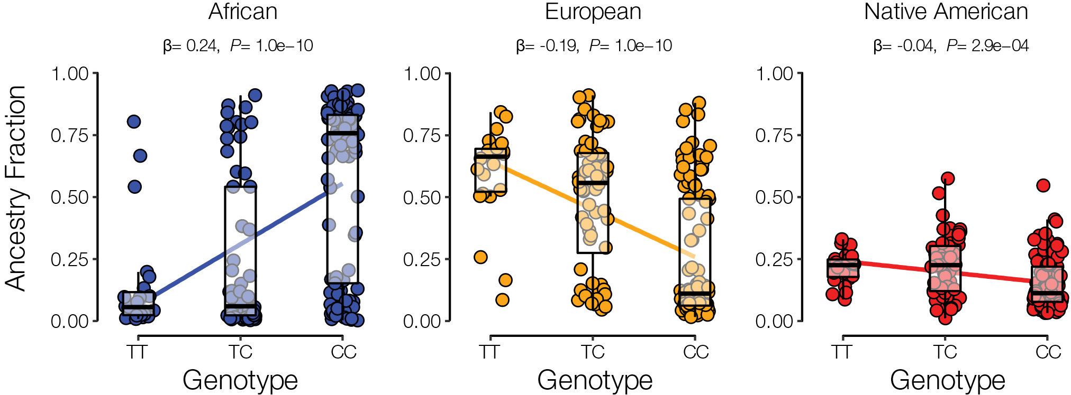
rs9923231 – Warfarin dosage (1A)
C allele is associated with the likelihood of requiring a higher dosage
C allele is positively associated with African ancestry and negatively associated with both European (strong) and Native American (marginal) ancestry

Slide 25
Conclusions
PharmaSNPs capture the global population diversity and recapitulate population structures seen with global SNO
PharmaSNP frequencies vary between populations
Ancestry and PharmaSNP frequency are inter-related and often well correlated

Slide 26

Acknowledgments
Jordan Lab
I. King Jordan
Dongjo Ban
Evan Clayton
Andrew Conley
Luz Karime Medina Cordoba
Beatriz Saldaña Farias
Saurabh Gulati
Tzu-Chuan Huang
Mani Jain
Shashwat Nagar
Héctor Espitia-Navarro
Emily Norris
Lava Rishishwar
Yini Yang

