Slide 1
Human specific loss of olfactory receptor genes Gilad, Man, Pääbo and Lancet. PNAS March 18, 2003 vol. 100 no. 6 3324-3327
Aroon Chande
April 02, 2013
Evolution

Slide 2
Olfactory receptors
Responsible for smell sensing and transmission
Olfactory receptor (OR) genes form the largest mammalian gene superfamily
Part of the G-protein coupled receptor (GPCR) hyperfamily
OR genes are a highly conserved superfamily
Significant consensus between primate OR gene sequences
Extant, nonfunctional genes form pseudogene subfamilies

Slide 3
Pseudogenes
Pseudogene formation is thought contribute directly to evolutionary change.
“Less-is-more” Hypothesis
“Loss of gene function may represent a common evolutionary response of populations undergoing a shift in environment and, consequently, a change in the pattern of selective pressures” [2]
LOF typically associated with a positive selective pressure [3]
The majority of human pseudogene families involved in chemoreception and immune response [4]
LOF appears to confer higher resistance to infection and increased kin-selection
LOF function suggested to play a role in development of complex languages in humans.

Slide 4
Human specific OR loss
Humans have >60% pseudogenes
Other primates have approximately half the relative number of pseudogenes.
Mice have the lowest pseudogene fraction, ≈20%.
Is the higher percent of disruptions in humans a general feature of primates?
Do different primates accumulate OR disruptions at different rates?

Slide 5
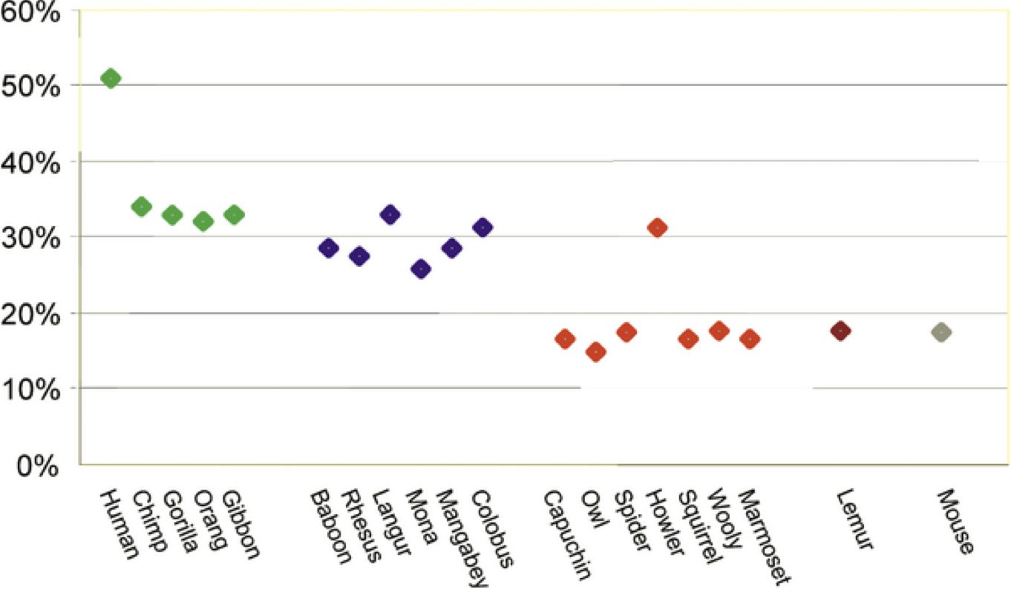

Figure 2. The Proportion of OR Pseudogenes in 20 Species
Gilad Y, Wiebe V, Przeworski M, Lancet D, et al. (2004) Loss of Olfactory Receptor Genes Coincides with the Acquisition of Full Trichromatic Vision in Primates. PLoS Biol 2(1): e5. doi:10.1371/journal.pbio.0020005
http://www.plosbiology.org/article/info:doi/10.1371/journal.pbio.0020005

Slide 6
Methods
OR gene sequences obtained from Human Olfactory Receptor Data Exploratorium (HORDE) database
60 ORs chosen at random, regardless of functional annotation.
Subfamily 7E excluded
>99% of subfamily 7E genes are pseudogenes in Humans.

Slide 7
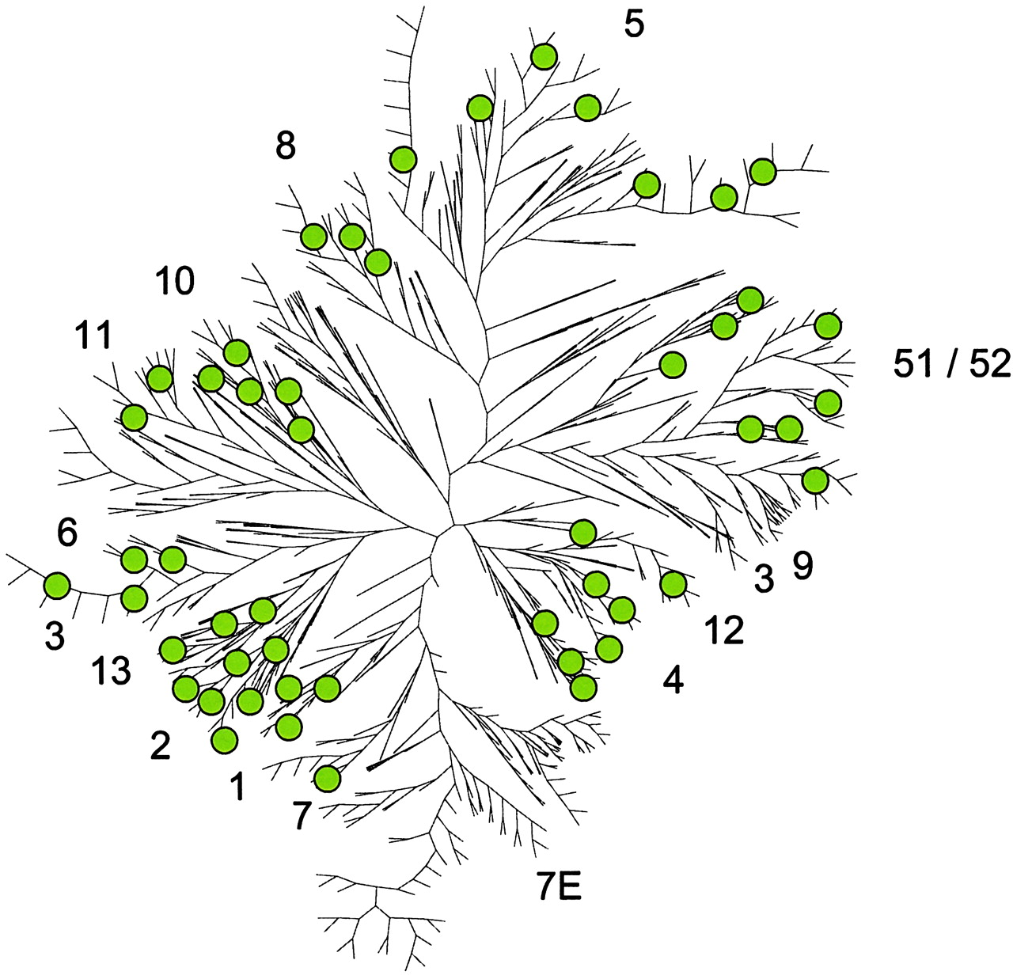
A neighbor-joining tree of all human OR loci in the HORDE database.
Gilad Y et al. PNAS 2003;100:3324-3327
©2003 by National Academy of Sciences
Notes:
A neighbor-joining tree of all human OR loci in the HORDE database. The names of the OR gene families are indicated next to the branches, which represent the majority of members from each subfamily. Few OR members of any subfamily may be dispersed elsewhere in the tree (not specified). The 50 ORs chosen at random for this study are indicated as circles.

Slide 8
Putative orthologs have high ORF consensus.
22bp PCR primer designed for each OR.
Same primers used for for all species.
After amplification, PCR products were sequenced both forward and backward.

Slide 9
Sequence Analysis
First and last ≈40bp, including primers, excluded.
Products verified by cross-referencing consensus sequence and HORDE database.
Two instances where ‘best match’ wasn’t gene of interest
related to length of BLAST.
Coding region disruptions identified separately for each species.
Only one disruption considered per gene
The first disruption inferred by comparing shared disruptions

Slide 10
Results
50 of the chosen human ORs amplified across all species.
Found on 14 chromosomes and in 13 OR families.
54% of studied human ORs contained disruptions.
One locus, which was a putative pseudogene, was found intact.
Human-specific polymorphism?
Other primate pseudogene fraction was 28-36%.
Significantly different from both human and mouse fractions.

Slide 11
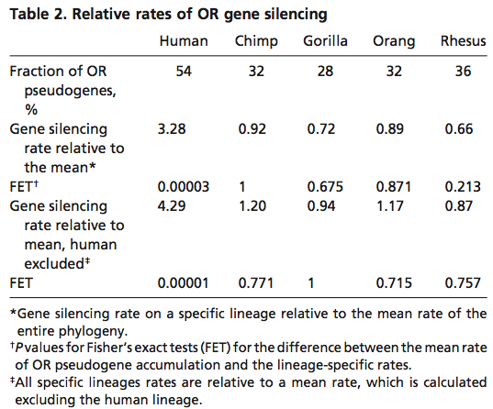

Slide 12
Conclusions
The data indicates that primates have higher OR coding region disruption rates than mice.
Non-human primates have insignificantly different interspecies rates of OR coding region disruption rates.
Humans accumulate disruptions ≈3.3 times faster than other primates.
The rate of pseudogene formation in mice is half that of non-human apes and nine times lower than humans.

Slide 13
Six ORs were pseudogenes in all primates.
Putative ancestral pseudogenes.
Nine were intact in all primates.
Three OR functional groups?
OR genes that are essential and thus under selective pressure to remain intact.
OR genes that are not important for humans but are for other primates.
OR pseudogenes that have lost their function in humans.

Slide 14
Potential experimental error
The difference between human and ape populations is 2- or 3-fold, requiring unlikely small ranges for selection coefficients in apes across their OR repertoire
Suggested that humans do not rely on their sense of smell as much as apes
This leads to a relaxed evolutionary restraints

Slide 15
References
Gilad Y, Man O, Pääbo S, Lancet D (2003) Human specific loss of olfactory receptor genes. Proc Natl Acad Sci U S A 100: 3324–3327.
Olson MV (1999) When less is more: Gene loss as an engine of evolutionary change. Am J Hum Genet 64: 18–23.
Olson,M.V. and Varki,A. (2003) Sequencing the chimpanzee genome: insights into human evolution and disease. Nature Rev. Genet., 4, 20–28.
Wang X, Grus WE, Zhang J (2006) Gene losses during human origins. PLoS Biology 4: e52.
Gilad Y, Wiebe V, Przeworski M, Lancet D, Pääbo S. Loss of olfactory receptor genes coincides with the acquisition of full trichromatic vision in primates. PLoS Biol 2007;5:e148

