Slide 1
Lane-Detection
Evan Hirsh and Aidan Rubenstein

Slide 2
Problem
While lane detection is a commonly used feature in cars today, it is overly complicated and is not cost effective to reproduce for the manufacturer.
Automobile engineers need accurate yet fast results in order to predict lane drifts and possible collisions with other cars or obstacles.
Companies such as Tesla and Comma.ai are looking for lightweight solutions that can be easily ported to smartphones and other devices for analysis.

Slide 3
Solution? Use a Python-Based Lane Detector
We can use conventional computer-vision techniques in Python to create a fast AND accurate solution to detect lanes!
The process for this type of lane detection would look like so:
Canny Edge Detection
Conversion to Grayscale & Gaussian Blur
Sobel edge detection
Non-maximum Suppression
Thresholding
Hysteresis
Create a triangular mask
Use Hough Transform to find an average of lane-lines and draw the detected pixels in the original image

Slide 4
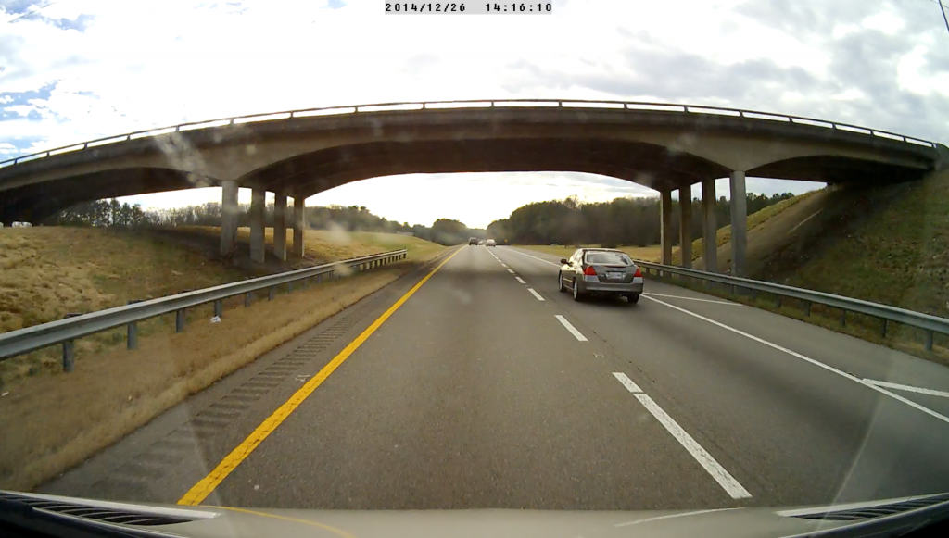
Original Image: dashcam.png

Slide 5
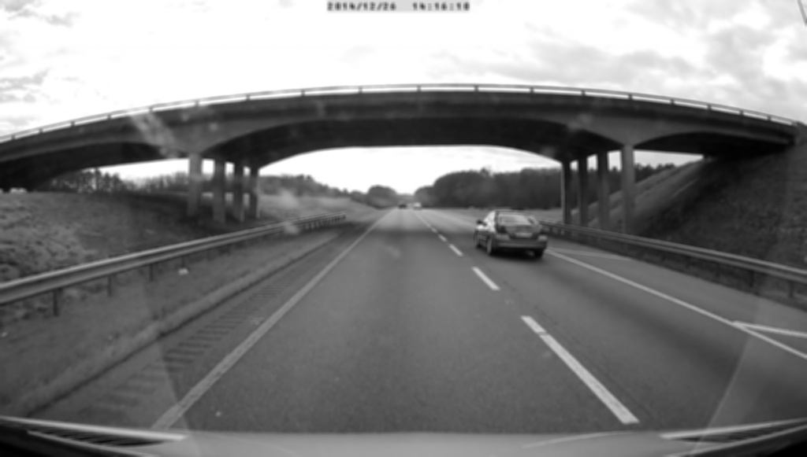
Canny-Edge Detection: Gaussian Blur

Slide 6
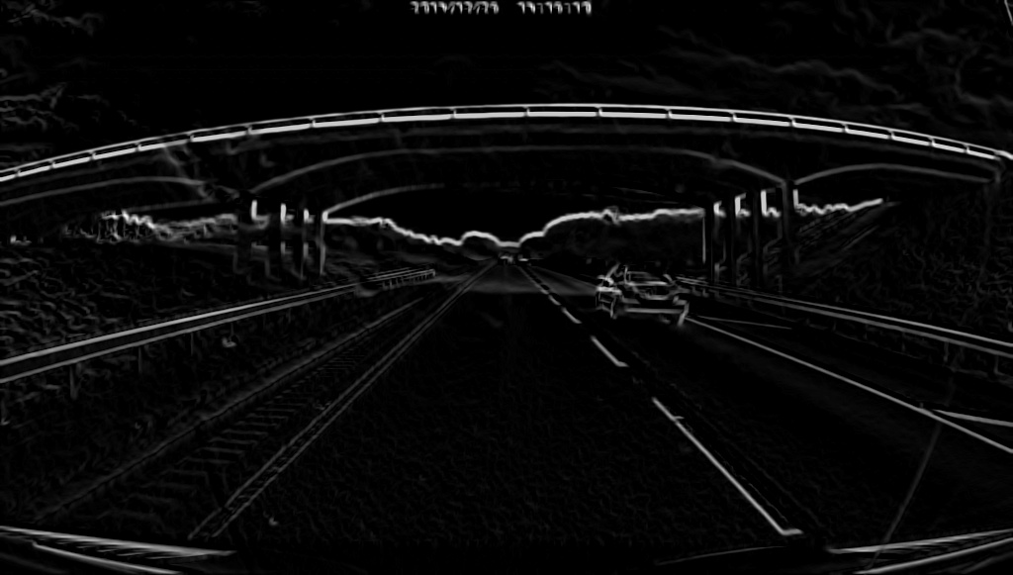
Canny-Edge Detection: Sobel Edge Detection

Slide 7
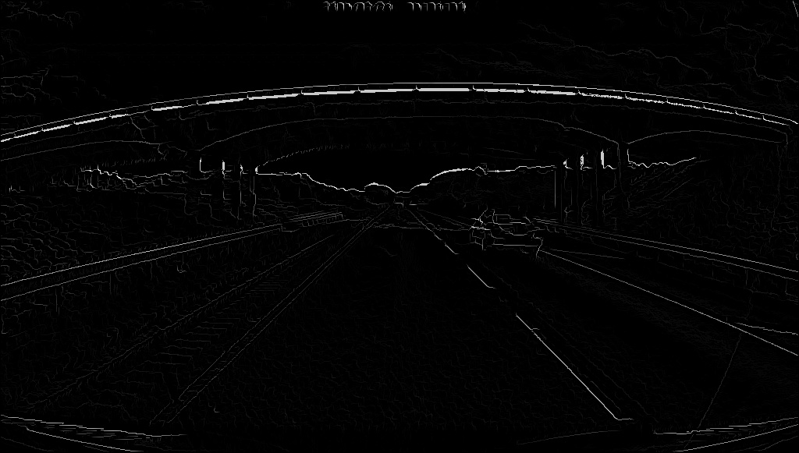
Canny-Edge Detection: Non-maximum Suppression

Slide 8
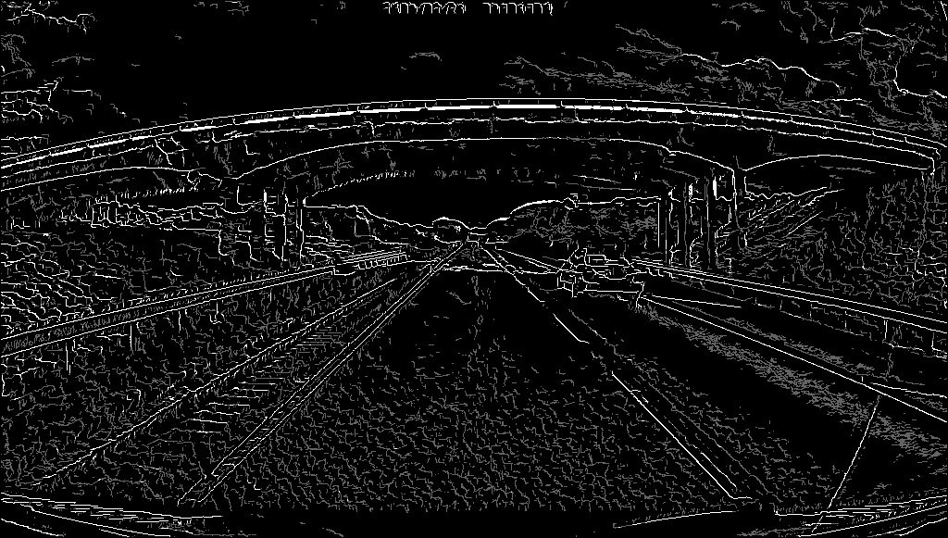
Canny-Edge Detection: Thresholding

Slide 9
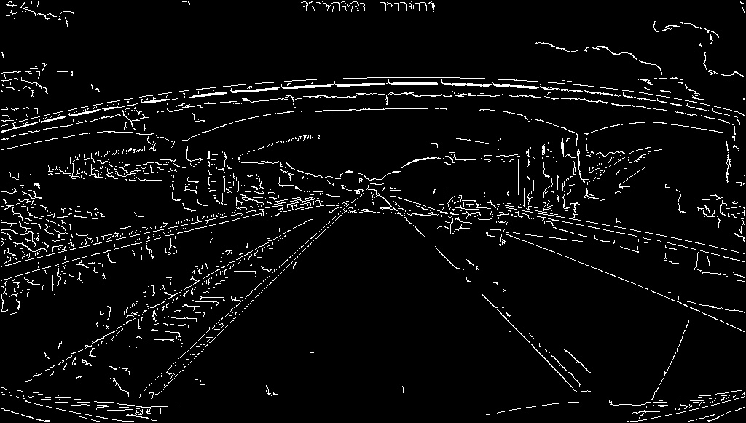
Canny-Edge Detection: Hysteresis

Slide 10
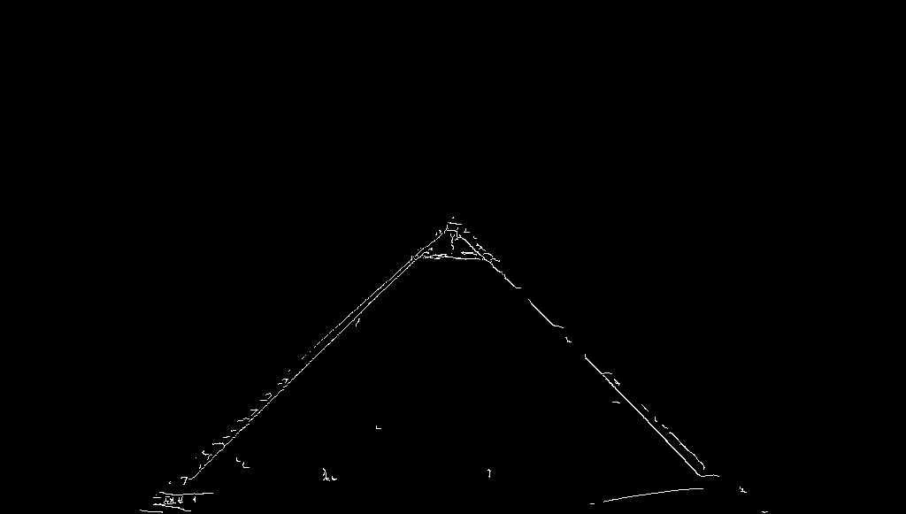
Creating a Triangle Filter

Slide 11
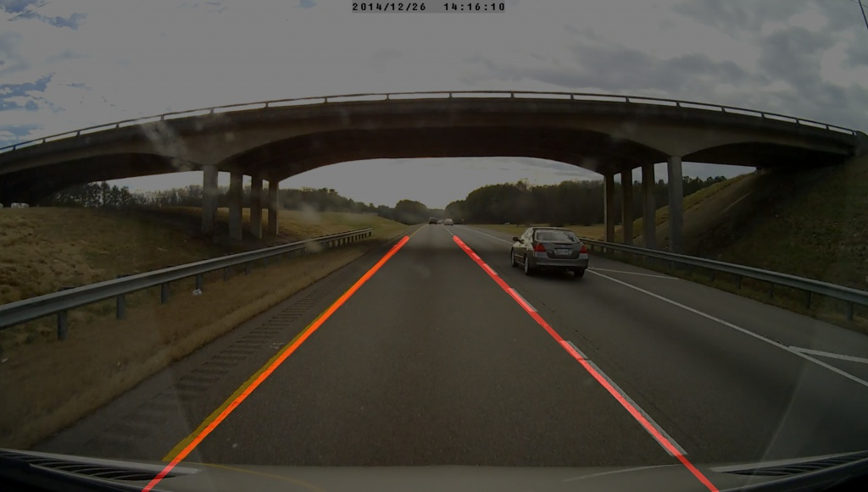
Using Hough Transform to Detect Lines

Slide 12
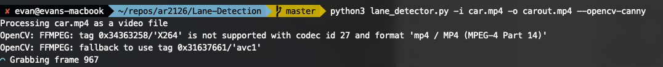
Program Architecture
Command line python program with detailed flags
Multithreaded using a pool
Detailed output, time estimation, etc

Slide 13
Lessons Learned
In order to process live video, we need a computationally efficient algorithm
Using standard convolution between Sobel filters and the image takes a long time, especially when it has to be done twice to find the x and y directions
Sobel filters are linear-separable, which means we can break the convolution into (img * [-1 0 1] * [[1], [2], [1]])
Even better, we can do (img[:, :2] - img[:, :-2]) and use those values to memoize the convolution without needing to do matrix operations! -> gives us O(n) instead of O(n^2)
There is no “one size fits all” solution for the triangular image mask
Since every image varies in size, and not every dashcam image is taken at the same angle, it is nearly impossible to have a perfect calculation to eliminate outlier pixels every time.

