Slide 1
Astro-Sage Call Center Performance Analysis
Presented by – Aditi Singh
Date - 01-Nov-2025

Slide 2
Who is AstroSage?
AstroSage is a leading astrology platform, serving as the world's largest astrology portal.
We connect users with professional astrologers, offer detailed horoscopes, create personalized birth charts (Kundli), provide matchmaking services, and sell astrological products through our AstroShop.

Slide 3
Objective
To analyze call and chat center data to understand performance, identify challenges, and uncover strategic opportunities for improvement.
Problem Statement
With a budget of ₹1 Crore, where should we invest to optimize efficiency, enhance customer satisfaction, and boost profitability?

Slide 4
Data Overview
Data Source: Astro-sage Call center system logs.
Size: 28,027 consultations
Calls: 8508 calls
Chats: 19514 chats
Timeframe: 01/12/2023 – 03/01/2024
Analysis Scope:
Call outcomes
Chat outcomes
Revenue Distribution
Guru Performance
Customer Satisfaction

Slide 5
Website Distribution
Majority of users prefer Gurucool which is almost 72% followed by app 28%
The dashboard is barely used (negligible).

Slide 6
How well chats work?
~28% of the chats are completed.
Majority of chats stay incomplete (34%) and failed ( 37%).
Chat handling still has room for improvement.

Slide 7
How well calls work?
~41% percent of calls are completed.
Around ~20% went unanswered , 15% went busy, 14% failed and ~10% stay as incomplete.
There is still enough room for improving call handling efficiency.

Slide 8
Daily call volume trend
Call Volume seems to fluctuate between 100 – 430.
This fluctuation indicates inconsistency in call volumes, demanding dynamic staffing to handle peak call periods.

Slide 9
Hourly call volume trend
Peak call hours of a day is 5:00 AM to 4:00 PM
Maximum of the calls are made between 7:00 to 8:00 AM (3539 calls), followed by 3:00 to 4:00 PM (3520 calls).
Handle the peak hours by implementing dynamic staffing based on workload.

Slide 10
Are our customers truly satisfied?
Most users rated 0-3, which clearly expresses dissatisfaction.
Very few users rate at 6-8 expressing satisfaction
There is still a lot improve in the aspect of customer satisfaction for good business

Slide 11
Top 10 gurus based on Earning
The chart displays the Top 10 Astrologers’ Earnings, highlighting significant variations in income levels.
Dr. Balkrisna leads with the highest earnings of 15,910.21, followed by Astro Ruchi at 10,274.66.
Most astrologers earn between 2,000 to 3,000, showing a large earnings gap among top performers.

Slide 12
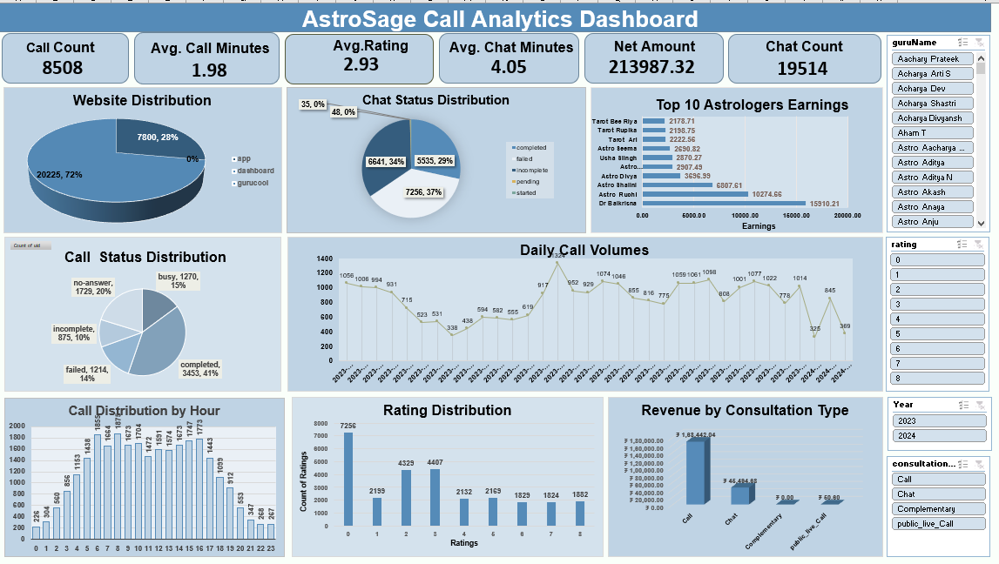

Slide 13
Conclusion
Analyzing the 28,027 records indicates only 40% of call completion rate and 57% repeat calls. This signals urgent need for transformation in our business model.
Coming to customer satisfaction, major pool of customers show dissatisfaction with our service. Improvement needed in the area of customer handling techniques.
Top performing gurus set a benchmark with a rating of 7.5. Adopting customer handling methods from these gurus can improve overall efficiency of the team.
Strategic investment in the area of tech upgrade and training programs should be our immediate concern in order to reduce drop rates and boost user ratings.
Hiring new resources is not our immediate concern. However, based on business expansion, the current team can also be expanded.

Slide 14
THANKYOU

