Slide 1


GSMA MENA IGNITE HACKATHON 2026
TrustMesh
AI-Agent Orchestration of Telecom Network Signals for Real-Time Fraud Defense
Theme 4: Secure Fintech, Payments & Anti-Fraud Innovation
Idea Phase Submission | July 2026
Notes:
• Open with the problem hook — 'Every 15 seconds, a SIM swap fraud attempt targets a financial transaction in the MENA region.' • Today we show you how telecom network intelligence stops it. • Let the title and tagline land for 2 seconds before speaking. • Establish credibility: this is a serious fintech security solution.

Slide 2
SIM Swap Fraud Is Crippling MENA Fintech
$6.7B
43%
Global OTP fraud losses annually (2025)
Increase in scam attempts in the UAE (IDEMIA 2026)
62%
$248B
Of UAE banks report rising fraud losses exceeding $5M each year (BioCatch)
MENA digital payments market at risk (2025, Mordor Intelligence)
Traditional fraud detection relies on behavioral heuristics — it cannot see the telecom-layer attack vectors that SIM swap fraud exploits.
Notes:
• Pause on the 43% UAE stat — let it land. • These aren't just numbers. Each represents real customers losing money while banks scramble to detect attacks they can't see. • The $248B market at risk shows the scale of what's unprotected. • Key insight: traditional systems are blind to telecom-layer signals.

Slide 3
INTRODUCING
TrustMesh
▭
✓
The AI Agent That Reads Telecom Signals to Stop Fraud in Real Time
SIM Swap
Number Verify
◯
Agentic Decision Engine
An LLM-powered agent autonomously decides which CAMARA APIs to call and interprets the results
◯
AI Agent
⇄
Step-Up Orchestration
Instead of binary block/allow, the agent selects the right verification step based on risk context
❄
Device Status
HIGH
MED
LOW
⊘
⚿
✓
✦
200ms Response
Block
Step-Up
Allow
Network API checks complete in under 200ms, embedded seamlessly into existing transaction flows
Notes:
• Emphasize 'agentic' — the AI decides which APIs to call, it's not a user clicking buttons. • This is the key differentiator the judges are looking for. • The 200ms response time is critical for real-time transaction flows. • Step-up orchestration is more sophisticated than simple block/allow.

Slide 4
How TrustMesh Works
01
02
03
04
05
▤
◯
✦
▦
⛨
Transaction Event
Agent Reasoning
CAMARA API Calls
Risk Scoring
Step-Up Decision
A payment or login triggers the agent via webhook (simulated in demo)
The LLM analyzes the event context and decides which network signals to check
Agent autonomously calls SIM Swap, Number Verification, and Device Status via Nokia NaC
Agent synthesizes signals into a 0-100 risk score with a natural-language explanation
Agent selects the appropriate response: allow, OTP to email, biometric re-auth, or block
Notes:
• Walk through the flow in 30 seconds. • Key point: step 2 is where the magic happens — the agent decides WHICH APIs to call based on context, not a hardcoded sequence. • Step 4 produces a natural-language explanation, not just a number. • Step 5 shows the nuance — it's not just block/allow, it's intelligent step-up.

Slide 5
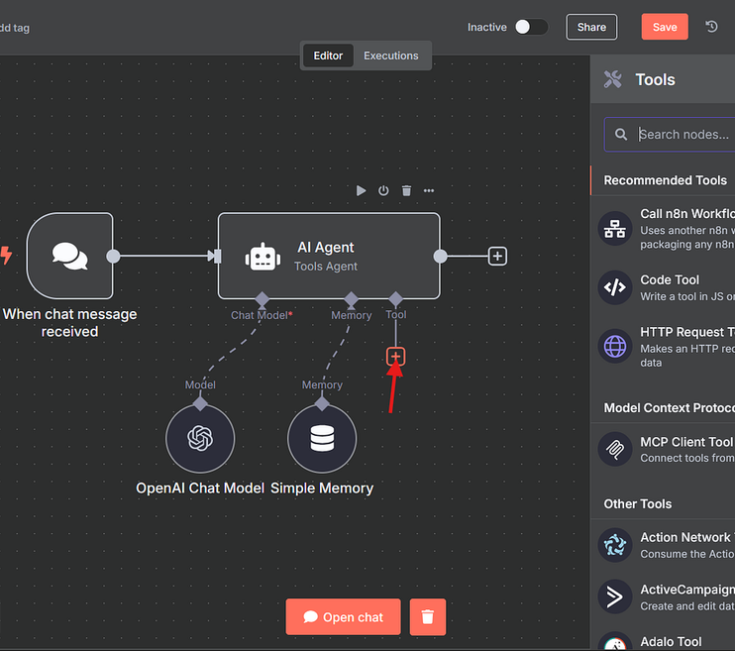
Built on Proven Infrastructure
01 Orchestration Layer:
n8n (community edition, self-hosted) — visual workflow builder with native AI Agent nodes
02 AI Brain:
Groq Llama 3.3 70B (free tier) or Google Gemini Flash — fast inference for real-time decisions
03 Network Intelligence:
CAMARA APIs via Nokia Network-as-Code — SIM Swap, Number Verification, Device Status
04 Integration:
Webhook-triggered, REST API output — drops into any existing fintech transaction pipeline
All AI agent tooling uses only the approved Resource & Tooling Guide (n8n is listed). Zero external agent frameworks.
TrustMesh agent workflow in n8n
Notes:
• Call out n8n specifically — it's on the approved tooling list, which is mandatory • Judges will verify tooling compliance, so this slide directly addresses that • Emphasize "zero external agent frameworks" — this is a constraint requirement • The Groq free tier keeps costs near-zero for the hackathon demo

Slide 6
Live Demo: What Judges Will See
✦
WITHOUT TRUSTMESH
⛨
WITH TRUSTMESH
🏛
User makes a $5,000 remittance transfer
🏛
User makes a $5,000 remittance transfer
⚠
SIM was swapped 2 hours ago — but the bank can't see it
◯
Agent detects SIM swap in last 24h + device mismatch
Transaction approved → Fraud succeeds → Money lost
✦
Risk Score: 87/100 — Agent triggers email OTP step-up
✦
VS
✓
User verifies via registered email → Transaction allowed safely
Traditional systems check behavioral patterns, not network-layer signals
Network intelligence catches what behavioral systems miss
Notes:
• This is the money slide — the before/after is immediately intuitive • Practice this demo flow — it needs to feel smooth and confident • Emphasize the 87/100 risk score as a concrete, actionable output • Key contrast: invisible telecom signal vs. visible network intelligence

Slide 7
Massive Market, Urgent Need
$39B
88%
$4.5B
UAE cross-border remittances (2025), growing to $50B by 2031 at 4.85% CAGR (Ken Research)
Of Dubai transactions are already digital non-cash — the attack surface is enormous (2025)
Projected MENA fintech revenue by 2025, up from $1.5B in 2022 — 3x growth in 3 years (McKinsey)
Revenue Model
Target Customers
Per-transaction API orchestration fee (fraction of a cent per check) + premium tier for step-up orchestration intelligence
UAE and Saudi neobanks, digital remittance platforms, cross-border payment processors
Notes:
• The $39B remittance number is the anchor — shows sheer scale of transactions needing protection • Connect this to why SIM swap fraud is specifically devastating for remittances • 88% digital = 88% of transactions are exposed to SIM-swap-based OTP interception • Business model is designed to be incremental and non-disruptive to adopt

Slide 8
Why TrustMesh Beats the Status Quo
FEATURE
TRADITIONAL FRAUD DETECTION
TRUSTMESH
SIM Swap Detection
✕
Not available
✓
Real-time via CAMARA API
Decision Logic
Hardcoded rules
✓
LLM-powered contextual reasoning
Response
Binary: block or allow
✓
Nuanced step-up orchestration
Integration
Months of custom development
Webhook + REST, drops into existing flow
✓
MENA Context
Generic global models
✓
Built for Gulf remittance corridors
TrustMesh turns invisible telecom signals into actionable fraud intelligence — in 200 milliseconds.
Notes:
- Don't read every row — highlight rows 1 and 3 as the key differentiators - The SIM swap detection alone is worth the price of admission - Stress that traditional systems literally cannot see SIM swaps - "LLM-powered contextual reasoning" means the agent adapts, unlike static rules

Slide 9
Our Team
☻
ATHIRA ANIL KUMAR
Full-Stack & AI Engineer
AI engineer specializing in natural language processing and agent frameworks.
Notes:
- Keep this brief — 15 seconds max - If solo, say "I'm building this as a solo founder, but the architecture is designed to scale with a team" - Don't apologize for missing team members — own the placeholder - Move quickly to the closing slide

Slide 10

MENA IGNITE HACKATHON 2026
TrustMesh
Turning Network Intelligence into Fraud Defense
See you at MWC Doha, November 2026
GSMA Open Gateway Hackathon | Theme 4: Secure Fintech
Notes:
- End with confidence: "TrustMesh: where telecom intelligence meets AI-driven fraud defense" - "We look forward to demoing this live in Phase 2. Thank you." - Pause after "Fraud Defense" — let the tagline land - No rush — this slide should breathe for a full 10 seconds

