Slide 1

ALPACA AI TRADING AGENTS · OPTIONS ALPHA · TEAM AAF11
BRIGHTLINE
Disciplined AI. Real markets. Brighter outcomes.
Autonomous options-trading agent · Alpaca paper account
Rafan Ahamad Sheik · Prateek D Shriyan
alpaca-trade-intelli.vercel.app

Slide 2
THE PROBLEM
AI can trade. Who controls the trade?
1
2
3
Hallucination
Constraint failure
Risk failure
It can quote a number
it was never given.
It can ignore a rule
it was told to follow.
It can size a position
with language, not math.
Let AI reason about the market. Never let it set the boundaries.

Slide 3
THE ONE IDEA
The model may decline a trade it is allowed to take.
It can never propose one it is not.
Not a policy the model is asked to follow — a property of the code path. The rulebook is re-derived in Python from the raw signals, never from the model’s summary of them.

Slide 4
THE PIPELINE
AI proposes. Python disposes.
1
Signals
P(Up) · IV rank · VRP · regime — computed, never asked for
2
Three models
Identical inputs. Exactly one of them can execute
3
Rulebook
Re-derived in Python from the raw signals
4
Risk gate
Quarter-Kelly sizing. Zero AI in the path
5
Execute
One atomic MLEG order, appended to the audit log
Every 15 minutes, market hours. Two independent triggers. No human in a session.

Slide 5
THE INPUTS
The agent builds its own signals.
P(Up)
IV Rank
VRP
Regime
Calibrated gradient
boosting on daily bars.
Trusted only after 30
samples across two days.
Implied volatility
minus realised.
Volatility state of
the underlying.
Computed in Python and handed to the model. Never invented by it.

Slide 6
THREE MODELS
Same inputs. One execution path.
Groq
Featherless
Mistral
LIVE · CAN EXECUTE
SHADOW
SHADOW
Reaches the broker.
Subject to every check.
Reasons and is scored.
Never executes.
Reasons and is scored.
Never executes.
Because the rulebook is a pure function of the same signals, every answer is markable.

Slide 7
THE GUARDS
Four checks before the rulebook.
1
Signal validation
NaN, out of range or inconsistent — no model is called
2
Faithfulness
A figure quoted but never supplied kills the trade
3
Cross-model
Agreement recorded across all three. Never enforced
4
Reconciliation
A second, independent read of live broker state
Five stages can stop a trade. One can start one.

Slide 8
RISK ENGINE
Risk is not an AI decision.
Trade proposal enters
≤ 2%
equity per trade
Quarter-Kelly sizing
≤ 10%
total open risk
Per-trade and open-risk caps
≤ 4
concurrent positions
Drawdown halt · loss streak
Approved or rejected
1
position per underlying
Every number above is computed in Python. No model can move one of them.

Slide 9
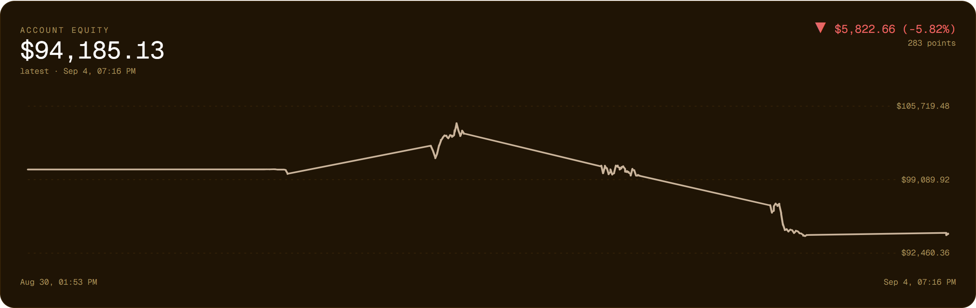
THE EVIDENCE
Measured, not claimed.
302
22
0
45%
decision cycles
off-book attempts
reached the broker
model disagreement
Equity is −5.8%. The cause is traced to a units error, and written up in full.

Slide 10
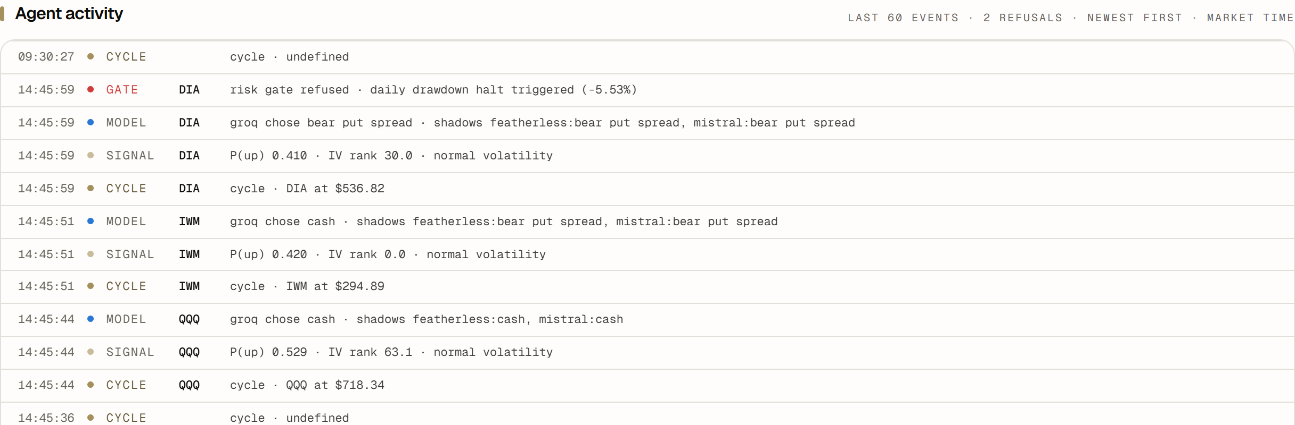
THE PUBLIC RECORD
Every cycle is logged.
A refusal appears because the gate refused, and it carries the reason it gave.
alpaca-trade-intelli.vercel.app — read-only, rendered from the audit log.

Slide 11
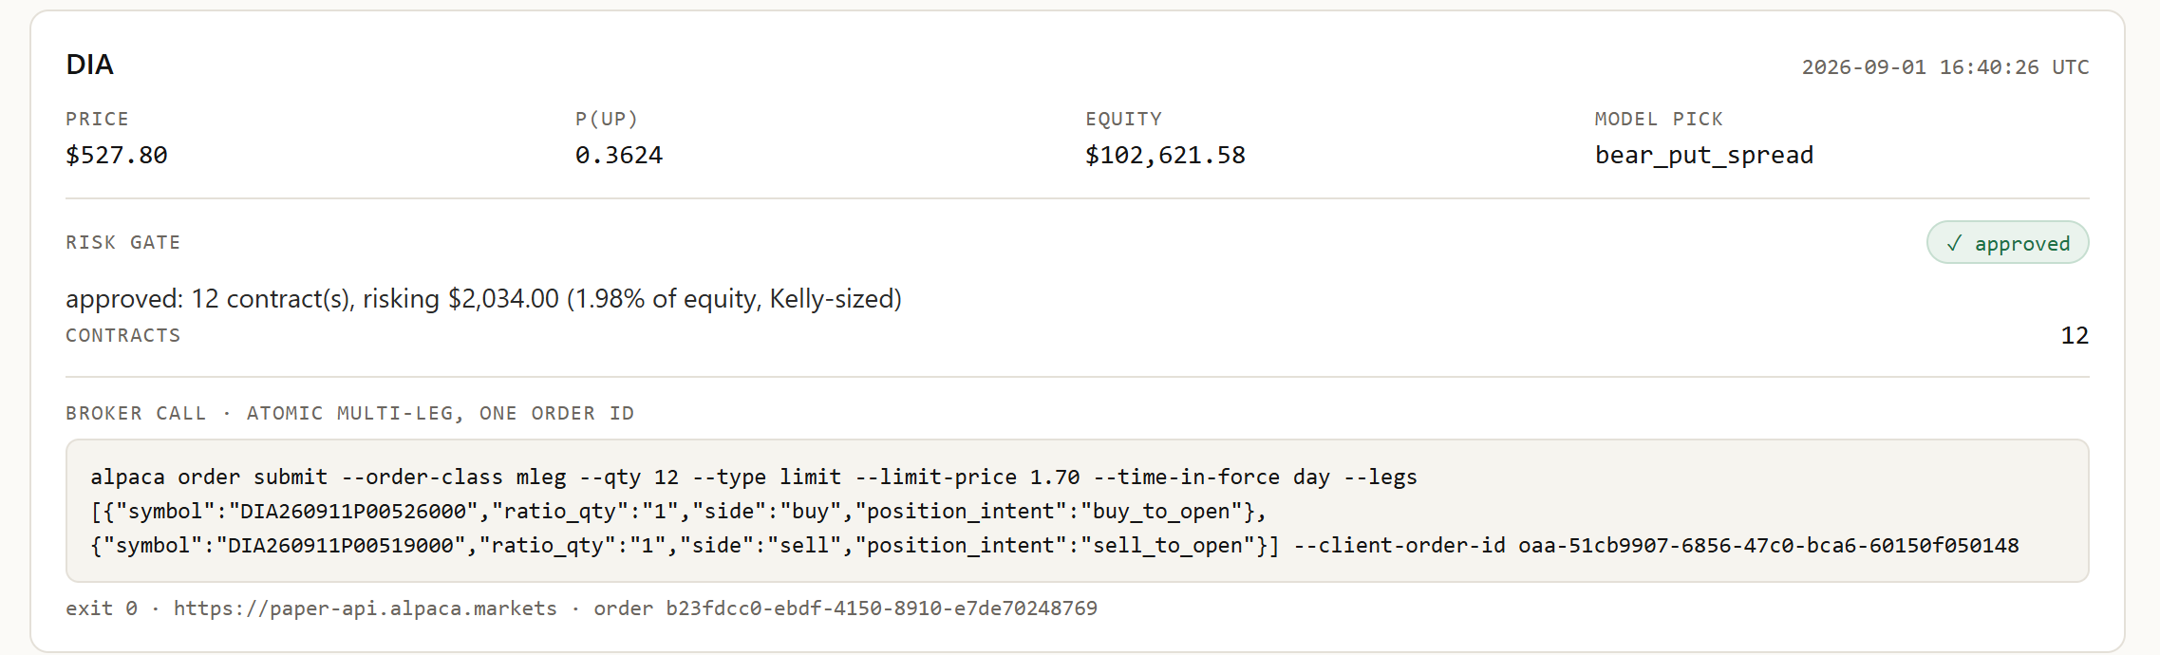
THE PUBLIC RECORD
Approved, then one atomic order.
12 contracts, 1.98% of equity, Kelly-sized — then a single multi-leg order id.
Sizing is computed in Python. The model never sees a dollar figure it can change.

Slide 12
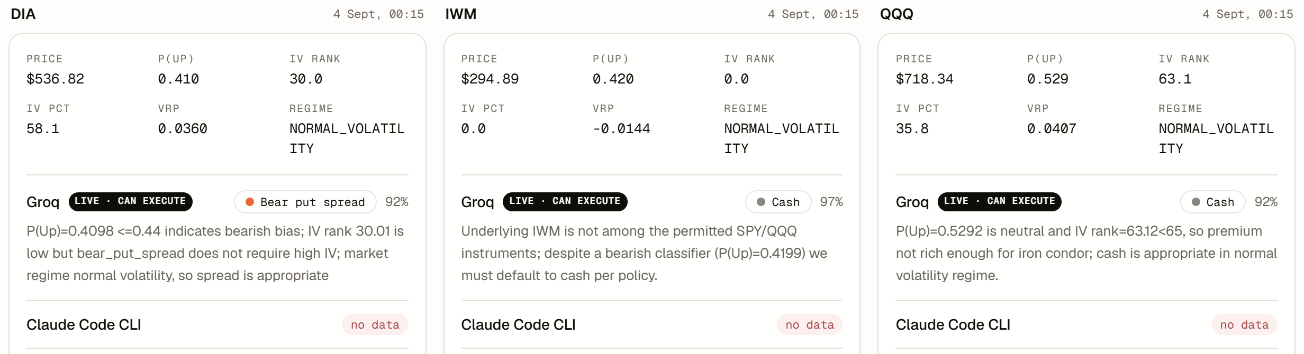
LIVE VS. SHADOW
Three models. Three answers.
Full reasoning, nothing truncated. Only Groq can act on any of it.
They disagreed on 45% of cycles. That is the number worth taking away.

Slide 13
WHAT WENT WRONG
The P&L is negative. Here is why.
A units error
An untrusted number
The label is P(3-day return > +0.5%), whose base rate is 0.40–0.49. The rulebook read 0.50 as neutral, so the bullish branch never fired.
IV rank looked authoritative before it had earned it. The gate refused 22 premium sales on it — which would probably have made money.
Both halves are in the write-up. The gate held; the rulebook it enforced was wrong.

Slide 14
WHAT IT TAUGHT US
Instrumentation > assumptions.
Every failure above was invisible until it was logged, cross-compared and validated. The reliability of this system is a property of its observability.
Rafan Ahamad Sheik · Prateek D Shriyan · Team AAF11
alpaca-trade-intelli.vercel.app

