Slide 1


MAJOR PROJECT – PHASE II
WKAI – Workshop AI: A Real-Time AI-Assisted Workshop Platform
Presented by:
Team ID: 23CSMPB03
Mustafa Muhammad Abdulla : 4PA22CS092
Mohammed Shammas I : 4PA23CS083
Mohammed Zahid Ibrahim : 4PA23CS085
Rafan Ahamad Sheik : 4PA23CS102
Guide:
Prof. Habeeb Ur Rehman
Assistant Professor
Department of CSE, PACE
Coordinator(s):
Dr. Hafeez MK / Prof. Sakeena
Department of CSE, PACE
Dept. of CSE | PACE
1
VTU Major Project – Phase II | 2026–27
Notes:
WKAI follows a live coding workshop with AI and turns it into a written guide, comprehension checks and error help while the class is still running.

Slide 2
Introduction / Background – Context
• Live coding workshops run on Zoom / Meet or an LMS
• Conferencing tools move pixels; they do not understand the content
• LMS platforms work before and after class, not during it
• What is typed, said and debugged live is shown once, then lost
30s
Looks away for thirty seconds
No way to catch up without interrupting
ERR
Hits an environment error
The whole class stops for one typo
END
The session ends
No written record beyond own notes
?
Is quietly confused
No signal ever reaches the instructor
Fig. 1 – What a student loses in a live coding session today
Dept. of CSE | PACE
2
VTU Major Project – Phase II | 2026–27
Notes:
Context: the tools used for live teaching either stream without understanding, or store content that was prepared separately.

Slide 3
Introduction / Background – Motivation
• Instructors get no automatic written guide of what they taught
• Stuck students fall behind invisibly in remote sessions
• Most lab-time interruptions are trivial, repeated errors
• Fast LPU inference (Groq) now makes live AI analysis practical
• Principle: use signals the session already produces; add no instructor work
Screen + speech
Summarise
Written guide
Same taught material
Ask questions
Comprehension check
Student error text
Diagnose
Debugging help
Fig. 2 – Three things instructors want, derived from signals the session already emits
Dept. of CSE | PACE
3
VTU Major Project – Phase II | 2026–27
Notes:
Motivation: the three things instructors want after class can all be derived from data the class already produces.

Slide 4
Introduction / Background – Domain Overview
• WKAI sits between three existing tool categories
• Each is strong on one axis and blind on the others
• None writes study material while the class is running
• WKAI serves one meeting shape, the hands-on workshop, in depth
Capability | Video conference | LMS | AI code assistant | WKAI
Live screen + audio | ✓ | ✗ | ✗ | ✓
Understands content | ✗ | ✗ | pasted text | ✓
Guide during class | ✗ | manual | ✗ | ✓
Session-aware help | ✗ | ✗ | context-blind | ✓
Checks while teaching | polls | async | ✗ | ✓
Helps before asked | ✗ | ✗ | ✗ | ✓
Fig. 3 – Capability comparison of existing tool categories
Dept. of CSE | PACE
4
VTU Major Project – Phase II | 2026–27
Notes:
Domain: conferencing, LMS and AI coding assistants each miss the in-session understanding WKAI provides.

Slide 5
Problem Statement
• Problem: no tool both streams a live coding session and understands it
• Gap: no live guide, no stuck-student signal, no context-aware debugging help
• Target users: instructors of 5–60 students; students on any browser
• Expected improvement: all of the above with zero extra instructor work
Instructor
screen + voice
Zoom / Meet
pixels only
Students
watch, then lose it
✗
No written guide of what was taught
✗
No signal that a student is stuck
✗
No debugging help grounded in this session
✗
No comprehension check during class
Fig. 4 – Today's pipeline carries pixels only – nothing is understood or kept
Dept. of CSE | PACE
5
VTU Major Project – Phase II | 2026–27
Notes:
Read the problem statement from the report, then show the illustration: everything after the conferencing tool is missing.

Slide 6
Problem Statement – Sub-problems
• Capture & delivery: fidelity and low latency to many viewers
• Comprehension: a coherent guide from continuous input
• Detection: notice stuck students without surveillance
• Intervention: correct help grounded in what was taught
• Cross-cutting: access and privileges must be provably controlled
1
Capture & delivery
2
Comprehension
Fails as degraded, unreliable video
Fails as fragments, or too late to use
3
Detection
4
Intervention
Fails silently – nobody notices
Fails as a confidently wrong answer
Fig. 5 – Each sub-problem fails in a different way
Dept. of CSE | PACE
6
VTU Major Project – Phase II | 2026–27
Notes:
Each sub-problem needs its own design answer because each fails differently.

Slide 7
Objectives
• O1 Capture and stream screen + audio with one form, one button
• O2 Turn transcript and screen into a live structured guide
• O3 Detect student errors; return grounded diagnoses
• O4 Zero-install browser app with token-based room access
• O5 Make instructor privileges impossible to spoof
Obj. | Measured result | Status
O1 | Native capture ~37 fps; one publish via SFU | Met
O2 | Guide blocks delivered live; grounding filter | Met
O3 | Auto-diagnosis on failed run; burst queued | Met
O4 | Browser only; signed join token (TC-1, TC-5) | Met
O5 | All abuse attempts rejected | Met
Fig. 6 – Each objective mapped to the result that evidences it
Dept. of CSE | PACE
7
VTU Major Project – Phase II | 2026–27
Notes:
Five objectives, each mapped to where its result is shown later in the deck.

Slide 8
Objectives – Scope
• Scope drawn on one test: can it be validated end to end this phase?
• Delivered: capture, streaming, 7 agents, student app, security
• Deferred: work depending on infrastructure not guaranteed this phase
• Deferred items become the future scope
Delivered
Deferred
Native capture (Windows, Linux)
SFU streaming + mesh fallback
7 LangGraph agents
Student app + sandbox
Assessments, workspaces
Token auth, rate limits
Theming, MCP server
macOS capture backend
Student native companion app
Multi-instance backend scaling
LMS export of the guide
Rubric-based AI evaluation
Fig. 7 – In-scope versus deferred work
Dept. of CSE | PACE
8
VTU Major Project – Phase II | 2026–27
Notes:
Scope: everything in the left column can be demonstrated by starting the apps and joining from a browser.

Slide 9
Literature Survey – Key Studies (1/2)
• Ten works reviewed (2026–2024), one per capability WKAI must combine
• LeafTutor [1] (2026): classify-then-intervene for live coding errors
• MMTutorBench [2] (2026): correctness and pedagogy scored apart
• ITS review [3] (2025): modern taxonomy and grounded feedback loops
• Video-MMLU [4] (2025): incremental segment-level summaries win
# | Work | Venue | Lesson taken
1 | Review of AI-based ITS | ArXiv '25 | Ground answers in bounded course material
2 | Ruffle & Riley | AIED '24 | Elicit before explaining
3 | Tutor CoPilot | Stanford '24 | Augment the live human tutor
4 | ScreenAI | IJCAI '24 | Screens are machine-readable
5 | MultiTutor | PMLR '25 | Discipline agent communication
Fig. 8 • Summary of reviewed literature • works 1 to 5 (2026–2025)
Dept. of CSE | PACE
9
VTU Major Project – Phase II | 2026–27
Notes:
Each paper maps to one design decision in WKAI.

Slide 10
Literature Survey – Key Studies (2/2)
• MathBuddy [5] (2025): retries and latency signal student struggle
• MultiTutor [6] (2025): state machine avoids agent traffic bottlenecks
• Ruffle & Riley [7] (2024): tutors must elicit, not hand out answers
• Tutor CoPilot [8] (2024): amplify the live instructor, within seconds
• ScreenAI [10] & Computing in GenAI [9] (2024): UI grounding & error scaffolding
# | Work | Venue | Lesson taken
5 | MultiTutor | PMLR '25 | Discipline agent communication
6 | MMTutorBench | ArXiv '25 | Score pedagogy apart from correctness
7 | Video-MMLU | CVPR '25 | Summarise per segment
8 | MathBuddy | EMNLP '25 | Cheap engagement proxies work
9 | LeafTutor | ArXiv '26 | Classify, then intervene
Fig. 9 • Summary of reviewed literature • works 6 to 10 (2025–2024)
Dept. of CSE | PACE
10
VTU Major Project – Phase II | 2026–27
Notes:
Continued literature table.

Slide 11
Literature Survey – Research Gap
• Each capability exists in isolation in the literature
• Prior systems assume known material, async use, a test suite, or a student who asks first
• None run on a live, unscripted session in real time
• WKAI: integrative and engineering-led, not model-led
Tutoring dialogue
[7]
Screen understanding
[10]
WKAI
all four, live,
in real time
Multi-agent coordination
[6]
Code-error tutoring
[1]
Fig. 10 – Capabilities that exist separately, combined live in WKAI
Dept. of CSE | PACE
11
VTU Major Project – Phase II | 2026–27
Notes:
The gap is integration under real-time constraints, not a better model.

Slide 12
Proposed System
• Core idea: the instructor teaches normally; WKAI watches, listens and writes
• Inputs: screen, voice, student errors and questions
• Outputs: live stream, guide, checks, diagnoses, answers
• Novelty: help triggered by events, before a student asks
Instructor screen
Live stream
WKAI
Capture
Understand
Deliver
Live guide
Instructor voice
Comprehension checks
Student errors
Error diagnosis
Student questions
Answers / escalation
Fig. 11 – High-level concept: signals in, help out
Dept. of CSE | PACE
12
VTU Major Project – Phase II | 2026–27
Notes:
Four signals in, five kinds of help out.

Slide 13
Proposed System – Key Features
• Zero-effort guide generation, with grounding gates
• Native OS-level capture at ~37 fps; SFU delivery
• Error diagnosis with a single fix command
• Code sandbox, quizzes, proctored assessments
• Workspace memory across a multi-day course
Live guide
from screen + speech
Grounding gates
reject invented blocks
Comprehension gating
answer to unlock
Error diagnosis
cause + fix command
Native capture
Rust, ~37 fps
SFU relay
1 upload, mesh fallback
Code sandbox
Py / JS / TS / Bash
Assessments
timed, proctored
Workspace memory
shared across sessions
Fig. 12 – Nine delivered features
Dept. of CSE | PACE
13
VTU Major Project – Phase II | 2026–27
Notes:
The features that the rest of the talk demonstrates.

Slide 14
Proposed System – Requirements
• Nine functional requirements, each traced to a test
• Security first: role and identity only from signed tokens
• Reliability: reconnect restores full state
• Usability: browser only, no account
• Scalability: request bursts never break rate limits
FR | Requirement | Status
1 | Start session, get room code | Verified
2 | Stream screen + audio live | Partial
3 | Live guide from transcript + screen | Verified
4 | Join with code, get signed token | Verified
5 | Grounded error diagnosis | Verified
6 | Instructor file sharing | Verified
7 | In-session quizzes | Verified
8 | Ended vs offline notices | Verified
9 | Themes with custom accent | Verified
Fig. 13 – Functional requirements and verification status
Dept. of CSE | PACE
14
VTU Major Project – Phase II | 2026–27
Notes:
FR-2 is partially verified because media is still tested by hand.

Slide 15
System Architecture
• Instructor app: Tauri + Rust + React; native capture
• Backend: Node.js, WebSocket, 7 agents, SFU broker
• Student app: React, browser only
• Data flow: control over WS + REST; media via Cloudflare SFU
• Dependencies: PostgreSQL, Redis, Groq, Cloudinary
Instructor
Tauri · Rust
Backend
Node · ws · agents
Student
React · browser
PostgreSQL
durable
Redis
room state
Groq
LLMs
Cloudinary
files
Cloudflare Realtime SFU + TURN
publish once → every student pulls a copy
Fig. 14 – WKAI block diagram – control path (teal) and media path (orange)
Dept. of CSE | PACE
15
VTU Major Project – Phase II | 2026–27
Notes:
Three apps, one backend contract. The media path is separate from control.

Slide 16
System Architecture – Layered View
• Five layers, each with a single responsibility
• Invariant 1: no client is authoritative; state comes from the server
• Invariant 2: control and media paths are independent
• Media was replaced wholesale with zero protocol changes
Presentation
two UIs, render from messages
Transport
WS control + separate media
Orchestration
agents, retries, queue
Persistence
Postgres + Redis (7-day TTL)
Capture
native Rust, bounded channel
Fig. 15 – Layered architecture of WKAI
Dept. of CSE | PACE
16
VTU Major Project – Phase II | 2026–27
Notes:
Two invariants account for most of the resilience.

Slide 17
System Architecture – Data Model
• PostgreSQL: what must outlive the session
• Redis: room state, transcript, agent memory, SFU location
• Redis entries expire after 7 days – no cleanup job
• No table of connected clients: that state is ephemeral
Table | Holds
sessions | workshop, room code, status, workspace
workspaces | course sharing AI memory
guide_blocks | guide cards in order
comprehension_questions | checks from guide content
shared_files | instructor files + URLs
messages | questions + replies
error_resolutions | errors + diagnoses
assessments (+4) | questions, attempts, answers, events
Fig. 16 – Persistent tables and their contents
Dept. of CSE | PACE
17
VTU Major Project – Phase II | 2026–27
Notes:
Postgres records only what must survive a session.

Slide 18
System Architecture – Real-Time Protocol
• One endpoint: ws://host/ws?token=…
• Token lifetimes: instructor 12 h, student 8 h
• Role, session and identity are read from the token only
• Reconnect returns a full session-state snapshot
Message | Direction
audio-transcript | instructor → server
guide-block | server → students
comprehension-question / -result | server ↔ students
student-error / error-resolved | student ↔ server
share-intent-detected | server → instructor
file-shared | server → students
session-state | server → new client
instructor-online / -offline | server → students
session-ended | server → room
Fig. 17 – Key WebSocket message types
Dept. of CSE | PACE
18
VTU Major Project – Phase II | 2026–27
Notes:
The token decides who you are; these message types carry the product.

Slide 19
Methodology / Workflow
• Step 1: instructor starts a session with one form
• Step 2: Rust captures screen frames and 30 s audio
• Step 3: Whisper transcribes; gates drop junk
• Step 4: agents generate grounded, validated blocks
• Step 5: WebSocket + SFU deliver to the room
• Step 6: diagnose, answer or escalate, run quizzes
1. Start session
2. Capture screen + mic
3. Transcribe + filter
4. Generate + ground
5. Deliver (WS + SFU)
6. Support students
Fig. 18 – Runtime workflow of a live session
Dept. of CSE | PACE
19
VTU Major Project – Phase II | 2026–27
Notes:
Six steps from starting a session to supporting a stuck student.

Slide 20
Methodology / Workflow – Message Sequence
• Instructor creates the room and gets a signed token
• Student joins with code + password, gets a join token
• Frames and transcripts flow in; guide blocks flow out
• Errors are diagnosed; questions reach the instructor or AI after 45 s
Instructor
Backend
Student
create session → token
join → join token
frames + transcript
guide-block
student-error
cause + fix command
question → inbox
reply / AI after 45 s
media via SFU
Fig. 19 – Session message sequence across the three applications
Dept. of CSE | PACE
20
VTU Major Project – Phase II | 2026–27
Notes:
Walk the sequence top to bottom.

Slide 21
Methodology / Workflow – AI Pipeline
• Screen frame every 25 s → vision model
• 30 s audio → Whisper → transcript gate
• Explainer agent uses ranked session context
• Grounding filter rejects invented blocks
• Surviving blocks saved and broadcast live
Screen frame
every 25 s
Vision model
Qwen3
Microphone
30 s chunks
Whisper
large-v3
Grounding filter
rejects narration / no code
Transcript gate
drops junk
Session context
IDF-ranked
Explainer
GPT-OSS-120B
Guide blocks
saved + broadcast
Fig. 20 – Capture-to-guide pipeline with its two rejecting gates
Dept. of CSE | PACE
21
VTU Major Project – Phase II | 2026–27
Notes:
Two gates reject rather than pass.

Slide 22
Methodology / Workflow – Agent Workflow
• Error agent: classify → diagnose → validate
• Invalid output retried a bounded number of times
• Intent agent: cheap lexical filter before any model call
• File-share intents are suggested, never auto-shared
• Cheap steps always run before expensive ones
Error diagnosis
Intent detection
Student error
Transcript
Classify
Lexical filter
Diagnose
Classify intent
Validate (Zod)
Match file
cause + fix
ask instructor
Fig. 21 – Error-diagnosis and intent-detection state machines
Dept. of CSE | PACE
22
VTU Major Project – Phase II | 2026–27
Notes:
Both graphs put cheap steps first.

Slide 23
Implementation – Environment & Tools
• Software: Node.js 20+, Rust + Tauri CLI, Vite
• Models: Qwen3 vision, GPT-OSS-120B, Whisper-large-v3 on Groq
• Data: Neon PostgreSQL + Redis
• Hardware: none custom; 8 GB RAM instructor PC
• Test setup: seeded demo room, all three apps started together
Layer | Technology
Instructor app | Tauri v2 (Rust + React + TS)
Student app | React 18 + TypeScript + Vite
Backend | Node.js + Express + ws
AI orchestration | LangChain + LangGraph + Zod
Inference | Groq API
Data | PostgreSQL + Redis
Media | Cloudflare Realtime SFU + TURN
Files | Cloudinary
Hosting / CI | Render, Vercel, GitHub Actions
Fig. 22 – Technology stack by layer
Dept. of CSE | PACE
23
VTU Major Project – Phase II | 2026–27
Notes:
Environment and tools used to build and test the system.

Slide 24
Implementation – Native Capture
• Rust captures the OS framebuffer, not a browser API
• JPEG encode runs on a second thread, overlapping capture
• SIMD encoder: 17.2 ms vs 36 ms before
• Capture call sets the ceiling at ~37 fps
• Platforms: Windows and Linux (X11) native; macOS stub
OS framebuffer
23.7 ms
RGB convert
2.6 ms
SIMD JPEG encode
17.2 ms · 2nd thread
Bounded channel
backpressure
Publish
SFU / preview
Fig. 23 – Capture pipeline stages and per-frame cost at 1920×1200
Dept. of CSE | PACE
24
VTU Major Project – Phase II | 2026–27
Notes:
The encoder was the ceiling until the SIMD switch.

Slide 25
Implementation – Live Delivery
• Phase I: one encode + upload per student (mesh)
• Phase II: one publish to the SFU; students pull copies
• Publisher location kept in Redis (restart-safe)
• TURN credentials minted server-side for campus networks
• No SFU configured → falls back to the mesh
Mesh
SFU
S
S
S
S
I
I
SFU
S
S
S
S
S
S
N uploads
1 upload
Fig. 24 – Peer mesh (Phase I) versus selective forwarding unit (Phase II)
Dept. of CSE | PACE
25
VTU Major Project – Phase II | 2026–27
Notes:
Instructor uplink no longer grows with class size.

Slide 26
Implementation – Security Model
• Flaw found: client declared its own role in the URL
• Anyone with a room code could become instructor
• Fix: HMAC-signed tokens; role read only from the token
• Also: rate limits, timing-safe compare, fail-closed boot
Before – client asserts role
ws://host/ws?room=ABC123&role=instructor
Accepted by the server: a full authorisation bypass.
After – server proves identity
ws://host/ws?token=eyJyb2xl… (signed)
Instructor token 12 h · student token 8 h. Client role parameters are never read.
Fig. 25 – Before and after the authentication rework
Dept. of CSE | PACE
26
VTU Major Project – Phase II | 2026–27
Notes:
The original design let the client assert its role.

Slide 27
Implementation – AI Agent Layer
• Seven agents share one contract: name, version, invoke, healthCheck
• Each agent is feature-flagged by an environment variable
• Agents talk only through LangGraph state, never directly
• Per-session queue: max 2 AI calls in flight
Agent | Trigger | Output
Error diagnosis | failed run | cause + fix
Intent detection | transcript | share suggestion
Transcript explainer | new segment | guide block
Comprehension coach | block published | question
Student messaging | question | answer / escalate
Notebook (Colab) | notebook link | diagnosis
Assessment author | instructor | test questions
Fig. 26 – The seven LangGraph agents and their triggers
Dept. of CSE | PACE
27
VTU Major Project – Phase II | 2026–27
Notes:
Every AI capability is an agent behind one contract.

Slide 28
Implementation – Build & Release
• Push to main deploys all three targets
• Backend to Render with schema migrations
• Student app and landing page to Vercel
• Installers: version bump, tag, signed Windows + Linux builds
• isTauri guard: UI preview in a browser, seconds not minutes
Render
Backend + migrations
git push main
Vercel
Student app + landing
GitHub Actions
Signed installers + auto-update
Fig. 27 – Automated deployment from one source of truth
Dept. of CSE | PACE
28
VTU Major Project – Phase II | 2026–27
Notes:
The version bump is automated because builds once shared a version number.

Slide 29
Module Description
• Instructor app: setup, present bar, live rail, settings
• Capture & streaming: Rust capture, SFU, TURN
• Backend relay: token auth, rooms, REST routes
• AI agent layer: 7 graphs, queue, gates
• Student app: join, guide, sandbox, AI help, Q&A
• Assessments: author, attempt, score, proctor
1
Instructor app
2
Capture & stream
wkai/
src-tauri, sfu/
3
Backend relay
4
AI agent layer
src/ws, routes/
src/ai/
5
Student app
6
Assessments
wkai-student/
routes/assessments
Fig. 28 – Six modules of the system
Dept. of CSE | PACE
29
VTU Major Project – Phase II | 2026–27
Notes:
Six modules and where they live in the repository.

Slide 30
Module Description – Assessments & MCP
• Author: AI assessment agent or by hand
• Attempt: questions sent without the answer key
• Score: computed on the server
• Proctor: focus loss, paste, tab changes recorded
• MCP server: an AI agent can run a whole session
Author
AI or manual
Attempt
no answer key
Score
server-side
Proctor
events recorded
MCP tools (wkai_*)
create_session
connect_instructor
send_screen_frame
speak
share_file
reply_to_student
list_students
end_session
Fig. 29 – Assessment module and the agent-facing MCP interface
Dept. of CSE | PACE
30
VTU Major Project – Phase II | 2026–27
Notes:
Assessments end to end, and the MCP tool surface.

Slide 31
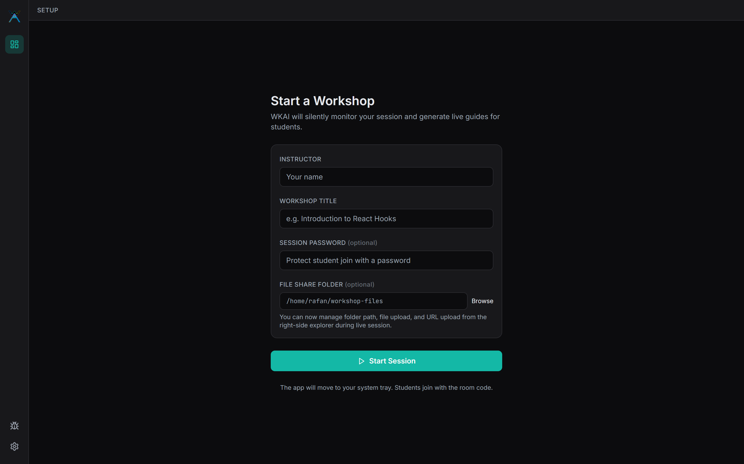
Results & Outputs – Starting a Session
• Instructor enters name, title, optional password and share folder
• One button starts the session and moves the app to the tray
• A six-character room code is issued with a 12 h token
• Objective met: O1 – one form, one button
Fig. 30 – Instructor desktop app – start a workshop
Dept. of CSE | PACE
31
VTU Major Project – Phase II | 2026–27
Notes:
Screenshot from the running system in a seeded demo room.

Slide 32
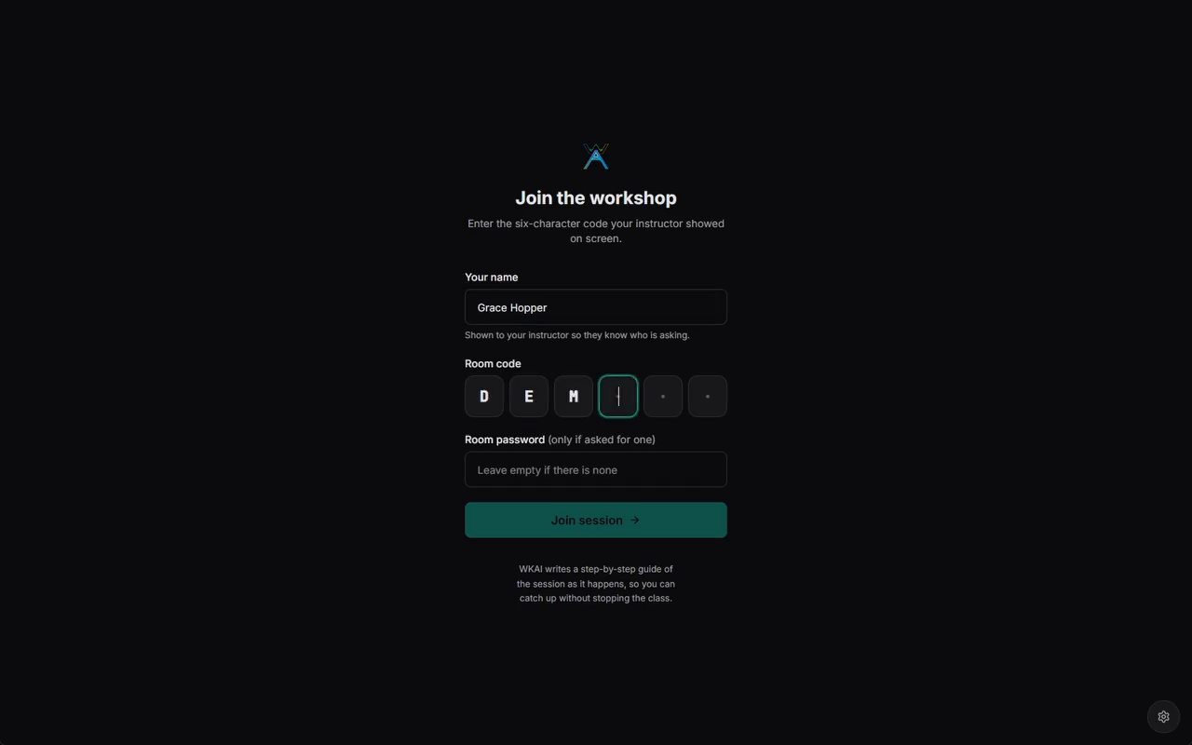
Results & Outputs – Student Join
• Student types a name, the room code and a password if set
• Password is checked on the server, never in the browser
• Server returns a signed 8 h join token
• Objective met: O4 – zero install, token-secured
Fig. 31 – Student web app – join with the room code
Dept. of CSE | PACE
32
VTU Major Project – Phase II | 2026–27
Notes:
Screenshot from the running system in a seeded demo room.

Slide 33
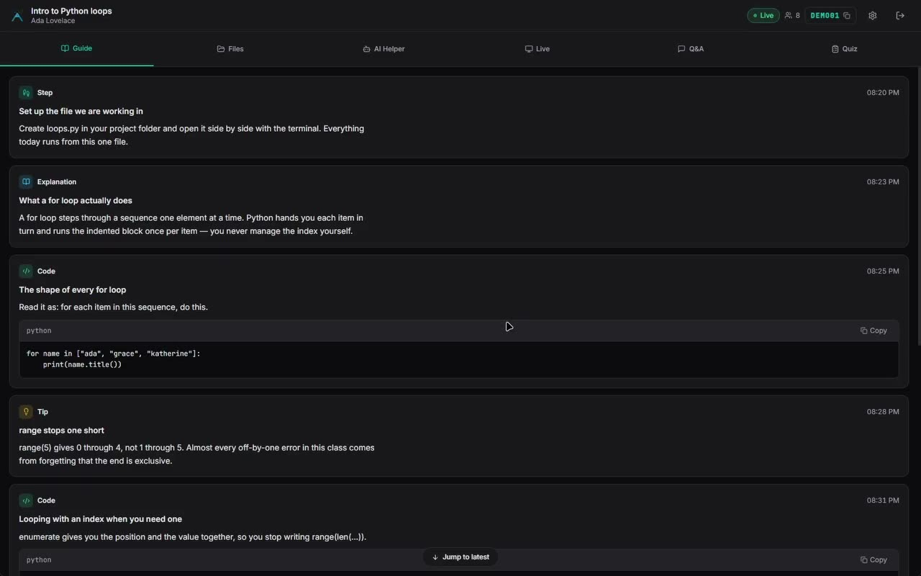
Results & Outputs – Live Guide
• Guide written from the instructor's screen and speech
• Typed blocks: step, explanation, tip, code
• Each block timestamped; code blocks copyable
• Objective met: O2 – live structured guide
Fig. 32 – Live guide generated during an 'Intro to Python loops' session
Dept. of CSE | PACE
33
VTU Major Project – Phase II | 2026–27
Notes:
Screenshot from the running system in a seeded demo room.

Slide 34
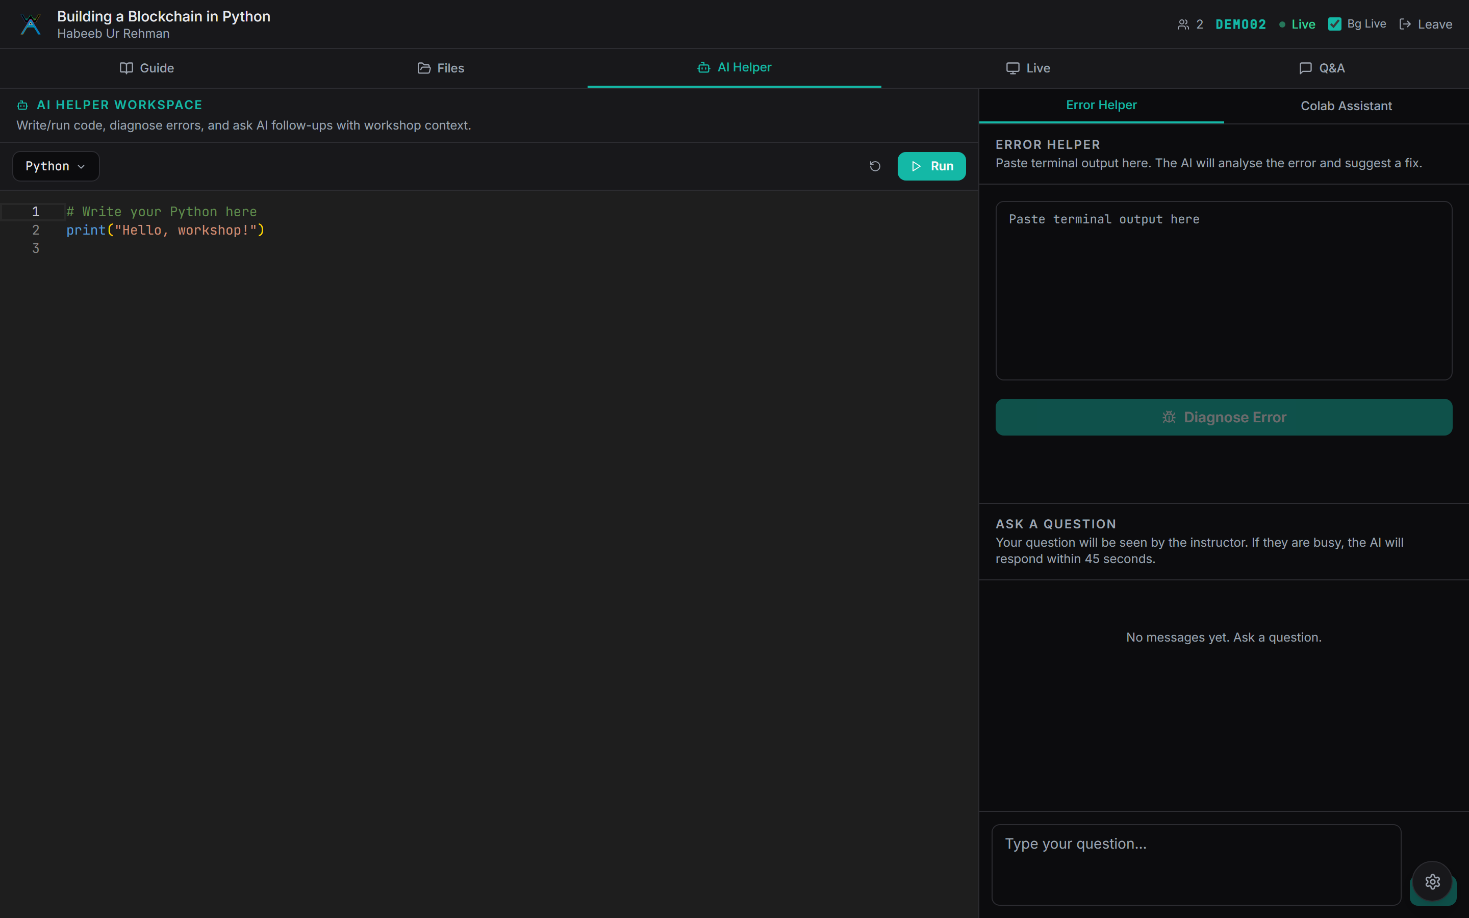
Results & Outputs – AI Helper
• Sandbox runs Python, JavaScript, TypeScript and Bash
• A failed run triggers diagnosis automatically
• Returns a plain-language cause and one fix command
• Objective met: O3 – grounded error diagnosis
Fig. 33 – AI Helper – sandbox, error diagnosis and notebook assistant
Dept. of CSE | PACE
34
VTU Major Project – Phase II | 2026–27
Notes:
Screenshot from the running system in a seeded demo room.

Slide 35
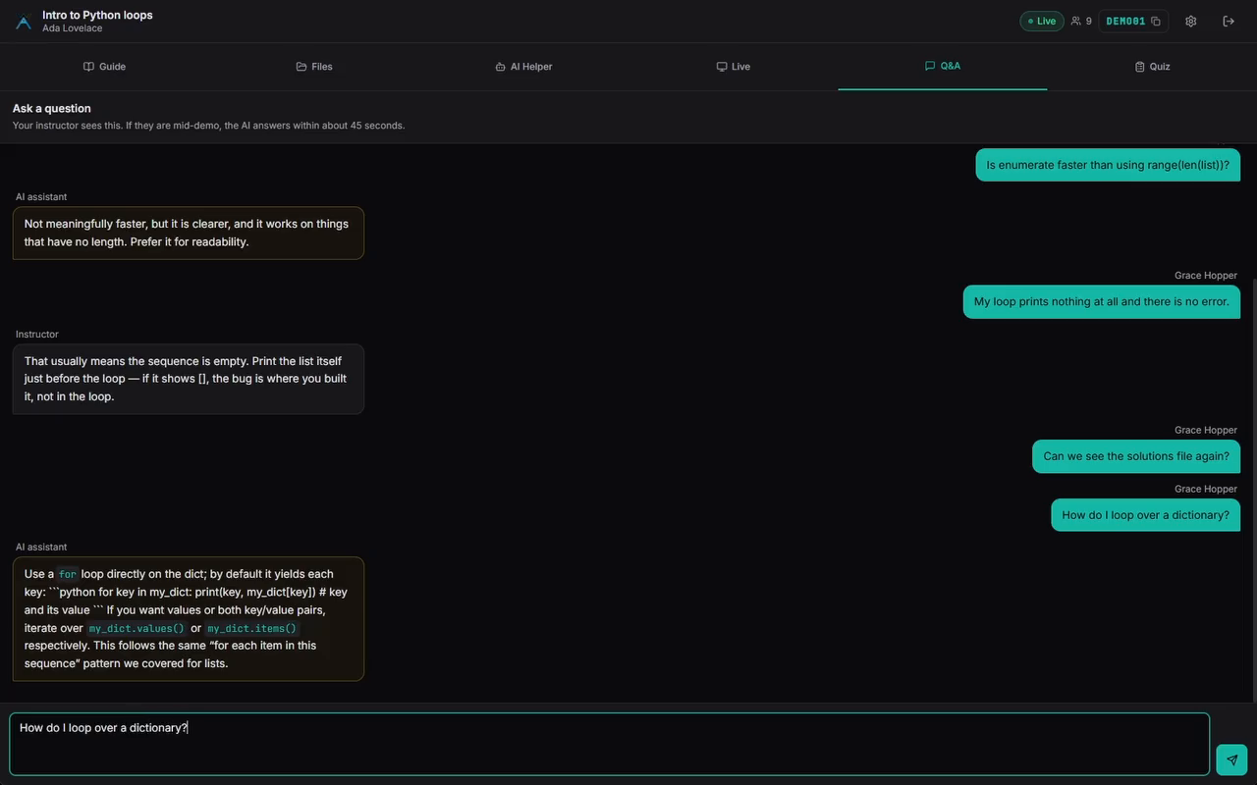
Results & Outputs – Private Q&A
• Questions are private between student and instructor
• Unanswered after 45 s → the AI replies
• Replies are labelled Instructor or AI assistant
• Answers use this session's own material
Fig. 34 – Private Q&A thread with instructor and AI replies
Dept. of CSE | PACE
35
VTU Major Project – Phase II | 2026–27
Notes:
Screenshot from the running system in a seeded demo room.

Slide 36
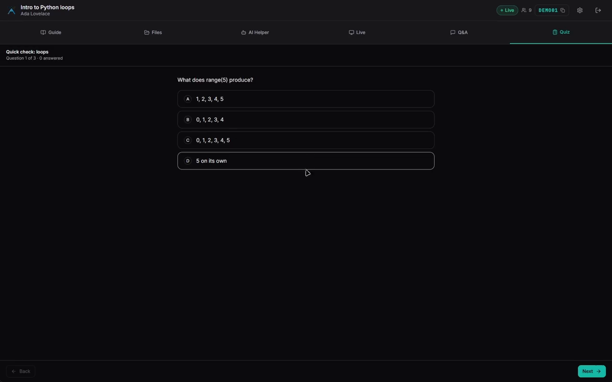
Results & Outputs – Comprehension Check
• Quick checks generated from recent guide content
• Answers are evaluated on the server
• Guide unlocks after a correct answer
• Gating is client-side and stated as advisory
Fig. 35 – Comprehension check generated from the live guide
Dept. of CSE | PACE
36
VTU Major Project – Phase II | 2026–27
Notes:
Screenshot from the running system in a seeded demo room.

Slide 37
Results & Outputs – Test Cases
• 13 system test cases, all passed
• Most are regression tests for defects fixed this phase
• Role spoofing, reconnect loop and lost broadcasts closed
• Security abuse attempts all rejected
# | Scenario | Result
1 | ?role=instructor, no token | Pass
2 | Instructor ends session | Pass
3 | Connect to ended room | Pass
4 | Diagnosis burst from class | Pass
5 | Join with correct password | Pass
6 | Share from watched folder | Pass
9 | Instructor joins full room | Pass
11 | No SFU configured | Pass
13 | Block only narrates screen | Pass
Fig. 36 – Selected system test cases and results
Dept. of CSE | PACE
37
VTU Major Project – Phase II | 2026–27
Notes:
Test cases from the report, most written after a real defect.

Slide 38
Results & Outputs – Objective-wise Results
• All five objectives met
• Quality limits outside the code are stated, not hidden
• Caveat: free inference tier bounds guide volume
• Caveat: quiz gating and proctoring are advisory
Obj. | Evidence | Status
O1 | One form → live; ~37 fps; SFU | Met
O2 | Live blocks; grounding filter | Met
O3 | Auto-diagnosis; TC-4 | Met
O4 | Browser only; TC-1, TC-5 | Met
O5 | Abuse attempts rejected | Met
Fig. 37 – Evaluation of the delivered system against each objective
Dept. of CSE | PACE
38
VTU Major Project – Phase II | 2026–27
Notes:
All five objectives met, with caveats named.

Slide 39
Performance Evaluation
• Metric: per-frame capture and encode cost (ms)
• Condition: 1920×1200 desktop, development machine
• Baseline: previous JPEG encoder, 36 ms
• Proposed: SIMD encoder, 17.2 ms
• Finding: 2.1× faster; ~37 fps, capture-bound
Fig. 38 – Per-frame cost of each capture stage (ms)
Dept. of CSE | PACE
39
VTU Major Project – Phase II | 2026–27
Notes:
The encoder was the ceiling; now capture is.

Slide 40
Performance Evaluation – Latency
• Measured informally on broadband, not a load test
• Transcription ~180× faster than real time
• Diagnosis within a few seconds end to end
• Class-wide bursts queued, never rate-limited
• Honest limit: ~50 vision frames/day on the free tier
Operation | Observed
Transcribe 30 s audio | < 0.2 s
Error classification | sub-second
Full diagnosis | a few seconds
Guide block per frame | a few seconds
Join → first render | sub-second
Reconnect within 8 s | no interruption
Cohort diagnosis burst | queued, bounded
Vision tokens per frame | ~3,900
Fig. 39 – Observed latency of key operations
Dept. of CSE | PACE
40
VTU Major Project – Phase II | 2026–27
Notes:
Numbers stated so the real-time claim is checkable.

Slide 41
Performance Evaluation – Test Coverage
• 106 automated tests across four suites
• Unit suite runs in ~10 s, before every commit
• End-to-end tests use real HTTP and sockets
• TypeScript and cargo builds act as gates
• Media pipeline still verified by hand
Fig. 40 – Automated tests by suite
Dept. of CSE | PACE
41
VTU Major Project – Phase II | 2026–27
Notes:
Four suites plus build gates.

Slide 42
Comparison with Existing Work
• Criteria: capture, upload, auth, bursts, restarts
• Baseline: our own Phase-I system
• Proposed: Phase-II WKAI
• Improvement: measured on the same code base
Criterion | Phase I | Phase II
Screen capture | Browser API | Native Rust
JPEG encode | 36 ms | 17.2 ms
Instructor upload | N streams | 1 stream
TURN credentials | Static | Server-minted
Instructor auth | ?role param | Signed token
AI burst | Rate-limited | Queued
Backend restart | Rooms lost | Rooms survive
Guide control | None | 2 gates
Fig. 41 – Phase-I baseline versus Phase-II WKAI
Dept. of CSE | PACE
42
VTU Major Project – Phase II | 2026–27
Notes:
Same code base, so every comparison is like for like.

Slide 43
Comparison with Existing Work – Related Systems
• LeafTutor diagnoses code errors, but offline with a spec
• Tutor CoPilot assists live tutors, but sees no screen
• MultiTutor coordinates agents, but not live
• Zoom / Meet stream live, but understand nothing
• WKAI: all of these, live, in one system
Criterion | Leaf Tutor | Tutor CoPilot | Multi Tutor | Zoom/ Meet | WKAI
Live session | ✗ | ✓ | ✗ | ✓ | ✓
Screen input | ✗ | ✗ | ✓ | ✓ | ✓
Code-error diagnosis | ✓ | ✗ | ✗ | ✗ | ✓
No spec needed | ✗ | ✓ | ✓ | ✓ | ✓
Written guide | ✗ | ✗ | ✗ | ✗ | ✓
Zero install | ✓ | ✓ | ✓ | ✗ | ✓
Fig. 42 – WKAI compared with the closest related systems
Dept. of CSE | PACE
43
VTU Major Project – Phase II | 2026–27
Notes:
Comparison uses each paper's own stated setting.

Slide 44
Conclusion & Future Scope
• A live session can write its own study material
• Native capture + SFU make it work for a real class
• Signed tokens closed the role hijack and enable future work
• The binding constraint was engineering, not the model
Guide, checks and help produced during class
1
~37 fps capture, one uplink for the room
2
Security rework became an enabling design
3
The frontier was the plumbing
4
Fig. 43 – Key takeaways
Dept. of CSE | PACE
44
VTU Major Project – Phase II | 2026–27
Notes:
Four takeaways.

Slide 45
Conclusion & Future Scope – Limitations & Roadmap
• Limitations: macOS capture stub; advisory quiz gating
• Free inference tier ≈ 50 vision frames/day
• Near term: send frames only on change; macOS capture
• Medium term: student companion app; split AI workers
• Long term: LMS export; multi-instance backend
Near
term
Cheaper frames · macOS capture · media regression test
Medium
term
Student companion app · separate inference workers
Long
term
LMS export · event-sourced sessions · rubric scoring
Fig. 44 – Future work roadmap
Dept. of CSE | PACE
45
VTU Major Project – Phase II | 2026–27
Notes:
Future work ordered by what users can see today.

Slide 46
Conclusion & Future Scope – Project Outcomes
• ICEST-27: conference paper accepted
• KSCST SPP 50th series: proposal prepared, to be submitted
• Report: Phase-II project report complete
• Releases: signed Windows and Linux installers
ICEST-27 paper
Accepted
KSCST SPP proposal
Accepted
Project report
Complete
Desktop releases
Shipped
Fig. 45 – Publications and deliverables
Dept. of CSE | PACE
46
VTU Major Project – Phase II | 2026–27
Notes:
Outcomes the coordinator verifies.

Slide 47
References (1/3)
[1] M. Bochard et al., "LeafTutor: An AI Agent for Programming Assignment Tutoring," arXiv, 2026.
[2] T. Yang et al., "MMTutorBench: First Multimodal Benchmark for AI Math Tutoring," ACL, 2026.
[3] M. Zerkouk et al., "A Comprehensive Review of AI-based Intelligent Tutoring Systems," arXiv, 2025.
[4] H. Li et al., "Video-MMLU: Massive Multi-Discipline Lecture Understanding Benchmark," CVPR, 2025.
[5] G. Mathur et al., "MathBuddy: Multimodal System for Affective Math Tutoring," EMNLP Demos, 2025.
[6] S. R. et al., "MultiTutor: Collaborative LLM Agents for Multimodal Student Support," PMLR, 2025.
[7] M. Schmucker et al., "Ruffle & Riley: LLM-Based Conversational Tutoring System," AIED, 2024.
[8] S. Wang et al., "Tutor CoPilot: A Human-AI Approach for Scaling Real-Time Expertise," Stanford, 2024.
Dept. of CSE | PACE
47
VTU Major Project – Phase II | 2026–27
Notes:
IEEE style references.

Slide 48
References (2/3)
[9] P. Denny et al., "Computing Education in the Era of Generative AI," Communications of the ACM, 2024.
[10] C.-F. Yeh et al., "ScreenAI: Vision-Language Model for UI and Infographics Understanding," IJCAI, 2024.
[11] Qwen Team, "Qwen2-VL: Enhancing Vision-Language Models with Dynamic Resolution," Alibaba, 2024.
[12] OpenAI, "Whisper Large-v3: Robust Speech Recognition via Scaled Weak Supervision," OpenAI, 2024.
[13] Q. Wu et al., "AutoGen: Enabling Next-Gen LLM Applications via Multi-Agent Conversation," MSR, 2024.
[14] LangChain / LangGraph, "LangGraph: Multi-Agent Orchestration Framework," LangChain Inc., 2025.
[15] Model Context Protocol Authors, "Model Context Protocol (MCP) Specification," Anthropic, 2024.
[16] D. Abts et al., "ThinkFast: A Tensor Streaming Processor for Accelerating Deep Learning," IEEE Micro, 2024.
Dept. of CSE | PACE
48
VTU Major Project – Phase II | 2026–27
Notes:
IEEE style references.

Slide 49
References (3/3)
[17] Groq Inc., "Groq LPU Inference Engine Documentation and API Reference," Groq, Inc., 2026.
[18] W3C, "WebRTC 1.0: Real-Time Communication Between Browsers," W3C Recommendation Update, 2024.
[19] J. Uberti and C. Jennings, "Javascript Session Establishment Protocol (JSEP)," IETF RFC Update, 2024.
[20] Cloudflare Inc., "Cloudflare Calls: WebRTC SFU and TURN Documentation," Cloudflare, 2026.
[21] LiveKit, "LiveKit Server: Real-Time Media and WebRTC SFU SDK Documentation," LiveKit, 2026.
[22] Tauri Development Team, "Tauri v2 Architecture: Desktop Webview Applications in Rust," 2026.
[23] W3C, "WebAssembly Core Specification 2.0: High-Performance Web Sandboxing," W3C Standards, 2024.
Dept. of CSE | PACE
48
VTU Major Project – Phase II | 2026–27
Notes:
IEEE style references.

Slide 50


Thank You / Q&A
• Questions & Discussion
• Project: WKAI – Workshop AI
• Team ID: 23CSMPB03
• Guide: Prof. Habeeb Ur Rehman
Website
Repository
wkai.vercel.app
github.com/Dinaltium/wkai
Project website and source repository
Dept. of CSE | PACE
49
VTU Major Project – Phase II | 2026–27
Notes:
Invite questions. QR codes open the live student app and the repository.

