Slide 1
Rubik’s Cube Solver with Move Tracker Feature
Team Members:
Meka Nandini
Aravind Ganipisetty

Slide 2
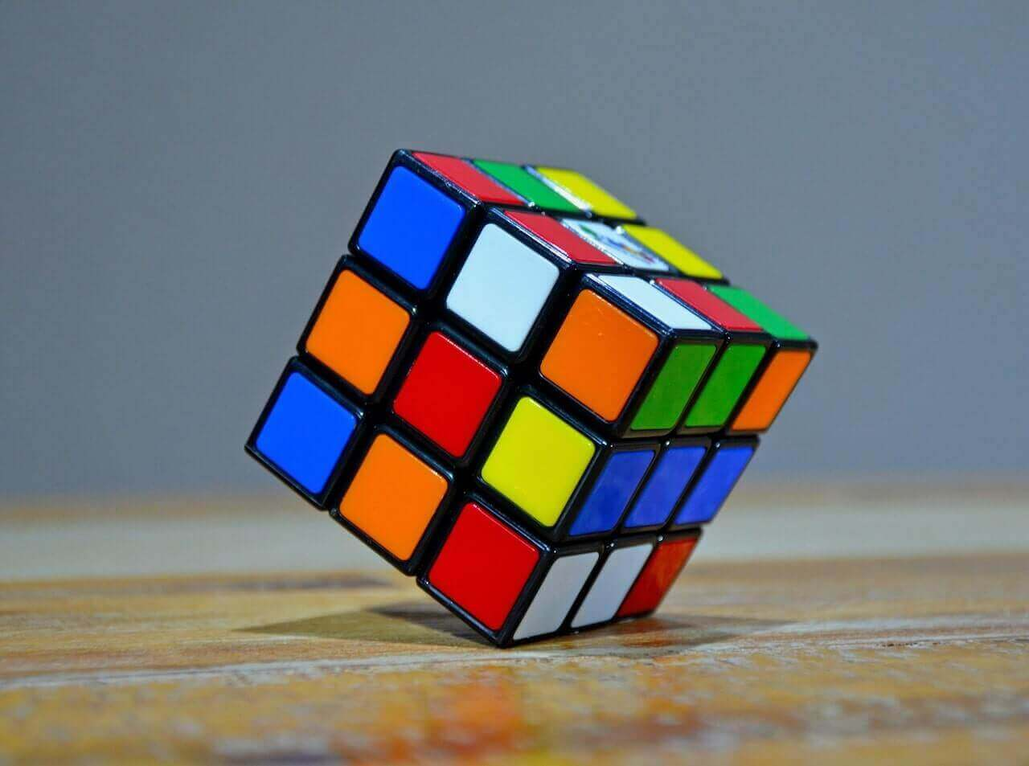
Project Objective
Solve a 4x4x4 Rubik’s Cube using feature-based Reinforcement Learning without human help.
Optimize for minimal steps and time.
Introduce a 'Move Tracker' that logs and displays each solving move.

Slide 3
Approach
Use Deep Q-Learning, A3C via PyTorch and OpenAI Gym.
Simulate cube environment for the agent to learn via trial and error.
Track each move with a logging system for analysis.

Slide 4
Methodology
Apply value iteration to map cube states.
Employ Q-learning and policy optimization.
Use high-performance computing for faster training.

Slide 5
System Flow Overview
User Inputs Scrambled Cube
Environment Setup using OpenAI Gym
Reinforcement Learning Agent (DQN / PPO) processes cube state
Outputs Move Sequence
Move Tracker Logs Each Step

Slide 6
Reinforcement Learning Process
• Agent chooses action based on cube state
• Environment provides reward and next state
• Policy updates to maximize reward
• Loop continues until cube is solved

Slide 7
Implementation Architecture
Python environment and OpenAI Gym for simulation
PyTorch for model training (DQN, PPO)
Move Tracker to record and visualize steps
Visualization tools: Matplotlib, terminal output

Slide 8
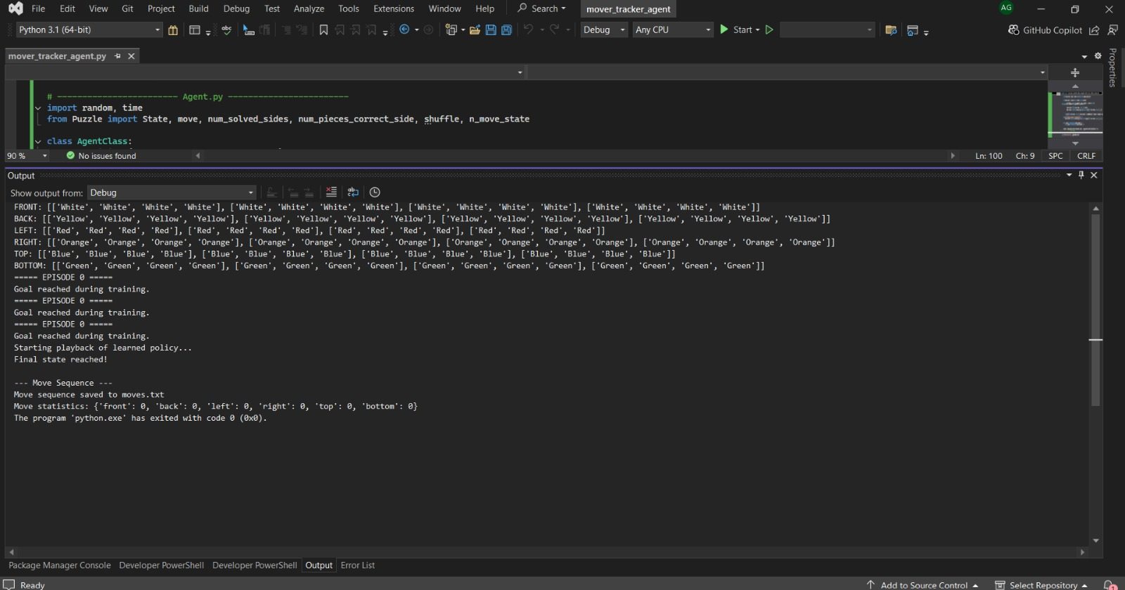

Slide 9
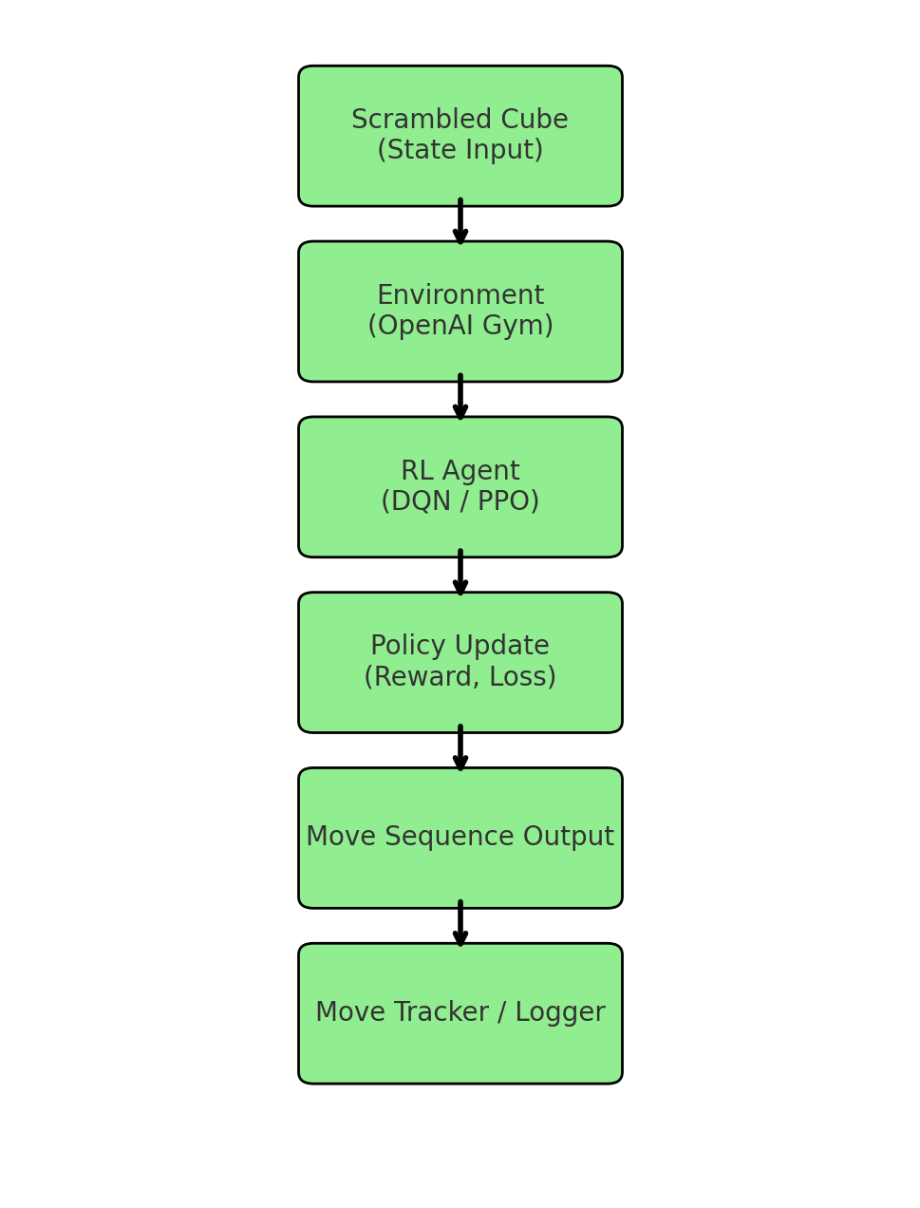
Flow Graph

Slide 10
Tools & Technologies
Python, PyTorch, OpenAI Gym, Matplotlib
High-performance computing resources

Slide 11
Deliverables
Source Code & Training Data
Technical Documentation
Final Project Report
YouTube Demo Video
Move Tracker Log System

Slide 12
Evaluation Criteria
Efficiency & Accuracy of Solving
Move Log Quality
Documentation Quality
Completion Time
User Feedback

Slide 13
Reference
Carlos, T. R. (2022). Reinforcement Learning: theoretical foundations and application to the Rubik’s Cube.

