Slide 1
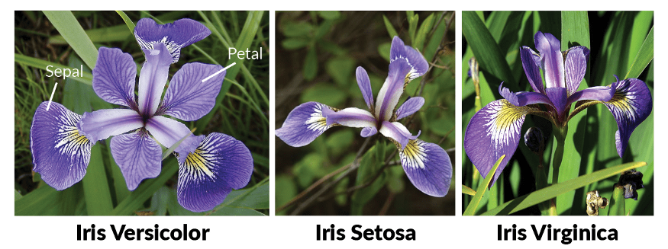
Classify IRIS flowers into three species
Anand Bharti – 18EC01029 Vishal Kumar Gupta – 18EE01032

Slide 2
Features/Attributes
About IRIS Dataset
The aim is to classify iris flowers among three species (setosa, versicolor, or virginica).
It includes three iris species with 50 samples each as well as some properties about each flower. One flower species is linearly separable from the other two, but the other two are not linearly separable from each other.
sepal_length: Sepal length, in centimeters, used as input.
sepal_width: Sepal width, in centimeters, used as input.
petal_length: Petal length, in centimeters, used as input.
petal_width: Petal width, in centimeters, used as input.
class: Iris Setosa, Versicolor, or Virginica, used as the target.

Slide 3
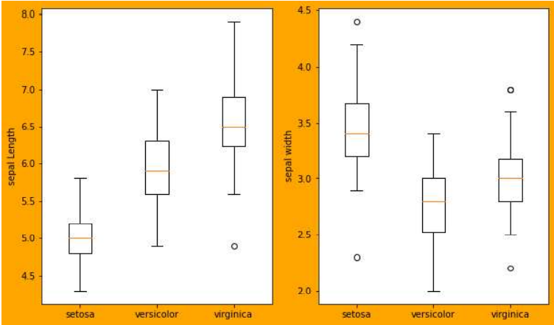
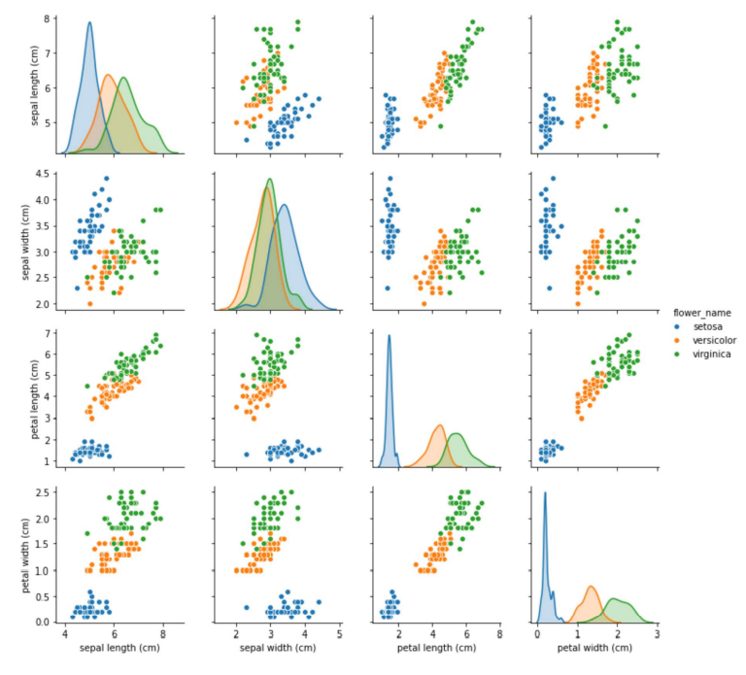
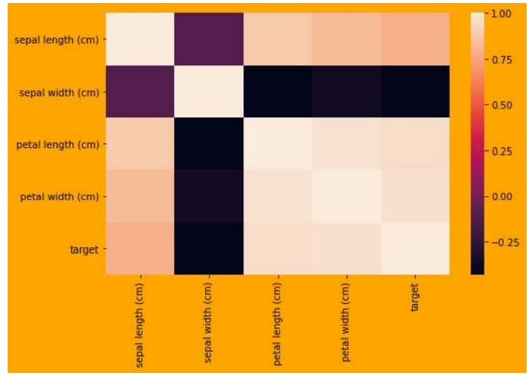
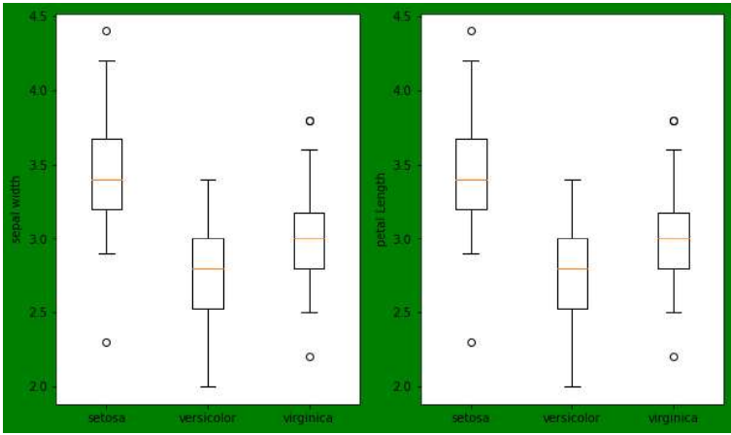
Data cleaning is done and different type of plots are plotted for visualization
Boxplot grouped by species
Pair Plot
Correlation Heat Plot
These plots give idea about distribution of input attributes

Slide 4
Observation
Using Sepal-Length & Sepal-Width features
We can only distinguish Setosa flower from others
Separating Versicolor & Virginica is much harder as they have considerable overlap
Hence, Sepal-Length & Sepal-Width features only work well for Setosa
Using Petal-Length & Petal-Width features
We can distinguish Setosa, Versicolor & Virginica fairly
There are slightly overlap of Versicolor & Virginica.
Graph shows that Petal (Length and Width) features are best contributor for Iris Species as compare to Sepal (Length and Width)

Slide 5
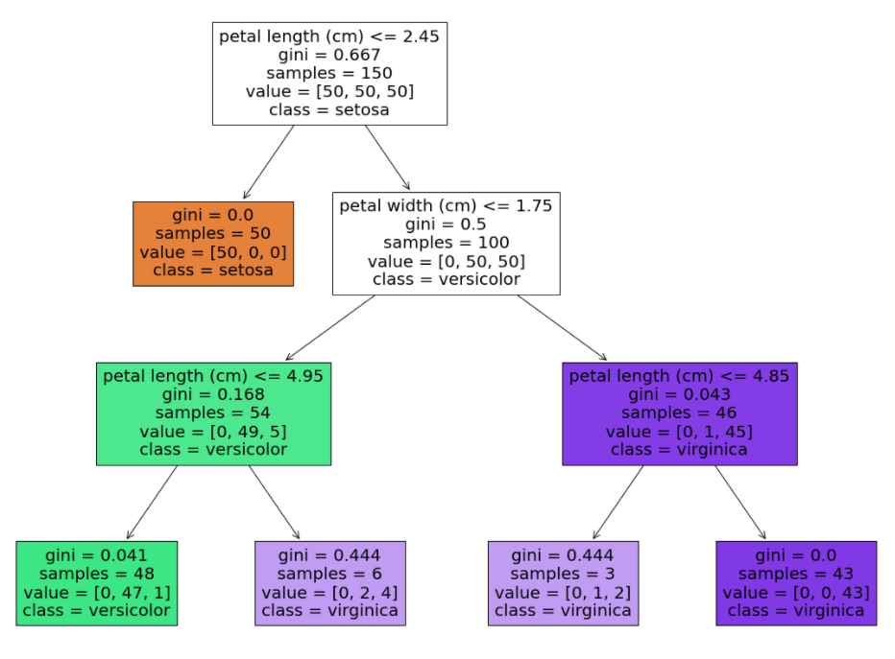
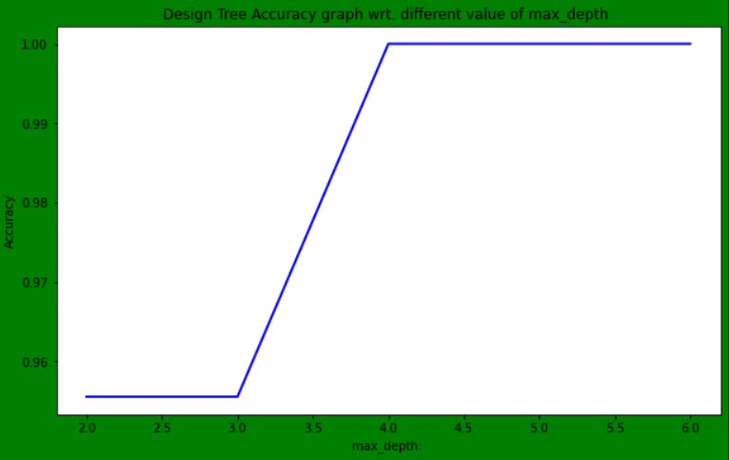
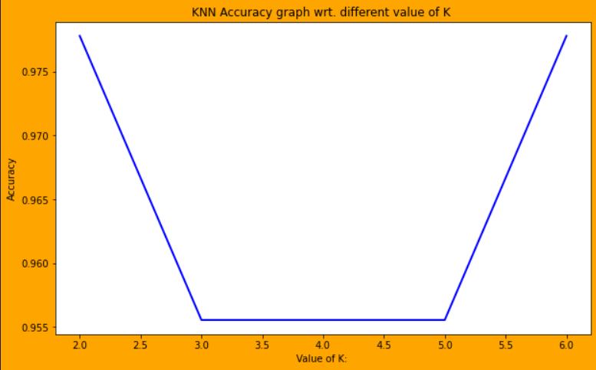
Model and Result
1. Support Vector Machine(SVM)
Accuracy = 0.955
2. Decision Trees (DTs)
Accuracy with depth of 3 = 0.955
3. Logistic Regression
Accuracy 0.967
4. K-Nearest Neighbors (KNN)
The accuracy is 0.977 WHERE n_neighbors=2

