Slide 1
Examples of plots
Abhijit Dasgupta
Strictly Confidential

Slide 2
Univariate plots

Slide 3
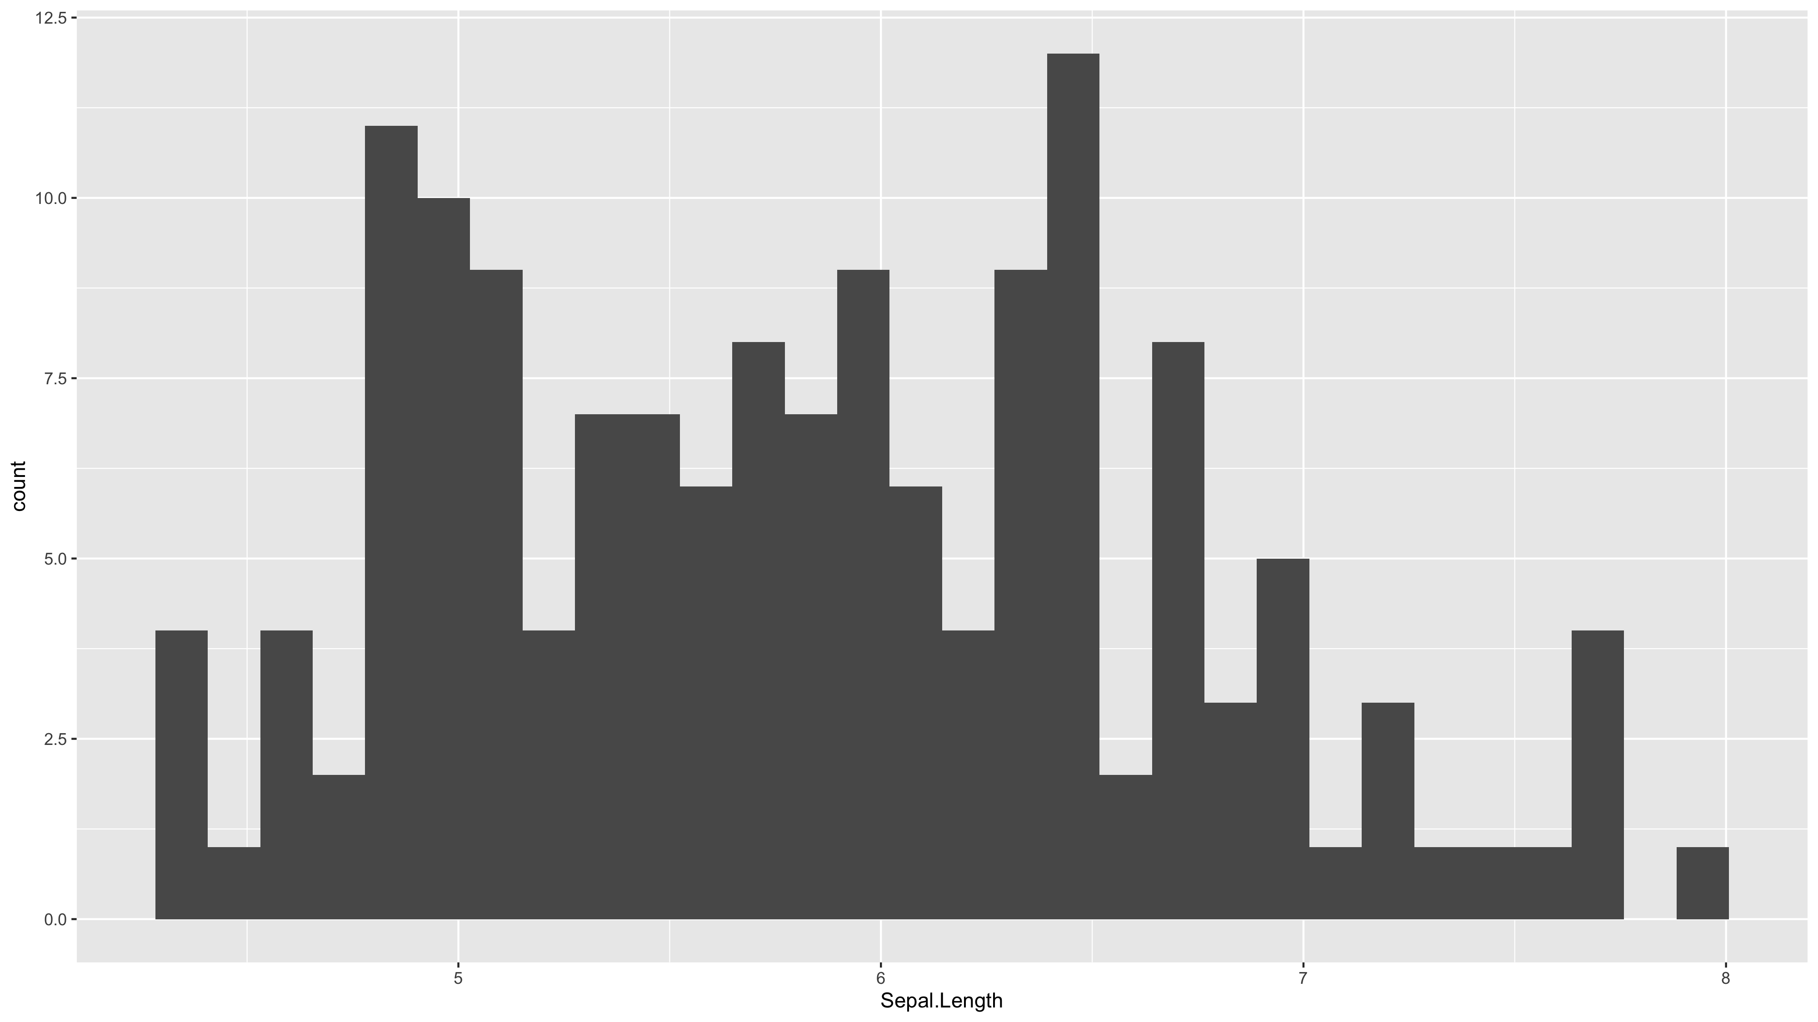

Slide 4
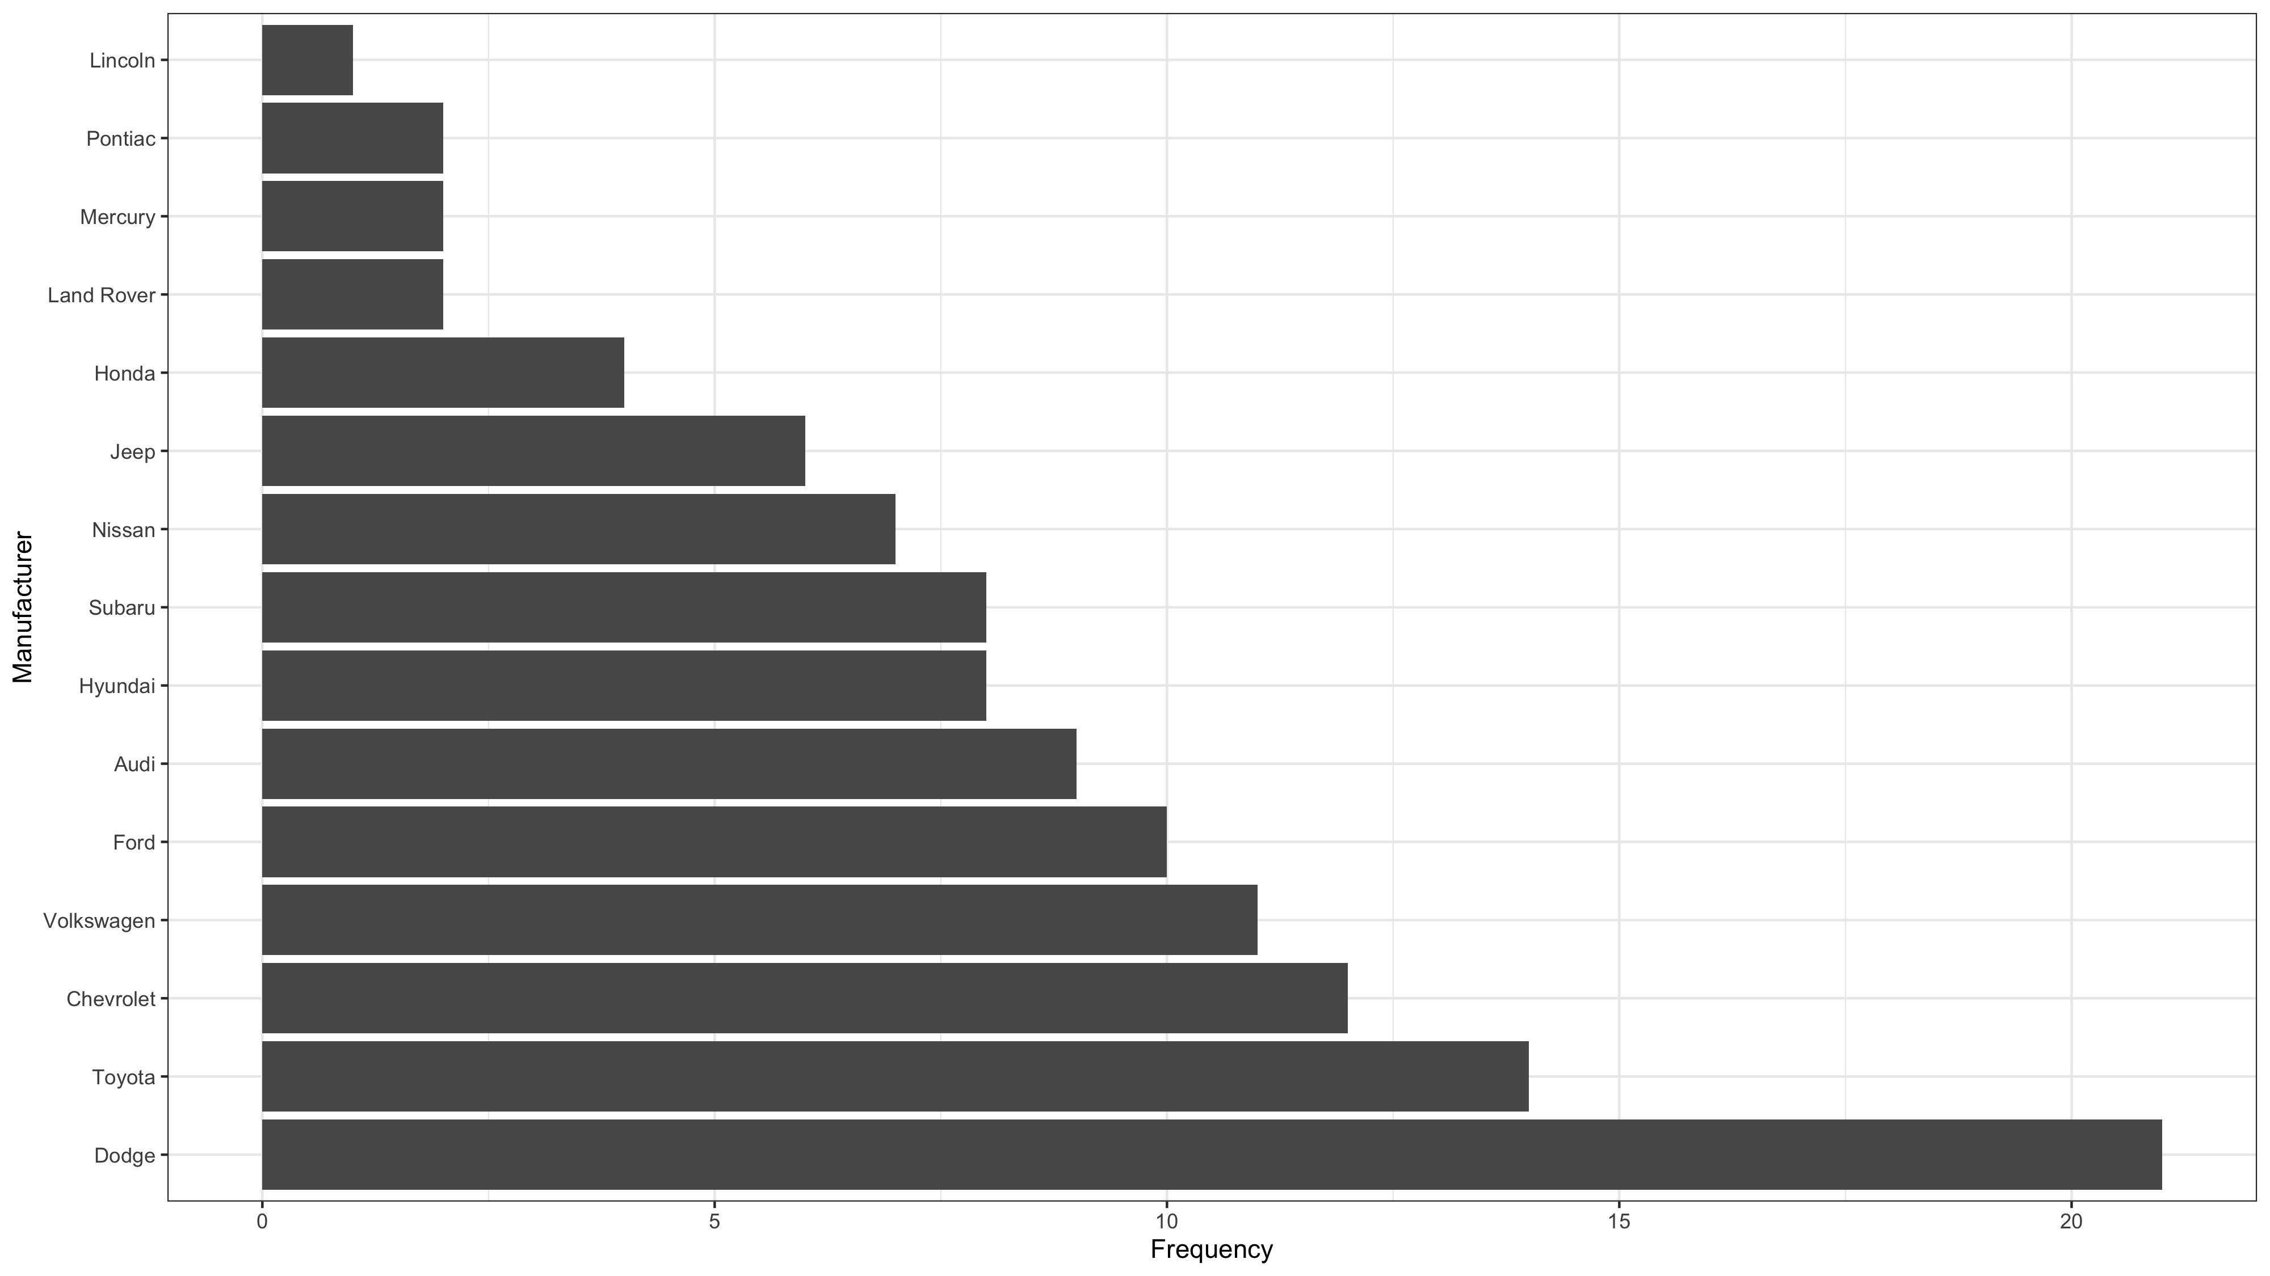

Slide 5
Bivariate plots

Slide 6
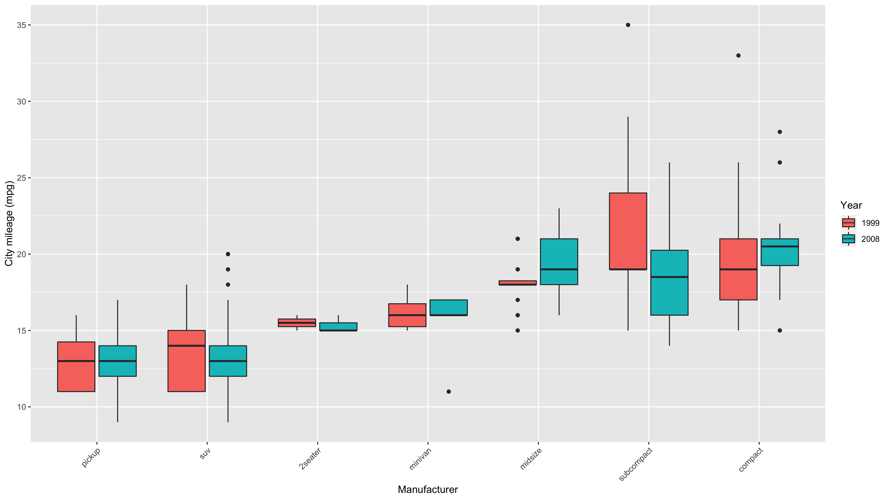

Slide 7
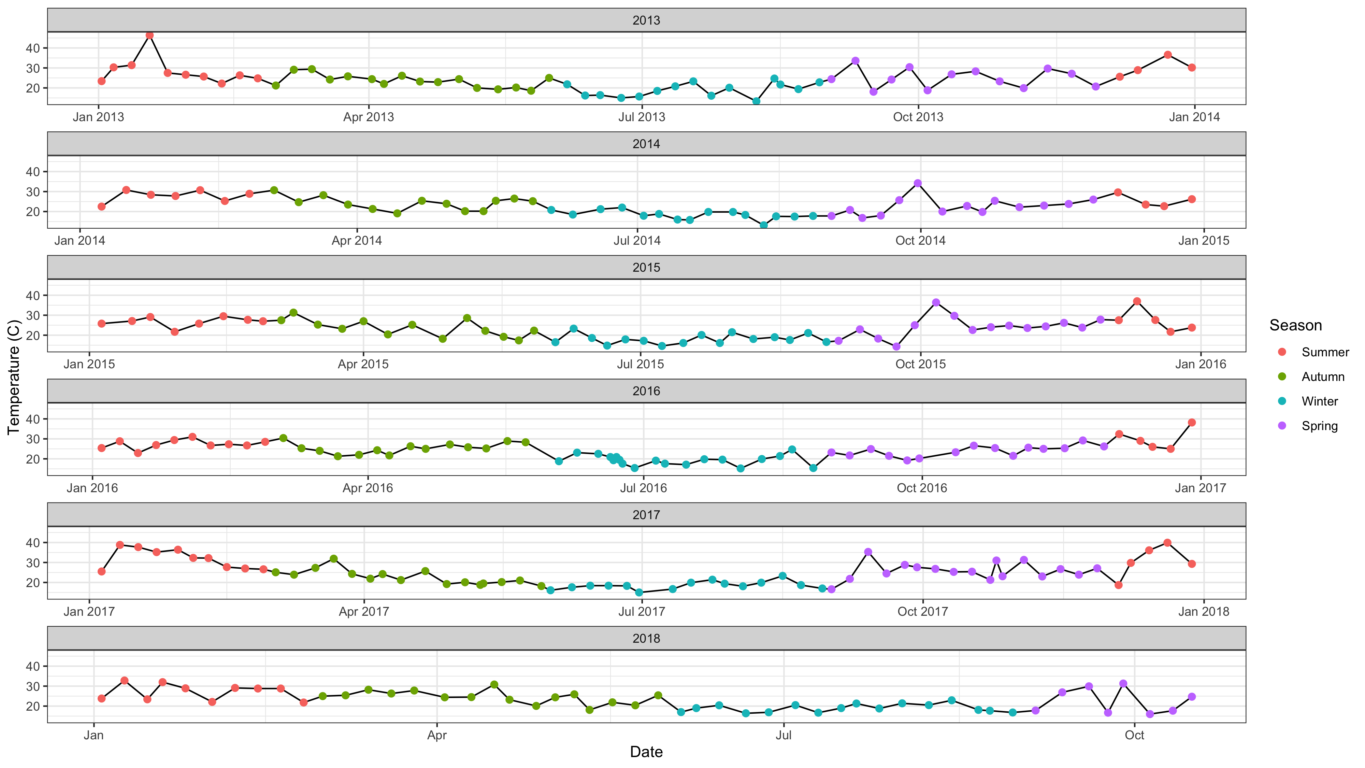

Slide 8
Survival curves

Slide 9
