Slide 1
Testing PPTX
Abhijit Dasgupta

Slide 2
R Markdown
This is an R Markdown presentation. Markdown is a simple formatting syntax for authoring HTML, PDF, and MS Word documents. For more details on using R Markdown see http://rmarkdown.rstudio.com.
When you click the Knit button a document will be generated that includes both content as well as the output of any embedded R code chunks within the document.

Slide 3
Slide with Bullets
Bullet 1
Bullet 2
Bullet 3

Slide 4
Slide with R Output
Characteristic | N = 150¹
Sepal.Length | 5.80 (5.10, 6.40)
Sepal.Width | 3.00 (2.80, 3.30)
Petal.Length | 4.35 (1.60, 5.10)
Petal.Width | 1.30 (0.30, 1.80)
Species
setosa | 50 (33%)
versicolor | 50 (33%)
virginica | 50 (33%)
¹Median (IQR); n (%) | 1

Slide 5
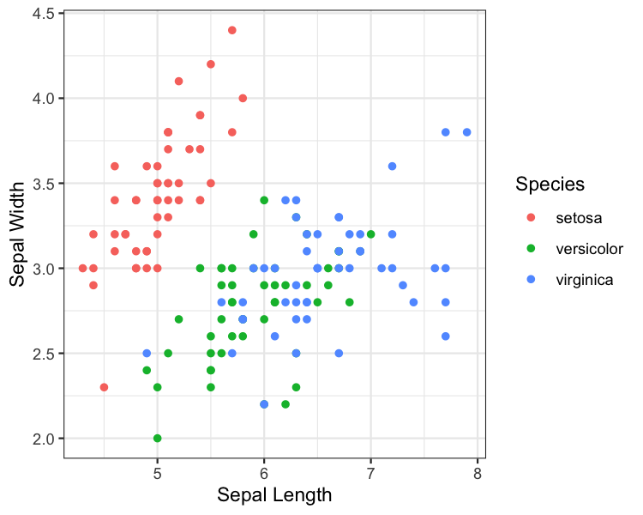
Slide with Plot

