Slide 1
Chapter 6
Development Plans
Quality Plans

Slide 2
Introduction
OK, we have the contract, now to do the planning:
We need both a Development Plan and a Quality Plan
We have proposal plans and internal documents. Enough? No!
These plans typically included time tables, estimates, staffing requirements, scheduled reviews, risks and more.
Seems like enough….
But the time invested in developing a development plan and a quality plan will play dividends.
Henry Kissinger once said: if you don’t have a plan, any road will get you there….Words to the Wise…

Slide 3
Introduction
Plans need
  Proposal materials re-examined and updated since contract time
  Much more comprehensive planning with respect to
    Schedule
    Resource estimates
    Development risk evaluations (technical, social, environmental, …)
    Many times there is a considerable lag between the plans and the OK!!
      Lots of things take place: staffing, securing budget, manpower, other urgent items…
  Additional subjects missing from approval proposal (ahead)
  To include the ability to sound alerts regarding scheduling difficulties, potential staff shortages, scarcity of development facilities, problems meeting contractual milestones, additional risks, etc.
  We MUST review to ensure we are all on the same page.

Slide 4
Introduction
Development and quality standards (ISO 9000.3 and CMM) require viable plans.
  We will discuss ISO 9000.3 and CMM and CMMi in considerable detail later.
We need to look at development plans and quality plans – their objectives and elements.
They are related but NOT the same.
Many times quality plans simply do not occur!
  Often times, if/when they do, they are pie in the sky!

Slide 5
Chapter Objectives
At the conclusion of this study, you need to be able to:
  Explain the objectives of a development plan and a quality plan
  Identify the elements of a development plan
  Identify the elements of a quality plan
  Identify the major software risk items
  Explain the process of software risk management
  Discuss the importance of development and quality plans for small projects
  Discuss the importance of development and quality plans for internal projects.

Slide 6
Development and Quality
Plans - Objectives
Planning is meant to prepare adequate foundations for successful and timely completion of the project. The planning process includes:
1. Scheduling development activities and estimating the
required manpower resources and budget
2. Recruiting team members and allocating development resources
3. Resolving development risks
4. Implementing required SQA activities
5. Providing management with data needed for project control

Slide 7
Elements of the Development Plan
1. Project Products, specifying “Deliverables”
Must specify items to be delivered to customer
documents, operations manuals, user manuals,
Must specify specific software products (along with
completion and installation dates
programs (unless centrally controlled), files …
Address conversion dates; handover, if maintaining;
Must specify or discuss training.
Who and how does training take place?
Must specify customer support!

Slide 8
Elements of the Development Plan
2. Project Interfaces
Interfaces with existing software packages…
(A course enrollment system might interface with an existing Billing System or Course Scheduling System…)
Interfaces with other software / hardware development and maintenance teams working on similar system or extension of the system
Interface with existing or new hardware

Slide 9
Elements of the Development Plan
3. Project’s methodology and development tools
Process used; tools / environment needed
Requirements capture and technologies used
Design approaches – architectural; procedural;
interface; communications; database….
Programming methodology
Testing Approaches etc.
What is the testing responsibilities and who does what? Individual testing? Separate testing shop?
Deployment
One shot; parallel; incremental…
4. Software Development Standards and Procedures
Development standards / procedures
(AFDSDCM 3008; AFM 300-4 -Data Elements and Codes)

Slide 10
Elements of the Development Plan
5. Map of the Development Process
Detailed definition of project’s phases:
inputs, activities, outputs (artifacts), specific activities
Estimates of each activity’s duration:
design reviews (managerial and technical), tests,
design and code correction activities, ….
Sequencing and dependency of activities
List professional resources needed overall and for each activity
Can show these in GANTT charts, which shows various activities by horizontal bars and whose lengths are proportional to the activity’s duration.
Can use PERT and CPM and other activities to communicate activities, durations, deliverable dates, …
Some like Microsoft Project.
Can use more modern tools too, like IBM’s Rational Team Concert (RTC)
6. Project milestones
7. Project staff organization and coordination with external participants

Slide 11
Elements of the Development Plan
6. Project milestones
Often part of the process – e.g. RUP, Scrum, other agile processes or other methodologies.
Major milestones; Minor milestones (what these mean!)
Often, these are defined by the software process used.
What are major and minor milestones in RUP?
In practice, these are often declared up front and we work backwards!!

Slide 12
Elements of the Development Plan
7. Project staff organization and coordination with external participants
Organizational structure – defines teams and tasks;
Defines expertise needed (certifications, experience, specialties), programming languages, development tools, levels of expertise, numbers of individuals needed and for specific periods of time; names of team leaders and team members (sometimes).
Often these responsibilities are ‘shredded out’ too
Long term leadership; team losses due to many factors; Estimates of staff availability is crucial and can cause the flag to be raised when certain levels are not met.

Slide 13
Elements of the Development Plan
8. Required development facilities
Required hardware, software, tools, space, infrastructure, …
9. Development Risks and Risk Management Actions
Development Risk: “a state or property of a development task or environment, which, if ignored, will increase the likelihood of project failure.
Risk Areas
Technology Risks – lack of expertise; not correct / needed tools
Personnel / Staff Shortages – loss of people; inability to recruit
Environmental Risk:
Where / how is application go be deployed?
Where / how is app to be developed?
Is it an app for the battlefield? Home?
Financial Risks
Social?
Interdependence of other organizational elements who
supply resources (subcontractors, specialized hardware, etc. )
Risk: Risk Identification, Risk Evaluation, Risk Mitigation, Risk Resolution.
Implementation of Risk Management Activities (frequency, threaded…,) Monitoring of Risk Management Activities.
10. Control methods
11. Project cost estimates

Slide 14
Elements of the Development Plan
10. Control methods
Progress reports and coordination meetings are planned to control project implementation
11. Project Cost Estimates
These are based on proposal cost estimates followed by thorough review and continual updating.
Changes can/will occur and these can be major budget impacts, such as subcontractors don’t fulfill their obligations or other unplanned expenditures arise.
Some projects are ‘successes’ but way over budget
Ultimately, the approval of the development plan will take place within the organization(s).

Slide 15
Elements of a Software Quality Plan
1. List of Quality Goals
Quality refers to how well the software performs its intended tasks, reliability; how often it fails, mean time between failures, etc.
But quantitative measures are usually preferred because more objective assessments can be made during software development and testing.
Quantitative goals can be used to imply qualitative goodness.
Availability of application? (99.5% of time)
Time to recover? (down time?)
Loading / peek loads? (No. of simultaneous transactions?)
Response time?
Quality goals are reflected in major acceptance criteria and are often reflected in the RFP or Software Requirements Specifications (non-functional software requirements)

Slide 16
Elements of a Software Quality Plan
2. Review Activities
All quality reviews must be planned:
design reviews,
code inspections,
design inspections, etc.
Also: Scope of review activity (coverage?)
Responsibilities of participants
Selection of participants
Type of review:
(technical, managerial, …)
Procedures - action lists, identify only, follow up

Slide 17
Elements of a Software Quality Plan
3. Software Tests
Must contain comprehensive list of planned tests:
unit, integration, system, … testing
schedule (part of iteration, phase?)
specific procedures (provide software, test plans, test procedures…Do you have test suits?)
Do you have automated test generators??
specific responsibilities (who does what?)
4. Acceptance Tests for software externally developed
Complete set of acceptance tests planned must exist within the qauality plan.
Especially true for externally developed software and should parallel those tests used for interanally developed software too.

Slide 18
Elements of a Software Quality Plan
Configuration Management Plans: tools, procedures and data for version releases
The quality plan must include tools and procedures for configuration management and change management and control.
Configuration and change management will thread the entire development and quality plans
The Quality Plan may be included in the Development Plan or separate document.
Quality Plans are often seen as design review plans, test plans, acceptance testing plans, etc.

Slide 19
Classes of Software Development Risks
1. Scheduling and timing risks
2. System functionality risks
3. Subcontracting risks
4. Requirement management risks
5. Resource usage and performance risks
6. Personnel management risks

Slide 20
Boehm and Ross's
Top 10 Software Risk Items
1. Developing wrong software functions *
2. Unrealistic schedules and budgets ***
3. Developing wrong user interface
4. Gold plating
5. Continuing stream of requirement changes ***
6. Shortfalls in externally furnished components
7. Shortfalls in externally performed tasks
8. Personnel shortfalls **
9. Real-time performance shortfalls
10. Straining computer science capabilities

Slide 21
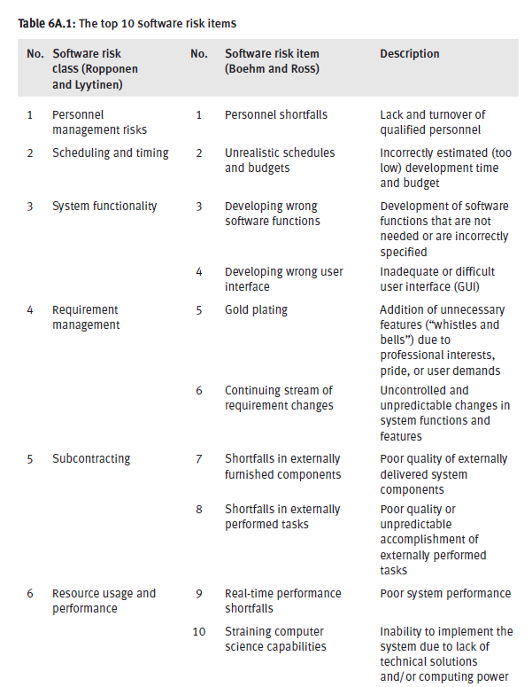

21

Slide 22
The Software Risk
Management Process
New
project
Pre
-
Risk identification
project
and assessment
Planning risk
Planning and updating risk
management activities
management activities
Ongoing
projects
Implementing
risk management actions
Identifying and
(risk resolution)
assessing new software
risks
Monitoring software risk
management activities
Required results
achieved
Evaluate
Unsatisfactory results
monitoring
results

Slide 23
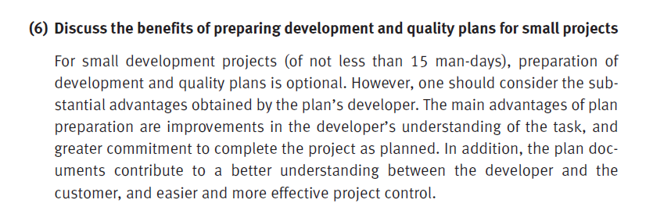
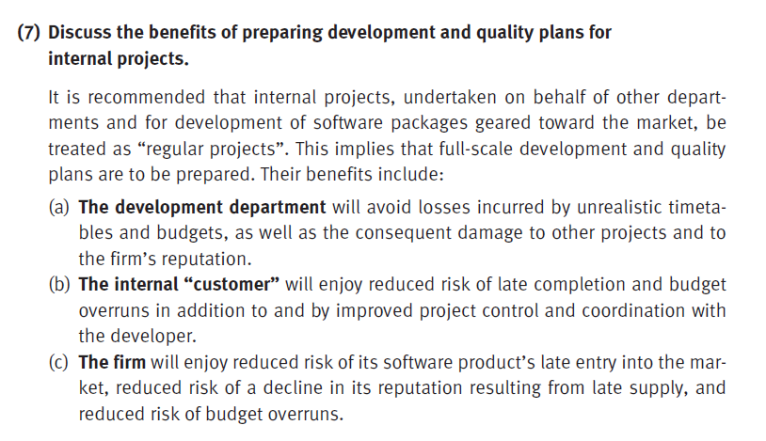
23

Slide 24
Review Questions – Chapter 6
Question 6.2, 6.3, 6.5, 6.7, 6.8

