Slide 1



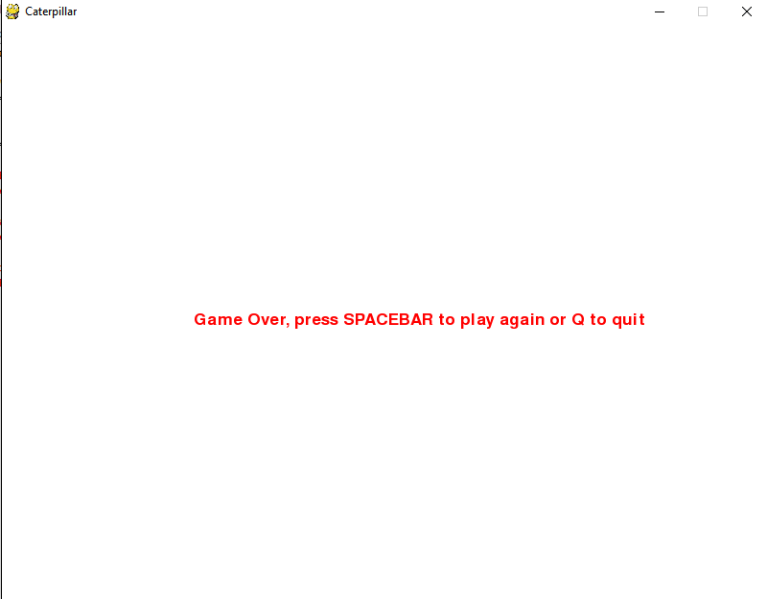
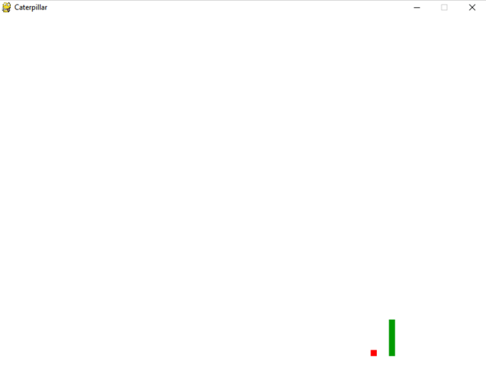
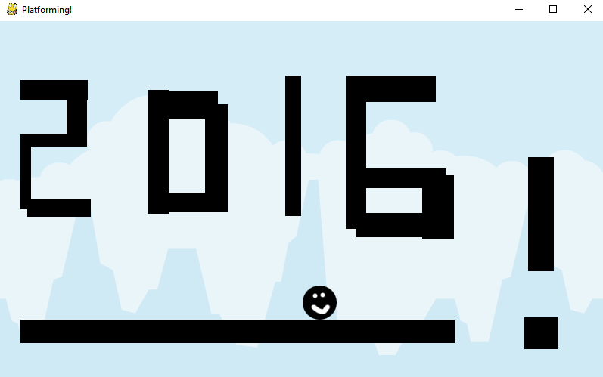

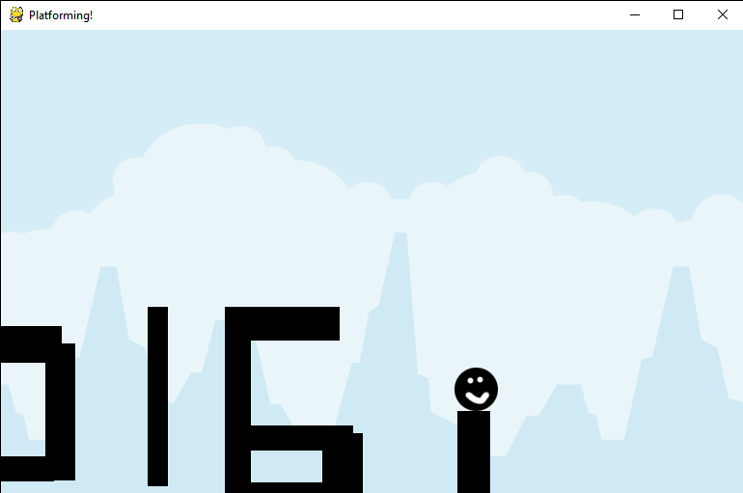

Game Programming with Python (Using Pygame )
Student: Stephanie
Faculty Mentor: Dr. Patrick Harrington
Northeastern State University, Spring 2016
ABSTRACT
Since the 1980s, videogames have become an ever-increasing presence in society. They provide entertainment, enrichment, and an opportunity to learn for many. From smaller games like Shovel Knight to large AAA titles like Mass Effect, all are developed by teams of programmers and go through the standard software development lifecycle before distribution. Game programming can be as complex or as simple as you make it.
The purpose of this project was to familiarize myself with a new language of my choice while learning the fundamentals of game programming and providing a functional game. I wanted the game to have 2D platforming elements, including such features as collision detection, gravity, camera scrolling, enemies, and boundaries.
Introduction
I have always been interested in programming videogames and was unfortunately unable to take any game programming classes here at Northeastern State University. I chose to learn game programming and create a game for my capstone because I wanted to learn the fundamentals of game programming on my own and provide a functional end product. A plethora of information on the subject exists online, and I decided to start with 2D programming because it's not as advanced as 3D game programming.
Game Design
My game is designed with future development in mind. It includes custom assets, gravity, collision detection, user-defined movement, and a scrolling camera, as well as polymorphism for the Level() and Character() classes to provide a framework to build further levels and objects, such as enemies. All future levels will be subclassed from the superclass Level() with base attributes, and future enemies will be subclassed from the superclass Character(). Levels are designed to be short with minimal hazards. Platforming can easily accommodate the addition of boundaries, enemies, collectibles, and score-keeping.
Pseudocode Examples
class Level(...)
instantiation
constructor(Level)
self.property1 = property
self.property2 = property
class Level1(Level)
instantiation
constructor(Level1)
...
level_design = [
level contents
]
class Character(...)
instantiation
constructor(Character)
self.property1 = property
self.property2 = property
Class Enemy(Character)
instantiation
constructor(Enemy)
...
collideable = true
Game Uses
Currently Platforming is in an alpha build, and though it is a functional game, it should be used as a framework to build a more polished 2D game on top of. Since Platforming is designed to be an easy game by nature, it may be best suited for young children or to be used as a learning tool. Custom assets can easily be inserted into Platforming and used in lieu of what is currently provided. Platforming can also be used to showcase some of the core functionalities of Pygame, such as key listeners, collision detection, and boundaries.
Summary
I am excited to have learned the basics of game programming through Python and Pygame and am happy I can put these projects on my resume and in my portfolio. Learning game programming has helped me better understand polymorphism, object-oriented methodologies, and working on a 2D plane with x and y coordinates. I also learned the importance of time management and keeping realistic goals when it comes to long-term programming projects.
As a pet project, I will continue developing Platforming and adding new features to make it a more polished, robust game in the future.
Technologies Used
Python 3.2 (incl. IDLE)
Pygame for Python 3.2
Git
GitHub
Resources
Pygame Official Documentation:
http://www.pygame.org/docs/
The Python Game Book: http://thepythongamebook.com/en:pygame:start
Thenewboston PyGame Lecture Series
Caterpillar:
boundaries
dynamic character
persistent movement
collectibles
Platforming:
custom assets
gravity
collision detection
user-defined movement
scrolling camera
polymorphism for future development
Game Features
Game Programming Terms Used
IDLE - python IDE
Assets - anything created by external software, like images, sounds, etc.
Game Loop - lets the game run whether there is player input or not
GUI - graphical user interface, elements that the player sees while playing
Player Input - input taken from the player
FPS - frames per second, the rate at which a device displays consecutive images (frames)
Collision Detection - a process of determining if two objects have collided by testing their bounds Platformer - player must jump throughout game levels to avoid hazards such as enemies, pitfalls, etc.
2D Game - has x and y coordinates for its objects and characters
Sprite - 2D graphics images of one object or character
Gravity - controls characters' horizontal and vertical movement speed in the game
Collectibles - items that can be collected to some end
Polymorphism - ability to process objects differently depending on their data type or class

