Slide 1

Game Programming with Python (using )
Stephanie CS4233 Spring 2016

Slide 2
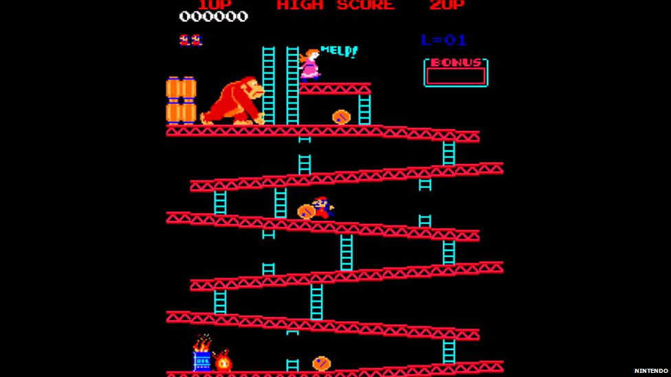
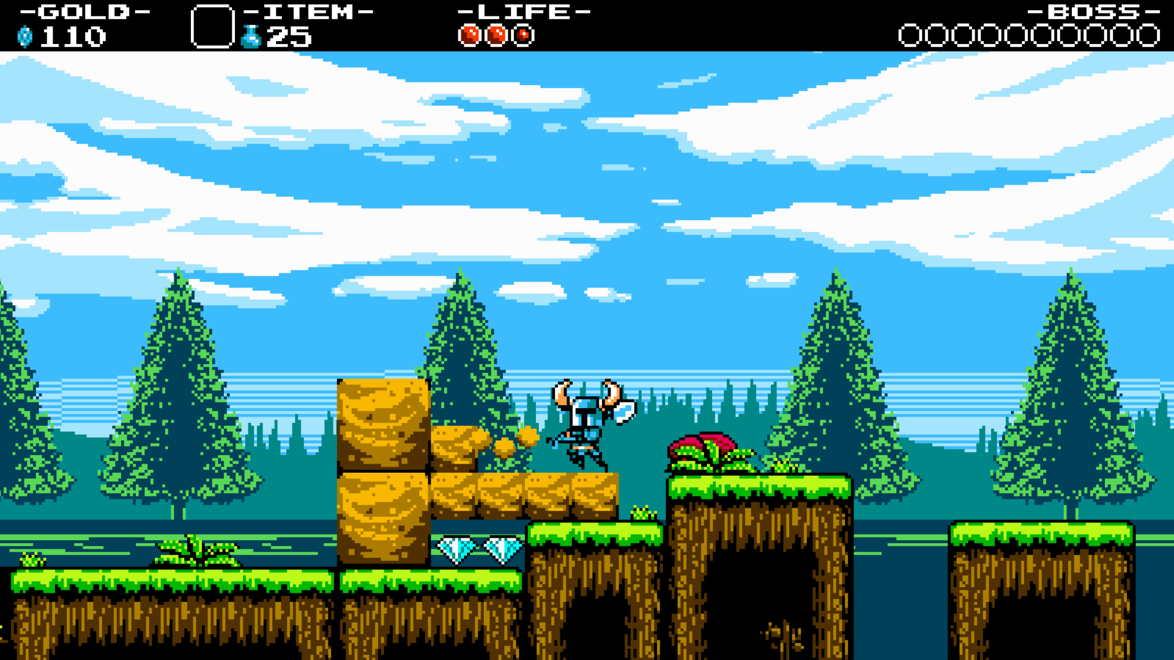
Basic Goals
Learn Python
Learn the fundamentals
of game programming
Make a functional game

Slide 3
“Caterpillar”
A “Snake” clone with boundaries, a dynamic player character, collectibles, and game over functionality.

Slide 4
“Platforming”
A simple platforming game with assets (player character and background), gravity, collideable objects (platforms), scrolling camera, and level-building functionality

Slide 5
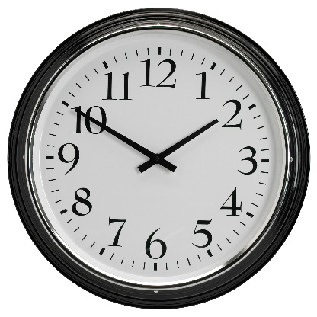
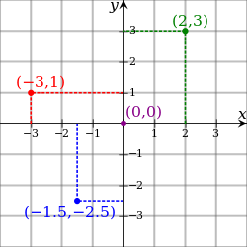
Challenges
Thinking in terms of (x,y)
The window is “drawn to” by any object that accesses it (player character, platforms, enemies, collectibles, etc.). These are all on a plane.
Keeping goals simple
Had to refine my goals many times to make sure they could be achieved. EX: from “online fighting game” to “functional platforming game.” Stayed realistic.
Maintaining code reusability/polymorphism
Code would get very long if each new level was its own class with its own properties. Each new level inherits from a superclass Level and has base attributes.
TIME
Underestimated how little time I had to achieve: learning new language, learning new programming concept, and creating functional program from this that met most of set goals.

Slide 6
Adaptations
Made one superclass Level for subclasses (level 1, level 2, etc.) to inherit from
Made one superclass Character for subclasses (player, enemy, etc.) to inherit from
Used a pre-created level-builder to build my levels so that I could plug in the coordinates (saved time)
Used PyGame module instead of creating game from scratch

Slide 7



Technologies
Python 3.2 (incl. IDLE, the Python IDE): an object-oriented, interpreted, and interactive programming language. Often compared to Lisp, Perl, C#, etc.
PyGame for Python: a cross-platform set of Python modules designed for writing video games. Includes computer graphics and sound libraries designed to be used with the Python programming language.
Git/GitHub: Version control software; web-based Git repository.

Slide 8


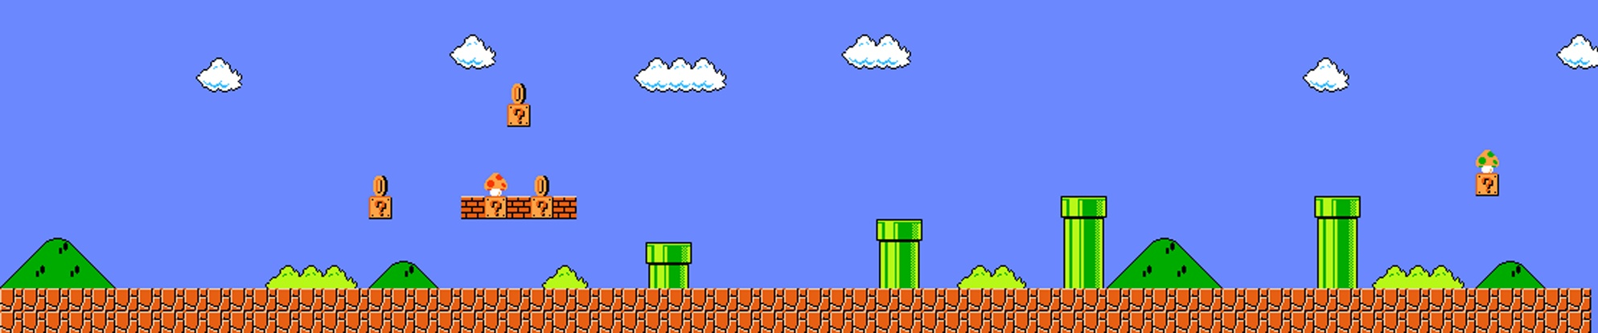
GOALS: Met and Unmet
Learn Python
Learn the fundamentals of game programming
Make a functional game
…with platforming elements
…with collectibles
…with death/game over
…with enemies

Slide 9
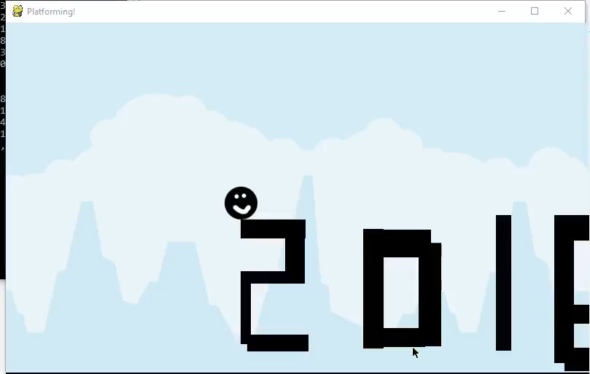
Short Demonstration

