Slide 1
An Assumption Based Framework for the purposes of Disaggregating Smart Meter Readings and User Profiling
Gregory Loyse
Imperial College London – Department of Computing

Slide 2
Motivation
Rising populations and development means more strain on energy resources. Conventional energy resources are constrained and can have negative environmental impact.
These concerns mean we require to be more efficient with consumption management. This requires better and automated analysis tools.
The UK government along with other political organisations have made smart meters an integral part of their energy strategy. By 2019 all homes to have smart meter.
Goal of this project is to attempt to profile users based solely on energy readings from smart meter.

Slide 3
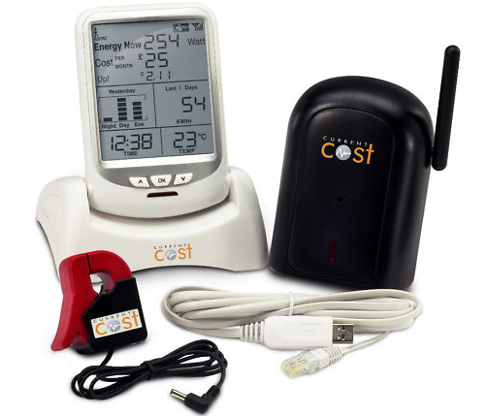
Smart Meter Hardware

Slide 4
Outline
The Raw Data
Signal Processing & Disaggregation
Abduction

Slide 5
1) The Raw Data
The nature and challenges of data set.

Slide 6
CurrentCost Monitor Data
<msg> start of message
<src>CC128-v0.11</src> source and software version
<dsb>00089</dsb> days since birth
<time>13:02:39</time> time
<tmpr>18.7</tmpr> Temperature
<sensor>1</sensor> Appliance Number
<id>01234</id> radio ID received from the sensor
<type>1</type> sensor Type, "1" = electricity
<ch1> sensor channel
<watts>00345</watts> data and units
</ch1>
</msg> end of message
(Taken from: http://www.currentcost.com/cc128/xml.htm)
Every 6 seconds above is emitted to serial port.
Only interested in watts and time. Need parser.
XML Processing (SAX event handler and Tree parsing)
Solution: Regular Expressions + Unix timestamp

Slide 7
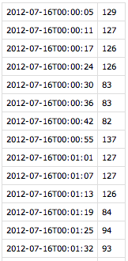
Recorded Data & management
Captures for 3+ weeks.
60*60*24/6 = 14400 per day. (in practice 12k-13k)
Over ¼ Million recordings.
File format requirements: self-descriptive, efficient.
CSV (not XML)
Program changed as understanding did.
Scripts for data transformation.
Timestamps

Slide 8
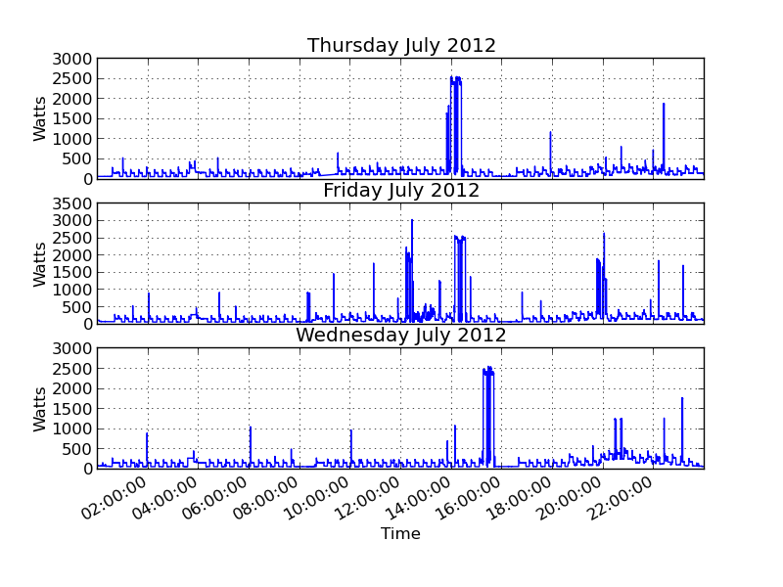
Day Graphs

Slide 9
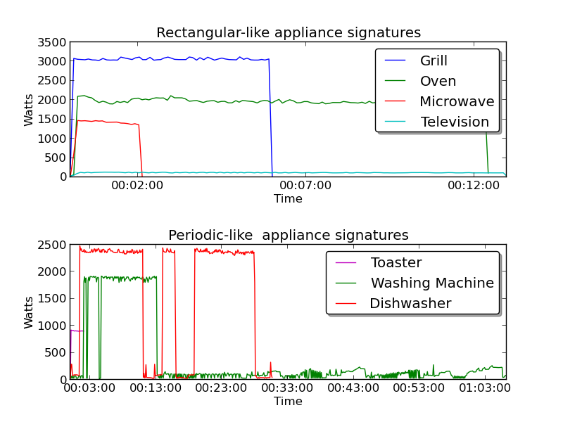
Appliances

Slide 10
2) Signal Processing & Disaggregation
Detecting appliances

Slide 11
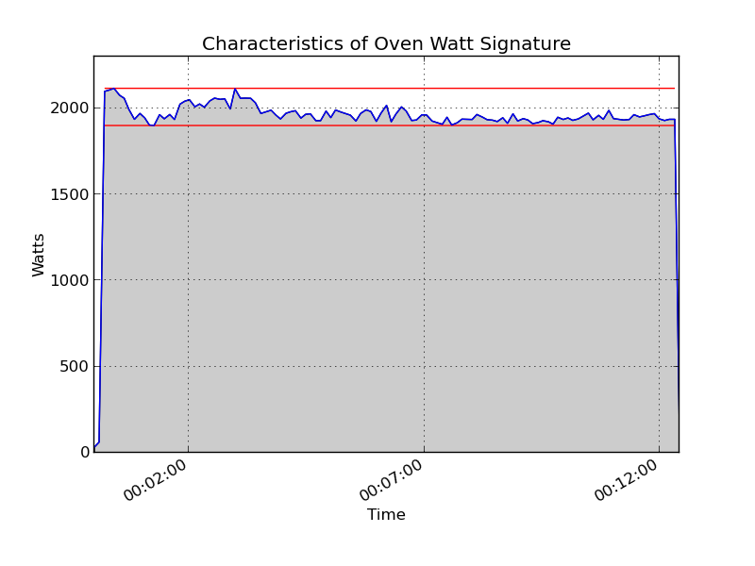
Appliance Signatures
Characteristics:
Intensity
Duration
Frequency
Area
Variation (max/min)

Slide 12
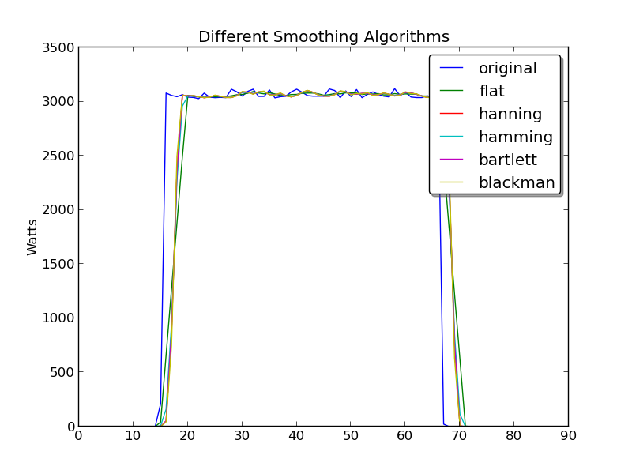
Smoothing Algorithms
Important to provide more precision in analysis.
Experimented with variety of smoothing algorithms
These provide a way of reducing the spread of values
Custom one
Off the shelf – not much to choose between them.

Slide 13
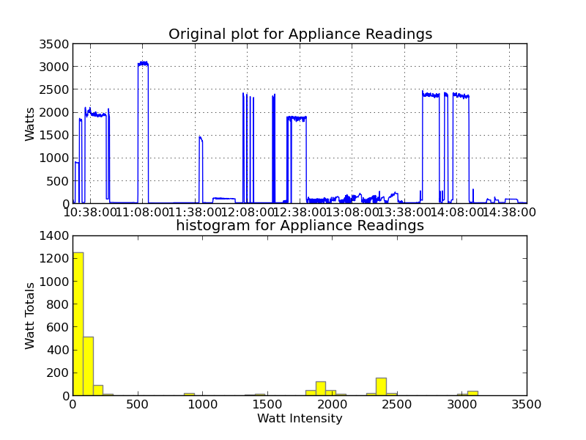
Histograms for Signal Analysis

Slide 14
Histogram – conclusion
Helps identify:
‘Phantom background’ usage
The intensities of each appliances
Duration: The higher the spikes, the longer the durations.
Issues:
Assumes a relatively non-busy signal (=simple household usage)

Slide 15
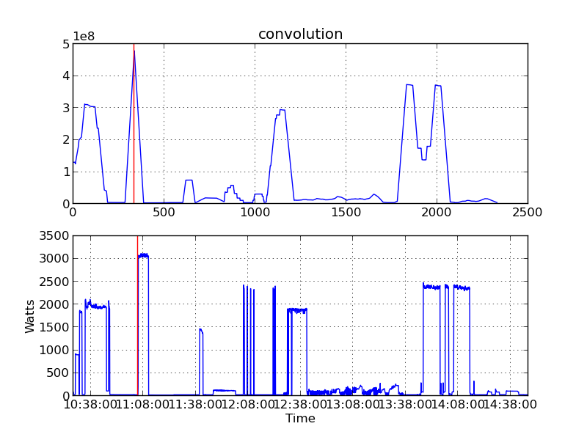
Convolve Function

Slide 16
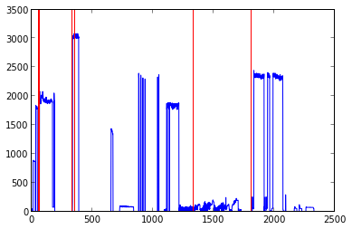
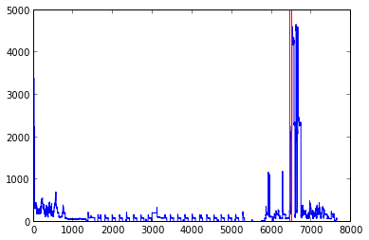
Convolve Function
On Test Data
On Real Data

Slide 17
Convolve Function Conclusion
Works well for Rectangular shaped appliances
Copes with degree of overlaying of appliance signatures
Combined with other constraints (especially intensity/duration measurements) works very well for relatively complicated signals. (fine at this low scale)
Scope for detecting repeated signals (== frequency in convolution graph)

Slide 18
3) Abduction
Bridging the world of signal processing and logic

Slide 19
Three parts to Abduction Logic Program
Theory. Set of observations - explanations/hypotheses. Contains:
Facts
Rules
Abducibles. Set of predicates that can are abducible from Theory.
Integrity Constraints. What states can’t co-exist.
(More detail in demo)

Slide 20
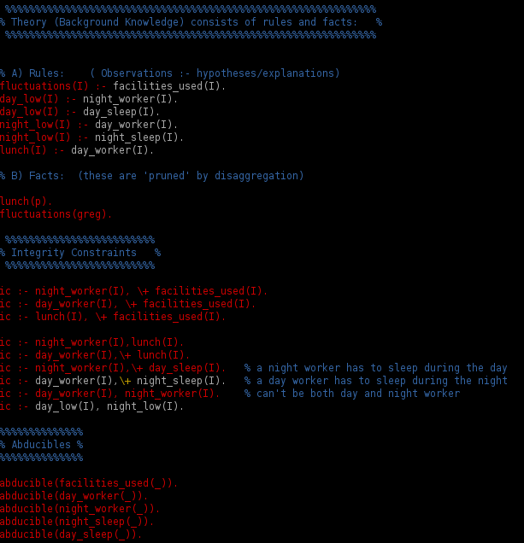
Abduction Program

Slide 21
Queries
?- query([fluctuations(p)],(As,_,_)).
Asserts an observation.
Other observations can be asserted in the file.
Is a request for what can be abduced.
(More detail during demo)

Slide 22
From Predicate Semantics to Signal Search Examples:
Predicate | Human language | Translation to signal processing
lunch(p) | ‘A person p has lunch’ | search for a toaster or grill signature (convolution + histogram intensity check) between the times of 13:00 and 15:00.
fluctations(p) | ‘There is activity/usage in the house’ | histogram analysis yields at least one bin other than phantom bins with significant counts.
night_low(p) | ‘no or little activity/usage during night’ | Histogram analysis of time slice between 23:00 and 8:00 returns no existence of bins other than phantom.

Slide 23
Abduction Conclusions
The Good:
No need for event system algorithm
Elegant and efficient way of directing signal search
Elegant way of specifying what you are looking for
The Bad:
‘Judgmental’ assumptions. Eg. One should eat lunch at a certain time. (the nature of abduction)
Requires a subtle abductive programming to not loose info available.
Introducing ‘fuzziness’ might address some of these issues.

Slide 24
Demo

Slide 25
Conclusion
This project presents a proof of concept.
With more work this is could well be a solution for simple households.
Information derived can be used for future reasoning such as recommendations for users and analysis and research for companies and government.
Eg. useful for automated building resources management.

Slide 26
Future Work
Recode project:
Object-oriented for maintainability
C++ version to run on embedded devices/phones
Dynamic System to exploit non-monotonicity of abductive logic.
Find more mathematical and statistical methods for signal processing. (refine ideas already alluded to).
‘Layered’ histogram analysis approach.
There are a finite number of overlapping device states. A program could generate these for more powerful and precise event identification.
Introduce more ‘fuzziness’.

Slide 27
The End
Questions?

