Slide 1
PARTCAST
AI-native demand planning for Aerospace
Maintenance, Repair, and Overhaul (MRO)
spare parts
PM Assignment · Arad Adler
Submitted for: Avaton · April 2026
PARTCAST

Slide 2
Problem Statement
01
MRO demand is forward-deterministic, not probabilistic.
A large share of future spare parts demand in aerospace Maintenance, Repair, and Overhaul (MRO) is knowable in advance. When an aircraft approaches a C-check, a scheduled heavy maintenance event, the required parts are already encoded in the maintenance program, the aircraft's flight-hours log, the airworthiness directives governing that airframe type, and the flight schedule driving its utilization rate. Compliance deadlines on those directives create hard replacement triggers on specific part numbers. Contract SLAs define which operators must be served and with what turnaround commitments.
The demand trigger is an engineering event with a known time horizon and a specific parts list attached. That makes it categorically different from the consumer or industrial demand that incumbent planning tools were built to sense.
02
Planners spend 60-70% of their review cycle on data reconciliation, not judgment.
Instead of evaluating demand signals, analysts spend the majority of every planning cycle manually pulling ERP exports, airline schedule feeds, FAA and EASA AD portals, supplier portals, and accumulated spreadsheets and reconciling them into a consensus forecast by hand. By the time that forecast reaches the supply chain team, it is already stale. A new AD was issued. A tail had an unscheduled removal. A supplier moved a delivery date. No one updated the plan. The process fails not because planners are bad at their jobs. It fails because the architecture of the tooling they use was designed around a consumption-history model of demand.
03
The consequence of getting it wrong is binary and catastrophic.
In most supply chains, a forecast miss degrades service levels, orders are delayed, customers are frustrated. In MRO, running out of a critical part grounds an aircraft. A grounded commercial aircraft costs an operator $150,000 or more per hour in lost revenue, crew costs, and passenger compensation. Many critical parts are single-source with 12-18 month lead times, no spot market, and in some cases export licensing requirements that add weeks to the procurement timeline. When you are out of the part, you are out. The cost of a forecast miss is not a premium freight charge, it is an aircraft on the ground for weeks.
PARTCAST
2

Slide 3
Where Traditional Planning Tools Break Down
Traditional planning applications (such as Kinaxis and others) are powerful platforms built for industries where demand flows through point-of-sale systems and distributor orders. Their core architectural assumption that demand is a statistical property of time series does not fit well for aerospace MRO.
Capability
What Aerospace MRO Requires
What Traditional Planning Systems Deliver
Demand signal type
Forward-deterministic: maintenance events, AD compliance deadlines, flight schedules, and contract SLAs create knowable future demand before it occurs
Consumption-history model: statistical pattern detection on historical actuals, designed to extrapolate past behavior, not reason about future scheduled events
Inventory unit
Serialized unit: each part carries a serial number, maintenance history, airworthiness certification status, and documentation chain required for installation
Fungible SKU: aggregate quantities with no individual unit tracking, no certification status, no airworthiness documentation requirement
Stockout consequence
A stockout grounds an aircraft (AOG -- Aircraft on Ground) at $150K+ per hour. Holding an extra unit is a carrying cost. Running out is a crisis. These are not equivalent outcomes.
A stockout is a delayed order. Expedite routes and spot markets exist as a fallback. A miss is recoverable, just more expensive.
Supplier structure
Single-source with 12-18 month lead times, no spot market, potential export licensing requirements, when supply is exhausted, no alternative procurement path exists
Multi-source assumption: spot procurement and expedite are treated as available recovery options; lead time variability is a cost, not an absolute constraint
Org topology
Split demand and supply ownership: the airline knows the demand (maintenance program, tail utilization) and the MRO provider owns the supply obligation, demand signals must cross an organizational boundary
Single-org assumption: demand planner and supply planner share data within one ERP instance; no designed-in support for cross-organizational demand signal handoff
PARTCAST
3

Slide 4
Why Now?
Three converging forces make solving this problem urgent and viable today.
01
Post-2020 supply chain fragility
18 months
The 2020 disruption exposed the fragility of lean MRO inventory strategies. Lead times that were measured in weeks stretched to 18 months. The industry spent two years in reactive mode and many operators are still rebuilding buffer stock. There is now genuine urgency around planning visibility that simply did not exist before 2020.
lead times at peak disruption
02
2025 tariff volatility
$150K+/hr
Components sourced from international suppliers face cost uncertainty that makes procurement planning harder. Demand accuracy, knowing what you will actually need before you have to order it, has become more valuable than it has ever been. Getting the forecast wrong now carries a higher dollar cost per miss.
cost of grounding one aircraft
03
700,000 technician shortage by 2043
700,000
The industry will not come close to filling the projected technician gap. Every hour a technician spends waiting for a part that should have been on the shelf is an hour of productive capacity permanently lost. Demand planning accuracy is now a workforce productivity problem, not just a logistics problem.
additional technicians needed by 2043
PARTCAST
4

Slide 5
Who We Build For
We focus on the demand planning loop, where fragmented signals, cross-organizational handoffs, and manual reconciliation create the highest operational risk.
Persona
Current Daily Reality
What Changes with Partcast
Demand Analyst
Spends 60-70% of the planning cycle manually reconciling flight schedules, AD portals, ERP exports, and spreadsheets, producing a forecast that is stale before it reaches supply.
Arrives at the demand review with a draft forecast pre-generated, top signals already surfaced, and changes since last cycle flagged with explanations. The job shifts from data assembly to signal evaluation.
Supply Planner
Receives a consensus demand plan that is already stale; spends significant time in reactive mode expediting after AOG events occur rather than positioning inventory in advance of them.
Sees live AOG risk scores by tail number, immediately knows when an approved demand update changes their inventory position, and gets ranked repositioning recommendations with downstream trade-off analysis.
S&OP Leader
Spends the first hour of every S&OP meeting reconciling data, figuring out what the current plan actually is and why it changed, instead of making forward-looking allocation decisions.
Receives an AI-generated S&OP package 48 hours before the meeting: FVA history, root-cause attribution, AOG risk summary, and forward plan. The meeting becomes a decision forum, not a data reconciliation session.
VP MRO Operations
Learns about AOG risk when an aircraft is already grounded, not 30-60 days before. The leading indicators, a tail approaching C-check with a critical part not yet on order, are buried in systems no one is synthesizing.
Has a live view of tails ranked by AOG risk with the specific demand and inventory factors driving each score. Escalations arrive before events, not after. Forward planning position is visible without depending on the planning team to surface it.
Agentic layer supporting the above workflows
AD Compliance Demand Agent
AOG Risk Scoring Agent
S&OP Package Agent
Autonomous: Parses new ADs, identifies in-scope tails, calculates time-to-compliance and demand gap, and queues a recommendation to the planner.
Autonomous: Re-scores AOG risk for every tail on a 6-hour cadence and immediately on unscheduled removal events, supplier lead time changes, or flight schedule shifts.
Autonomous: Computes cycle variances, classifies root causes (model error vs override error vs external shock), calculates FVA metrics, and assembles the full S&OP package.
Handoff: Hands off when the demand gap requires a procurement decision -- planner sees the full reasoning chain, per-tail calculations, and confidence flags before approving.
Handoff: Hands off at Alert (66+) with a demand recommendation; at Critical (86+) escalates to the S&OP Leader with a procurement countdown and time-sensitive action bar.
Handoff: Hands off a live annotatable document, not a PDF, where the S&OP Leader records decisions on each flagged item and closes the cycle.
PARTCAST
5

Slide 6
Product Strategy
The core strategy is to transform demand planning from a manual, reconciliation-driven process into an event-driven system that produces actionable, explainable recommendations.
MRO demand is largely knowable in advance, but fragmented across systems. The product prioritizes signal integration and decision workflows over raw data aggregation, enabling planners to focus on evaluating decisions rather than assembling inputs.
Strategic Principles
Event-driven planning over historical forecasting
AOG risk minimization as the primary objective
1
4
Demand is modeled based on maintenance events, AD compliance, and utilization -- not consumption history.
All decisions are framed around avoiding aircraft-on-ground events, not generic service levels.
Decision support over data aggregation
Human-in-the-loop learning
2
5
The system surfaces prioritized, actionable recommendations rather than exposing raw data.
Planner overrides are captured as structured inputs to continuously improve the system.
Explainability over black-box accuracy
3
Recommendations are backed by clear signal-level reasoning that planners can validate.
PARTCAST
6

Slide 7
Product Strategy
Strategic Trade Offs
Deterministic logic
vs
machine learning
Actionability
vs
completeness of data
The product starts with deterministic, event-driven modeling to ensure transparency and immediate value, with ML layered in as override and actuals data becomes available.
Recommendations are generated with available signals and confidence flags rather than delayed for perfect data completeness.
Guidance
vs
full automation
Depth
vs
breadth of coverage
The system prioritizes guided decision-making, with planners approving or overriding recommendations rather than fully autonomous execution.
Initial focus is on solving demand planning deeply for MRO operators, before expanding across additional workflows or verticals.
PARTCAST
7

Slide 8
How We Measure Success
Success is defined by shifting from reactive, spreadsheet-driven planning to proactive risk management with measurable improvements in forecast accuracy, cycle time, and decision accountability.
Metric
Definition
Baseline Today
Target at 12 Months
Forecast Value Add (FVA)
% of cases where the AI-generated forecast is more accurate than the planner-overridden forecast, measured at actuals close
Unmeasured -- no attribution system exists
AI outperforms human override in >15% more cases
Aircraft-on-Ground (AOG) Risk Coverage
% of AOG events that were preceded by a Partcast early-warning signal within a 30-day window
0% -- no proactive risk scoring exists
>80% of AOG events flagged in advance
Demand Review Cycle Time
Calendar days from signal update to approved consensus demand plan
~10 days -- manual reconciliation across systems
<2 days -- AI pre-builds recommendations
Override Attribution Rate
% of planner overrides that include a structured rationale (reason category + explanation)
<10% -- overrides are largely undocumented
>90% -- structured rationale captured by default
Planner Adoption Rate
% of demand analysts using AI-generated forecasts as their starting point
0% -- tool does not exist
>80% within 6 months of deployment
PARTCAST
8

Slide 9
How Partcast Works
Partcast is structured as a four-layer system that transforms fragmented demand signals into actionable, auditable planning decisions. The architecture handles both structured signals (e.g., flight schedules, maintenance events) and semi-structured signals (e.g., AD documents, supplier updates), while maintaining explainability and planner control.
Signal Ingestion Layer
1
Demand Intelligence Engine
2
Collaborative Planning Layer (UX)
3
Demand-Supply Matching Engine
4
Ingests and normalizes demand signals from multiple sources: flight schedules and maintenance event calendars, airworthiness directives (FAA / EASA), supplier lead time data and contract SLAs, ERP historical consumption
Generates demand forecasts at the part number x tail number level using an event-driven model: reasons forward from maintenance schedules and compliance deadlines, constructs demand timelines and confidence ranges, detects anomalies between expected and actual consumption
Presents AI-generated recommendations to planners through a structured workflow: prioritized demand review queue, signal-level explanations for each recommendation, approve / override / escalate actions with rationale capture
Maps approved demand plans to serialized inventory positions: identifies supply gaps and scores AOG (Aircraft-on-Ground) risk per tail, generates repositioning and procurement recommendations, surfaces trade-offs across competing inventory needs
Structured signals are processed deterministically. Semi-structured signals are parsed with AI and assigned confidence scores, with low-confidence data routed for planner review.
AI is used for extracting structured data from AD documents and identifying deviations. Core demand logic remains deterministic and auditable.
All decisions are logged, enabling forecast-to-actual attribution and continuous learning.
Outputs are decision-ready and tied directly to operational risk.
PARTCAST
9

Slide 10
Where AI is Used (and Where It is Not)
Where AI is Used
Where AI is Not Used
1
Signal extraction from semi-structured data
Core demand modeling and planning logic remain deterministic:
AI is used to parse and structure inputs that are not natively machine-readable: airworthiness directives (ADs), supplier updates and lead time changes, contract SLA documents. This converts unstructured inputs into structured signals that can be used in demand planning.
Demand derived from maintenance events and compliance timelines
Time-to-compliance calculations
2
Anomaly detection and pattern recognition
Demand gap and coverage calculations
ML models monitor actual consumption vs event-driven forecasts to: detect unexpected removals or failure patterns, identify deviations from expected demand, surface signals that require planner review.
AOG risk scoring logic
3
Continuous learning from planner behavior
These components are rules-based and fully auditable.
AI learns from planner overrides and forecast vs actual outcomes. This improves forecast accuracy over time and adapts to operator-specific patterns.
PARTCAST
10

Slide 11
Core Agents
Partcast uses a set of specialized agents to translate AI capabilities into actionable workflows. Each agent is responsible for a specific stage in the planning loop. Agents do not replace planners. They augment decision-making and automate data synthesis, while keeping the human in control.
AD Compliance Demand Agent
1
AOG Risk Scoring Agent
2
S&OP Package Agent
3
Transforms regulatory and operational inputs into structured demand signals
Continuously monitors demand and supply conditions to surface operational risk
Aggregates decisions and prepares structured outputs for planning cycles
Parses airworthiness directives (ADs) and maintenance requirements
Evaluates inventory coverage against upcoming demand events
Compiles forecast changes, overrides, and key signals
Identifies affected aircraft (tails) and required parts
Identifies aircraft at risk of AOG based on timing and supply gaps
Summarizes drivers of change and associated risks
Generates demand recommendations with supporting context
Prioritizes high-risk items for planner review
Produces a complete S&OP-ready package for review
Role in system:
Role in system:
Role in system:
Converts external rules and documents into actionable demand
Shifts planning from reactive to proactive risk management
Replaces manual preparation with automated, explainable outputs
PARTCAST
11

Slide 12
Design Principles
Deterministic first, AI-augmented where necessary
1
Explainable outputs with signal-level reasoning
2
Core demand logic is based on structured, event-driven calculations. AI is applied selectively where it adds value (e.g., signal extraction, anomaly detection), ensuring early reliability and long-term extensibility.
Every recommendation is supported by a transparent chain of signals (e.g., tail-level demand drivers, compliance deadlines, lead times). Planners evaluate reasoning, not opaque model outputs.
Human-in-the-loop decision making with full auditability
3
Continuous learning from overrides and actual outcomes
4
Planners approve, override, or escalate all recommendations. Each decision is logged with structured rationale, enabling traceability and accountability across the planning process.
Planner feedback and forecast-to-actual outcomes are captured as training signals. The system improves over time by learning from real-world decisions and their results.
PARTCAST
12

Slide 13
Roadmap & Prioritization
Prioritization follows a phased approach grounded in two core dimensions: immediate operational value for planning teams and long-term platform leverage through data accumulation and learning loops.
Phase 1
Signal Foundation & Trust
0-6 months
Phase 2
AI Sensing & Learning
6-12 months
Phase 3
Supply Matching & Risk
12-18 months
Phase 4
Agentic Planning & Autonomy
18-24 months
Key Capabilities
Signal ingestion (ERP, schedules, ADs), event-driven demand baseline (part x tail), demand review UX, recommendation explanations, audit trail and override capture
ML models trained on overrides and actuals, anomaly detection, confidence ranges, FVA tracking, bias analytics
Demand-supply matching engine, serialized inventory mapping, AOG risk scoring per tail, repositioning recommendations, S&OP package generation
Autonomous agents for demand updates and risk monitoring, planner supervision controls, continuous planning loop, incremental autonomy based on performance
Value Delivered
Immediate improvement in planning cycle time and visibility
Measurable improvement in forecast accuracy
Shift from reactive execution to proactive risk management
Significant reduction in manual planning effort
Moat Being Built
Structured demand signal + override rationale dataset begins forming
Customer-specific learning loop tied to real planning behavior
Workflow integration into S&OP and supply decision processes
Institutional knowledge captured in system + high switching cost
PARTCAST
13

Slide 14
Roadmap & Prioritization
Approach
Given the complexity of MRO demand planning and the need to build trust in an AI-assisted system, it is neither practical nor desirable to deliver full autonomy from day one. Instead, prioritization follows a phased approach grounded in two core dimensions:
Immediate operational value for planning teams (cycle time reduction, visibility, AOG risk awareness)
Long-term platform leverage through data accumulation and learning loops
This approach ensures early, tangible value to drive adoption and trust, while building the structured data and workflow foundation required for advanced AI capabilities.
Phase
Focus
Key Capabilities
Phase 1
Signal Foundation & Trust
Establish demand visibility and replace manual reconciliation workflows
Signal ingestion (ERP, schedules, ADs), event-driven demand baseline (part × tail), demand review UX, recommendation explanations, audit trail and override capture
Phase 2
AI Sensing & Learning
Improve forecast accuracy and introduce measurable learning
ML models trained on overrides and actuals, anomaly detection, confidence ranges, FVA tracking, bias analytics
Phase 3
Supply Matching & Risk Management
Connect demand planning to inventory decisions and AOG risk
Demand-supply matching engine, serialized inventory mapping, AOG risk scoring per tail, repositioning recommendations, S&OP package generation
Phase 4
Agentic Planning & Autonomy
Transition to continuous, exception-based planning
Autonomous agents for demand updates and risk monitoring, planner supervision controls, continuous planning loop, incremental autonomy based on performance
PARTCAST
13

Slide 15
Roadmap & Prioritization
01
0-6 months
02
6-12 months
03
12-18 months
04
18-24 months
Signal Foundation
AI Sensing
Supply Matching
Agentic Planning
Scope
Scope
Scope
Scope
Ingest ERP, flight schedules, and maintenance event data
Train ML models on override and actuals data
Launch demand-supply matching engine
Deploy autonomous agents for demand updates and risk monitoring
Build deterministic, event-driven demand baseline (per part x tail)
Add confidence ranges and anomaly detection
Introduce AOG risk scoring per tail
Enable planner supervision and controlled autonomy
Generate repositioning recommendations with trade-off visibility
Launch demand review UX with AI-generated recommendations and audit trail
Launch FVA tracking and bias analytics
Expand system to continuous planning vs periodic cycles
Auto-generate S&OP planning package
Value delivered:
Value delivered:
Value delivered:
Value delivered:
Immediate improvement in planning cycle time and visibility
Measurable improvement in forecast accuracy
Shift from reactive execution to proactive risk management
Significant reduction in manual planning effort
Moat:
Moat:
Moat:
Moat:
Structured demand signal + override rationale dataset begins forming
Customer-specific learning loop tied to real planning behavior
Workflow integration into S&OP and supply decision processes
Institutional knowledge captured in system + high switching cost
PARTCAST
14

Slide 16
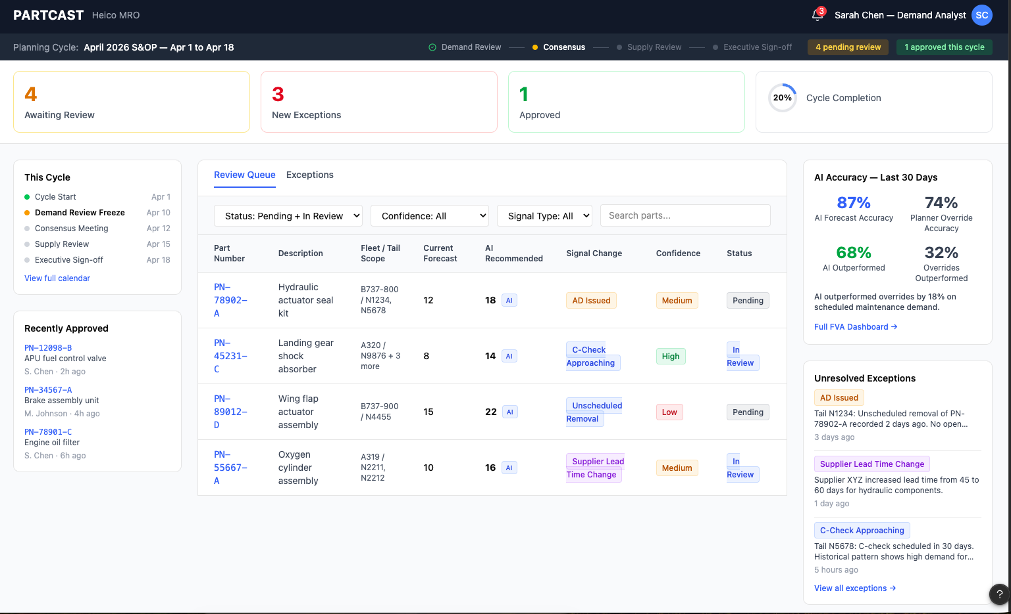
UX: Demand Review Queue
Purpose: The planner's daily starting point. Transforms fragmented demand signals into a prioritized queue of actionable decisions, replacing manual reconciliation.
Workflow
1
Assess cycle status -- view items awaiting review, new exceptions, and overall cycle progress
2
Work through prioritized queue -- each row represents a demand decision, ranked by urgency and signal change
3
Evaluate signals at a glance -- see key drivers (ADs, maintenance events, supplier updates) and affected tails
4
Focus using filters -- filter by status, confidence, or signal type to isolate high-priority items
5
Drill into decision -- select a row to evaluate recommendation and take action (approve / override / escalate)
Outcome: Reduces planning cycle time by shifting from manual data gathering to structured, AI-assisted decision-making
PARTCAST
15

Slide 17
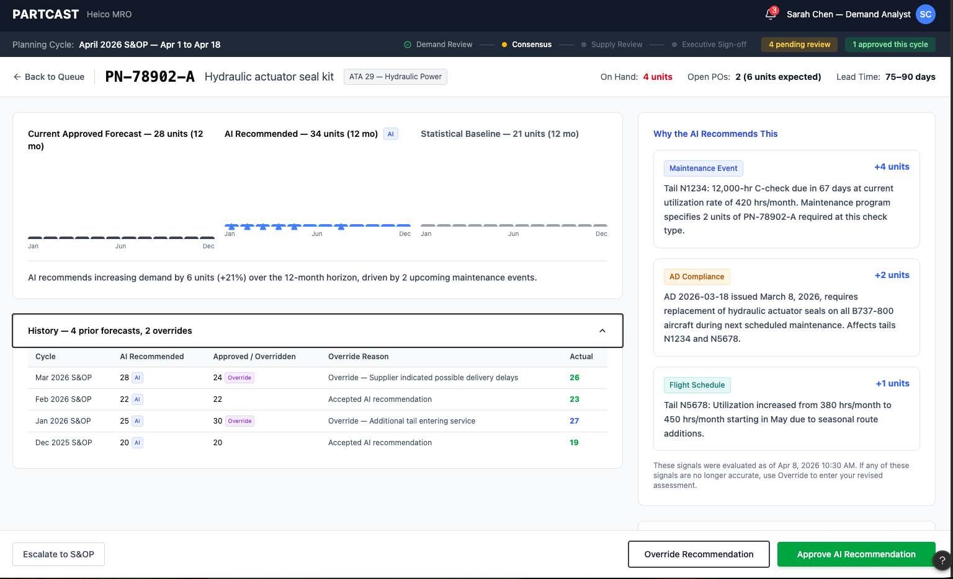
UX: Demand Recommendation Detail
Purpose: TThe core decision screen. Enables the planner to evaluate AI recommendations using signal-level reasoning and inventory risk scenarios, and take action (approve, override, or escalate).
Workflow
1
Understand forecast differences -- compare current plan, AI recommendation, and statistical baseline across time
2
Review signal evidence -- evaluate ranked signals (e.g., maintenance events, ADs, utilization) with per-signal demand impact
3
Assess inventory risk -- view stocking scenarios in operational terms (coverage, AOG exposure, carrying cost)
4
Reference historical decisions -- review past overrides and actual outcomes to inform current judgment
5
Take action -- approve AI recommendation, override with rationale, or escalate to S&OP
Outcome: Enables fast, explainable, and auditable decisions by shifting from intuition-based planning to evidence-driven, risk-aware decision-making
PARTCAST
16

Slide 18
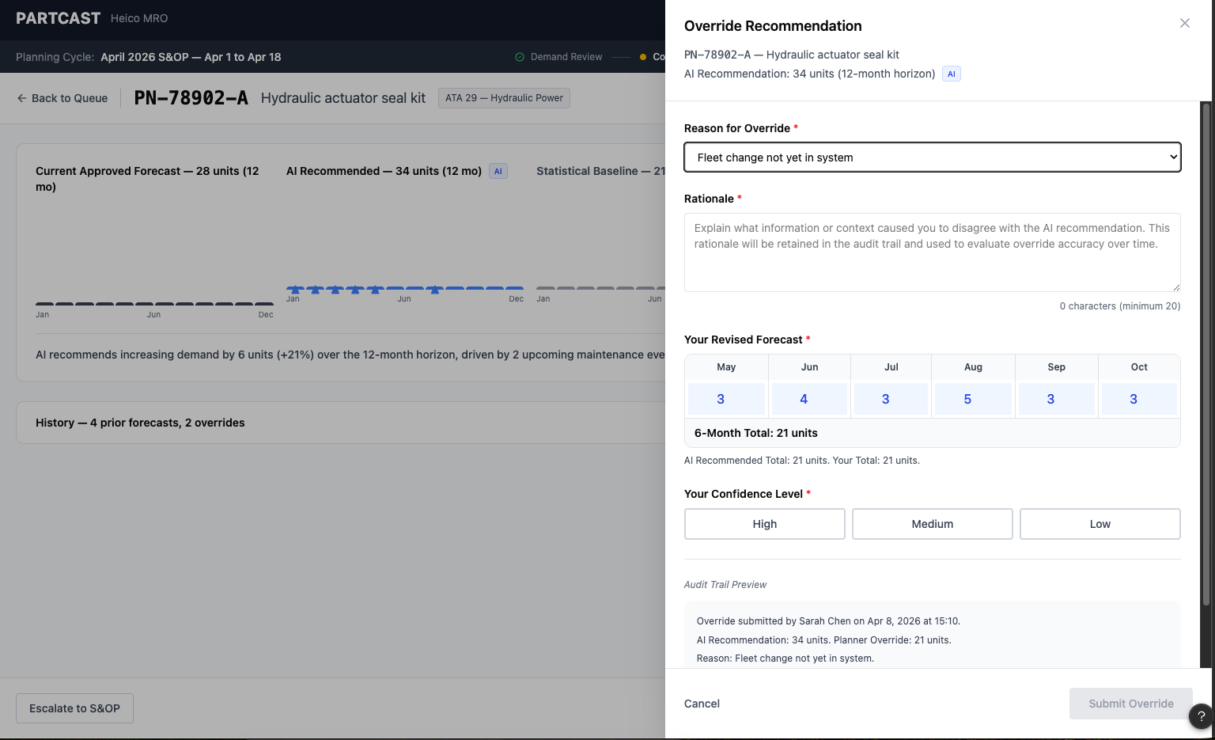
UX: Override Panel
Purpose: Enables planners to override AI recommendations with structured rationale and forecast adjustments, creating a complete audit trail and learning signal for the system.
Workflow
1
Select reason category -- classify override using standardized taxonomy (e.g., fleet change, supplier issue, AD update)
2
Provide detailed rationale -- capture context behind the decision in structured, auditable form
3
Adjust forecast values -- modify monthly forecast based on planner judgment and domain knowledge
4
Indicate confidence level -- record planner confidence to support future accuracy evaluation
5
Review audit trail preview and submit -- validate how the decision will be recorded before submitting
Outcome: Creates a structured dataset of planner decisions, rationale, and outcomes, enabling continuous learning, FVA measurement, and long-term model improvement
PARTCAST
17

Slide 19
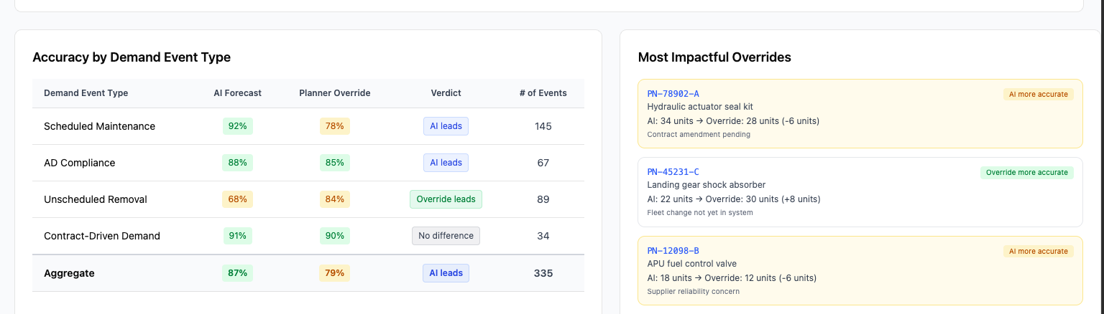
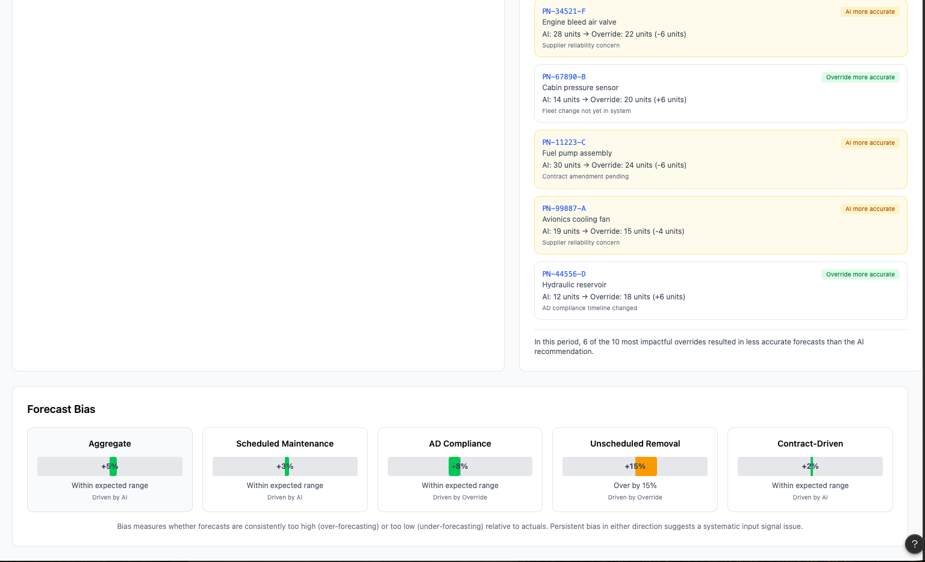
UX: FVA Dashboard
Purpose: Provides visibility into whether AI recommendations or planner overrides are more accurate over time, enabling data-driven decision-making and continuous improvement.
Workflow
1
Understand performance at a glance -- review headline insight summarizing AI vs planner accuracy over selected time period
2
Analyze accuracy trends over time -- compare AI, planner overrides, and statistical baseline across a rolling horizon
3
Identify strengths by demand type -- see where AI leads (e.g., scheduled maintenance) vs where planner judgment adds value
4
Review high-impact decisions - examine largest overrides and whether they improved or reduced forecast accuracy
5
Detect systematic bias -- identify over- or under-forecasting patterns across demand categories
Builds trust through transparent performance measurement, enabling planners to improve decisions over time and guiding when to rely on AI vs human judgment
PARTCAST
18

Slide 20
Why Partcast Wins
Why Partcast Wins
Owns the planning workflow (not just data)
1
Builds a proprietary decision dataset
2
Improves continuously through human-in-the-loop learning
3
Partcast replaces the most critical and underserved workflow in MRO planning -- the demand review cycle. Instead of acting as a reporting layer, it becomes the system where planners evaluate, decide, and act, embedding directly into daily operations.
Every interaction generates structured data: demand signals (ADs, schedules, utilization), planner overrides and rationale, forecast vs actual outcomes. This creates a customer-specific dataset of decisions and outcomes that cannot be replicated without sustained usage.
The system learns from when planners override, when AI is correct, and where each approach performs better. Over time, this leads to higher forecast accuracy (FVA), better calibration of AI recommendations, and increasing planner trust and adoption.
Creates durable switching costs through workflow and trust
4
Expands from wedge to platform
5
Once embedded: planning cycles depend on Partcast outputs, S&OP processes align around its recommendations, historical decisions and rationale are stored within the system. Switching away means losing accumulated learning, audit history, and decision context.
Starting with demand review, Partcast expands into supply matching and AOG risk management, S&OP decision support, and continuous, agent-driven planning. This creates a path from single workflow to core planning platform.
PARTCAST
PARTCAST
19
19

