Slide 1

Baseball Stats
Predicting Player Futures
Reuben Hough

Slide 2

Objectives:
Gather information on baseball statistics
Find good ways to identify the best players
Find ways to predict who will become a good player

Slide 3
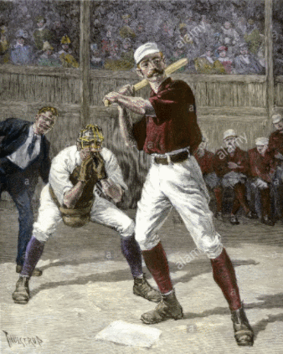
1871 - 2019
A wide-ranging set of statistics:
Fielding
Pitching
Season and Post-Season
Colleges attended
Salary
And more, from 20,000 players

Slide 4
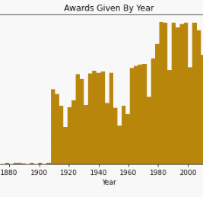
The STATS
Number of awards given by year
Years

Slide 5
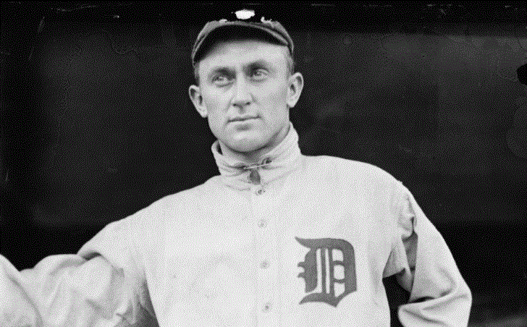
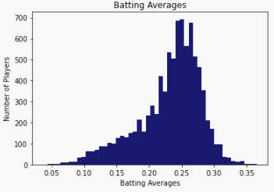
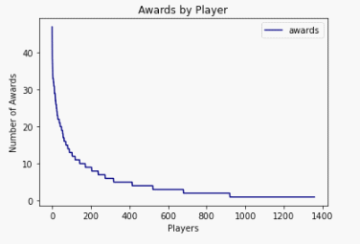
Top Players

Slide 6
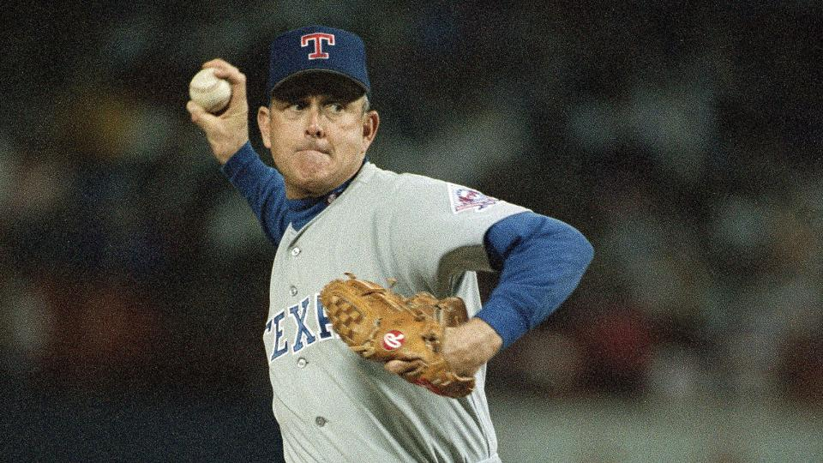
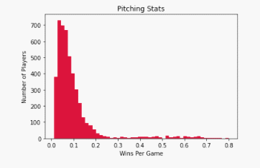
Pitchers
Separate statistics
and modeling

Slide 7

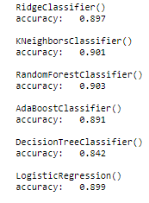
Comparing Classifiers
Accuracy,
Type I and II Errors

Slide 8
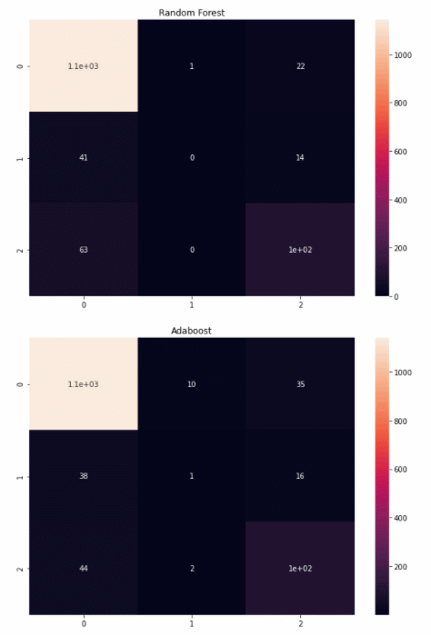
Confusion MatriCies
Random Forest
Ridge Classifier
Regression

Slide 9
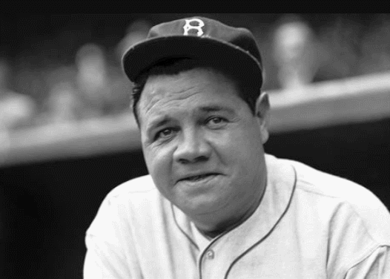
Recommendations
Observe future development of players
Identify players that could benefit from training
Get a better understanding of motivation
Get personally involved

Slide 10

Future Work
Gather more data, 2020 may be interesting
Time series prediction
More players (like Nippon Baseball in Japan)

Slide 11


