Slide 1
Northwest Housing Prices
Module 4 Project
Reuben Hough

Slide 2
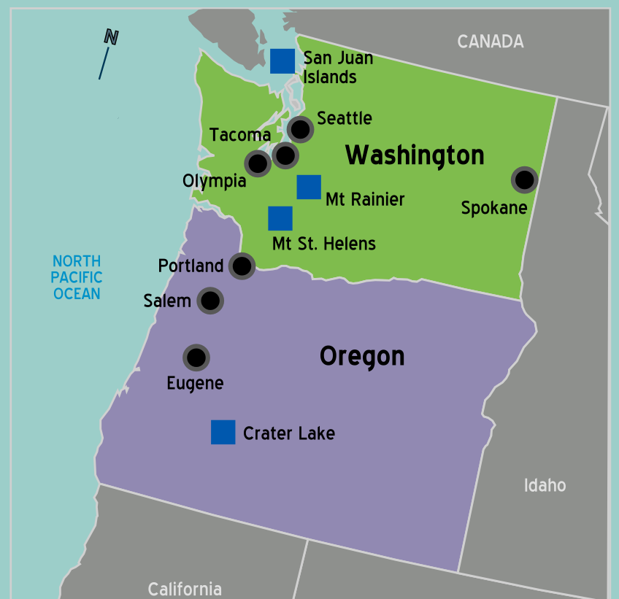
The Data
Nationwide median housing prices
provided by Zillow.com
Almost 15,000 zip codes
20 years of data
Northwest States
Every Zip Code in Oregon and Washington States
559 Zip Codes (6 had incomplete records)

Slide 3
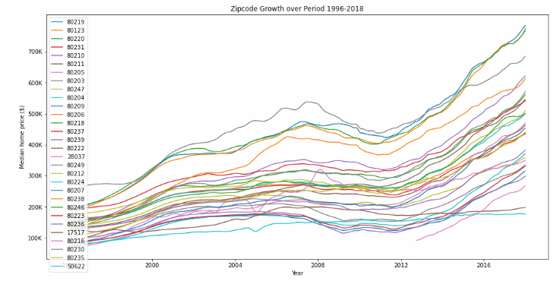
Find the “best” zip codes for bank investment
Model needs to account for 2008 Market Crash
Then maximize ROI, while avoiding poor predictors

Slide 4
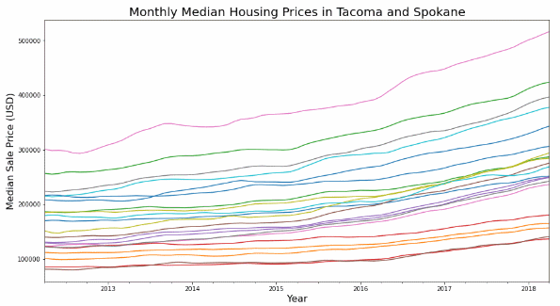
Tacoma & Spokane
After the housing crisis, most places pick back up and start gaining median price, even in Spokane.
As you can see, some zip codes do better than others. But you can never tell which ones might be better to invest in

Slide 5
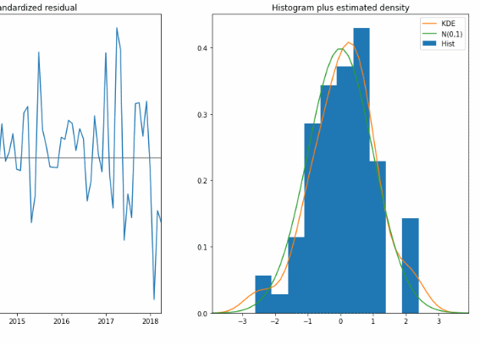
Checking for Normality
Data is checked for normality to make sure it is easy to work with and interpret

Slide 6
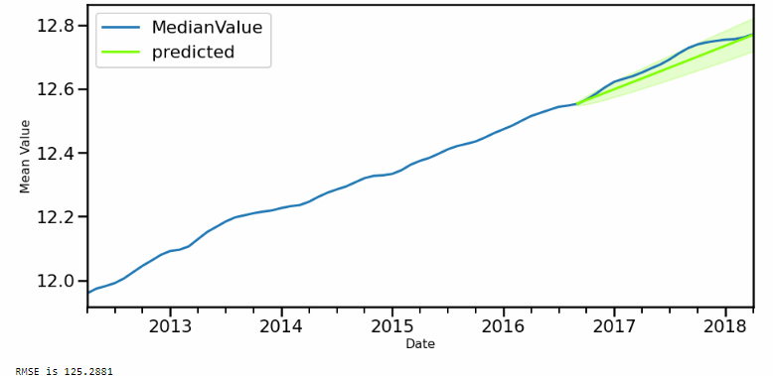
Measuring and Minimizing Volatility
Prediction Spread (confidence interval) is based on past volatility.
RMSE and the prediction quality are taken into account when choosing the best ZipCodes.

Slide 7
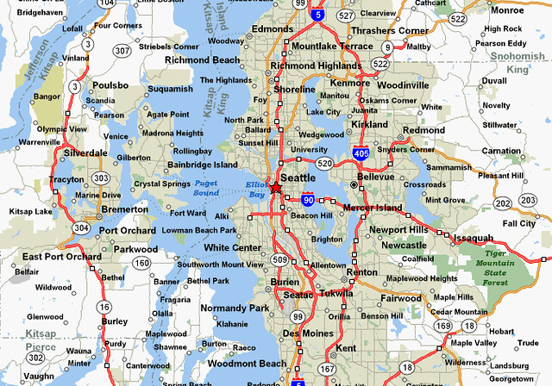
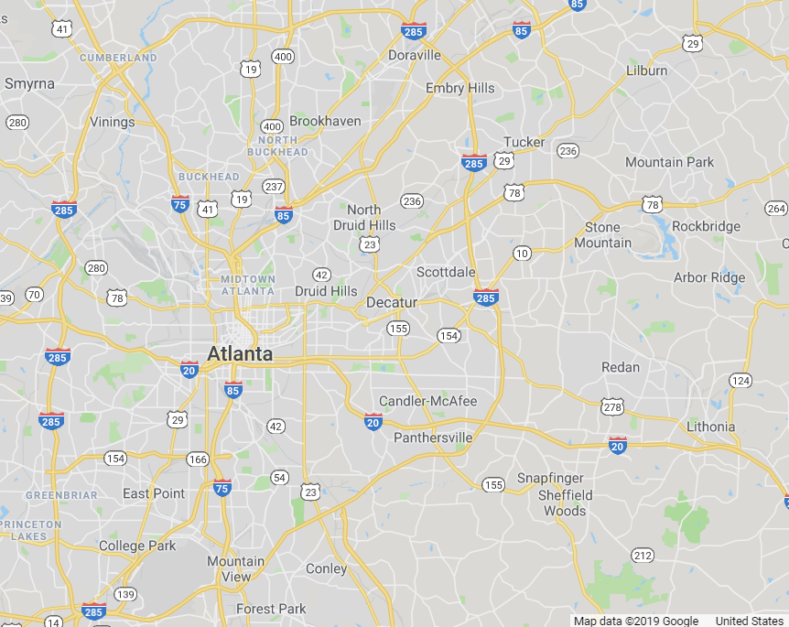
Conclusions & Recommendations
The 5 “best” zip codes are:
98106 (Seattle)
98108 (Seattle)
98007 (Bellvue)
98043 (Mountlake Terrace)
98004 (Bellvue)
Investing in the Seattle area seems to be the best bet for the northwest

Slide 8

Future Work
Wider search area
More time since bubble
Manhattan

Slide 9
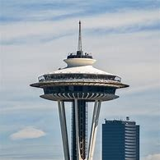
Thank you

