Slide 1
Modular Multimodal RAG for Industrial Equipment Documentation
Autonomous Reasoning with Visual Understanding

Slide 2
The Documentation Challenge
30+ PDF manuals, hundreds of pages each
2,800+ images: diagrams, schematics, photos, tables
16 equipment families across injection molding, thermal analysis, rheometry, spectroscopy
A technician troubleshooting a hydraulic issue needs the pump schematic – not a paragraph about it.
Notes:
Ground the audience in the physical reality. This is a specific fleet of manufacturing and characterization equipment at the laboratory. The scale (2,800+ images across 30 PDFs) makes manual search impractical and keyword search unreliable.

Slide 3
What Technicians Actually Need
Text-Only RAG: Returns a paragraph describing the pump, then says “Refer to page 465 of the manual for the full schematic.” It tells you to look at the manual – which you were already doing.
Multimodal RAG: Returns the text explanation plus the actual schematic from page 465, with the source citation. The image IS the answer.
Notes:
This is the core motivation. It is not about generating images – it is about retrieving the RIGHT existing image from thousands of candidates.

Slide 4
Why Current Approaches Fall Short
Problem | What Goes Wrong
Keyword Dependency | “pump diagram” misses “hydraulic_assembly_03.png”
No Visual Understanding | Images stored as opaque blobs with filename-only metadata
OCR Loses Visuals | OCR extracts text but discards the image itself
Brittle Classification | Manual tagging – inconsistent across 2,800 images
Tight Coupling | Image logic embedded in main app – changes break everything
Notes:
Problem 3 is critical: traditional OCR (Tesseract, Adobe) converts images to text but throws away the visual. A hydraulic schematic becomes meaningless when reduced to OCR text. Our system keeps the actual image and makes it searchable via VLM descriptions.

Slide 5
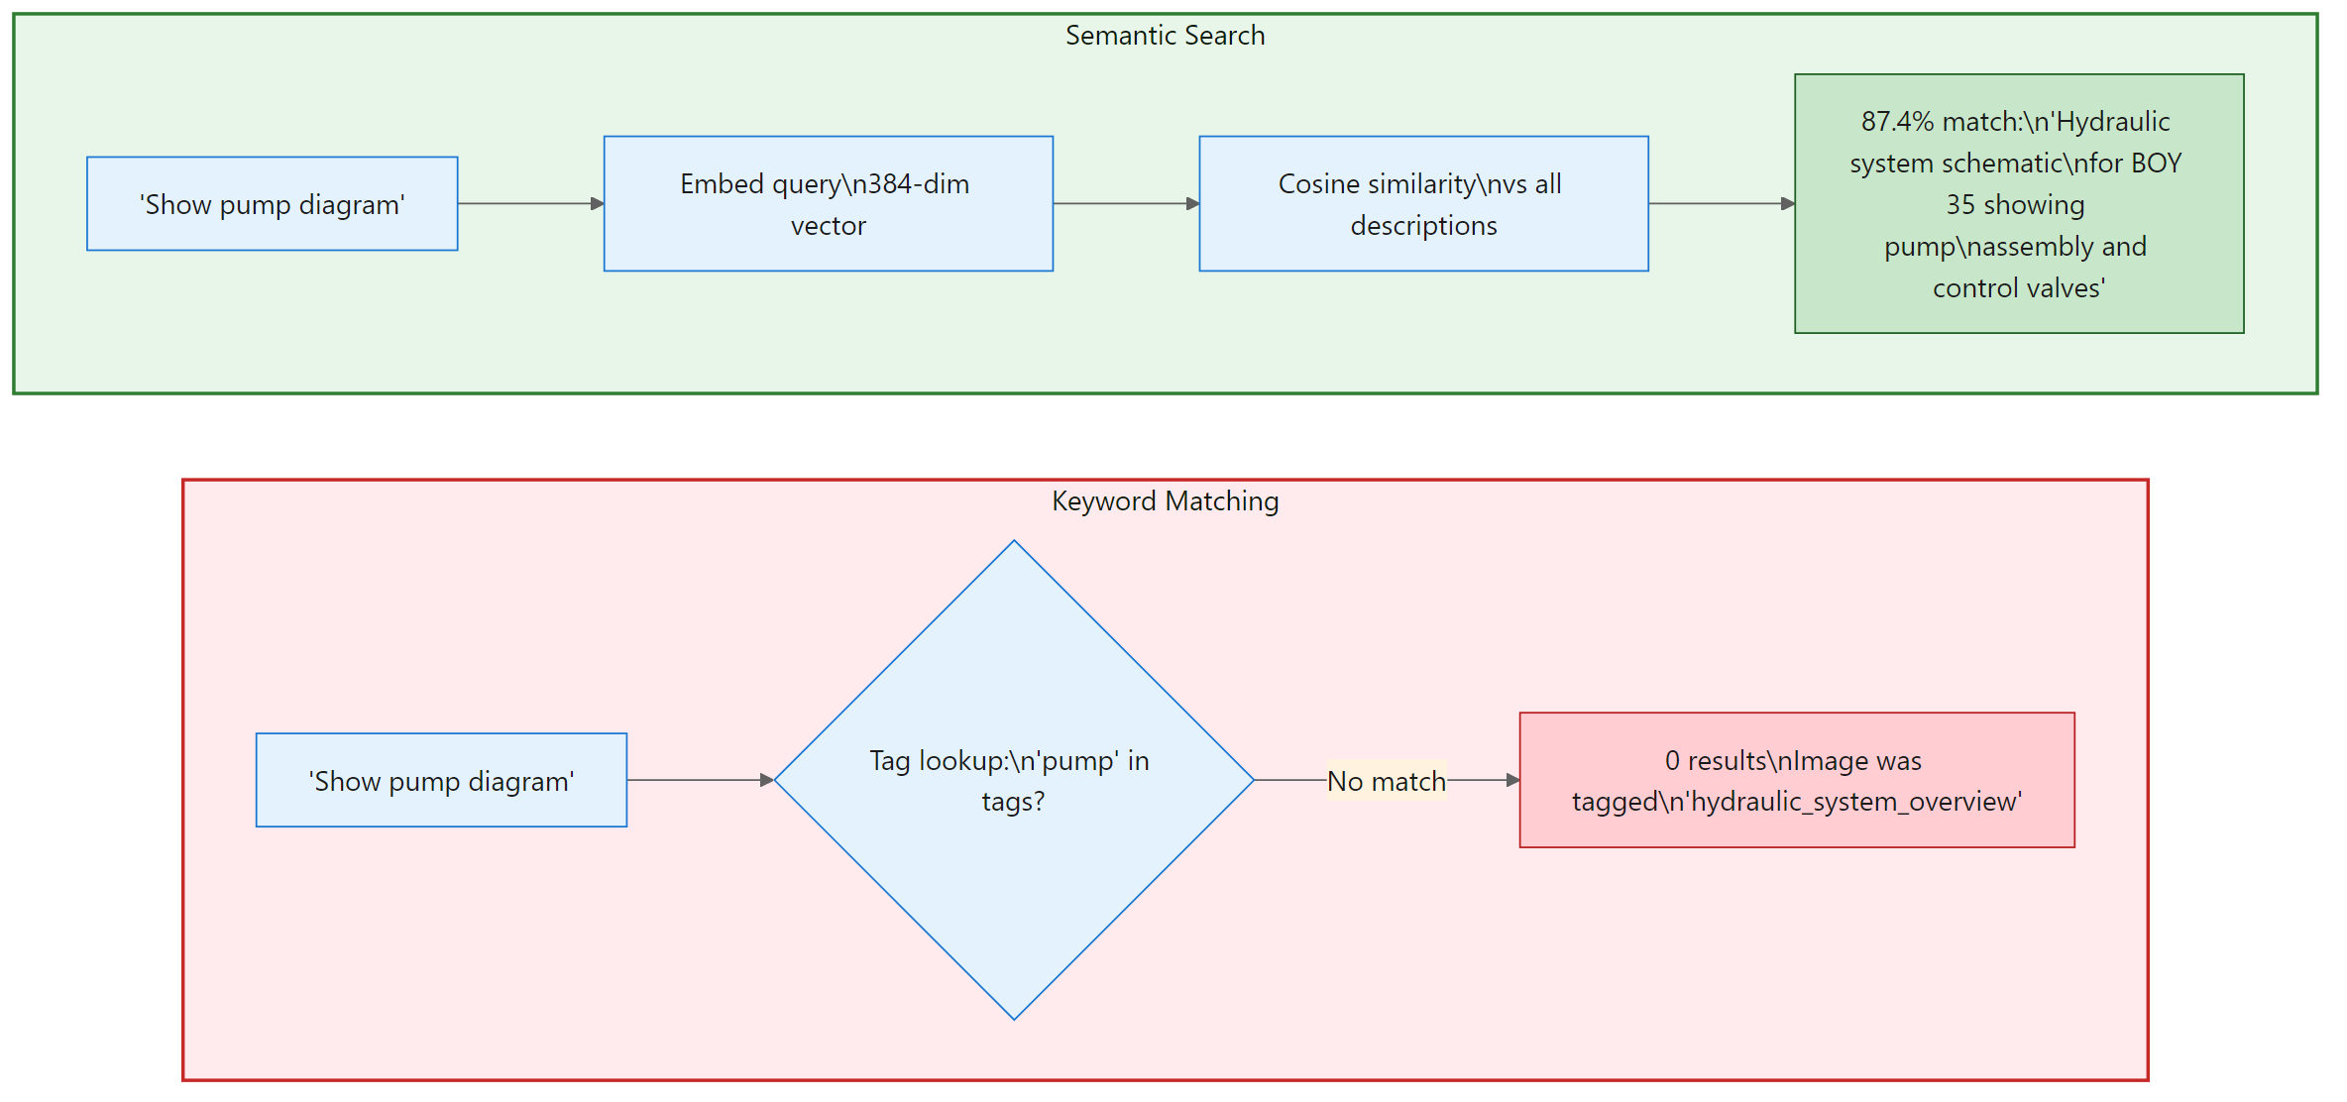
The Semantic Gap
A Vision-Language Model describes images in natural language. That text is embedded – richer and more searchable than raw image embeddings.
Keyword matching fails silently while semantic search finds the correct image
Notes:
The keyword approach fails silently. No error, just “no results.” This is a deliberate design choice over CLIP-style direct image embedding: VLM descriptions capture domain-specific details that generic image embeddings miss.

Slide 6
Decoupled Architecture
Different compute profiles. Different update cycles. Same data contract. Updating the VLM requires zero changes to the reasoning engine.
Two-service architecture with shared data contract
Notes:
These are two Python projects that share a filesystem interface. VLM-YOLO-Detector is GPU-intensive batch processing (run once). Agentic-RAG is real-time LLM inference (per-query).

Slide 7
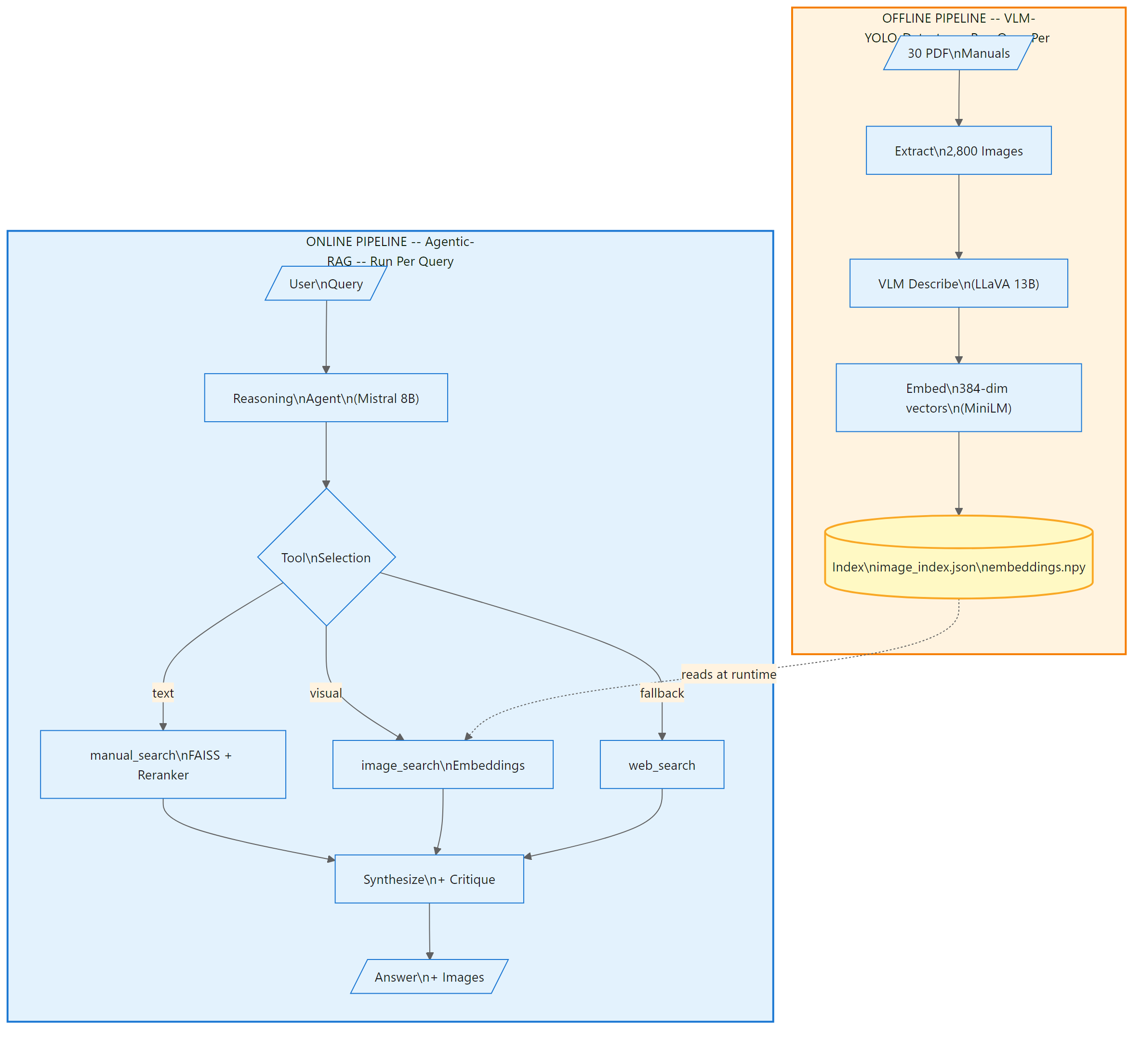
Complete Pipeline: PDF to Answer
Top = offline batch processing (run once per manual). Bottom = online per-query reasoning. The index in the middle connects them.
End-to-end pipeline: offline batch processing and online per-query reasoning
Notes:
Tell the audience: “This is the full picture. Every subsequent slide zooms into one part of this pipeline.”

Slide 8
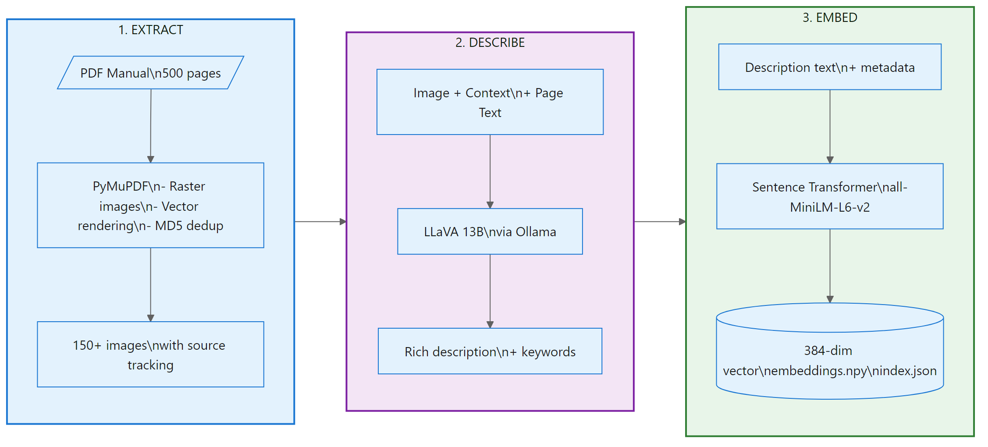
Three-Stage Vision Pipeline
Extract: PyMuPDF with raster + vector rendering, MD5 dedup. Describe: LLaVA 13B generates rich descriptions with equipment context. Embed: all-MiniLM-L6-v2 produces 384-dim vectors.
Three stages: Extract, Describe, Embed
Notes:
The VLM does not see images in isolation – it receives equipment type and page text as context. “Diagram” is useless; “hydraulic pump schematic for BOY 35 with port connections P, T, A, B” is searchable.

Slide 9
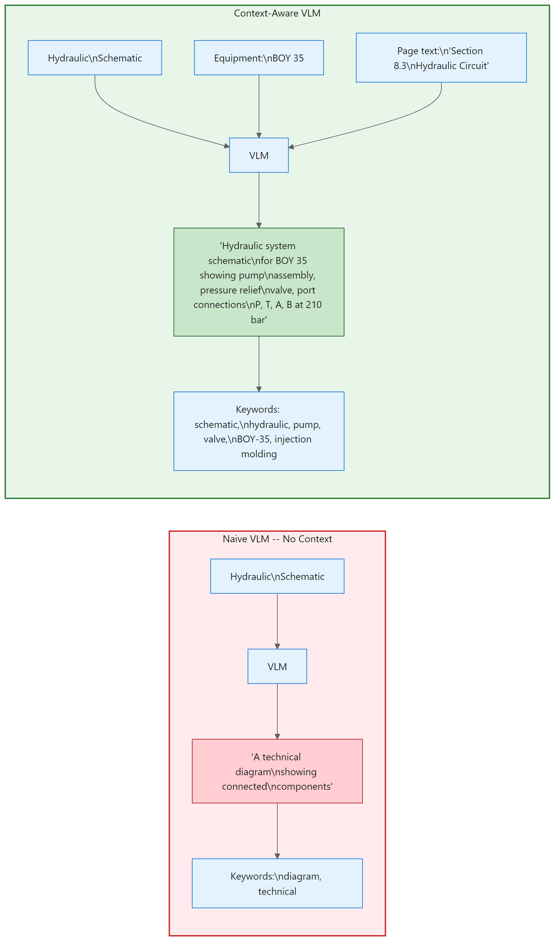
Context Changes Everything
8 content types classified automatically: diagram, component, warning, procedure, specification, table, schematic, photo. The VLM adapts descriptions based on equipment family context.
Naive VLM produces generic descriptions; context-aware VLM produces specific ones
Notes:
Without context, VLM descriptions are too generic to differentiate between 2,800 images. The 8 content types enable filtering: if a user asks for a “wiring diagram,” the system boosts schematics and penalizes photos.

Slide 10
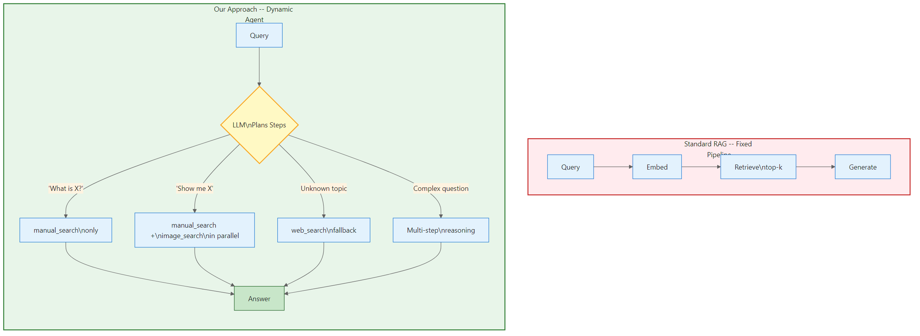
Autonomous Agent Architecture
The LLM decides which tools to use at runtime – not a hard-coded if/else chain. Text-only questions use manual_search; visual requests add image_search in parallel; unknown topics trigger web_search.
Fixed pipeline vs dynamic agent with runtime tool selection
Notes:
A fixed pipeline that always runs image search wastes compute on text-only questions. The agent reads the query and adapts. Think of it like an experienced technician who knows when to open the manual and when to search online.

Slide 11
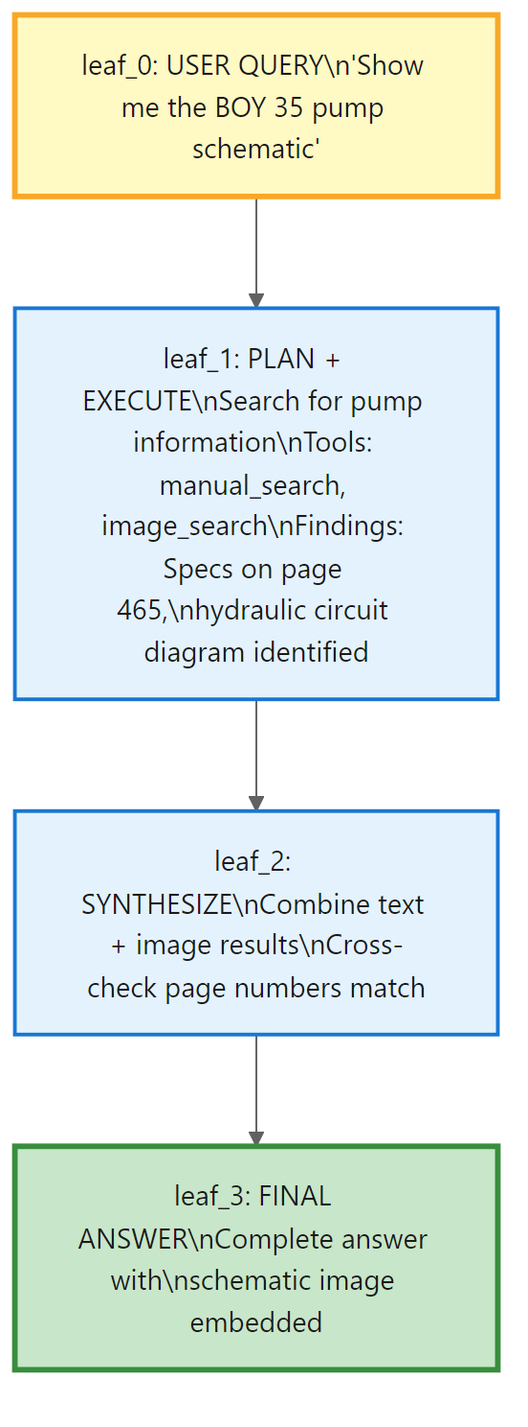
Reasoning Tree
Each node stores: reasoning step, tool calls, synthesized result. Children inherit full parent context. Max depth 5. Most queries resolve in 2-3 steps.
Tree-of-thought reasoning structure with context accumulation
Notes:
The tree structure is what makes this “agentic” rather than a chatbot. Context accumulation is critical: later nodes see everything earlier nodes discovered. This tree is what the UI visualizes in real-time.

Slide 12
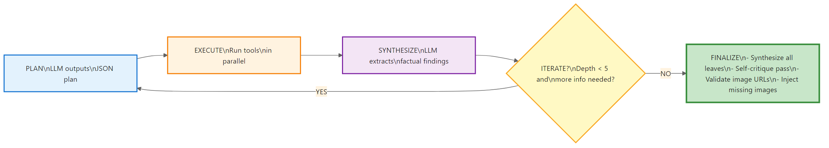
Agent Execution Loop
Single agent (not multi-agent) to minimize latency. Parallel tool execution. JSON-structured outputs for auditability. FINALIZE: synthesis, self-critique, URL validation, image injection.
Plan, Execute, Synthesize, Iterate, Finalize
Notes:
Walk through one cycle: LLM outputs JSON plan, tools execute in parallel, LLM extracts factual findings, check if enough to answer. Single agent vs. multi-agent was deliberate: multi-agent adds latency not justified here.

Slide 13
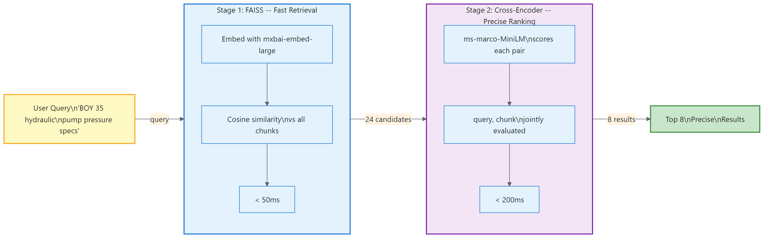
Two-Stage Text Retrieval
A chapter intro scores high on embedding similarity but does not answer the question. The cross-encoder reads the full (query, chunk) pair and correctly ranks the spec table above the generic intro.
FAISS fast retrieval followed by cross-encoder precise ranking
Notes:
800-char chunks with 150 overlap. mxbai-embed-large-v1 for embedding, ms-marco-MiniLM-L-6-v2 for reranking. FAISS searches the entire index in milliseconds. The cross-encoder only processes 24 candidates.

Slide 14
Image Search: Composite Scoring
Component | Weight | What It Measures
Semantic Similarity | 0-10 | Query meaning vs VLM description
PDF Source Match | 0-30 | Correct machine manual?
Page Proximity | 0-8 | Near pages with text hits?
Content Type Match | 0-8 | Image type matches request?
Notes:
BOY-35 schematic scores 49.2 (semantic 6.2 + PDF 30.0 + page 5.0 + type 8.0). A similar APSX-PIM schematic scores only 15.1: higher semantic similarity but zero PDF match.

Slide 15
Three Layers of Answer Validation
Self-Critique: Second LLM call strips claims not supported by retrieved context.
URL Validation: Post-processing removes hallucinated image paths.
Missing Image Injection: Walks reasoning tree; appends up to 3 relevant images the LLM forgot to include.
Result: 98% source accuracy across evaluations.
Notes:
Layer 1 was developed after evaluation showed the model adding correct but unsourced domain knowledge. Layer 3 addresses “lossy synthesis” – the LLM finds images but generates a text-only answer.

Slide 16
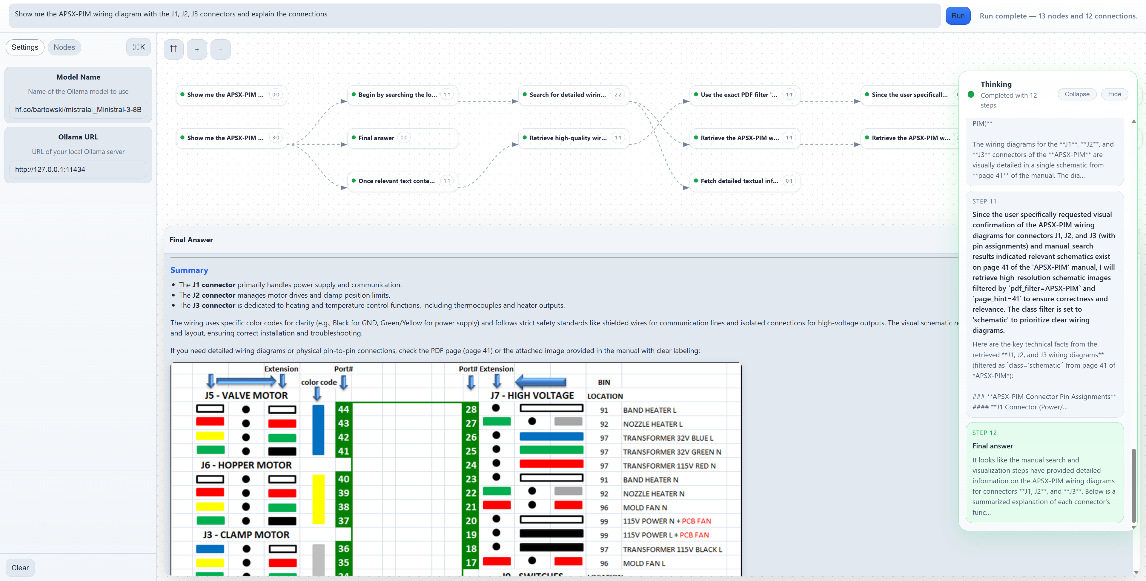
Interactive Reasoning UI
Interactive reasoning tree (HTML5 Canvas) – Real-time thinking stream (SSE) – Node inspector for tool calls – Images embedded in answer – Source citations with PDF name and page number.
Screenshot of the frontend showing reasoning tree, live stream, and answer with images
Notes:
The UI is not cosmetic – it is a trust mechanism. Users need to understand WHY the system gave an answer and WHERE the information came from. The reasoning tree makes the system auditable.

Slide 17
Live Demonstration
Demo | Query | Shows
1 | “What is the EVV unit on the BOY 35?” | Text-only retrieval
2 | “Show me the pump schematic” | Multimodal search
3 | “Safety warnings for APSX-PIM?” | Different machine/type
Notes:
Keep to 3-4 minutes. Have queries pre-typed. Point out: tree building on canvas, tool selection differences between queries, embedded image + source citation.

Slide 18
Why This Architecture Matters
Independent scaling, independent updates, failure isolation, technology freedom. New manual? Re-run pipeline. GPU server down? Text answers still work.
Four architectural benefits
Notes:
In a lab, equipment and software evolve at different rates. A new manual release should not require rewriting the AI system. The filesystem-based data contract is intentionally simple.

Slide 19
Future Roadmap
Near-Term: API integration (HTTP/gRPC). MCP Protocol for standardized tool-to-LLM communication.
Mid-Term: CLIP joint embeddings for direct image-to-query matching. Real-time indexing with watch-folder auto-pipeline.
Long-Term: Confidence scoring with uncertainty estimates. Multi-agent specialization for troubleshooting, maintenance, and safety.
All models run locally via Ollama – fully air-gapped operation.
Notes:
CLIP embeddings are the biggest potential improvement. Confidence scoring is especially important for lab environments: a confidently wrong answer is more dangerous than an uncertain one.

Slide 20
Five Things to Remember
The problem is real. Manufacturing needs visual + textual answers.
Semantic understanding bridges the gap. VLM descriptions enable natural language image search.
Autonomous reasoning adapts. Tree-of-thought planning, not a fixed pipeline.
Modularity enables evolution. Vision and reasoning components evolve separately.
Transparency builds trust. Reasoning tree, citations, image provenance.
“From keyword search to semantic understanding – multimodal RAG that works the way technicians think.”
Notes:
Q and A: “Scale to 100+ manuals?” Linear. “Non-English?” Multilingual embeddings. “Latency?” Under 100ms search + 5-15s generation. “Air-gapped?” Yes, all local via Ollama.

