Slide 1

Brainstation : SOUTHWEST AIRLINES CO.
CRUZALD
ADRIANE
VICTOR

Slide 2
KEY TERMS
FL_DATE – flight date
AIRLINE – airline name
FL_number – flight number
Origin_city – city of origin for the flight
Dest_city – city of destination for the flight
Dep_delay – departure delay in minutes
Arr_delay – arrival delay in minutes
Cancelled – if flight is cancelled(y/n)
Delay_due_carrier – carrier delay in minutes
Delay_die_weather – weather delay in minutes
Delay_due_nas – national air system delay in minutes
Delay_due_securiy – security delay in minutes
Delay_due_late_aircraft – late aircraft delay in minutes

Slide 3
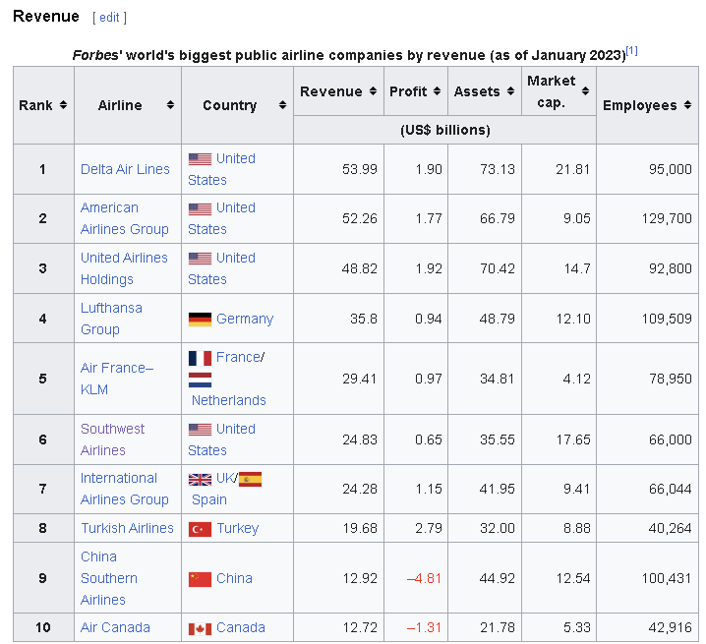
INTRODUCTION
Southwest Airlines was founded 56 years ago in 1967
Formerly known as Air Southwest
Largest low-cost carrier or low-cost airline as of April 2020 (WIKI)
Operates with low-cost carrier model
Budget, discount carrier
Lower fares
Reduced comfort

Slide 4
HYPOTHESIS
Number of Cancellations are directly proportional to number of flights
Did Covid affect Southwest Airlines' operations?
COVID WAS DETECTED LATE 2019, (webmd.com)
TRAVEL BAN WAS IMPLEMENTED MARCH 2020 BY TRUMP ADMINISTRATION, (webmd.com)
BAN LIFTED JUNE 2022 (theamericandream)
What preventative measures or policies do other companies for saving money have that Southwest airlines don’t?

Slide 5
DATA PROCESSING
DOWNLOAD .CSV DATASET FROM KAGGLE:
Flight Delay and Cancellation Dataset (2019-2023) (kaggle.com)
ORIGINALLY FROM BUREAU OF TRANSPORTATION STATISTICS
PRE-MERGED IN KAGGLE FROM 2019 JANUARY TO 2023 AUGUST
VARIABLES INCLUDE ORIGIN, DESTINATION, CANCELLATION REASONS, AND DELAYS IN MINUTES(VARYING).

Slide 6
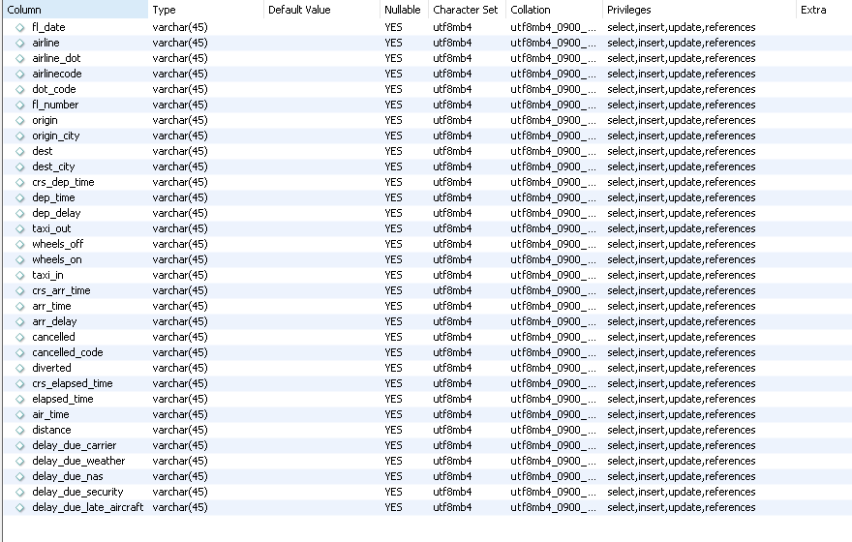
DATA PROCESSING
CREATE TABLE IN MYSQL WORKBENCH NAMED 'flightdata'

Slide 7
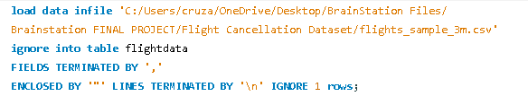
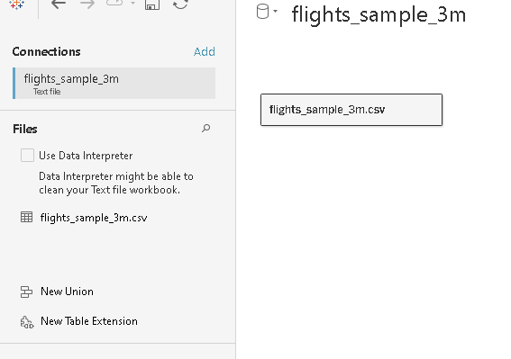
DATA PROCESSING
LOAD .CSV TO MYSQL USING COMMAND:
RESULT:
LOAD .CSV TO TABLAEU

Slide 8
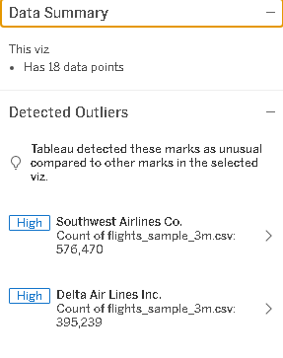
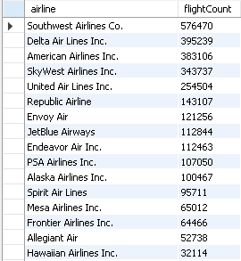
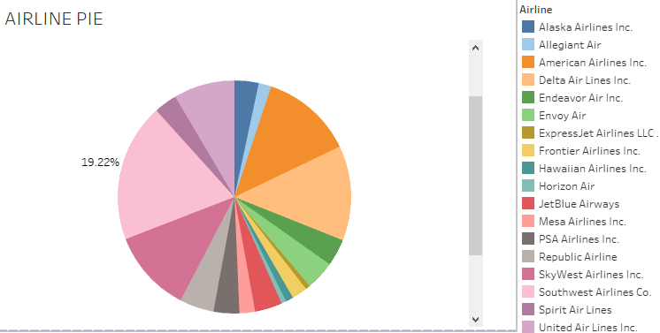
DETERMINING OUTLIERS OF DELAYS AND CANCELLATIONS

Slide 9
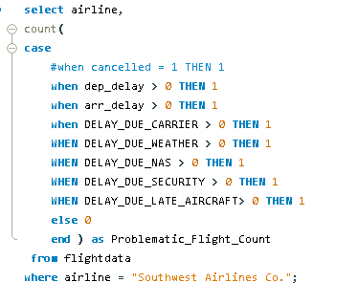
TALLY OF DELAYS/CANCELLATIONS

Slide 10

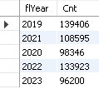
FLIGHT DELAYS/CANCELLATIONS PER YEAR

Slide 11

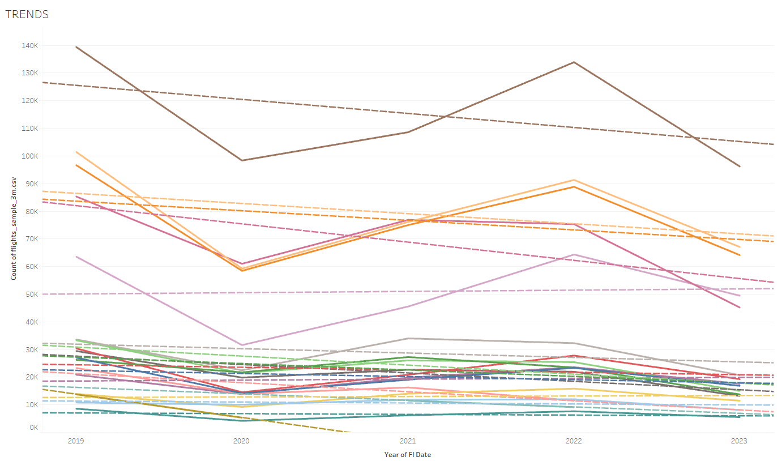
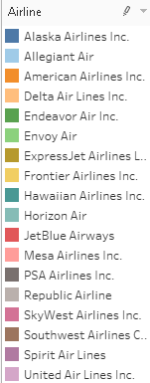




Slide 12
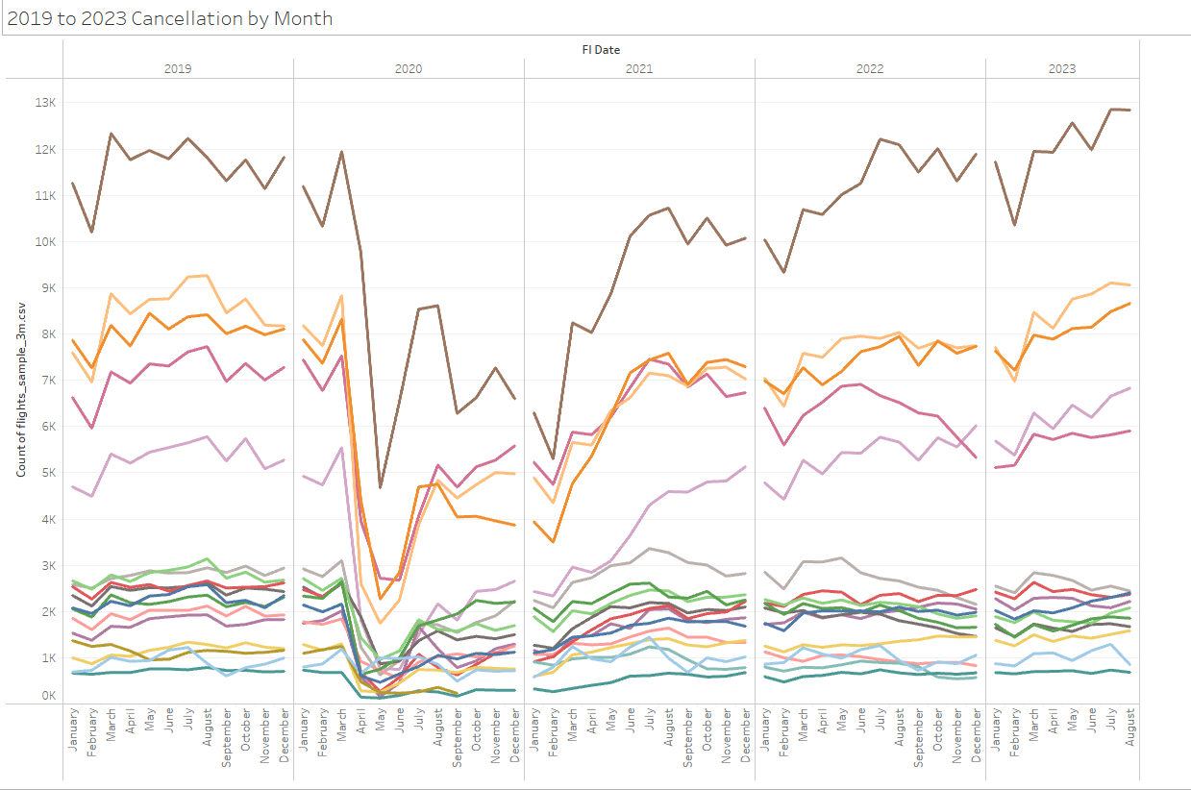
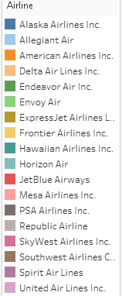

Slide 13
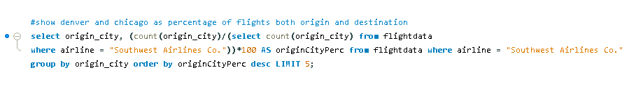
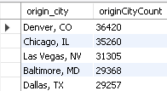
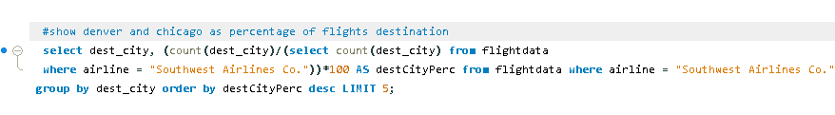
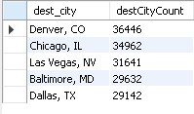
CITIES WITH THE MOST FLIGHT DELAYS/CANCELLATIONS
ORIGIN CITY
DESTINATION CITY

Slide 14
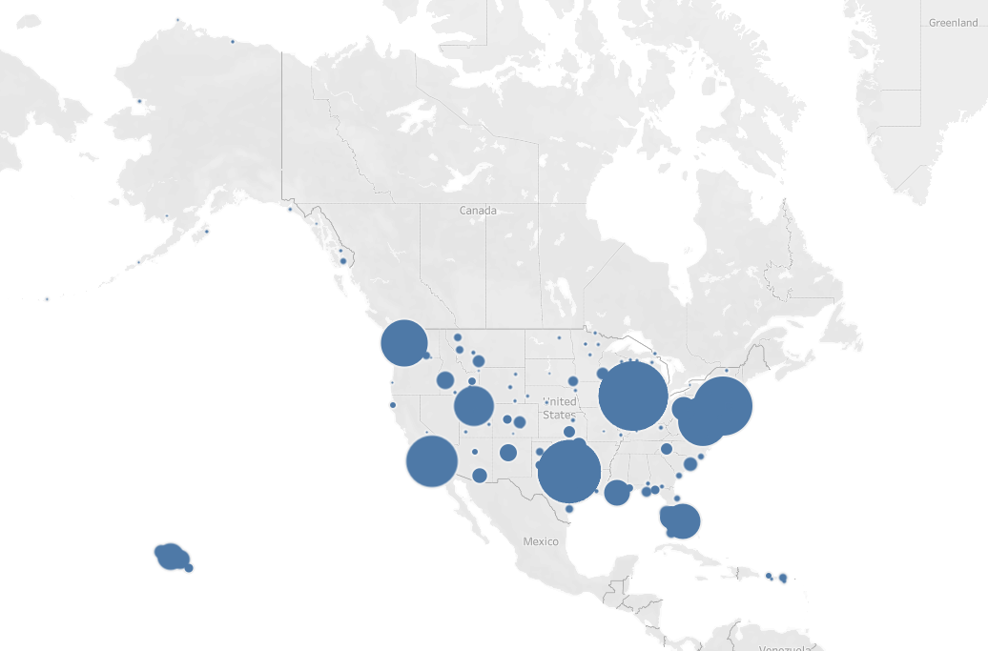
ORIGIN CITY

Slide 15
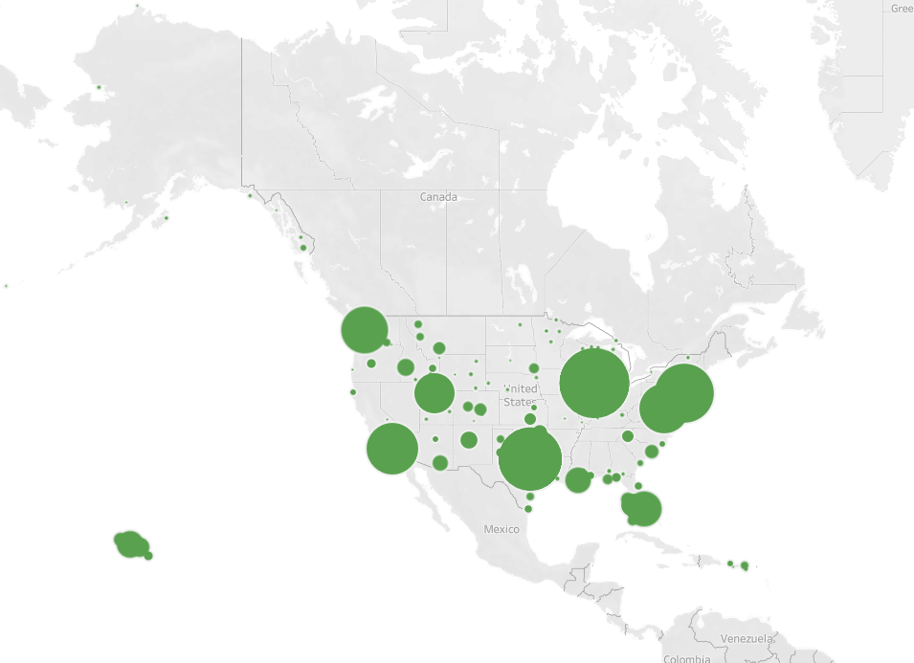
DESTINATION CITY

Slide 16
DERIVED INSIGHTS
NUMBER OF CANCELLATIONS AND DELAYS WERE AFFECTED BY THE START OF TRAVEL BAN IN 2020
THERE IS A NEGATIVE TREND OF CANCELLATIONS AND FLIGHT DELAYS FROM 2019 TO 2023
DENVER AND CHICAGO ARE THE CITIES MOST TRAVELLED TO AND FROM THAT HAVE DELAYS/CANCELLATIONS
ACCORDING TO THE CIRIUM, ON-TIME PERFORMANCE REVIEW 2022 REPORT, SOUTH-WEST SCORED AN OTP OF 74.06%, MAKING IT ONE OF THE TOP 5 MAINLINE AIRLINES IN THE N.A. REGION

Slide 17
CONCLUSION
COVID AFFECTED THE NUMBER OF FLIGHTS, BUT IMPROVED THE NUMBER OF CANCELLATIONS
SOUTHWEST AIRLINES IS LOSING REVENUE (6TH IN REVENUE AS OF JANUARY 2023) ACCORDING TO WIKI
STILL TOP 5 N.A. AIRLINE ACCORDING TO 2022 REPORT
SOUTHWEST AIRLINES HAS THE MOST NUMBER OF FLIGHTS FLOWN COMPARED TO OTHER AIRLINE COMPANIES

Slide 18
RECOMMENDATIONS
IMPROVE COMPANY POLICY BY CHARGING PENALTIES ON CUSTOMERS
IMPROVE AIRLINE OPERATIONS AND MAINTENANCE POLICIES
BETTER SCHEDULING PRACTICES
ADVANCED PLANNING
COLLABORATE/SHARE DATA WITH OTHER COMPANIES TO IMPROVE ON-TIME PERFORMANCE(OTP)

Slide 19
REFERENCES:
U.S. Department of Transportation - Air Travel Consumer Report: https://www.transportation.gov/airconsumer/air-travel-consumer-reports
FlightStats - Global Flight Tracker and Travel Planning: https://www.flightstats.com/
Flight Delays – What can be improved?: (25) Flight Delays: What can be improved? | LinkedIn
U.S. Passenger Carrier Delay Costs | Airlines For America
Coronavirus History: How Did Coronavirus Start? (webmd.com)
End of the US Travel Ban (the-american-dream.com)
Largest airlines in the world - Wikipedia

