Slide 1
GPSmaf
Develop an interface that allows selecting populations and time. The program will merge patterns that are too close based on the minor allele frequencies of the chosen populations. The results will be printed on the screen.
Arash Darzian

Slide 2
Methods
Data Collection and Preprocessing
Grouping of Samples
Calculation of Allele Frequencies
Feature Extraction and Clustering
Development of Interactive Web Application
Performance Evaluation

Slide 3
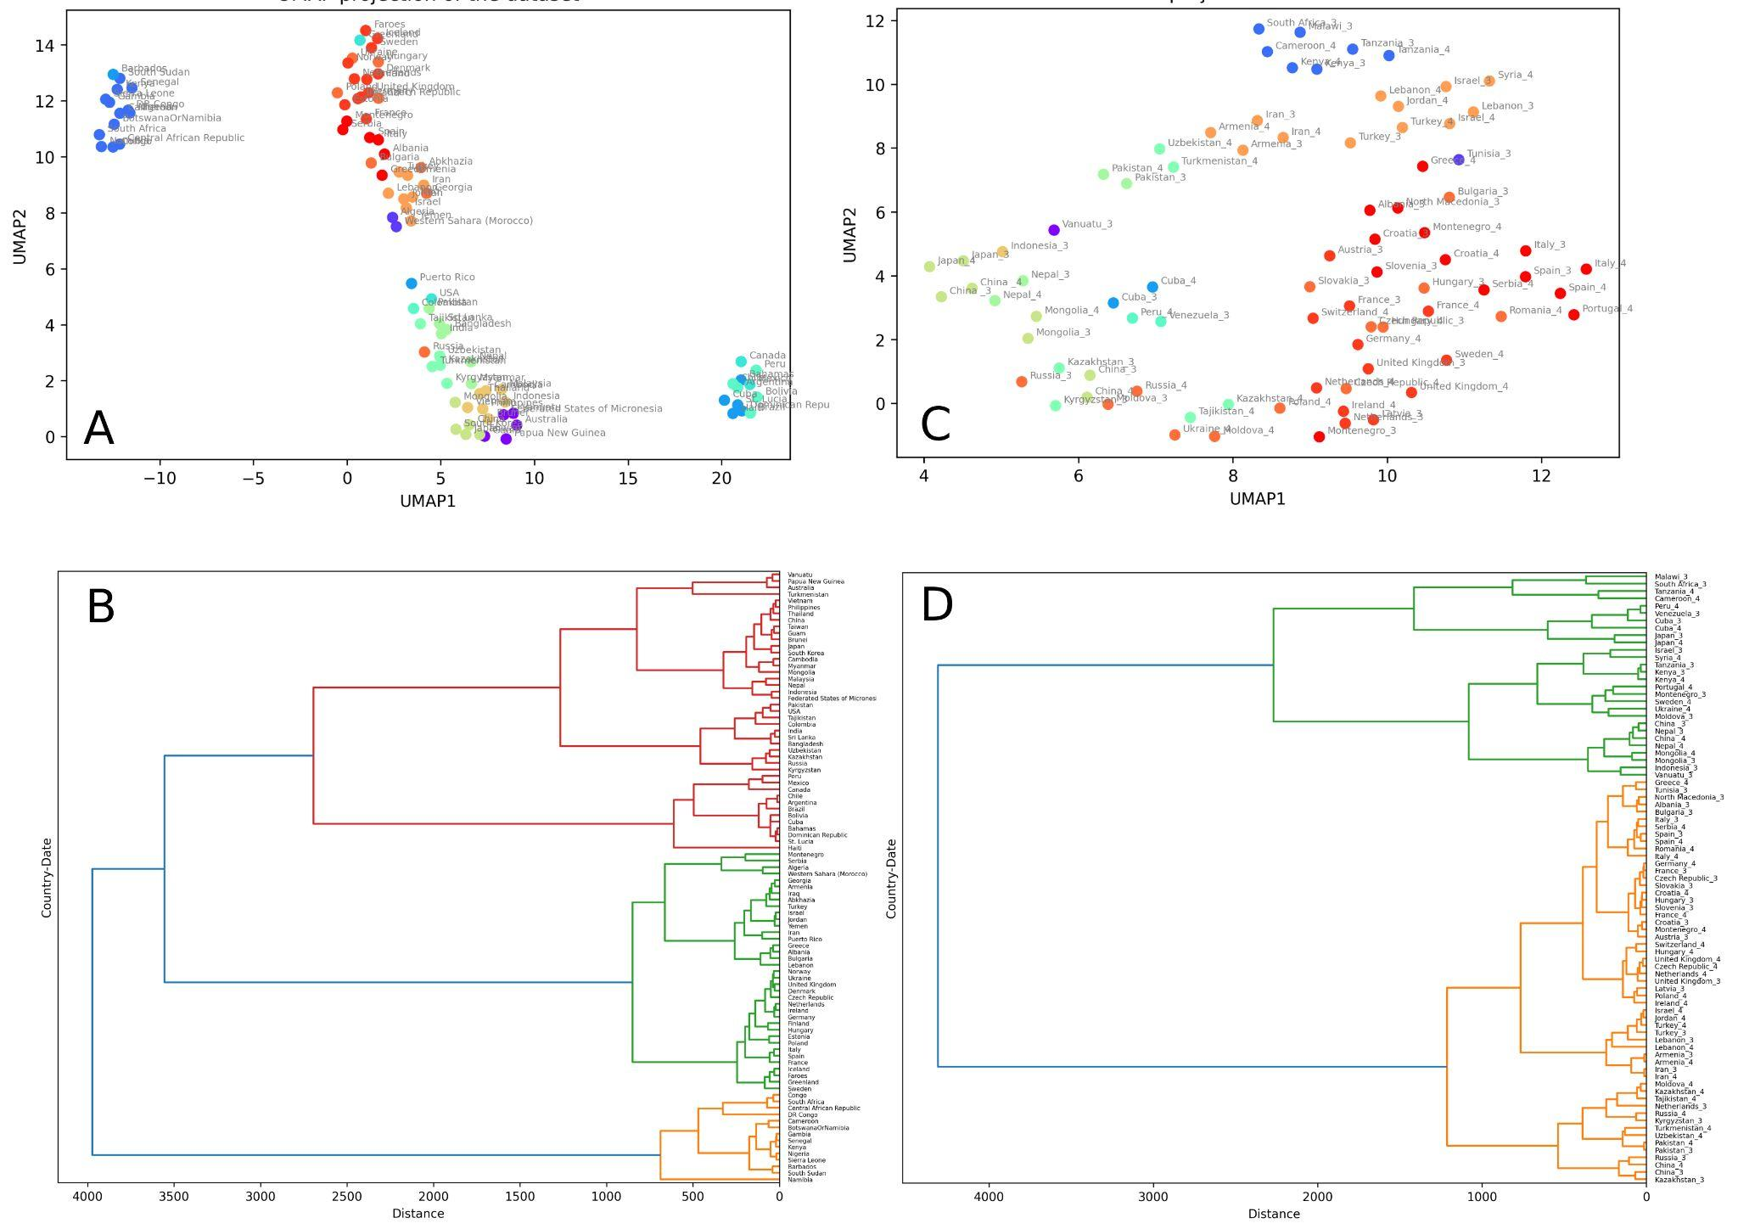
Results
https://gpsmaf.streamlit.app/

