Slide 1

Spot the Spot
- Predicting stable spot instance price
Project By – Anupam Bhattacharjee Aradhna Tiwari Pooja Giri Soumil Dhar

Slide 2
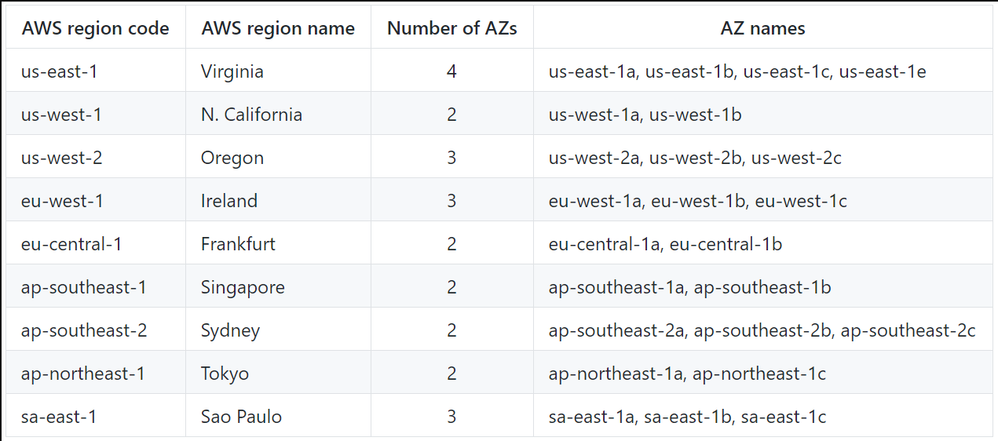
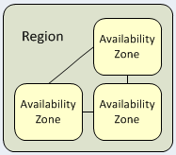
Amazon Web Services (AWS) is a comprehensive, evolving cloud computing platform provided by Amazon.com.
Collection of Remote Computing Services (web services) that together make up a cloud computing platform
Located in 9 geographical regions : Each region is wholly contained within a single country and all of its data stay within the designated Region.
Each region has multiple availability zones
These zones are data centers providing AWS
services
They are isolated from each other to prevent spreading between zones.
Amazon Web Services

Slide 3
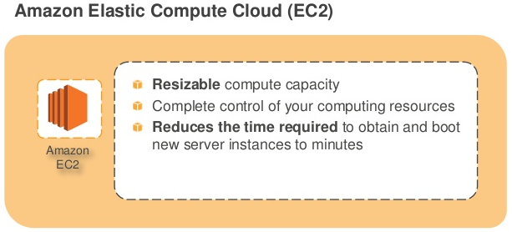
Amazon Elastic Compute Cloud
Amazon EC2 = Virtual Machine
Amazon EC2 : on-demand compute power
Obtain and boot new server instances in minutes.
Quickly scale capacity up or down
Servers from $0.02 (2 cents) per hour
On Demand, Reserved, and Spot Pricing
Key features:
Supports for Windows, Linux, FreeBSD and OpenSolaris.
Supports all majors web and application platforms.
Deploy across Availabilty Zones for reliability.
Monitors status and usage.

Slide 4
EC2 Instance Types
General Purpose:
provides a balance of compute, memory, and network resources, and it is a good choice for many applications
Example: M3
Computer Optimized:
optimized for compute-intensive workloads
Example: C3
Memory Optimized:
optimized for memory-intensive applications and offer lower price per GB of RAM
Example: R3
Storage Optimized:
provide Non-Volatile Memory Express (NVMe) SSD backed instance storage optimized for low latency, very high random I/O
Example: I3

Slide 5
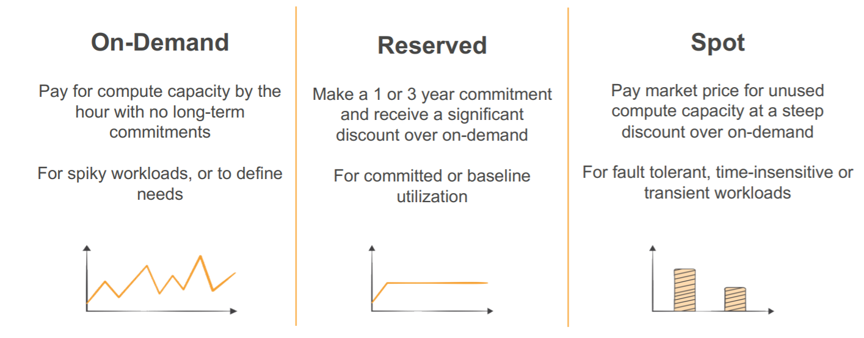
EC2 Price Types

Slide 6
Spot Instances - Working
Concept:
To use Spot Instances, you place a Spot Instance request specifying the maximum price you are willing to pay per instance hour.
If your maximum price bid exceeds the current Spot Price, your request is fulfilled and your instances will run until either you choose to terminate them or the Spot Price increases above your maximum price (whichever is sooner).
Pricing:
You will often pay less per hour than your maximum bid price. Amazon EC2 adjusts the Spot Price periodically as requests come in and available supply changes. Everyone pays that same Spot Price for that period regardless of whether their maximum bid price was higher. You will never pay more than your maximum bid price per hour.
If you’re running Spot Instances and your maximum price no longer meets or exceeds the current Spot Price, your instances will be terminated. This means that you will want to make sure that your workloads and applications are flexible enough to take advantage of this opportunistic capacity.
Spot Instance Requests can be one-time or persistent. A one-time request will only be satisfied once; a persistent request is eligible for consideration again after the associated Spot Instance is terminated.

Slide 7
WHY ?
AWS ec2 Spot Market
The ec2 spot market fluctuates based on the supply and demand for ec2 instances.
We can save a lot of money by analyzing the market and using more computing resources when they’re cheap.
Spot instances are available at up to 90% discount compared to On-demand instances.
Instance Type | On-Demand ($) | Spot ($)
m4.large | 0.126 | 0.0147
m4.xlarge | 0.252 | 0.0289
m4.2xlarge | 0.504 | 0.0531
m4.4xlarge | 1.008 | 0.1155
m4.10xlarge | 2.52 | 0.2863

Slide 8
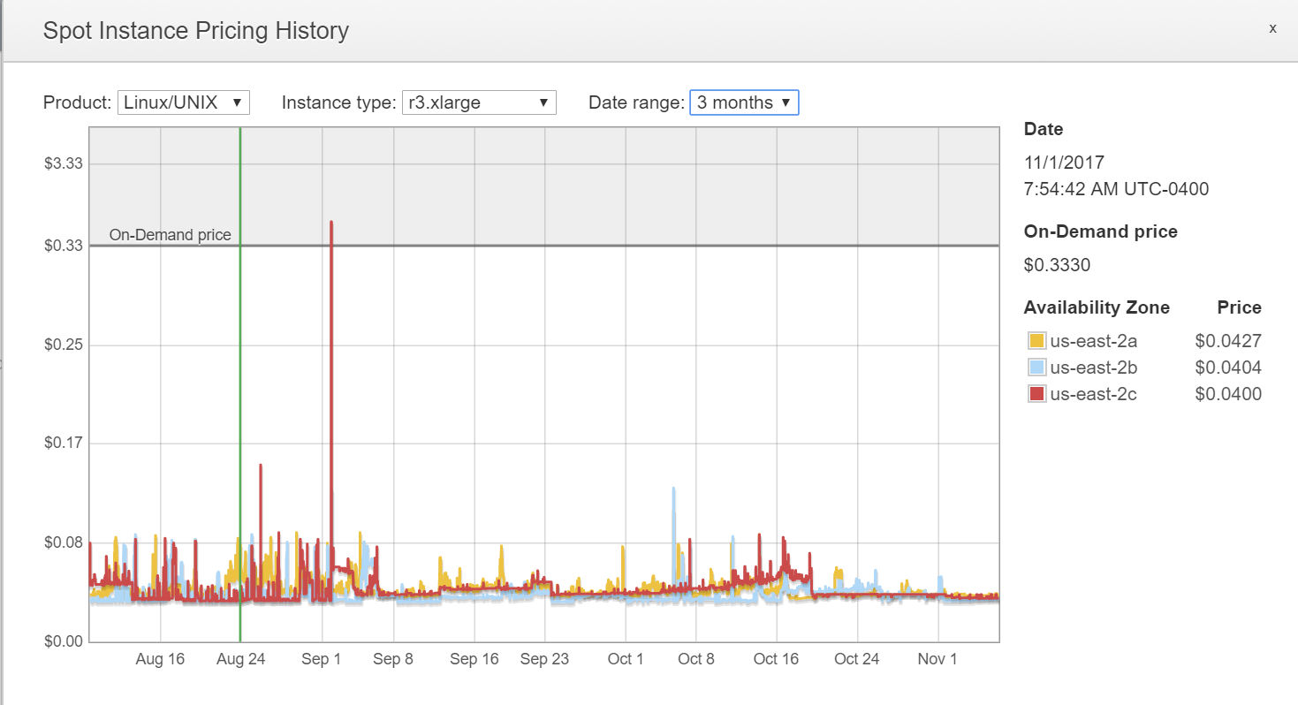
AWS Spot Market Trend

Slide 9
Objective
Prediction of a stable spot bidding price range for the next 24 hours for a given instance type, availability zone, product description and execution duration.

Slide 10
Getting the data
Pre-requisites:
- AWS Account
- AWS CLI Package
Amazon CLI [Command line interface] It is a unified tool to access AWS services from command line and automate them through scripts.
We fetched data using DESCRIBE-SPOT-PRICE-HISTORY API (AWS CLI)
DESCRIBE-SPOT-PRICE-HISTORY is one of the AWS API that returns the spot price history upto 90 days of data.
This API provides different filters :
- availibilty zone - instance type
- product description
- spot price
- time stamp

Slide 11
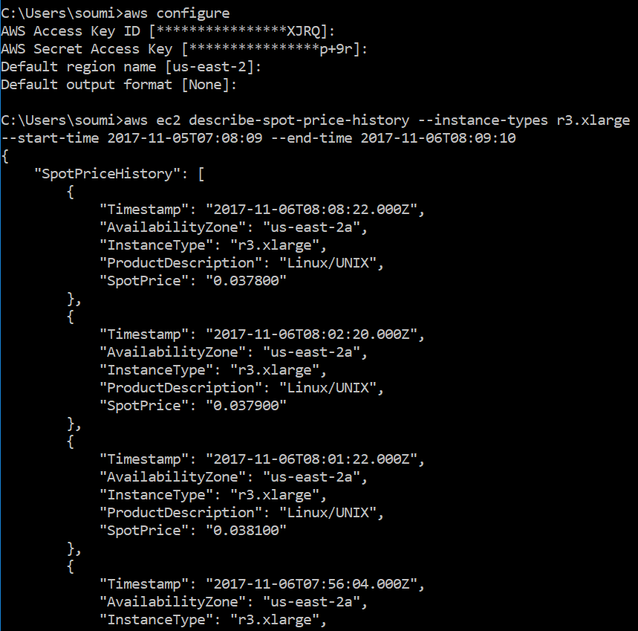

Slide 12
Getting the data in R
No packages available for fetching data through aws describe-spot-price-history api.
In order to hit this API indirectly, we used the command prompt using system() function in R.
The data fetched is in JSON format
We then converted into a data frame for our further analysis
The data varies with small and irregular intervals of time.
Data Cleaning

Slide 13
Data Cleaning
To start with the data exploratory analysis, we included the following for data cleaning:
Extracted the date and day of the week from timestamp.
Categorized the timestamps having irregular intervals into the quarters of the day, as depicted in the table below:
Finally, we chose maximum spot price against the categorical data.
Categories | Time Range
Morning = 1 | 05:00 – 12:00
Afternoon = 2 | 12:00 – 17:00
Evening = 3 | 17:00 – 21:00
Night = 4 | 21:00 – 05:00

Slide 14
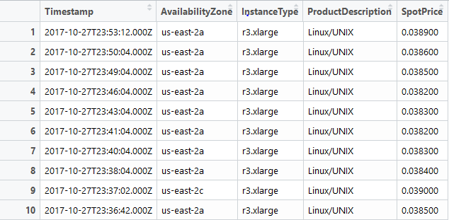
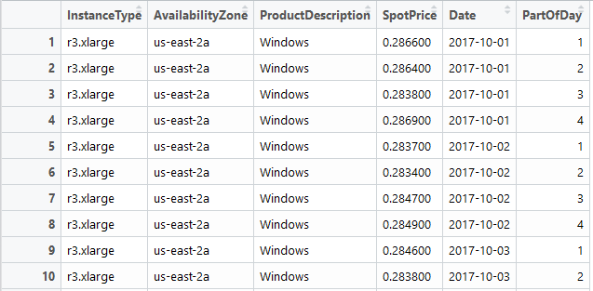
Data Cleaning
Before
After

Slide 15
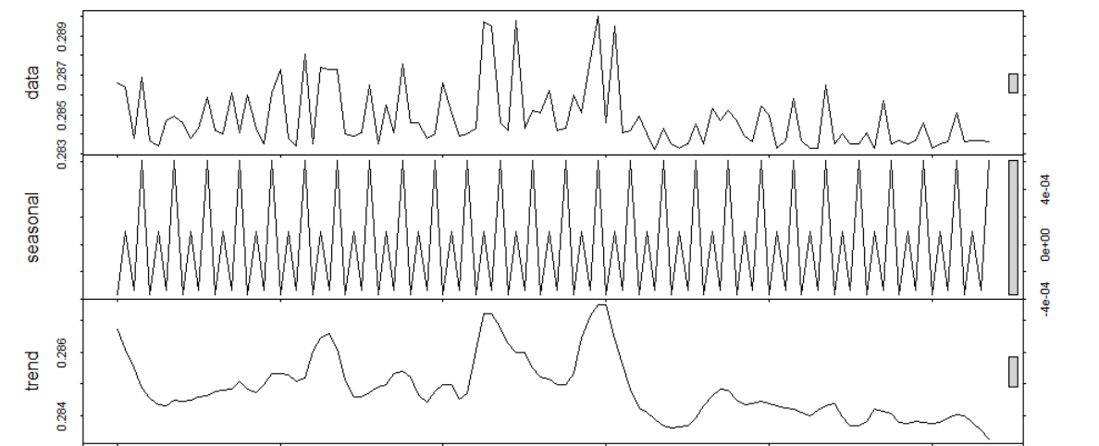
Time Series
Fixing the instance type ,availability zone and product description , the dependent variable Spot Price Bid varies with time making it a time series problem.
Instance type, availability zone and product description are categorical variables which is used to filter the dataset.
We categorize a day into 4 quarters, Morning, Afternoon, Evening and Night. It is intuitive that the demand would differ in different timings of the day (broadly classified above) and also in different days of the week. (Seasonality)

Slide 16
Time Series Analysis- Introduction to Models
Implemented 4 models considering the seasonality of the time series:
Holt Winters:
Holt's model captured level and trend.
Winter's model improved the Holt's model by adding seasonality, this came to be known as the Triple Exponential Smoothing or Holt-Winter's Model
Seasonal Naïve:
The seasonal naïve method accounts for seasonality by setting each prediction to be equal to the last observed value of the same season. For example, the prediction value for today’s spot price will be equal to the previous day’s spot price.
ARIMA:
ARIMA is an acronym that stands for AutoRegressive Integrated Moving Average which extends ARMA model in order to make the time series stationary. It makes use of differencing of raw observations i.e. subtracting an observation from an observation at the previous time step.
Seasonal ARIMA:
SARIMA is an acronym that stands for Seasonal AutoRegressive Integrated Moving Average. The model extends the ARIMA model to introduce the seasonality parameter.

Slide 17
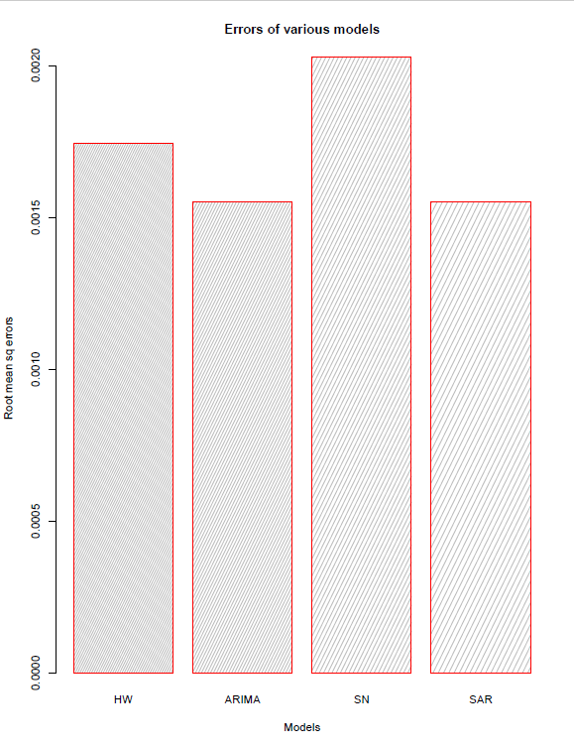
Time Series Analysis- Comparing the Models
We compare the models based on the root mean square error(RMSE) value which defines the accuracy.
A model with minimum RMSE value is considered to be the best.
The figure below depicts this value against the 4 models being used:

Slide 18
DEMO

Slide 19
Future Enhancements
Extending the prediction feature to predict the price for up to 10 days.
Expanding the scope to include spot price range with respect to availability zones.
Enhancing the visual aspects of app.
Achieve higher accuracy by using different models or mixed modelling.

Slide 20
Questions??

Slide 21
THANK
YOU

