Slide 1
Mini Project: Predict Factors Influencing Sales
Sales and Profit Analysis using Python Libraries

Slide 2
Project Objectives
Analyze sales trends
Analyze profit trends
Find highest sales category
Find highest profit region
Analyze sales vs profit relationship
Generate business insights

Slide 3
Python Libraries Used
Pandas
NumPy
Matplotlib
Seaborn
python-pptx

Slide 4
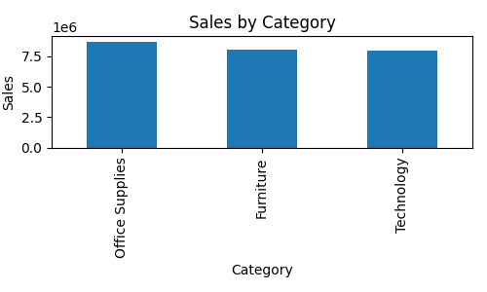
Highest Sales Category

Slide 5
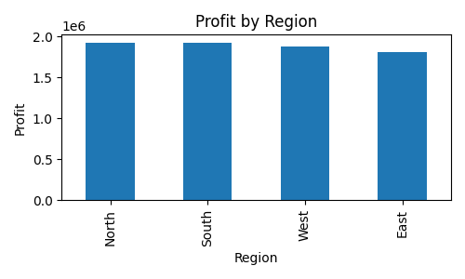
Highest Profit Region

Slide 6
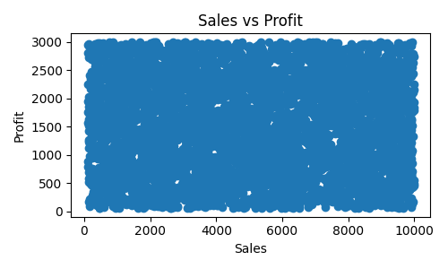
Sales vs Profit Relationship

Slide 7
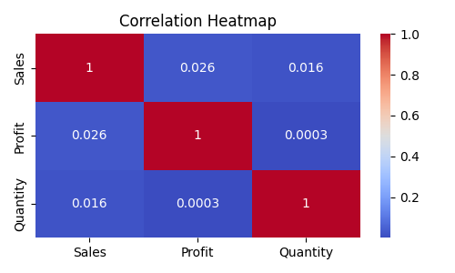
Correlation Heatmap

Slide 8
Business Insights
Office Supplies category has the highest sales.
North region generates the highest profit.
Sales and Profit show weak positive correlation.
Higher sales do not always guarantee higher profit.
Businesses should focus on profitable regions and products.

Slide 9
Conclusion
This project analyzed sales data using Python libraries to identify sales trends, profit trends, category performance, regional performance, and variable correlations.

