Slide 1
A 3–6 month fear unwind needs earnings to hold
Team thesis: safety-related fears fade as the next 1–2 reports confirm optical demand and execution.
Valuation reference | Price | Vs. Sept 17 close | Interpretation
Sept 14 shock close | $835 | -6.6% | Observed price; essay causality not established
Sept 17 reference close | $894 | — | Frozen entry comparison
Pre-event close: Sept 11 | $927 | 3.7% | Pure price-recovery benchmark
Analyst average target | $1,149 | 28.6% | 12-month cross-check; needs more than pure unwind
63.7% of the event-day dollar drop had already recovered by the reference close.
A $1,149 target requires an additional 23.9% beyond the pre-event price.
Sources: S1, S3, S4, S16 | AI: source extraction, model and slides; team review pending.
1
Notes:
This is the user-directed thesis, not a causal conclusion. Distinguish the observed event-price recovery from additional upside to a 12-month analyst benchmark. Use the dated reference close consistently; do not claim it is live. The independent DCF is below the current price under the required conservative assumptions.
Source URLs:
S1 https://investor.lumentum.com/financial-news-releases/news-details/2026/Lumentum-Announces-Fourth-Quarter-and-Full-Fiscal-Year-2026-Results/default.aspx
S3 https://stockanalysis.com/stocks/lite/history/
S4 https://stockanalysis.com/stocks/lite/forecast/
S16 https://darioamodei.com/post/we-must-pace-the-frontier

Slide 2
Operating upside is explicit; the ramp and margins fade
Five years capture the ramp, then five years normalize growth and margins before terminal value.
Driver | Bull assumption / path | Source or logic
Revenue by end market | Cloud + Industrial; FY27 6,652m | Base FY27/28: $6.32bn / $9.61bn [S4]; former split estimated
EML / 1.6T / OCS | EML +1–3%; mix +2–5%; OCS +$150m → $1.49bn | LITE-specific incremental revenue; explicit team estimates
Adjusted EBIT margin | 40.75% FY27 → 42.5% peak → 25% terminal | Sourcing adds up to 150bp, then fades; peer margin bracket
SBC / cash tax | 4.5% of sales / 20% | SBC remains an economic cost; tax above FY26 adjusted rate
D&A / capex / NWC | D&A 4→5.5%; capex 13→6%; NWC 18% | Depreciation only; capex exceeds terminal depreciation
Long-run growth / exit | 3% g / 16× economic EBITDA | Below ~4% nominal GDP; mature multiple, not current peer peak
Capital / timing | Treasury options; June capital; FY27 stub | Cash principal + net conversion shares; no double counting
Sources: S1, S2, S4, S5, S11, S12 | AI: source extraction, model and slides; team review pending.
2
Notes:
All drivers are in the Assumptions sheet. FY26 former-segment allocation is estimated because LITE reorganized to one segment and reports Components / Systems products. EML and 1.6T percentages are revenue uplift proxies, not reported market share. OCS is incremental to Base, not total disclosed OCS revenue. Tax and valuation assumptions do not improve in Bull.
Source URLs:
S1 https://investor.lumentum.com/financial-news-releases/news-details/2026/Lumentum-Announces-Fourth-Quarter-and-Full-Fiscal-Year-2026-Results/default.aspx
S2 https://www.sec.gov/Archives/edgar/data/1633978/000162828026057358/lite-20260627.htm
S4 https://stockanalysis.com/stocks/lite/forecast/
S5 https://investor.lumentum.com/financial-news-releases/news-details/2025/Lumentum-Announces-Fourth-Quarter-and-Full-Fiscal-Year-2025-Results/
S11 https://www.sec.gov/Archives/edgar/data/820318/000119312526346860/d128030dex991.htm
S12 https://investor.marvell.com/news-events/press-releases/detail/1031/marvell-technology-inc-reports-second-quarter-of-fiscal-year-2027-financial-results

Slide 3
Full unlevered cash-flow build: FY2027–2031
USD millions. Economic EBIT retains recurring stock compensation; acquired amortization is not added twice.
USD m | 2027 | 2028 | 2029 | 2030 | 2031
Cloud / Networking | 6,391 | 10,054 | 13,482 | 16,776 | 19,674
Industrial Tech | 261 | 276 | 293 | 310 | 329
Revenue | 6,652 | 10,330 | 13,775 | 17,087 | 20,004
Adjusted EBIT | 2,711 | 4,390 | 5,854 | 7,091 | 7,901
Less SBC / payroll | -299 | -465 | -620 | -769 | -900
Economic EBIT | 2,411 | 3,925 | 5,235 | 6,322 | 7,001
Less cash tax | -482 | -785 | -1,047 | -1,264 | -1,400
NOPAT | 1,929 | 3,140 | 4,188 | 5,058 | 5,601
Add D&A | 266 | 465 | 689 | 940 | 1,100
Less capex | -865 | -1,136 | -1,309 | -1,367 | -1,500
Less ΔNWC | -644 | -662 | -620 | -596 | -525
Unlevered FCF | 686 | 1,807 | 2,948 | 4,034 | 4,676
Sources: S1, S2, S4 | AI: source extraction, model and slides; team review pending.
3
Notes:
Forecast outputs are model assumptions. D&A means depreciation-only add-back because the adjusted EBIT starting point already removes acquired amortization. Every projected year, including FY32–36, is visible in Excel. FY27 is a full-year operating forecast; its DCF cash flow is then multiplied by the remaining-year fraction.
Source URLs:
S1 https://investor.lumentum.com/financial-news-releases/news-details/2026/Lumentum-Announces-Fourth-Quarter-and-Full-Fiscal-Year-2026-Results/default.aspx
S2 https://www.sec.gov/Archives/edgar/data/1633978/000162828026057358/lite-20260627.htm
S4 https://stockanalysis.com/stocks/lite/forecast/

Slide 4
WACC comes from risk components, not the price target
Primary WACC 13.97%; identical across Bear / Base / Bull. Own-beta cross-check: 11.86%.
Component | Value | Basis
Risk-free rate | 4.94% | Sept 17 US 10-year Treasury
Equity risk premium | 4.50% | Above 4.14% observed implied ERP
Peer unlevered beta | 2.01 | Median COHR / MRVL / FN
Relevered LITE beta | 2.01 | Market weights; economic capital structure
Cost of equity | 13.98% | Rf + beta × ERP
Pretax cost of debt | 7.44% | Rf + assumed 250bp credit spread
Debt / equity weights | 0.10% / 99.90% | In-money notes treated as equity equivalents
WACC | 13.97% | Ke × E/V + Kd × (1−tax) × D/V
Peer | Raw beta | Unlevered
COHR | 2.10 | 2.01
MRVL | 2.25 | 2.21
FN | 1.21 | 1.21
Conservative choices:
ERP above observed; peer beta above LITE’s 1.54; terminal growth 3%.
No lower discount rate in Bull.
Sources: S6, S7, S8, S9, S10, S15 | AI: source extraction, model and slides; team review pending.
4
Notes:
Market-value peer debt/equity used for unlevering; 25% common peer tax proxy. Relever at LITE economic capital structure. In-money notes are treated as equity equivalents in WACC and valuation, while contractual cash principal is included in the liquidity test. Cost of debt is marginal risk-free plus spread, not the low convertible coupon.
Source URLs:
S6 https://home.treasury.gov/resource-center/data-chart-center/interest-rates/TextView?type=daily_treasury_yield_curve&field_tdr_date_value=2026
S7 https://pages.stern.nyu.edu/adamodar/New_Home_Page/home.htm
S8 https://stockanalysis.com/stocks/cohr/statistics/
S9 https://stockanalysis.com/stocks/mrvl/statistics/
S10 https://stockanalysis.com/stocks/fn/statistics/
S15 https://stockanalysis.com/stocks/lite/statistics/

Slide 5
Terminal value uses a mature margin, under both methods
FY2036 adjusted EBIT margin 25%; economic EBIT margin 20.5% after recurring SBC.
Bull terminal / DCF metric | Gordon growth | Exit multiple
Long-run assumption | 3.0% growth | 16.0× EBITDA
Normalized terminal FCF / EBITDA | 4,311m | 7,078m
Terminal value, undiscounted | 39,284m | 113,242m
PV terminal value | 10,945m | 31,551m
PV explicit cash flows | 17,624m | 17,624m
Enterprise value | 28,569m | 49,175m
TV AS % OF EV | 38.3% | 64.2%
No perpetual peak margin
42.5% peak → 25% terminal.
Peer context: COHR 21.8%; MRVL 36.6% adjusted margins.
Gordon implies only 5.6× terminal EBITDA.
Sources: S1, S2, S11, S12 | AI: source extraction, model and slides; team review pending.
5
Notes:
Gordon normalizes FY2037 working-capital investment at 3% growth. Exit applies 16 times FY2036 economic EBITDA after SBC, not non-GAAP EBITDA before SBC. Both terminal values are discounted to September 18. The exit method is more generous than Gordon; do not average them automatically.
Source URLs:
S1 https://investor.lumentum.com/financial-news-releases/news-details/2026/Lumentum-Announces-Fourth-Quarter-and-Full-Fiscal-Year-2026-Results/default.aspx
S2 https://www.sec.gov/Archives/edgar/data/1633978/000162828026057358/lite-20260627.htm
S11 https://www.sec.gov/Archives/edgar/data/820318/000119312526346860/d128030dex991.htm
S12 https://investor.marvell.com/news-events/press-releases/detail/1031/marvell-technology-inc-reports-second-quarter-of-fiscal-year-2027-financial-results

Slide 6
The per-share bridge exposes the valuation gap
Cash principal is deducted; only net conversion-premium shares enter the denominator.
USD m, except shares / prices | Gordon | Exit
Enterprise value | 28,569 | 49,175
Add cash / short-term investments | 2,738 | 2,738
Less debt principal | -1,647 | -1,647
Less minority / senior preferred | 0 / 0 | 0 / 0
Equity after cash principal | 29,660 | 50,266
Core + net conversion shares | 98.77m | 100.83m
Value per share | $300 | $499
Upside / downside vs $894 | -66.4% | -44.2%
Interpretation
The operating Bull case is not enough to support today’s price under these conservative valuation assumptions.
A sentiment rebound is possible; it is not a DCF-derived target.
Sources: S2, S3 | AI: source extraction, model and slides; team review pending.
6
Notes:
Preferred participates one-for-one and has no senior liquidation claim; include shares, not a separate $2bn deduction. Options use 0.2m shares and $8.10 strike via treasury method at reference price. Full RSUs 2m and PSUs 0.8m included at target payout. Capped-call benefit excluded. Both cases below are standalone DCF values, not a forced recovery target.
Source URLs:
S2 https://www.sec.gov/Archives/edgar/data/1633978/000162828026057358/lite-20260627.htm
S3 https://stockanalysis.com/stocks/lite/history/

Slide 7
Sensitivity: neither terminal convention hides the risk
Bull cash flows; blue-axis inputs are editable in Excel. Values shown are dollars per share.
Gordon growth
Exit EBITDA multiple
WACC / g | 2.0% | 2.5% | 3.0% | 3.5% | 4.0%
11.97% | $350 | $357 | $365 | $374 | $384
12.97% | $318 | $324 | $330 | $336 | $343
13.97% | $292 | $296 | $300 | $305 | $311
14.97% | $269 | $272 | $276 | $280 | $284
15.97% | $250 | $252 | $255 | $258 | $261
WACC / exit | 12× | 14× | 16× | 18× | 20×
11.97% | $483 | $528 | $573 | $618 | $663
12.97% | $451 | $493 | $534 | $575 | $617
13.97% | $423 | $461 | $499 | $536 | $574
14.97% | $396 | $431 | $466 | $501 | $536
15.97% | $372 | $404 | $436 | $468 | $500
Discount-rate normalization alone must be justified independently. The model does not reduce WACC merely to reproduce an analyst price target.
Sources: S1, S2, S6, S7 | AI: source extraction, model and slides; team review pending.
7
Notes:
Central row uses exact component WACC. Gordon grid recalculates terminal FCF for each g; exit grid applies mature EBITDA multiples. Both use the full capital bridge including conversion regimes. These values are alternatives, not additive.
Source URLs:
S1 https://investor.lumentum.com/financial-news-releases/news-details/2026/Lumentum-Announces-Fourth-Quarter-and-Full-Fiscal-Year-2026-Results/default.aspx
S2 https://www.sec.gov/Archives/edgar/data/1633978/000162828026057358/lite-20260627.htm
S6 https://home.treasury.gov/resource-center/data-chart-center/interest-rates/TextView?type=daily_treasury_yield_curve&field_tdr_date_value=2026
S7 https://pages.stern.nyu.edu/adamodar/New_Home_Page/home.htm

Slide 8
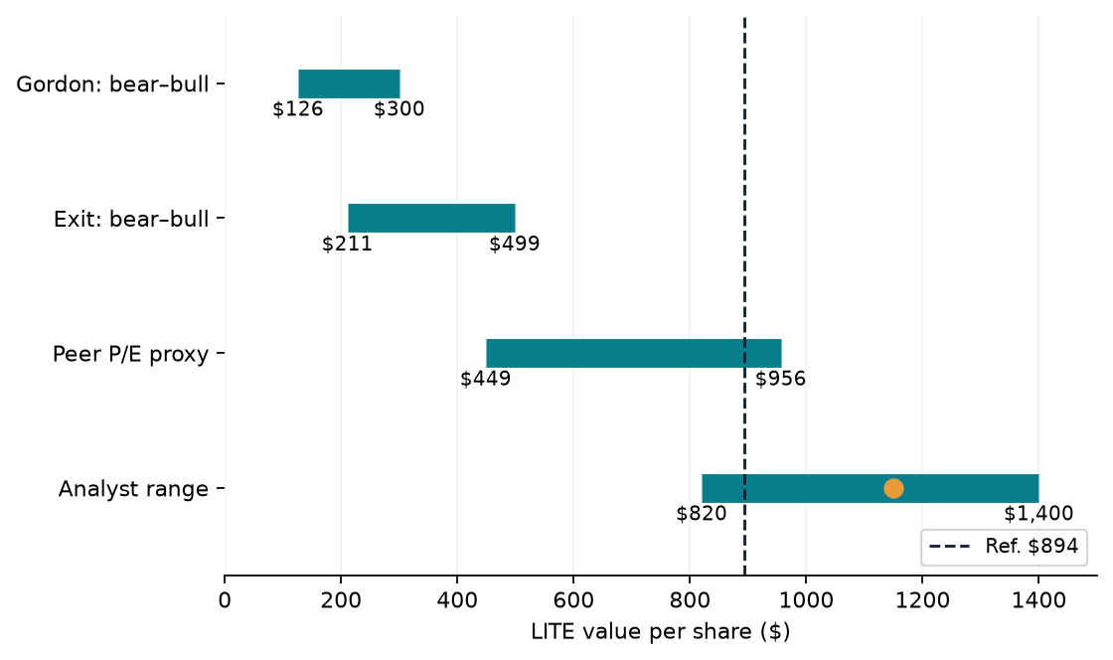
Cross-checks distinguish intrinsic value from a recovery trade
The analyst average is a 12-month benchmark; our proposed catalyst window is 3–6 months.
Peer | EV / EBITDA | Fwd P/E
COHR | 41.9× | 31.4×
MRVL | 74.6× | 44.1×
FN | 24.1× | 20.7×
Peer P/E × $21.67 LITE EPS:
$449–$956
Indicative, not a like-for-like target.
Sources: S3, S4, S8, S9, S10 | AI: source extraction, model and slides; team review pending.
8
Notes:
Football field is a range display, not a probability distribution. Peer P/E range uses vendor forward multiples times LITE FY27 consensus adjusted EPS $21.67; NTM/fiscal-period mismatch limits comparability. Peer EV/EBITDA values are current trailing vendor proxies, not terminal assumptions. Analysts may use different growth, margins and discount rates.
Source URLs:
S3 https://stockanalysis.com/stocks/lite/history/
S4 https://stockanalysis.com/stocks/lite/forecast/
S8 https://stockanalysis.com/stocks/cohr/statistics/
S9 https://stockanalysis.com/stocks/mrvl/statistics/
S10 https://stockanalysis.com/stocks/fn/statistics/

Slide 9
Bear / Base / Bull: operating survival is not an equity floor
Only operating execution varies; common WACC, tax, terminal growth, terminal margin and exit multiple.
USD m except per share | Bear | Base | Bull
FY27 revenue | 5,600 | 6,320 | 6,652
FY27 uFCF | 184 | 655 | 686
FY31 revenue | 9,036 | 17,528 | 20,004
Gordon value | $126 | $268 | $300
Exit value | $211 | $448 | $499
Gordon return | -85.9% | -70.0% | -66.4%
Bear cash remains positive
Minimum modeled year-end cash / investments:
$2.70bn
All principal funded; no buybacks or acquisitions assumed.
Invalidate the trade if orders slip, utilization weakens or the next guidance cannot support continuing execution.
Sources: S1, S2, S4 | AI: source extraction, model and slides; team review pending.
9
Notes:
Bear is not an insolvency scenario. Economic FCF remains positive and a simplified annual liquidity schedule pays all debt principal with no new financing. It does not establish intraperiod liquidity, covenant compliance or a share-price floor. A larger share-price downside is retained rather than artificially truncating the bear.
Source URLs:
S1 https://investor.lumentum.com/financial-news-releases/news-details/2026/Lumentum-Announces-Fourth-Quarter-and-Full-Fiscal-Year-2026-Results/default.aspx
S2 https://www.sec.gov/Archives/edgar/data/1633978/000162828026057358/lite-20260627.htm
S4 https://stockanalysis.com/stocks/lite/forecast/

Slide 10
Reverse DCF: what must be true at today’s price?
Conditional market-implied paths expose the gap between a near-term fear unwind and long-term valuation.
At $894 | Required outcome | Meaning
Growth-only solve | 59.5% Cloud CAGR | FY28–31; fade to 3% by FY36
Implied FY31 revenue | $41.7bn | vs Bull $20.0bn
Implied FY31 capex | $3.1bn | Explicit funding burden, not costless growth
Margin-only solve | 171.4% | Above 100%: economically infeasible
Price-implied discount rate | 6.6% | Below independent 14.0% WACC
Capex supports continuity
Meta: $130–145bn CY2026 guide.
Amazon: $169bn TTM net PPE, +64%.
These support spending today; they do not prove the market-implied decade of LITE growth.
Defend the 3–6 month rebound as a conditional sentiment trade; the conservative DCF does not certify today’s price as cheap.
Sources: S1, S2, S3, S13, S14 | AI: source extraction, model and slides; team review pending.
10
Notes:
Growth solve fixes FY27 Bull sales, solves FY28–31 Cloud CAGR and fades that growth to 3% over FY32–36. Margins use Bull path ending at 25%. Margin solve fixes Bull revenue and solves FY28–31 margin, fading to 25% thereafter. Capex flexes with sales. This is not an assertion of a single investor consensus. Price-implied rates are diagnostic and differ from independent WACC. Meta guidance and Amazon TTM spending periods differ; do not add them.
Source URLs:
S1 https://investor.lumentum.com/financial-news-releases/news-details/2026/Lumentum-Announces-Fourth-Quarter-and-Full-Fiscal-Year-2026-Results/default.aspx
S2 https://www.sec.gov/Archives/edgar/data/1633978/000162828026057358/lite-20260627.htm
S3 https://stockanalysis.com/stocks/lite/history/
S13 https://investor.atmeta.com/investor-news/press-release-details/2026/Meta-Reports-Second-Quarter-2026-Results/default.aspx
S14 https://ir.aboutamazon.com/news-release/news-release-details/2026/Amazon-com-Announces-Second-Quarter-Results/default.aspx

