Slide 1
ASSIGNMENT
Submitted By: Aradhya Raj Mehra

Slide 2
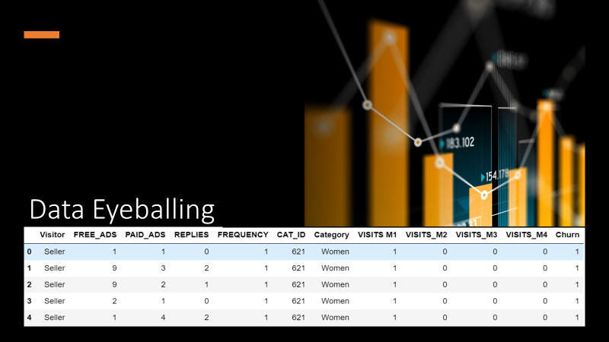

Slide 3
Data Dictionary
Column name | Description
ENCRPTD_USER_ID | USER_ID (unique number per visitor, encrypted)
FREE_ADS | NUMBER OF FREE ADS PLACED (no fee paid to EasyHome)
PAID_ADS | NUMBER OF PAID ADS PLACES (fee paid to EasyHome)
REPLIES | NUMBER OF ADS THE USER REPLIED ON (sent a question to the seller, or placed a bid)
VISITS | NUMBER OF VISITS IN THIS 28 DAYS
FREQUENCY | NUMBER OF UNIQUE DAYS VISITED LAST 28 DAYS (min 1, max 28)
CAT_ID | FAVORITE CATEGORY (ID, not always available, based on categories visited)
VISITS_M2 | NUMBER OF VISITS IN MONTH +1
VISITS_M3 | NUMBER OF VISITS IN MONTH +2
VISITS_M4 | NUMBER OF VISITS IN MONTH +3

Slide 4

Questions
Marketing Opportunities
What type of visitors should we aim for to increase our number of visits, and why?
Where would you suggest Marketing could take actions to grow from 5% YoY to 8% YoY?
Any other insights that might be interesting to inspire the Marketing team with.
Competitive Landscape
Conceptual cohort analysis and follow ups

Slide 5

Question 1
Marketing Opportunities

Slide 6

What type of visitors should the company aim for to increase the number of visits, and why?

Slide 7

There were around 77% sellers and only 23% buyers that were present in the first month. This figure goes down as the month keeps changing.

Slide 8
The number of users are max in Hobby, DIY Home.

Slide 10

92% of categories have more sellers than the potential buyers

Slide 11
The churn is most in categories like DIY HOME, Tickets, Children and Hobby which can be seen such that because of the presence of no. of buyers and sellers are so imbalanced that visitors tend to leave the category most.

Slide 12

Based on Visitor Categories i.e. Seller and Buyer, if we tend to find the churn%, buyer’s have a churn% of 4% however, seller’s have a churn of 7%.
Easy Home should be aiming to increase Buyer’s number, as the number of Sellers present outpace the number of Buyers present.

Slide 13
Where would you suggest Marketing could take actions to grow from 5% YoY to 8% YoY?
Categories | Sum of PAID_ADS | Replies (Buyers)
Animals | 2285 | 4605
Audio, TV | 1820 | 4239
Baby | 4411 | 10018
Children | 10222 | 5036
Cycles | 2423 | 5541
DIY Home | 8739 | 8426
Hobby | 43673 | 3339
Home lighting | 8745 | 17995
Laptop parts | 4895 | 12050
Telecommunication | 1589 | 6909
Toys | 1112 | 4439
Women | 3215 | 6600
Out of 12 most subscribed to paid ads, 8 are in top of getting replies by buyers.
Easy Home can use this stats to market their services.

Slide 14


Channels for Marketing
The Easy Home can try to pull off more traffic from search engines with the help of some tools:
Search Engine Optimization (SEO)
Email Marketing
Online Advertising

Slide 15
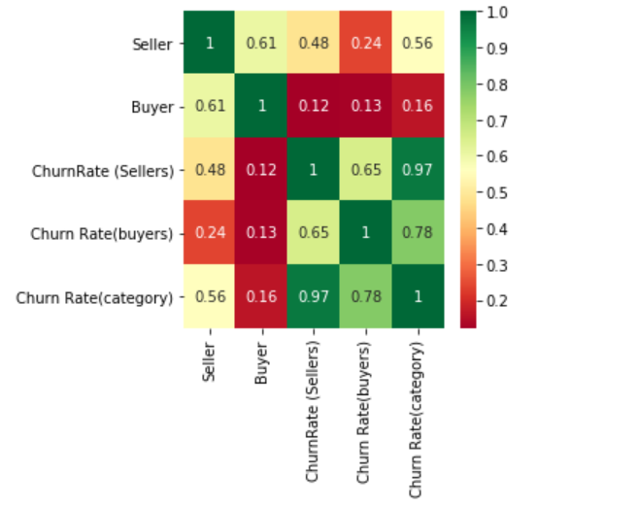
Insights
The churn rate of category visitor is likely to be more dependent on churn rate of sellers than the buyers.
This can happen because the sellers are not satisfied with the leads they are getting, can be seen with the help of a heatmap (Figure 1)
Category | Seller | Buyer | Churn Rate (Sellers) | Churn Rate(buyers) | Churn Rate(category)
Hobby | 17659 | 490 | 10% | 3% | 10%
DIY Home | 14966 | 2704 | 10% | 7% | 9%
Children | 14368 | 1844 | 10% | 8% | 10%

Slide 16
Competitive Landscape
Question 2

Slide 17

Strong elements of Facebook Marketplaces
Facebook Marketplace cuts the middle men cost, the owner can directly be contacted on just pressing the toggle button i.e. Ask for details.
The recommendation is more personalised as it tends to apply unsupervised Machine leaning algorithm to cluster items.
No need to register yourself or getting verified, one just need a Facebook account and you are in the world of billion of items, one can share the item with his/her friends who are on FB to get consent or so.
With daily active users of 1.4 billion, there are more chances for a seller to be discovered.

Slide 18
EasyHome vs Facebook Marketplace
As the users available to EasyHome are less compared to FB Marketplace, it can position itself as absolutely authentic and verified marketplace unlike Facebook where there can be a chance of spam accounts.
The quality of recommendation can be more granular for EasyHome.
EasyHome have more categories than the FB Marketplace, so once they’ll be managing their supply and demand it can happen to be more liked and authentic place.
EasyHome can create a chatbot for customer to raise query and than can redirect the question to owner if the database doesn’t have answer to that.

Slide 19
Conceptual cohort analysis and follow ups
Question 3

Slide 20
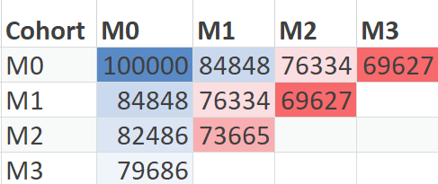
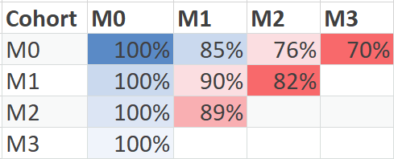
Cohort Analysis
Lifetime retention analysis of buyers is done to analyse which and how many user stayed across the months.
The cohort can help us to track the behavior of the users.

Slide 21
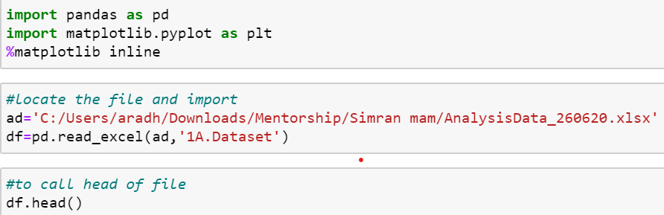
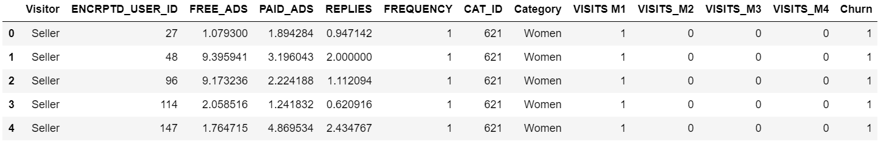
Python Query

Slide 22


Follow up Analysis Recommendation
If we had access to more data, we can perform Predictive Analysis that which customer is likely to stay and which is likely to be churn.
If the data was in large chunk. The Acquisition or Retention report can be more detailed.
Can use ML algorithms to deploy the prediction after training the model.

Slide 23


