Slide 1
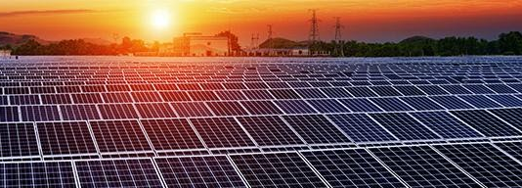
Solar, a non-conventional Source: Study of Challenges in the Residential Sector
By Aradhya Raj Mehra
1903702

Slide 2

Abstract
The factors and challenges that determine the buying behavior in residential sector of Solar Industry were studied. The study was divided into two parts. The first part dealt with the challenges faced by the common people who don’t have a solar connection as well as who have it already. The second part of the study analyzed the challenges faced by an EPC company while handling a residential sector customer. An online experiment was conducted where the awareness level and factors affecting the behaviour were taken into consideration.
After analyzing the results, it was found that there were more than one factor or challenge that mainly affects the buying pattern of a customer or a user. The experiment results show that majority of respondents are likely to be aware of Solar and prefer it but the main challenge is the high capital cost and weak public policies offered by the government.Descriptive Statistics were used to drive results.

Slide 3
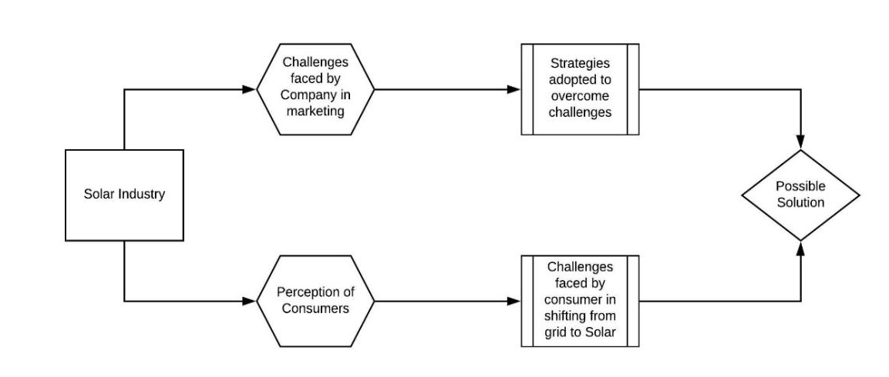
Research Model

Slide 4
Research Methodology
Sampling Method
Two sets of samples will be collected:
Companies: Non-Probabilistic, Judgemental Sampling, Snowball Sampling.
Customers: Non-Probabilistic, Convenient Sampling, Snowball Sampling.
Research Framework
The research took place in two parts:
The first questionnaire was distributed discuss among 90 respondents and their responses were collected and analyzed, however, 5 of them were strikes off due to incomplete information.
The second questionnaire dealt with the factors that a company considers as a challenge when converting a lead to a customer.
The Following analysis was completely based on Descriptive Statistics.

Slide 5
Research Objective
To understand the perception of customers regarding solar energy installations.
To understand the challenges faced by solar companies in marketing their products.
To analyze the challenges faced by the customer is shifting from grid supply to solar power.

Slide 6
Review of Literature
Environmental impacts of solar energy technologies (Energy Policy 33 289–29, 2005): The author suggested that a unit of power generated through the Solar technology in use it can save upto 0.6 kg of C02 to be emitted in the atmosphere when using conventional fuels to generate electricity.
Consumer attitudes towards domestic solar (Energy Policy Volume 34, Issue 14, 2006 by Adam Fiers, Charles Neame): They Distributed the residential solar sector into two groups: early adopters and the early majority. The ‘early majority’ demonstrated a positive perception of the environmental characteristics of solar power, however, its financial, economic, and aesthetic characteristics are limiting the adoption.
Solar Energy Fundamentals and Challenges in Indian restructured power sector (International Journal of Scientific and Research Publications, Volume 4, Issue 10, 2014): It was observed that inspite of a positive side of Solar Power Generation on environment, technical barrierssuch as efficiency can not be neglected, which doesn’t allow solar to perform as it can in the Energy generation sector in India.
Solar Photovoltaics Fundamentals, Technologies, and Applications (PHI Learning PVT. LTD, 2015, by Chetan Singh Solanki): The author discussed Technologies to fabricate solar cells such as monocrystalline, pollycrystalline, amorphous and the applications of the technology in the real world, explained the pros and cons of the technology and the process of implenting following the guidelines to install a sytem at different levels such as utility, domestic and commercial.

Slide 7
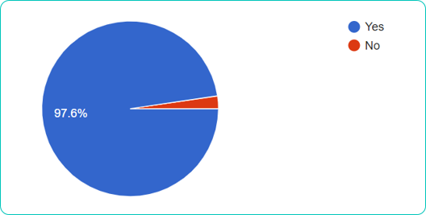
Findings
The respondents were asked if they were a residential consumer of electricity, all the respondents agreed to that
The respondents were asked that if they are aware of an alternative source other than a grid such as solar, about 97.6% were already aware however 2.4% were not.
Awareness about Solar technology

Slide 8
The respondents were asked about do they think, that they can shift to solar energy at the household level to meet the energy demand partially or completely. 64.7% agreed that they can, 31.8% responded that they needed more information, however, 3.5% disagreed that they don’t think so.
The respondents were asked do they have a solar power system installed at their home, 80% disagreed and 20% agreed that they do have a solar power system at their place.

Slide 9
When asked about that they think solar energy-based technologies have a much lesser impact on biodiversity and the environment, 49.4% strongly agree, whereas 37.6% agree and 12.9% responded neutrally.
71.8% of the respondents agreed that the energy generated from solar technology can replace the use of conventional fuels (like oil/coal/gas etc.), whereas 24.7% responded that to maybe and 3.5% disagreed with this statement.

Slide 10
Respondents Without a solar Connection
A situation was given to the respondents, who denied that they don’t have a solar system installed at their home, that if they have been told that “if you have to install 1 KW at your place you’ll have to pay 54 thousand rupees which will be connected to the grid and you can switch between sources i.e. grid and solar, and also the payback period will be around 4 years and the plan will generate electricity for 25 years”. To which 55.9% would agree to install, however, 38.2% were not sure and 5.9% disagreed.

Slide 11
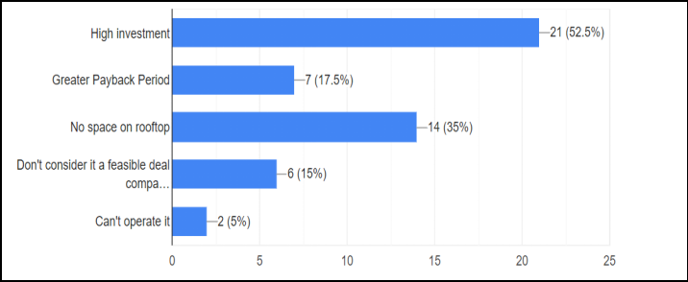
With reference to Situation 1, the respondents were asked if they are not sure or they disagreed to install what could be the reason for the same, 52.5% of respondents consider it as a high investment, 35% of respondents do not have enough space on the rooftop.

Slide 12
In order to analyze people’s perception of government initiatives, 44.1% agreed, 17.6% disagreed and 38.2% consider they do but not enough.
Respondents were questioned that if they are aware of government subsidies offered on the purchase of solar energy generation system, 29.4% agreed that they were aware, 29.4% disagreed that they are not, however, 41.2% are aware but insufficient information.
Situation 2 as “if they are told for promoting solar power systems government is providing 40% up to your 3-kW plant and 20% above 3 kW up to 10 kW. Would they be interested in installing a system at their place”?
69.1% of total respondents wish to use a solar power system in the future however, 30.9% responded to maybe and there were 0% who absolutely disagreed.

Slide 13
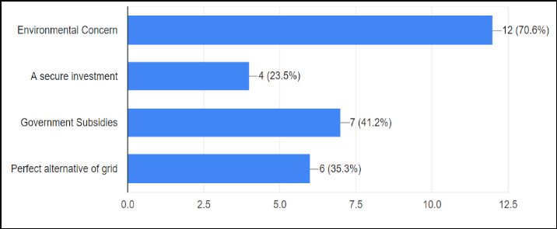
Respondents With a Solar Connection
When asked the respondents about the factors that drive them to install the power generation system, 70.6% responded that it was due to environmental concern, 41.2% responded that the government subsidy was the reason.

Slide 14
The respondents were then asked to rate the challenges they considered were acting as the barrier when switching from grid to solar as a source of electricity generation. Most of the respondents faced High capital cost as a major barrier, followed by Insecurities related to Government Subsidies, Space constraint however the least faced challenge is Availability of feasible alternative i.e. grid.
When respondents were asked if the user will recommend this source of power generation to others. 88.2% agreed, however, 11.8% disagreed to recommend.

Slide 15
Perception and Challenges faced by an EPC in the residential sector
3 of the respondents i.e. companies were located in Agra, 3 of them in New Delhi, 1 from Gurgaon, and 1 from Trichy, Tamil Nadu.
37.5% of respondents were working as an EPC for the last 2 years, 25% ranged from 2-5 years, 25% for 5-8 years, and 12.5% were working for more than 8 years.
When asked about the tentative capacity installed in the residential sector, the following were the results.
50% of the companies claimed that less than 20% of leads get converted into a customer and following shows the trend.

Slide 16
87.5% of respondents consider that the high capital cost is the main factor that affects buying behavior, 62.5% responds that lack of awareness is also a major factor, 50% responds to the weak public policies are affecting the behavior. The following are the complete results
Most of the companies face that high capital cost while handling a residential customer, followed by a lack of awareness and weak public policies

Slide 17
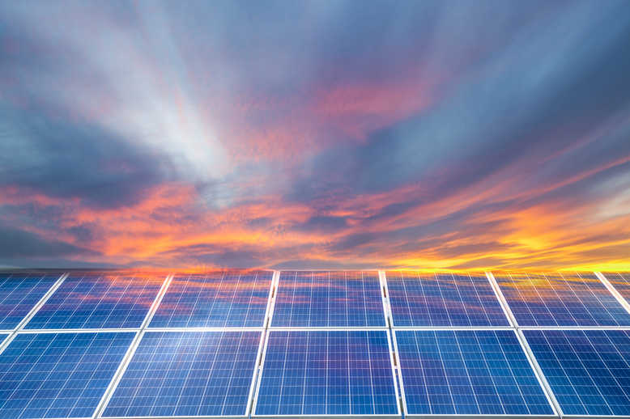
Conclusion
The study clearly presents the favorable case scenario for Solar adoption and expansion. Over 97% of respondents were aware of this technology and quite a great amount of individuals agreed that solar technology has a lesser impact on the environment as compared to conventional sources. Respondents have a positive outlook towards solar technology, that can replace fossil fuel. About 70% are willing to adopt renewables in the future. Despite a positive way for solar, there are various challenges ahead that need to be addressed and deployed in future actions. The most common of them for a respondent who doesn’t own an SPV System is the high capital cost, however, for an owner, the barrier faced was either high capital cost followed by weak public policies (i.e. Subsidies). The biggest challenge according to an EPC company while handling a residential potential customer, is also the costs related and policies by the government followed by the lack of awareness proving to be the biggest challenge for SPV technology providers. Awareness with respect to government subsidies and policies on Solar accounted to be low. It is very important to supply information for common people in an easy-to-understand manner. Lastly, there is a need for a shared vision, and the call to action for both governments, both at center and state to promote more people to install their independent system.

