Slide 1

WEB CRAWLER
Under the guidance of
Mr. Saurabh Mishra
Submitted by
Kartikeya Agarwal-2012762
Aradhya Mishra-2012513
Abhishek Bhatt-2012465

Slide 2
TABLE OF CONTENTS
Serial no. | Title
1 | Abstract
2 | Introduction
3 | Literature Review
4 | Problem Statement
5 | Objective
6 | Methodology
7 | System requirements
8 | UML Activity Diagram
9 | UML Sequence Diagram
10 | Algorithm
11 | Output
12 | Pert Chart
13 | References

Slide 3
ABSTRACT
The present idea discloses an idea to build a crawler or bot which could crawl over web pages efficiently. Information gathering is an essential phase for collecting important and relevant data to carry out security tests or penetration testing. Information gathering is a time-consuming and laborious phase for which there are special automated tools to ease the gathering of information, producing more efficient results. These tools or programs are called web crawlers. When the crawlers visit a website, they search for other pages that are worth visiting. Web crawlers can link to new sites, note changes to existing sites and mark dead links. The web crawler looks at the keywords in the pages, the kind of content each page has and the links, environment of the target, versions and software used by the target before returning the information

Slide 4
INTRODUCTION
Information gathering is the very first phase of any penetration testing or vulnerability assessment. It is an act of collecting information from various sources. It is hard to collect data or information from millions of sources therefore web crawlers or bots or spiders are used.
To find information on the hundreds of millions of Web pages that exist, a search engine employs special software robots, called spiders, to build lists of the words found on Web sites. When a spider is building its lists, the process is called Web crawling. The term crawling literally means scanning through any piece of text, be it links to other websites, image captions, descriptions, articles, anything. It's like a spider searching through the web.
A crawler is a program that visits Web sites and reads their pages and other information in order to create entries for a search engine index. Web Crawlers collect information such as URL of the website, meta tag information, links in webpage, content of the webpage
Some web crawlers are autonomous and require no instructions once started. This project will focus on a user driven web crawler where user input will direct where the crawler goes and how the collected data is analyzed

Slide 5
Technology used
Python
Visual Code Studio
Different python libraries

Slide 6
HOW& WHY I CHOOSE WEB CRAWLER
I choose web crawler as my project because while studying web development in my internship I was interested in the relationship bw websites and the search engines and how a web crawler works. I was curious by the fact that how a programme can fetch a vast amount of data so quickly.
The crawling process begins with a list of web addresses from past crawls and sitemaps provided by website owners. As our crawlers visit these websites, they use links on those sites to discover other pages. The software pays special attention to new sites, changes to existing sites and dead links. Computer programs determine which sites to crawl, how often and how many pages to fetch from each site
Web crawlers are currently being used in various markets to collect and analyze information. This information can provide the ability to gain an edge over competitors such as showing the average price of their products. Web crawling has been around for over a decade but can be applied to new and emerging markets. With a few small changes in code most websites can be scraped for information.

Slide 7
PROBLEM STATEMENT
Information gathering is the most important and time-consuming task which needs to be done before any security testing or penetration testing. To reduce this time and improve the efficiency of searching along with producing relevant information of the target, a web crawler is developed which ease this laborious phase.

Slide 8
LITERATURE REVIEW
According to P Boldi, Web crawlers help in collecting information about a website and the links related to them[2].
There are many research papers and media articles written on the importance of web crawlers. C Olston in his paper talks about how efficient web crawling is important while describing the practices of a web crawler [3].
Sergey Brin in their article[4] says that the crawler is designed to crawl and index the Web efficiently and produce much more satisfying search results

Slide 9
OBJECTIVE
The objective of this project is to develop a tool which could crawl websites and help in information gathering process of VAPT.
The sub-objectives of the project are:
1. To ease the task of information gathering.
2. To fetch relevant data efficiently.
3. To use different user-agent strings to find more content.

Slide 10
METHODOLOGY
For the optimal design, planning, implementation and achievement of the project objectives, waterfall model is being used. It is a sequential model with each phase dealing with series of tasks and distinct objectives. By separating the set of concerns, the large and complex task of building the software is broken into smaller tasks which make it easier to handle.
The project is divided into four main sections:-
1.Requirement Analysis
1. Studying the existing techniques and journals published on web crawlers
2. Assessment of the requirements of the project
3. Defining the scope of the project
2.Design and development of prerequisites
1. Defining the various use cases of the project
2. Preparing the data flow diagram of the project
3. Preparing the various modules of the project- parsing URL, implementing user-agents, linking web pages, indexing, implementation and unit testing.

Slide 11
3. Implementation & unit testing
Creating the modules language.
Integrating the modules
Testing each module separately.
4. Testing
Testing the integration of modules
Testing the System.

Slide 12
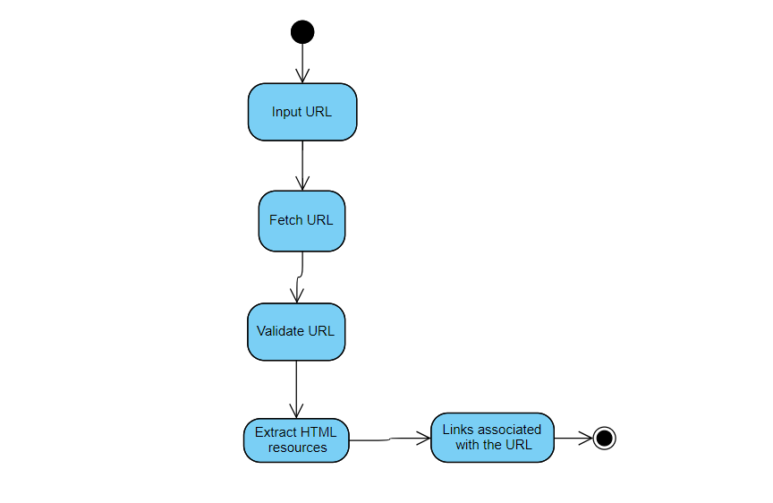
UML Activity Diagram

Slide 13
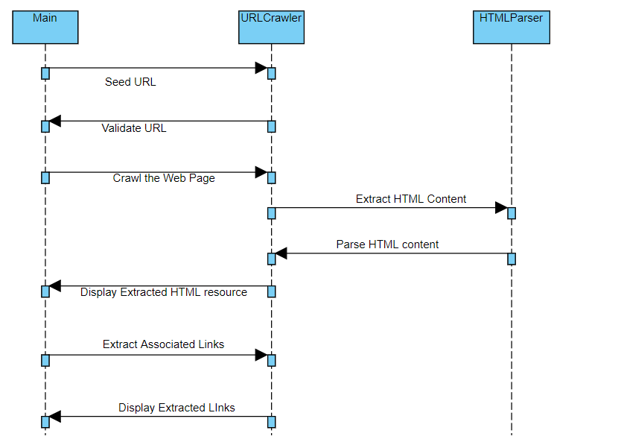
UML sequence Diagram

Slide 14
Algorithm
Initiaization
Get input URL
url = input("What is your url? ")
Fetching URL
requests.get(url)
Validate URL
Extract and parse HTML content
html=urlopen(url)
soup = BeautifulSoup(html, 'lxml')
Extract Links associated with the URL
all_links = soup.find_all("a")
for link in all_links:
print(link.get("href"))

Slide 15
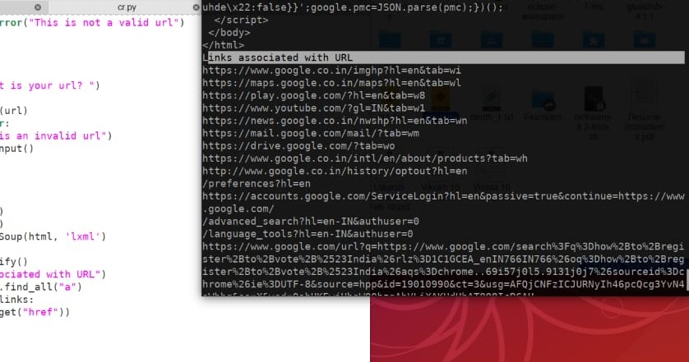
Output

Slide 16
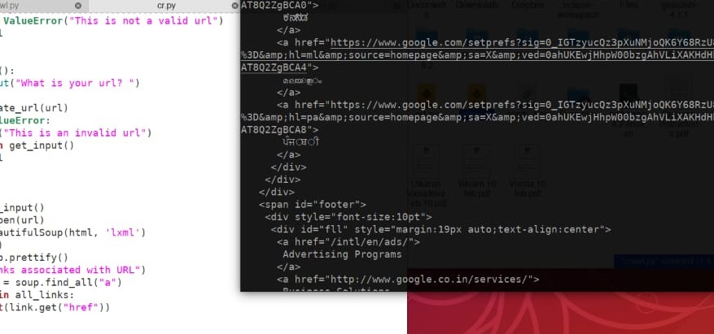
Output

Slide 17
USES OF WEB CRAWLER
update their web content or indices of others sites' web content
copy all the visited pages for subsequent processing by a search engine which will index the downloaded pages to provide lightning fast searches
automate maintenance tasks on a website, such as checking links or validating HTML code
Web crawlers are mainly used to create a copy of all the visited pages for later processing by a search engine, that will index the downloaded pages to provide fast searches. Crawlers can also be used for automating maintenance tasks on a Web site, such as checking links or validating HTML code.

Slide 18
REFERENCES
[1] Carlos castilo , “Effective web crawling”, Department of Computer Science and Technology, University of chille, 2005.
Available at - https://dl.acm.org/citation.cfm?id=1067287
[2] P Boldi, M Santini “Ubicrawler: A Scalable distrubted web crawler”, Wiley Library (2004).
Available at: https://onlinelibrary.wiley.com/doi/abs/10.1002/spe.587
[3] C Olston, “ Web Crawler”. Foundations and trends in information retrieval, 2010.
Available at: https://www.nowpublishers.com/article/Details/INR-017
[4]Sergey Brin, "Anatomy of large-scale hyper textual web search engine ", Lawrence page, 2012
Available at: https://www.sciencedirect.com/science/article/abs/pii/S1389128612003611

