Slide 1

OPERATING SYSTEM

Slide 2
OPERATING SYSTEM
An Operating System (OS) is an interface between a computer user and computer hardware.
An operating system is a software which performs all the basic tasks like file management, memory management, process management, handling input and output, and controlling peripheral devices such as disk drives and printers.

Slide 3
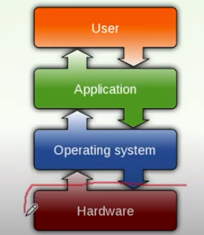
OPERATING SYSTEM

Slide 4
OPERATING SYSTEM
Every general-purpose computer consists of the hardware, operating system, system programs, and application programs.
The hardware consists of memory, CPU, ALU, and I/O devices, peripheral device, and storage device.
System program consists of compilers, loaders, editors, OS, etc.
The application program consists of business programs, database programs.

Slide 5
OPERATING SYSTEM
The operating system is a set of special programs that run on a computer system that allows it to work properly.
It performs basic tasks such as recognizing input from the keyboard, keeping track of files and directories on the disk, sending output to the display screen and controlling peripheral devices.

Slide 6
OPERATING SYSTEM - FUNCTIONS
Memory Management
Processor Management
Device Management
File Management
Security
Control over system performance
Job accounting
Error detecting aids
Coordination between other software and users

Slide 7
OPERATING SYSTEM - FUNCTIONS
Memory Management:
Memory management refers to management of Primary Memory or Main Memory.
An Operating System does the following activities for memory management −
Keeps tracks of primary memory, i.e., what part of it are in use by whom, what part are not in use.
In multiprogramming, the OS decides which process will get memory when and how much.
Allocates the memory when a process requests it to do so.
De-allocates the memory when a process no longer needs it or has been terminated.

Slide 8
OPERATING SYSTEM - FUNCTIONS
Processor Management:
In multiprogramming environment, the OS decides which process gets the processor when and for how much time. This function is called process scheduling. An Operating System does the following activities for processor management −
Keeps tracks of processor and status of process. The program responsible for this task is known as traffic controller.
Allocates the processor (CPU) to a process.
De-allocates processor when a process is no longer required.

Slide 9
OPERATING SYSTEM - FUNCTIONS
Device Management:
An Operating System manages device communication via their respective drivers. It does the following activities for device management −
Keeps tracks of all devices. Program responsible for this task is known as the I/O controller.
Decides which process gets the device when and for how much time.
Allocates the device in the efficient way.
De-allocates devices.

Slide 10
OPERATING SYSTEM - FUNCTIONS
File Management:
A file system is normally organized into directories for easy navigation and usage. These directories may contain files and other sub directories.
An Operating System does the following activities for file management −
Keeps track of information, location, uses, status etc. The collective facilities are often known as file system.
Decides who gets the resources.
Allocates the resources.
De-allocates the resources.

Slide 11
OPERATING SYSTEM - FUNCTIONS
Security − By means of password and similar other techniques, it prevents unauthorized access to programs and data.
Control over system performance − Recording delays between request for a service and response from the system.
Job accounting − Keeping track of time and resources used by various jobs and users.
Error detecting aids − Production of dumps, traces, error messages, and other debugging and error detecting aids.
Coordination between other software and users − Coordination and assignment of compilers, interpreters, assemblers and other software to the various users of the computer systems.

Slide 12
OPERATING SYSTEM - FUNCTIONS
Resource Management:
User Pgm - Access – Several Resources during execution.
Ex – CPU , MM , I/O devices , S/w ( compiler , linker, loader)
Managed by OS - allocate user.
Time Management ( CPU and Disk Scheduling)
Space Management ( Main and Secondary Storage)
Process Synchronization and Deadlock handling.
Accounting and Status Informaion.
:

Slide 13
OPERATING SYSTEM – DESIGN APPROACHES
Layered Approach
Kernel Based Approach
Virtual Machine Approach

Slide 14
Layered Approach
A system can have different designs and modules.
One of them is the layered approach, in which the operating system is broken into a number of layers, the bottom layer (layer 0) being hardware and the highest (layer N) being the user interface.

Slide 15
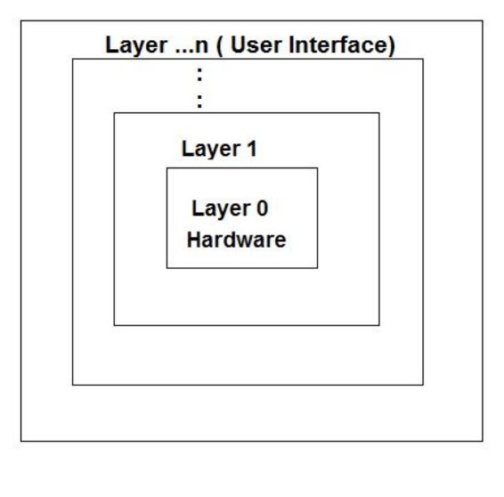
Layered Approach

Slide 16
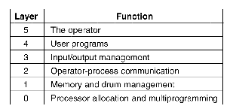
Layered Approach

Slide 17
Layered Approach
A system can have different designs and modules.
One of them is the layered approach, in which the operating system is broken into a number of layers, the bottom layer (layer 0) being hardware and the highest (layer N) being the user interface.

Slide 18
Layered Approach
Layer 0 dealt with allocation of the processor, switching between processes when interrupts occurs, or timers expired. Layer 0 provided the basic multiprogramming of the CPU.
Layer 1 handles the memory management. It allocated space for processes in main memory.
Layer 2 Manages communication between each process and the operator console.

Slide 19
Layered Approach
Layer 3 manage the I/O devices and buffering the information streams to and from them.
Layer 4 is the place where the user programs are found. They did not have to worry about process, memory, console, or I/O management.
The system operator process was located in layer 5.

Slide 20
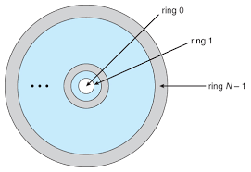
Layered Approach - MULTICS

Slide 21
Layered Approach - Advantages
SIMPLICITY OF CONSTRUCTION AND DEBUGGING
- The layers are selected so that each uses functions (operations) and services of only lower-level layers.
- The first layer can be debugged without any concern for the rest of the system, because, by definition, it uses only the basic hardware
- Once the first layer is debugged, its correct functioning can be assumed while the second layer is debugged, and so on.
- If an error is found during debugging of a particular layer, the error must be on that layer, because the layers below it are already debugged. Thus, the design and implementation of the system is simplified.

Slide 22
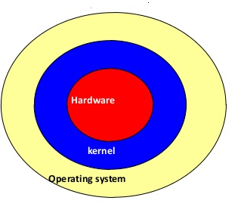
Kernel Based Approach

Slide 23
Kernel Based Approach
A kernel is a central component of an operating system.
It acts as an interface between the user applications and the hardware.
It manages the communication between the software (user level applications) and the hardware (CPU, disk memory, etc).
The kernel provides functions like Process management, Device management, Memory management, Interrupt handling, I/O communication, File system, etc.

Slide 24
Kernel Based Approach
All the basic system services like process and memory management, interrupt handling, etc. were packaged into a single module in kernel space.
This type of architecture led to some serious drawbacks like the huge size of the kernel, poor maintainability, which meant fixing bugs or addition of new features required recompilation of the whole kernel!

Slide 25
Layered Approach – Kernel Based Approach
Kernels may be classified mainly in three categories:
Monolithic Kernel
Micro Kernel

Slide 26
Monolithic Kernel
the kernel consists of different modules which can be dynamically loaded and unloaded.
This modular approach allows easy extension of OS's capabilities.
With this approach, maintainability of the kernel also has become easy as only the concerned module needs to be loaded and unloaded every time there is a change or bug fix.
Also, because of this dynamic loading and unloading of the modules, stripping down the kernel for smaller platforms (like embedded devices, etc.) became easy too.

Slide 27
Micro Kernel
This structure designs the operating system by removing all non-essential components from the kernel and implementing them as system and user programs.
This result in a smaller kernel called the micro-kernel.
Advantages of this structure are that all new services need to be added to user space and does not require the kernel to be modified.
Thus it is more secure and reliable as if a service fails then rest of the operating system remains untouched. Mac OS is an example of this type of OS.

Slide 28
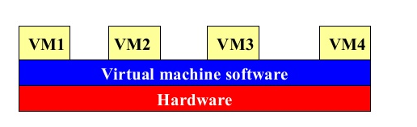
Virtual Machine (VM) Approach

Slide 29
Virtual Machine (VM) Approach
The fundamental idea behind a virtual machine is to abstract the hardware of a single computer (the CPU, Memory, Disk drives, Network Interface Cards, and so forth) into several different execution environments and thereby creating the illusion that each separate execution environment is running its own private computer.
By using CPU Scheduling and Virtual Memory techniques, an operating system can create the illusion that a process has its own processor with its own (virtual) memory.

Slide 30
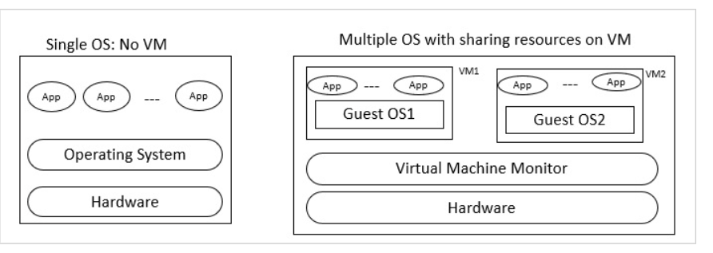
Virtual Machine (VM) Approach
The fundamental idea behind a virtual machine is to abstract the hardware of a single computer (the CPU, Memory, Disk drives, Network Interface Cards, and so forth) into several different execution environments and thereby creating the illusion that each separate execution environment is running its own private computer.
By using CPU Scheduling and Virtual Memory techniques, an operating system can create the illusion that a process has its own processor with its own (virtual) memory.

Slide 31
Virtual Machine (VM) Approach
Virtual Machine abstracts the hardware of our personal computer such as CPU, disk drives, memory, NIC (Network Interface Card) etc, into many different execution environments as per our requirements, hence giving us a feel that each execution environment is a single computer.

Slide 32
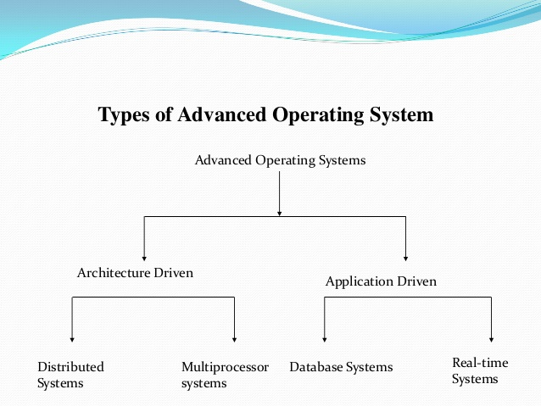
Types of Advanced Operating System

Slide 33
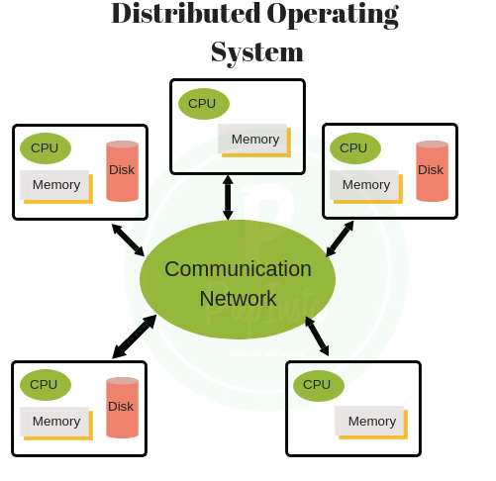
Distributed Systems

Slide 34
Distributed Systems
Various autonomous interconnected computers communicate each other using a shared communication network.
Independent systems possess their own memory unit and CPU. These are referred as loosely coupled systems or distributed systems.
These system’s processors differ in size and function. The major benefit of working with these types of operating system is that it is always possible that one user can access the files or software which are not actually present on his system but on some other system connected within this network i.e., remote access

Slide 35
Distributed Systems
Advantages
With resource sharing facility, a user at one site may be able to use the resources available at another.
Speedup the exchange of data.
Failure of one site in a distributed system doesn’t affect the others, the remaining sites can potentially continue operating.
Reduction of the load on the host computer.
Reduction of delays in data processing.

Slide 36
Multiprocessor Systems
Multi-processing operating system consists of multiple CPUs. Each CPU is connected to the main memory.
The task to be performed is divided among all the processors.
For faster execution and improved performance, each processor is assigned a specific task.
Once all the tasks of each processor are completed, they are compiled together in order to produce a single output.
The allocation of resources for each processor is handled by the operating system. This process results in better utilization of the available resources and improved performance.

Slide 37
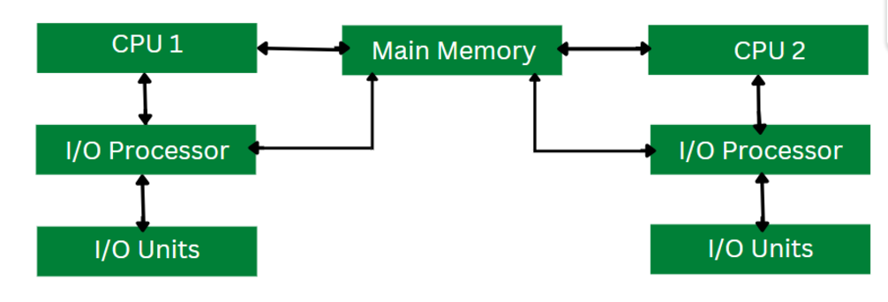
Multiprocessor Systems

Slide 38
Database Systems
Should support the Concept of Transactions.
Operations to Store, Retrieve , Manipulate data.
Primitives for Concurrency Control , System Failure Recovery.

Slide 39
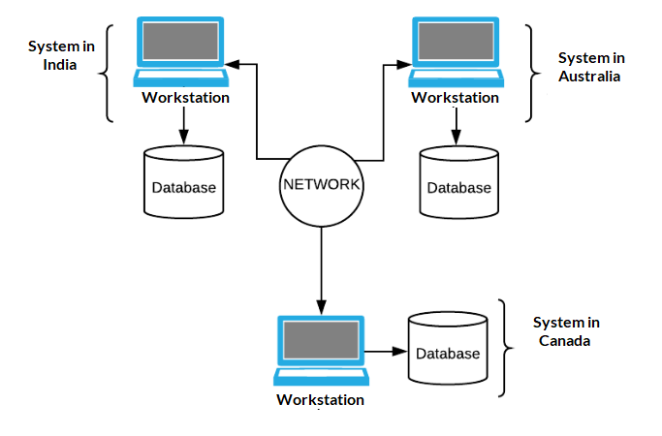
Database Systems

Slide 40
Real Time Operating Systems
Real-time operating system (RTOS) is an operating system intended to serve real time application that process data as it comes in, mostly without buffer delay.
In a RTOS, Processing time requirement are calculated in tenths of seconds increments of time. It is time-bound system that can be defined as fixed time constraints. In this type of system, processing must be done inside the specified constraints. Otherwise, the system will fail.
A real-time operating system must have well-defined, fixed time constraints, otherwise the system will fail. For example, Scientific experiments, medical imaging systems, industrial control systems, weapon systems, robots, air traffic control systems, etc.

Slide 41
Real Time Operating Systems
There are two types of real-time operating systems.
Hard real-time systems
critical tasks complete on time. secondary storage is limited or missing and the data is stored in ROM.
Soft real-time systems
A critical real-time task gets priority over other tasks and retains the priority until it completes.
For example, multimedia, virtual reality, Advanced Scientific Projects like undersea exploration and planetary rovers, etc.

Slide 42
Process
A process is basically a program in execution. The execution of a process must progress in a sequential fashion.
A process is defined as an entity which represents the basic unit of work to be implemented in the system.

Slide 43
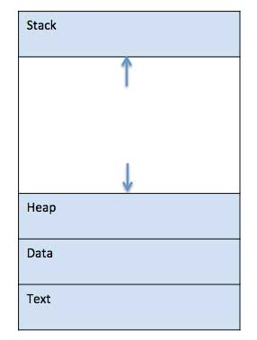
Process – How it look in Memory?

Slide 44
Process
Stack - contains the temporary data such as method/function parameters, return address and local variables.
Heap - This is dynamically allocated memory to a process during its run time.
Data - This section contains the global and static variables.
Text - This includes the current activity represented by the value of Program Counter and the contents of the processor's registers.

Slide 45
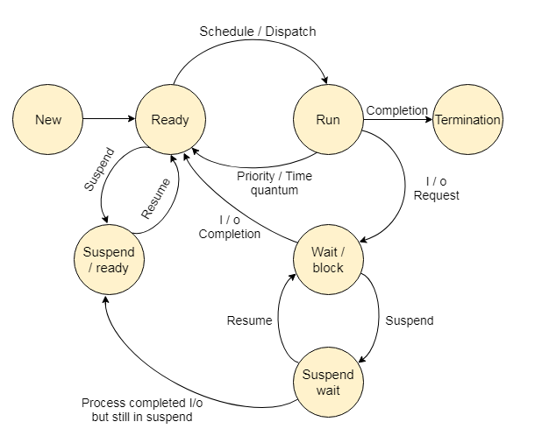
Process Life Cycle

Slide 46
Process Life Cycle
Start/ New
This is the initial state when a process is first started/created.
Ready
The process is waiting to be assigned to a processor. Ready processes are waiting to have the processor allocated to them by the operating system so that they can run. Process may come into this state after Start state or while running it by but interrupted by the scheduler to assign CPU to some other process.

Slide 47
Process Life Cycle
Running
Once the process has been assigned to a processor by the OS scheduler, the process state is set to running and the processor executes its instructions.
Waiting
Process moves into the waiting state if it needs to wait for a resource, such as waiting for user input, or waiting for a file to become available.
Terminated or Exit
Once the process finishes its execution, or it is terminated by the operating system, it is moved to the terminated state where it waits to be removed from main memory.

Slide 48
Process
Suspend ready
A process in the ready state, which is moved to secondary memory from the main memory due to lack of the resources (mainly primary memory) is called in the suspend ready state.
If the main memory is full and a higher priority process comes for the execution then the OS have to make the room for the process in the main memory by throwing the lower priority process out into the secondary memory. The suspend ready processes remain in the secondary memory until the main memory gets available.

Slide 49
Process
Suspend wait
Instead of removing the process from the ready queue, it's better to remove the blocked process which is waiting for some resources in the main memory.
Since it is already waiting for some resource to get available hence it is better if it waits in the secondary memory and make room for the higher priority process. These processes complete their execution once the main memory gets available and their wait is finished.

Slide 50
Process Control Block (PCB)
While creating a process the operating system performs several operations.
To identify the processes, it assigns a process identification number (PID) to each process.
As the operating system supports multi-programming, it needs to keep track of all the processes.
For this task, the process control block (PCB) is used to track the process’s execution status.

Slide 51
Process Control Block (PCB)
Each block of memory contains information about the process state, program counter, stack pointer, status of opened files, scheduling algorithms, etc.
All these information is required and must be saved when the process is switched from one state to another.
When the process makes a transition from one state to another, the operating system must update information in the process’s PCB.

Slide 52
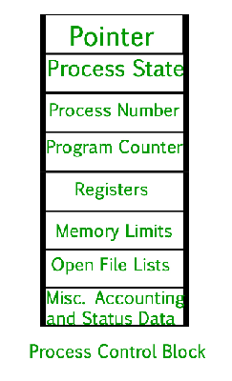
Process Control Block (PCB)

Slide 53
Process Control Block (PCB)
Pointer – It is a stack pointer which is required to be saved when the process is switched from one state to another to retain the current position of the process.
Process state – It stores the respective state of the process.
Process number – Every process is assigned with a unique id known as process ID or PID which stores the process identifier.
Program counter – It stores the counter which contains the address of the next instruction that is to be executed for the process.

Slide 54
Process Control Block (PCB)
Register – These are the CPU registers which includes: accumulator, base, registers and general purpose registers.
Memory limits – This field contains the information about memory management system used by operating system. This may include the page tables, segment tables etc.
Open files list – This information includes the list of files opened for a process.

Slide 55
Process Control Block (PCB)
Miscellaneous accounting and status data –
This field includes information about the amount of CPU used, time constraints, jobs or process number, etc.
When the process makes a transition from one state to another, the operating system updates its information in the process’s PCB.
The operating system maintains pointers to each process’s PCB in a process table so that it can access the PCB quickly.

Slide 56
Concurrent Processes
2 processes are concurrent if their execution overlap in time.
Ie execution of 2nd process starts before 1st process completes.
in multiprocessor system it is easy to visualize.
Mechanisms:
- Shared variables : The processes access a common Variable / data
- Message passing : Send / Receive primitives
Threads

Slide 57
Critical Section Problem
A Critical Section is a code segment that accesses shared variables and has to be executed as an atomic action.
It means that in a group of cooperating processes, at a given point of time, only one process must be executing its critical section.
If any other process also wants to execute its critical section, it must wait until the first one finishes.

Slide 58
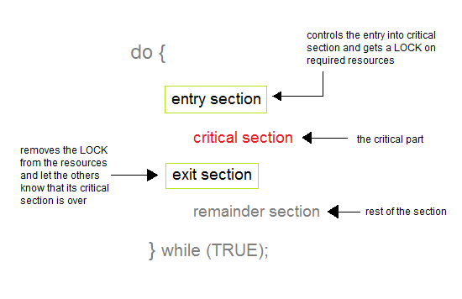
Critical Section Problem

Slide 59
Critical Section Problem
A critical section is a segment of code which can be accessed by a signal process at a specific point of time. The section consists of shared data resources that required to be accessed by other processes.
The entry to the critical section is handled by the wait() function, and it is represented as P().
The exit from a critical section is controlled by the signal() function, represented as V().
In the critical section, only a single process can be executed. Other processes, waiting to execute their critical section, need to wait until the current process completes its execution.

Slide 60
Critical Section Problem
Entry Section: It is part of the process which decides the entry of a particular process.
Critical Section: This part allows one process to enter and modify the shared variable.
Exit Section: Exit section allows the other process that are waiting in the Entry Section, to enter into the Critical Sections. It also checks that a process that finished its execution should be removed through this Section.
Remainder Section: All other parts of the Code, which is not in Critical, Entry, and Exit Section, are known as the Remainder Section.

Slide 61
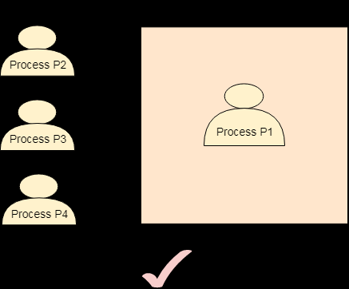
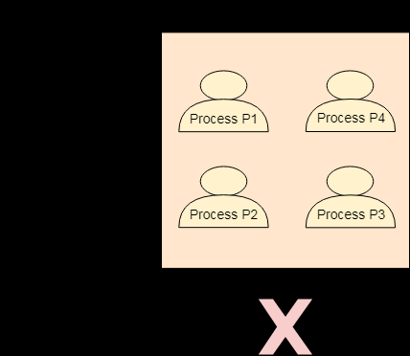
Rules for Critical Section
Mutual Exclusion
Our solution must provide mutual exclusion. By Mutual Exclusion, we mean that if one process is executing inside critical section then the other process must not enter in the critical section.

Slide 62
Semaphores
Semaphore is simply a variable that is non-negative and shared between threads.
A semaphore is a signaling mechanism, and a thread that is waiting on a semaphore can be signaled by another thread. It uses two atomic operations, 1)wait, and 2) signal for the process synchronization.

Slide 63
Characteristic of Semaphore
It is a mechanism that can be used to provide synchronization of tasks.
It is a low-level synchronization mechanism.
Semaphore will always hold a non-negative integer value.
Semaphore can be implemented using test operations and interrupts, which should be executed using file descriptors.

Slide 64
Example of Semaphore
Shared var mutex:
Process I , semaphore =0
begin
.
.
P(mutex); p =Wait
execute CS; ===release CS
Semaphore = 1
V(mutex); V= signal
.
.
End;

Slide 65
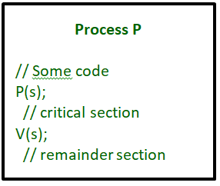
Example of Semaphore

Slide 66
Some point regarding P and V operation
P operation is also called wait, sleep or down operation and V operation is also called signal, wake-up or up operation.
Both operations are atomic, and semaphore(s) is always initialized to one.
A critical section is surrounded by both operations to implement process synchronization.
.critical section of Process P is in between P and V operation.

Slide 67
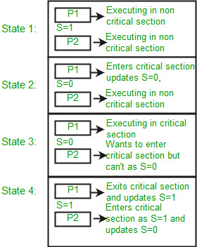
Some point regarding P and V operation

Slide 68
Some point regarding P and V operation
Let there be two processes P1 and P2 and a semaphore s is initialized as 1.
Now if suppose P1 enters in its critical section then the value of semaphore s becomes 0.
Now if P2 wants to enter its critical section then it will wait until s > 0, this can only happen when P1 finishes its critical section and calls V operation on semaphore s.
This way mutual exclusion is achieved. Look at the below image for details which is Binary semaphore.

Slide 69
Other Synchronization Problems
Dining Philosophers Problem
Producer – Consumer Problem
Readers – Writers Problem

Slide 70
Dining Philosophers Problem
The Dining Philosopher Problem states that K philosophers seated around a circular table with one chopstick between each pair of philosophers.
There is one chopstick between each philosopher. A philosopher may eat if he can pickup the two chopsticks adjacent to him. One chopstick may be picked up by any one of its adjacent followers but not both.

Slide 71
Dining Philosophers Problem
Let's understand the Dining Philosophers Problem with the below code, we have used fig 1 as a reference to make you understand the problem exactly.
The five Philosophers are represented as P0, P1, P2, P3, and P4 and five chopsticks by C0, C1, C2, C3, and C4.

Slide 72
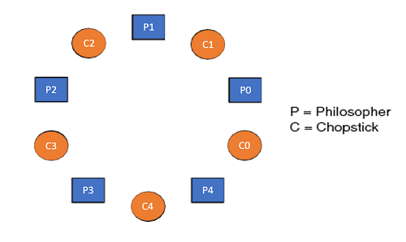
Dining Philosophers Problem

Slide 73
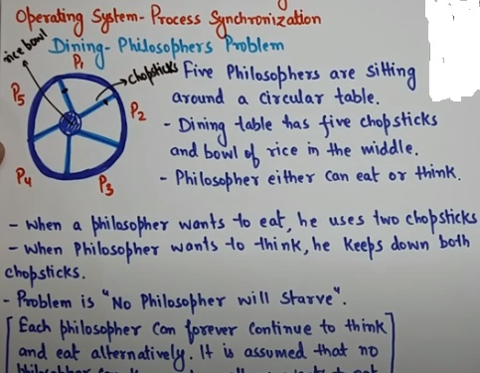
Dining Philosophers Problem

Slide 74
Dining Philosophers Problem
Void Philosopher
{
while(1)
{
take_chopstick[i];
take_chopstick[ (i+1) % 5] ;
. .
. EATING THE NOODLE
.
put_chopstick[i] );
put_chopstick[ (i+1) % 5] ;
.
. THINKING
}
}

Slide 75
Dining Philosophers Problem
Suppose Philosopher P0 wants to eat, it will enter in Philosopher() function, and execute take_chopstick[i]; by doing this it holds C0 chopstick after that it execute take_chopstick[ (i+1) % 5]; by doing this it holds C1 chopstick( since i =0, therefore (0 + 1) % 5 = 1)
Similarly suppose now Philosopher P1 wants to eat, it will enter in Philosopher() function, and execute take_chopstick[i]; by doing this it holds C1 chopstick after that it execute take_chopstick[ (i+1) % 5]; by doing this it holds C2 chopstick( since i =1, therefore (1 + 1) % 5 = 2)
But Practically Chopstick C1 is not available as it has already been taken by philosopher P0, hence the above code generates problems and produces race condition.

Slide 76
Dining Philosophers Problem - Solution
1. wait( S )
{
while( S <= 0) ;
S--;
}
2. signal( S )
{
S++;
}

Slide 77
Producer Consumer Problem
The Producer-Consumer problem is a classic problem this is used for multi-process synchronization i.e. synchronization between more than one processes.
In the producer-consumer problem, there is one Producer that is producing something and there is one Consumer that is consuming the products produced by the Producer. The producers and consumers share the same memory buffer that is of fixed-size.
The job of the Producer is to generate the data, put it into the buffer, and again start generating data. While the job of the Consumer is to consume the data from the buffer.

Slide 78
What's the problem here?
The following are the problems that might occur in the Producer-Consumer:
The producer should produce data only when the buffer is not full. If the buffer is full, then the producer shouldn't be allowed to put any data into the buffer.
The consumer should consume data only when the buffer is not empty. If the buffer is empty, then the consumer shouldn't be allowed to take any data from the buffer.
The producer and consumer should not access the buffer at the same time.

Slide 79
Pseudo code for producer
do {
.
. PRODUCE ITEM
.
wait(empty);
wait(mutex);
.
. PUT ITEM IN BUFFER
.
signal(mutex);
signal(full);
} while(1);
Initialized to n ( count empty space)
Initialized to 1
Mutex , Empty , full are semaphores
Initialized to 0, Counts full space

Slide 80
Pseudo code for producer
In the above code, mutex, empty and full are semaphores.
Here mutex is initialized to 1, empty is initialized to n (maximum size of the buffer) and full is initialized to 0.
The mutex semaphore ensures mutual exclusion. The empty and full semaphores count the number of empty and full spaces in the buffer.
After the item is produced, wait operation is carried out on empty. This indicates that the empty space in the buffer has decreased by 1. Then wait operation is carried out on mutex so that consumer process cannot interfere.
After the item is put in the buffer, signal operation is carried out on mutex and full. The former indicates that consumer process can now act and the latter shows that the buffer is full by 1

Slide 81
Pseudo code for Consumer
do {
wait(full);
wait(mutex);
. .
. REMOVE ITEM FROM BUFFER
.
signal(mutex);
signal(empty);
.
. CONSUME ITEM
.
} while(1);

Slide 82
Pseudo code for Consumer
The wait operation is carried out on full. This indicates that items in the buffer have decreased by 1. Then wait operation is carried out on mutex so that producer process cannot interfere.
Then the item is removed from buffer. After that, signal operation is carried out on mutex and empty. The former indicates that consumer process can now act and the latter shows that the empty space in the buffer has increased by 1.

Slide 83
Readers – Writers Problem
Consider a situation where we have a file shared between many people.
If one of the people tries editing the file, no other person should be reading or writing at the same time, otherwise changes will not be visible to him/her.
However, if some person is reading the file, then others may read it at the same time.
Precisely in OS we call this situation as the readers-writers problem

Slide 84
Readers – Writers Problem
Problem parameters:
One set of data is shared among a number of processes.
Once a writer is ready, it performs its write. Only one writer may write at a time.
If a process is writing, no other process can read it.
If at least one reader is reading, no other process can write.
Readers may not write and only read.

Slide 85
Readers – Writers Problem
Three variables are used: mutex, wrt, readcnt to implement solution.
semaphore mutex, wrt; // semaphore mutex is used to ensure mutual exclusion when readcnt is updated i.e. when any reader enters or exit from the critical section and semaphore wrt is used by both readers and writers.
int readcnt; // readcnt tells the number of processes performing read in the critical section, initially 0.

Slide 86
Readers – Writers Problem
Three variables are used: mutex, wrt, readcnt to implement solution.
semaphore mutex, wrt; // semaphore mutex is used to ensure mutual exclusion when readcnt is updated i.e. when any reader enters or exit from the critical section and semaphore wrt is used by both readers and writers.
int readcnt; // readcnt tells the number of processes performing read in the critical section, initially 0.

Slide 87
Readers – Writers Problem
Functions for sempahore :
– wait() : decrements the semaphore value.
– signal() : increments the semaphore value.
1. wait( S )
{
while( S <= 0) ;
S--;
}
2. signal( S )
{
S++;
}

Slide 88
Write Process
Writer process:
Writer requests the entry to critical section.
If allowed i.e. wait() gives a true value, it enters and performs the write. If not allowed, it keeps on waiting.
It exits the critical section.

Slide 89
Write Process
do {
// writer requests for critical section
wait(wrt);
// performs the write
// leaves the critical section
signal(wrt);
} while(true);

Slide 90
Read Process
Reader requests the entry to critical section.
If allowed:
  it increments the count of number of readers inside the critical section. If this reader is the first reader entering, it locks the wrt semaphore to restrict the entry of writers if any reader is inside.
  It then, signals mutex as any other reader is allowed to enter while others are already reading.
  After performing reading, it exits the critical section. When exiting, it checks if no more reader is inside, it signals the semaphore “wrt” as now, writer can enter the critical section.
If not allowed, it keeps on waiting.

Slide 91
do {
// Reader wants to enter the critical section
wait(mutex);
// The number of readers has now increased by 1
readcnt++;
// there is atleast one reader in the critical section
// this ensure no writer can enter if there is even one reader
// thus we give preference to readers here
if (readcnt>=1)
wait(wrt);
// other readers can enter while this current reader is inside
// the critical section
signal(mutex);
// current reader performs reading here
wait(mutex); // a reader wants to leave
readcnt--;
// that is, no reader is left in the critical section,
if (readcnt == 0)
signal(wrt); // writers can enter
signal(mutex); // reader leaves
} while(true);
Read Process

Slide 92
Language Mechanism for Synchronization - Monitors
The monitor is one of the ways to achieve Process synchronization. The monitor is supported by programming languages to achieve mutual exclusion between processes.
It is the collection of condition variables and procedures combined together in a special kind of module or a package.
The processes running outside the monitor can’t access the internal variable of the monitor but can call procedures of the monitor.
Only one process at a time can execute code inside monitors.

Slide 93
Language Mechanism for Synchronization - Monitors
Characteristics of Monitors.
1. Inside the monitors, we can only execute one process at a time.
2. Monitors are the group of procedures, and condition variables that are merged together in a special type of module.
3. If the process is running outside the monitor, then it cannot access the monitor’s internal variable. But a process can call the procedures of the monitor.
4. Monitors offer high-level of synchronization
5. Monitors were derived to simplify the complexity of synchronization problems.
6. There is only one process that can be active at a time inside the monitor.

Slide 94
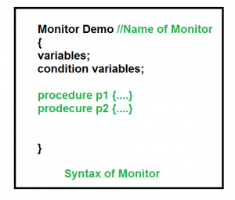
Language Mechanism for Synchronization - Monitors

Slide 95
Language Mechanism for Synchronization - Monitors
Condition Variables:
Two different operations are performed on the condition variables of the monitor.
Wait.
signal.
Wait operation
x.wait() : Process performing wait operation on any condition variable are suspended. The suspended processes are placed in block queue of that condition variable.
Note: Each condition variable has its unique block queue.
Signal operation
x.signal(): When a process performs signal operation on condition variable, one of the blocked processes is given chance.

Slide 96
Language Mechanism for Synchronization - Monitors
Advantages of Monitor:
Monitors have the advantage of making parallel programming easier and less error prone than using techniques such as semaphore.
Disadvantages of Monitor:
Monitors have to be implemented as part of the programming language . The compiler must generate code for them. This gives the compiler the additional burden of having to know what operating system facilities are available to control access to critical sections in concurrent processes. Some languages that do support monitors are Java,C#,Visual Basic,Ada and concurrent Euclid.

Slide 97
SERIALIZER
Serializers are abstract data types very similar to monitors.
As in a Monitor only one process can have accesses or control over a serializer at a given time.
The operations users invoke to access a resource are actually the operations of the serializers.
When a process access a serializer it gains control of the serializer and is said to be in possession of the serializer.
But in the procedures of a serializer there are certain regions in which multiple process can be active. These regions are known as Hollow regions.

Slide 98
SERIALIZER
As soon as a process enters a hollow region, it releases the serializer so that some other process can access it.
Thus concurrency is achieved in the hollow regions of a serializer. Remember that in a hollow region the process just releases the serializer and does not exit it. So that the process can regain control when it gets out of the hollow region.

Slide 99
SERIALIZER
whenever a process requests to gain or regain access of a serializer certain conditions are checked. The process is held in a waiting queue until the condition is true.
This is accomplished using an enque operation. The syntax of the enque command is
enque (<priority>, <queue-name>) until (<condition>)
The queue name specifies the name of the queue in which the process has to be held and the priority options specifies the priority of the process to be delayed.

Slide 100
SERIALIZER
A hallow region in a procedure is specified by a join-crowd operation. The syntax of the join-crowd command is
join-crowd (<crowd>) then <body> end On invocation of a join-crowd operation, possession of the serializer is released, the identity of the process invoking the join-crowd is recorded in the crowd, and the list of statements in the body is executed.
When the process completes execution of the body, a leave-crowd operation is executed. As a result of the leave-crowd operation the process regains control of the serializer. Please note that, if the serializer is currently in possession of some other process then the process executing the leave crowd operation will result in a wait queue.

Slide 101
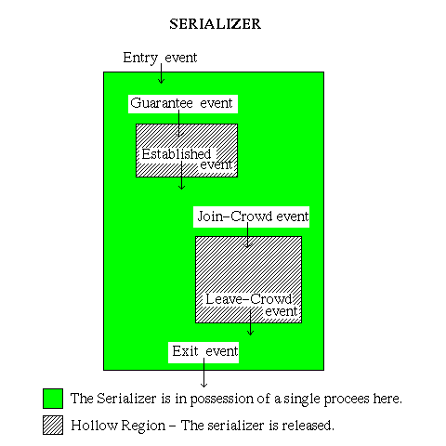
SERIALIZER

Slide 102
SERIALIZER
Every operation in a serializer can be identified as an event.
An Entry event can be a request for serializer, in which a condition will be checked. ( For eg., Is the serializer free for the process to enter ? )
If the condition is true the process gains control of the serializer. Then before the process accesses the resource, a guarantee event is executed , else the process releases the control of the serializer and waits in its queue.
When a resource is available the process enters (Join-Crowd event) the Crowd and accesses the process. After completing the job with the resource, the process leaves (Leave-Crowd event) the crowd and regains control of the serializer ( if the serializer is available, else it has to wait).serializers also allow a timeout event which can avoid processes waiting for a condition longer than the specified period.

Slide 103
Process Deadlocks - Introduction to Deadlock
Every process needs some resources to complete its execution. However, the resource is granted in a sequential order.
The process requests for some resource.
OS grant the resource if it is available otherwise let the process waits.
The process uses it and release on the completion.

Slide 104
Process Deadlocks - Introduction to Deadlock
A Deadlock is a situation where each of the computer process waits for a resource which is being assigned to some another process.
In this situation, none of the process gets executed since the resource it needs, is held by some other process which is also waiting for some other resource to be released.

Slide 105
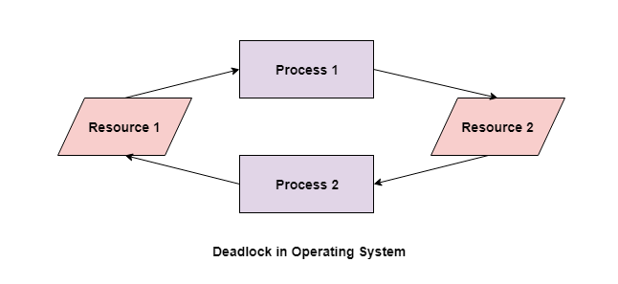
Process Deadlocks - Introduction to Deadlock

Slide 106
Process Deadlocks - Introduction to Deadlock
In the above diagram, the process 1 has resource 1 and needs to acquire resource 2.
Similarly process 2 has resource 2 and needs to acquire resource 1.
Process 1 and process 2 are in deadlock as each of them needs the other’s resource to complete their execution but neither of them is willing to relinquish their resources.

Slide 107
Deadlocks vs Starvation
Starvation occurs if a process is indefinitely postponed.
This may happen if the process requires a resource for execution that it is never allotted or if the process is never provided the processor for some reason.

Slide 108
Deadlocks vs Starvation
Some of the common causes of starvation are as follows −
If a process is never provided the resources it requires for execution because of faulty resource allocation decisions, then starvation can occur.
A lower priority process may wait forever if higher priority processes constantly monopolize the processor.
Starvation may occur if there are not enough resources to provide to every process as required.
If random selection of processes is used then a process may wait for a long time because of non-selection.

Slide 109

Fundamental Causes of Deadlocks
Mutual Exclusion: There should be a resource that can only be held by one process at a time. In the diagram below, there is a single instance of Resource 1 and it is held by Process 1 only.

Slide 110
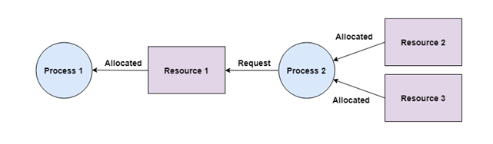
Fundamental Causes of Deadlocks
2. Hold and Wait:
A process can hold multiple resources and still request more resources from other processes which are holding them.
In the diagram given below, Process 2 holds Resource 2 and Resource 3 and is requesting the Resource 1 which is held by Process 1.

Slide 111
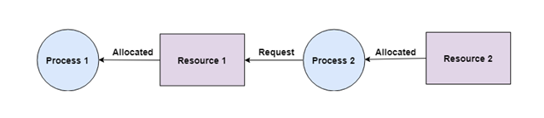
Fundamental Causes of Deadlocks
No Preemption
A resource cannot be preempted from a process by force. A process can only release a resource voluntarily.
In the diagram below, Process 2 cannot preempt Resource 1 from Process 1. It will only be released when Process 1 relinquishes it voluntarily after its execution is complete.

Slide 112
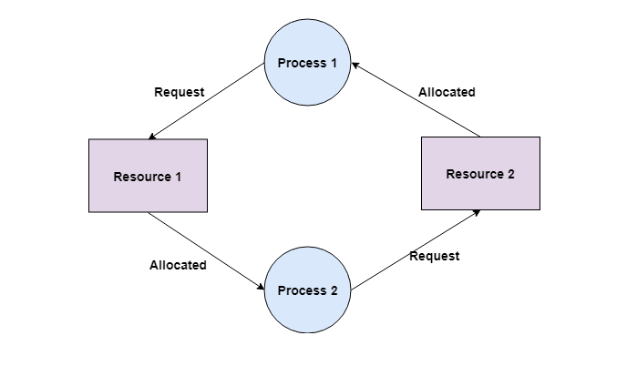
Fundamental Causes of Deadlocks
4. Circular Wait
A process is waiting for the resource held by the second process, which is waiting for the resource held by the third process and so on, till the last process is waiting for a resource held by the first process.
This forms a circular chain. For example: Process 1 is allocated Resource2 and it is requesting Resource 1. Similarly, Process 2 is allocated Resource 1 and it is requesting Resource 2. This forms a circular wait loop.

Slide 113
Deadlock Handling Strategies
Deadlock Prevention
Deadlock Detection
Deadlock Avoidance

Slide 114
Deadlock Handling Strategies
Deadlock Detection
A deadlock can be detected by a resource scheduler as it keeps track of all the resources that are allocated to different processes. After a deadlock is detected, it can be resolved using the following methods −
All the processes that are involved in the deadlock are terminated. This is not a good approach as all the progress made by the processes is destroyed.
Resources can be preempted from some processes and given to others till the deadlock is resolved.

Slide 115
Deadlock Handling Strategies
Deadlock Prevention
It is very important to prevent a deadlock before it can occur. So, the system checks each transaction before it is executed to make sure it does not lead to deadlock.
If there is even a slight chance that a transaction may lead to deadlock in the future, it is never allowed to execute.

Slide 116
Deadlock Handling Strategies
Deadlock Avoidance
It is better to avoid a deadlock rather than take measures after the deadlock has occurred.
The wait for graph can be used for deadlock avoidance.
This is however only useful for smaller databases as it can get quite complex in larger databases.

Slide 117
Models of Deadlocks
The single unit Request Model
The AND Request Model
The OR Request Model
The AND – OR Request Model
The P – out – of – Q Request Model

Slide 118
Models of Deadlocks
The single unit Request Model:
A single process can request only one unit of a resource at a time.

Slide 119
Models of Deadlocks
2. The AND Request Model:
A process can simultaneously request multiple resources and it remains blocked until it is granted all of the requested resources.

Slide 120
Models of Deadlocks
The OR Request Model:
A process can simultaneously request multiple resources and it remains blocked until it is granted any one of the requested resources.

Slide 121
Models of Deadlocks
4. The AND - OR Request Model:
Generalization of the AND and the OR Request Model.
Ex:
A request “R1 AND (R2 OR R3) can be satisfied with either “R1 AND R2” or with “R1 AND R3”

Slide 122
Models of Deadlocks
5. The P – out – of - Q Request Model:
A process simultaneously request Q resources and remains blocked until it is granted any P of the resources.
When P = Q , it is AND Request Model.
When P=1 , it is OR Request Model.

Slide 123
Models of Resources
Modelling of resources is important in deadlock because processes interact with each other by requesting and blocking for resources.
Resource – any object that processes can request and wait for.
Resource – can consist of any number of identical units
Process – can request any number of units of a resource.

Slide 124
Types of Resources
Reusable Resources:
Does not vanish as a result of its use , can be used again and again.
In a system , a reusable resource Has fixes number of units and these units can neither be created nor destroyed.
Process request a unit – hold it during usage – release it on completion.- can be assigned to another waiting process.
  Ex – CPU , Memory , I/O devices.

Slide 125
Types of Resources
Consumable Resources:
Vanishes as a result of its use.
When a unit – assigned to a process – its consumed and cease to exit.
No fixed number of units in a system – resources can be created and destroyed.
One or more producers of a consumable resources.
Producer – not blocked- can produce any number of units of that resource.
Ex- msg, interrupt signal , V operations in Semaphore.

Slide 126
Types of Resource Accesses - Modes
Exclusive
Shared

Slide 127
A Graph Theoretic Model Of a System State
General Resource Systems:
A nonempty set of processes
A nonempty set of Resources (partitioned into 2 sets) , a set of reusable resources and a set of Consumable resources.
Reusable resources – non negative integer denoting total number of units of resources present in the system.
Consumable resources = nonempty subset of processes – producers.

Slide 128
A Graph Theoretic Model Of a System State
General Resource Graph:
State of a system modelled by Directed Graph
Nodes corresponds to Processes and Resources.
Edge represents interaction.
Process denoted by rectangle and resources by Circle.
Consumable resource thick circle.
Request edge.
Assignment edge.
Fig 3.1 , pg 52

Slide 129
Operations On the General Resource Graph
1. Request a Resource
2. Acquire a Resource
3. Release a Resource

Slide 130
Operations On the General Resource Graph
1. Request a Resource
Process pi in active state can request one or more number of units of resource rj.
Thus a request operation result in an addition of request edges to the general resource graph.

Slide 131
Operations On the General Resource Graph
2. Accquire a Resource
In state S , if a process pi has e number of request edges to resource rj, the e units of Rj can be assigned to pi.

Slide 132
Operations On the General Resource Graph
3. Release a Resource
Releasing units of resources after usage.
Fig 3.2 , pg 53
Fig 3.3
Fig 3.4

Slide 133
System with Single Unit Request
The condition for deadlock in a system using the AND condition is the existence of a cycle.
• The condition for deadlock in a system using the OR condition is the existence of a knot.
A knot (K) consists of a set of nodes such that for every node a in K, all nodes in K and only the nodes in K are reachable from node a.

Slide 134
System with Single Unit Request
A process can request only one resource at a time.
Resource graph of a System can contain only one outgoing edge from a process node.
Simplifies the condition for deadlock in a general resource system

Slide 135
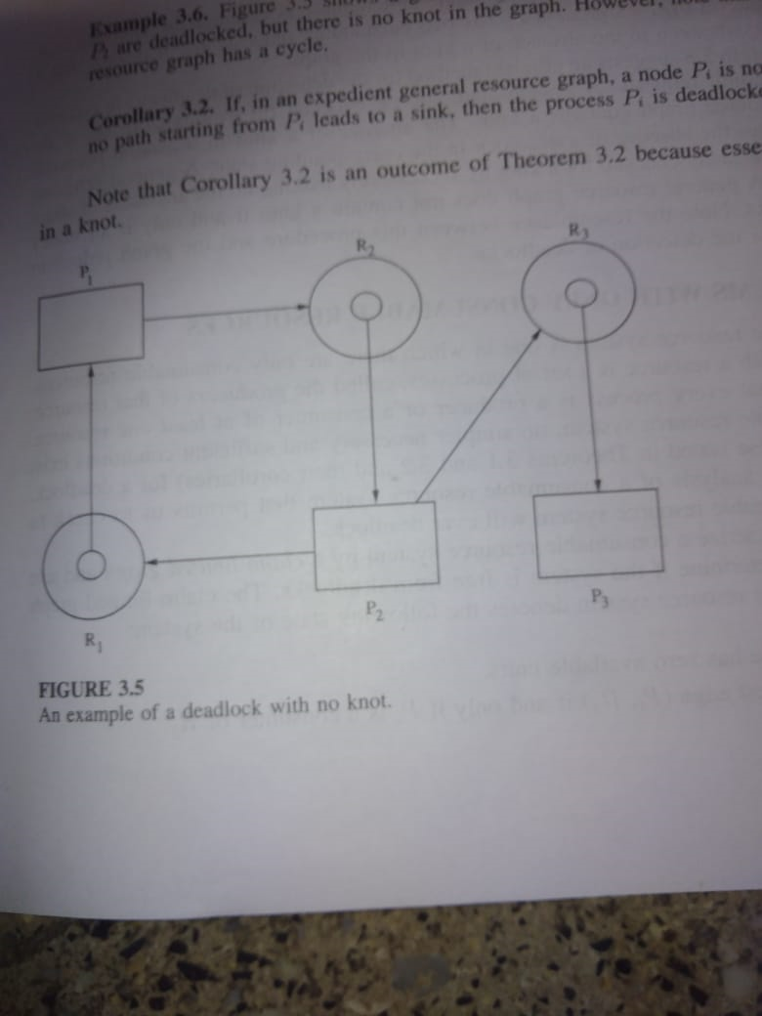
System with Single Unit Request

Slide 136
System with Single Unit Request
Process p2 has two outstanding request and it is seen that a deadlock exists even in the absence of a knot in the graph.
The absence of knot implies the absence of deadlock in corresponding state.

Slide 137
System with Only Consumable Resources
There are only consumable resources.
Associated with the resource is a set of processes, called producer.
Use Claim initiated graph and check if the system is free from deadlock.
Request edge (pi,rj) if and only if pi is consumer of rj.
Resources exhausted- every consumer of every resource- requesting one unit of all the resources .
Fig 3.6 pg 59.
P1 is producer of R1 and consumer of R2.
P2 is producer for R2 and consumer of R1.
If there is a third process that is the producer of any of the resource and not consumer , system would have been deadlock free.

Slide 138
System with Only Reusable Resources
Systems with single unit resources.
Deadlock detection.
Deadlock prevention.
Deadlock Avoidance.

