Slide 1
DISTRIBUTED OPERATING SYSTEMS
Distributed system – describe a system with the following characteristics:
Several computers – don’t share memory or clock.
Communication – exchange message over a communication network.
Each Computer – Own memory + OS
Resources - Local , Remote
Local - Owned and Controlled by a computer.
Remote - Owned and Controlled by other computer – accessed via network.
Accessing remote resources – expensive than local - Communication delay – CPU overhead.

Slide 2
COMMUNICATION NETWORKS
Deals with Communication aspects of Distributed System.
All Computers in DS – interconnected through a Communication n/w.
Computers – exchange msg – access data – through network.
Communication networks – Wide Area Networks , Local Area Networks.

Slide 3
COMMUNICATION NETWORKS
Wide Area Networks
Packet Switching Verses Circuit Switching
OSI Reference Model
Overview of OSI Layers
Local Area Networks

Slide 4
COMMUNICATION NETWORKS
Bus / Tree Topology
CSMA / CD Protocol
Ring Topology

Slide 5
COMMUNICATION PRIMITIVES
Communication Networks – Send raw bit streams of data in DS.
Communication Primitives – high level construct which pgm use with n/w
Communication Models- Message Passing, Remote Procedure Call.

Slide 6
MESSAGE PASSING MODEL
In this method, processes communicate with each other without using any kind of shared memory.
If two processes p1 and p2 want to communicate with each other, they proceed as follows:
Establish a communication link (if a link already exists, no need to establish it again).
Start exchanging messages using basic primitives.
We need at least two primitives:
– send(message, destination) or send(message)
– receive(message, Source) or receive(message)
Ex : Client – Server Computing

Slide 7
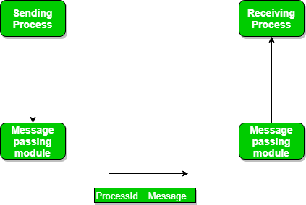
COMMUNICATION PRIMITIVES

Slide 8
SYNCHRONOUS VS ASYNCHRONOUS MESSAGE PASSING:
In standard Message passing model , Messages are copied Three times:
(i) from the user buffer to the kernel buffer - sender
(ii) from the kernel buffer of the sending computer to the kernel buffer of the receiving computer.
(iii) from the kernel buffer on the receiving computer to the user buffer.
These are called as Buffer Option.

Slide 9
SYNCHRONOUS VS ASYNCHRONOUS MESSAGE PASSING:
With non blocking primitives SEND primitive return control to the user program as soon as the message is copied from the user buffer to the kernel buffer.
Receive signal its intention to receive a message and provides a buffer to copy a message.
Receiving process may either check periodically for the arrival of messages or be signaled by the kernel upon the arrival of the messages.

Slide 10
SYNCHRONOUS VS ASYNCHRONOUS MESSAGE PASSING:
With blocking primitives SEND primitive does not return control to the user program until the message has been sent or until an ack has been received.
Receive primitive does not return control until a message is copied to a usesr buffer.
Reliable receive primitive sends an ack.
Unreliable – no ACK.

Slide 11
SYNCHRONOUS VS ASYNCHRONOUS MESSAGE PASSING:
With Synchronous – SEND primitive is blocked until a Receive primitive is executed at the receiving computer.
Asynchronous – the messages are buffered.
SEND not blocked even if there is no corresponding execution of receive.
Receive can be a blocking or non blocking primitive.

Slide 12
SYNCHRONOUS VS ASYNCHRONOUS MESSAGE PASSING:
There are basically three preferred combinations:
Blocking send and blocking receive.
Non-blocking send and Non-blocking receive.
Non-blocking send and Blocking receive (Mostly used).

Slide 13
        Remote Procedure Calls
A remote procedure call is an interprocess communication technique that is used for client-server based applications. It is also known as a subroutine call or a function call.
A client has a request message that the RPC translates and sends to the server.
This request may be a procedure or a function call to a remote server. When the server receives the request, it sends the required response back to the client. The client is blocked while the server is processing the call and only resumed execution after the server is finished.

Slide 14
        Remote Procedure Calls
The sequence of events in a remote procedure call are given as follows −
The client stub is called by the client.
The client stub makes a system call to send the message to the server and puts the parameters in the message.
The message is sent from the client to the server by the client’s operating system.
The message is passed to the server stub by the server operating system.
The parameters are removed from the message by the server stub.
Then, the server procedure is called by the server stub.

Slide 15
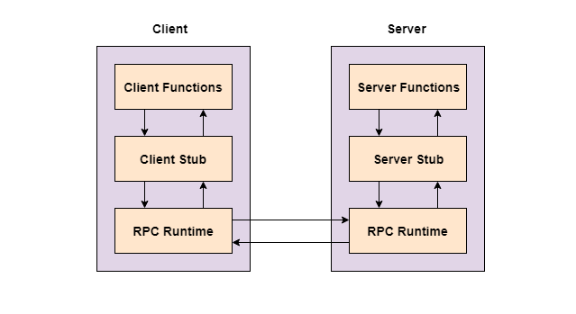
        Remote Procedure Calls

Slide 16
INHERENT LIMITATIONS OF A DISTRIBUTED SYSTEMS
Distributed System is a collection of self-governing computer systems efficient of transmission and cooperation among each other by the means of interconnections between their hardware and software.
It is a collection of loosely coupled processor that appears to its users a single systematic system. Distributed systems has various limitations such as in distributed system there is not any presence of a global state.
This differentiates distributed system computing from databases in which a steady global state is maintained.
Distributed system limitations has the impact on both design and implementation of distributed systems.

Slide 17
INHERENT LIMITATIONS OF A DISTRIBUTED SYSTEMS
There are mainly two limitations of the distributed system which are as following:
Absence of a Global Clock
Absence of Shared Memory

Slide 18
ABSENCE OF A GLOBAL CLOCK
In a distributed system there are a lot of systems and each system has its own clock.
Each clock on each system is running at a different rate or granularity leading to them asynchronous.
In starting the clocks are regulated to keep them consistent, but only after one local clock cycle they are out of the synchronization and no clock has the exact time.

Slide 19
ABSENCE OF A GLOBAL CLOCK
Time is known for a certain precision because it is used for the following in distributed system:
Temporal ordering of events
Collecting up-to-date information on the state of the integrated system
Scheduling of processes

Slide 20
ABSENCE OF A GLOBAL CLOCK
There are restrictions on the precision of time by which processes in a distributed system can synchronize their clocks due to asynchronous message passing.
Every clock in distributed system is synchronize with a more reliable clock, but due to transmission and execution time lapses the clocks becomes different.
Absence of global clock make more difficult the algorithm for designing and debugging of distributed system.

Slide 21
ABSENCE OF SHARED MEMORY:
Distributed systems have not any physically shared memory, all computers in the distributed system have their own specific physical memory.
As computer in the distributed system do not share the common memory, it is impossible for any one system to know the global state of the full distributed system.
Process in the distributed system obtains coherent view of the system but in actual that view is partial view of the system.
As in distributed system there is an absence of a global state, it is challenging to recognize any global property of the system. The global state in distributed system is divided by many number of computers into smaller entities.

Slide 22
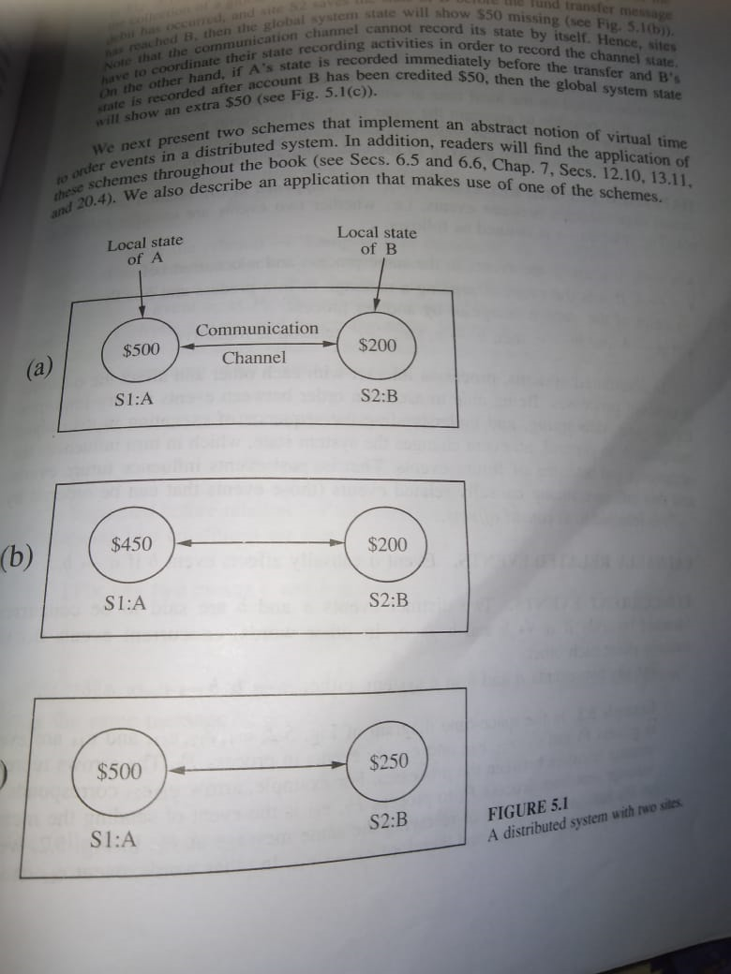
ABSENCE OF SHARED MEMORY:

Slide 23
ABSENCE OF SHARED MEMORY:
S1 , S2 – Two distinct sites of DS.
Bank Account – A , B.
S1 - $ 50 from A –B.
S1 – State of A after transfer.
S2 – State before fund transfer,

Slide 24
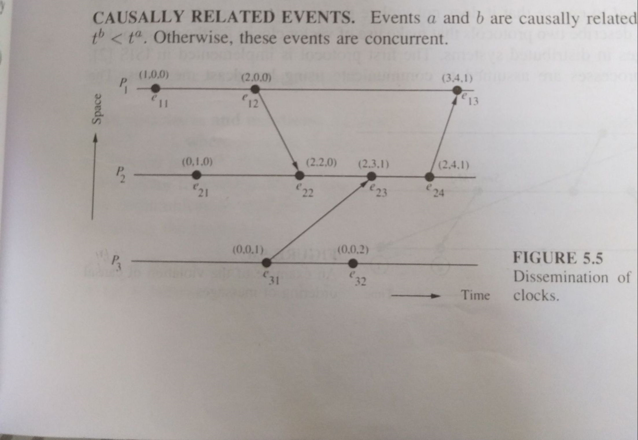
IMPLEMENTATION RULES
[

Slide 25
Causal Ordering
• a ^ b if ta < tb
• Events a and b are causally related if ta < tb or tb < ta, else they are concurrent
• Note that this is still not a total order

Slide 26
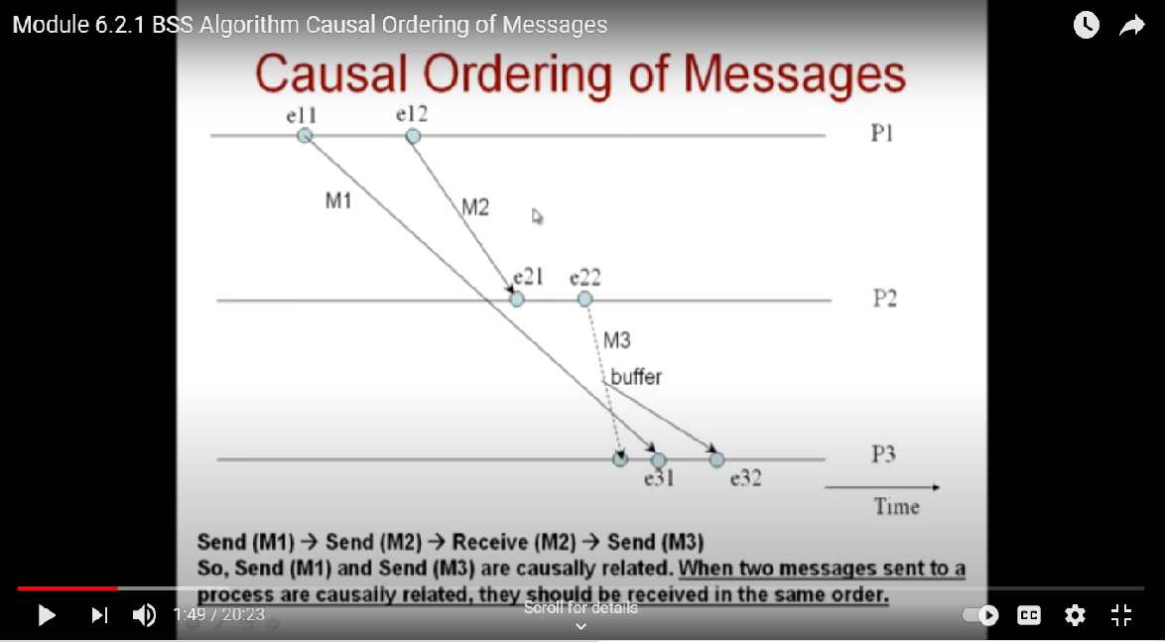
Causal Ordering
• a ^ b if ta < tb
• Events a and b are causally related iff ta < tb or tb < ta, else they are concurrent
• Note that this is still not a total order

Slide 27


Global State Problem
How to collect or record a coherent (consistent) snapshot of the state of an entire distributed system?
One application of this problem is in implementing a breakpoint for debugging a distributed application.
That is, suppose we want to suspend execution of all the processes in a way that we can examine what each of them is doing, and later resume them.

Slide 28
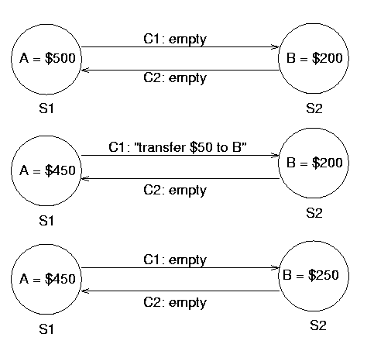
Global State Problem
Banking Example

Slide 29
Chandy-Lamport’s Algorithm
• Uses special marker messages.
• One process acts as initiator, starts the state collection by following the marker sending rule below.
• Marker sending rule for process P:
- P records its state and
- For each outgoing channel C from P on which a marker has not been sent already, P sends a marker along C before any further message is sent on C

Slide 30
Chandy Lamport’s Algorithm contd..
• When Q receives a marker along a channel C:
- If Q has not recorded its state then Q records the state of C as empty; Q then follows the marker sending rule
- If Q has already recorded its state, it records the state of C as the sequence of messages received along C after Q’s state was recorded and before Q received the marker along C

Slide 31
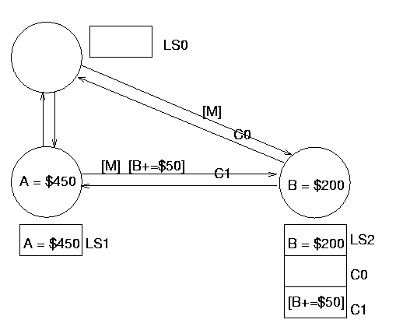
Chandy Lamport’s Algorithm contd..

Slide 32
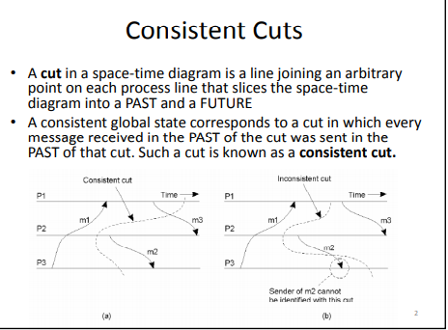
I

Slide 33
I Termination Detection

Slide 34
Termination Detection
• Model
- processes can be active or idle
- only active processes send messages
- idle process can become active on receiving a computation message
- active process can become idle at any time
- Termination: all processes are idle and no computation message are in transit
- Can use global snapshot to detect termination also

Slide 35
Distributed Mutual Exclusion
Mutual exclusion is a concurrency control property which is introduced to prevent race conditions.
It is the requirement that a process can not enter its critical section while another concurrent process is currently present or executing in its critical section i.e only one process is allowed to execute the critical section at any given instance of time.
Mutual exclusion is a concurrency control property which is introduced to prevent race conditions.
It is the requirement that a process can not enter its critical section while another concurrent process is currently present or executing in its critical section i.e only one process is allowed to execute the critical section at any given instance of time.

Slide 36
Requirements of Mutual exclusion Algorithm:
No Deadlock:
Two or more site should not endlessly wait for any message that will never arrive.
No Starvation:
Every site who wants to execute critical section should get an opportunity to execute it in finite time. Any site should not wait indefinitely to execute critical section while other site are repeatedly executing critical section.
Fairness:
Each site should get a fair chance to execute critical section. Any request to execute critical section must be executed in the order they are made i.e Critical section execution requests should be executed in the order of their arrival in the system.
Fault Tolerance:
In case of failure, it should be able to recognize it by itself in order to continue functioning without any disruption.
Mutual exclusion is a concurrency control property which is introduced to prevent race conditions.
It is the requirement that a process can not enter its critical section while another concurrent process is currently present or executing in its critical section i.e only one process is allowed to execute the critical section at any given instance of time.

Slide 37
Solution to distributed mutual exclusion:
Token Based Algorithm:
A unique token is shared among all the sites.
If a site possesses the unique token, it is allowed to enter its critical section.
This approach uses sequence number to order requests for the critical section.
Each requests for critical section contains a sequence number. This sequence number is used to distinguish old and current requests.
This approach ensures Mutual exclusion as the token is unique.
Ex
Suzuki-Kasami’s Broadcast Algorithm
Mutual exclusion is a concurrency control property which is introduced to prevent race conditions.
It is the requirement that a process can not enter its critical section while another concurrent process is currently present or executing in its critical section i.e only one process is allowed to execute the critical section at any given instance of time.

Slide 38
Suzuki-Kasami’s Broadcast Algorithm
Suzuki–Kasami algorithm is a token-based algorithm for achieving mutual exclusion in distributed systems.
This is a permission-based algorithm in which REQUEST and REPLY messages ensure mutual exclusion.
In token-based algorithms, a site is allowed to enter its critical section if it possesses the unique token. Non-token based algorithms uses timestamp to order requests for the critical section whereas sequence number is used in token-based algorithms.
Each requests for critical section contains a sequence number. This sequence number is used to distinguish old and current requests.
Mutual exclusion is a concurrency control property which is introduced to prevent race conditions.
It is the requirement that a process can not enter its critical section while another concurrent process is currently present or executing in its critical section i.e only one process is allowed to execute the critical section at any given instance of time.

Slide 39
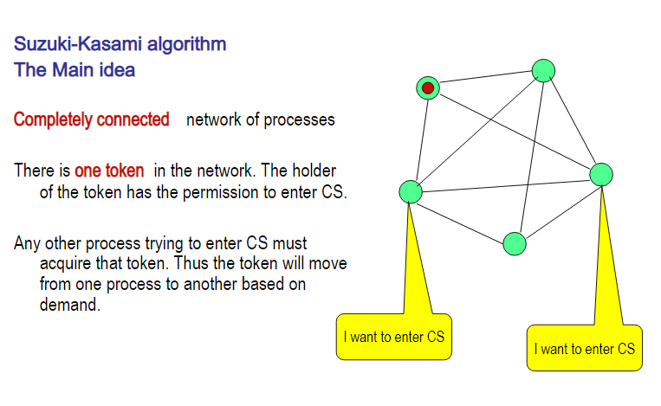
Suzuki-Kasami’s Broadcast Algorithm
Mutual exclusion is a concurrency control property which is introduced to prevent race conditions.
It is the requirement that a process can not enter its critical section while another concurrent process is currently present or executing in its critical section i.e only one process is allowed to execute the critical section at any given instance of time.

Slide 40
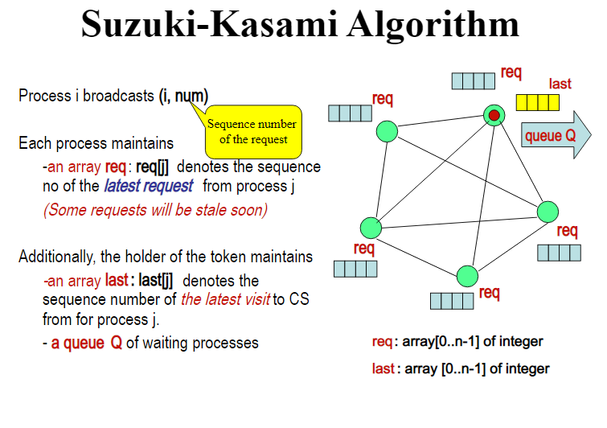
Suzuki-Kasami’s Broadcast Algorithm
Mutual exclusion is a concurrency control property which is introduced to prevent race conditions.
It is the requirement that a process can not enter its critical section while another concurrent process is currently present or executing in its critical section i.e only one process is allowed to execute the critical section at any given instance of time.

Slide 41
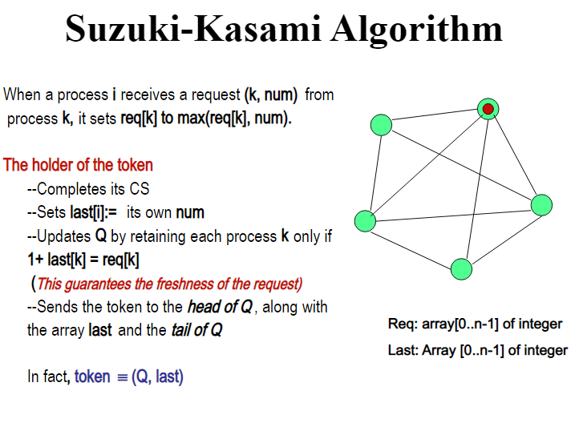
Suzuki-Kasami’s Broadcast Algorithm
Mutual exclusion is a concurrency control property which is introduced to prevent race conditions.
It is the requirement that a process can not enter its critical section while another concurrent process is currently present or executing in its critical section i.e only one process is allowed to execute the critical section at any given instance of time.

Slide 42
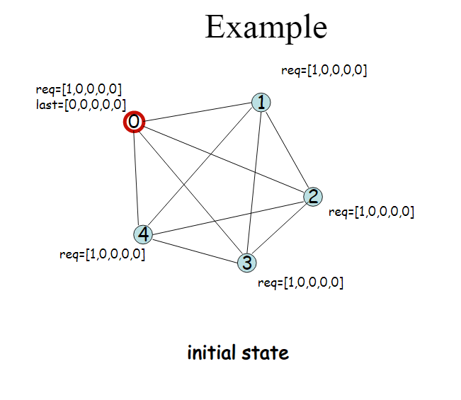
Suzuki-Kasami’s Broadcast Algorithm
Mutual exclusion is a concurrency control property which is introduced to prevent race conditions.
It is the requirement that a process can not enter its critical section while another concurrent process is currently present or executing in its critical section i.e only one process is allowed to execute the critical section at any given instance of time.

Slide 43
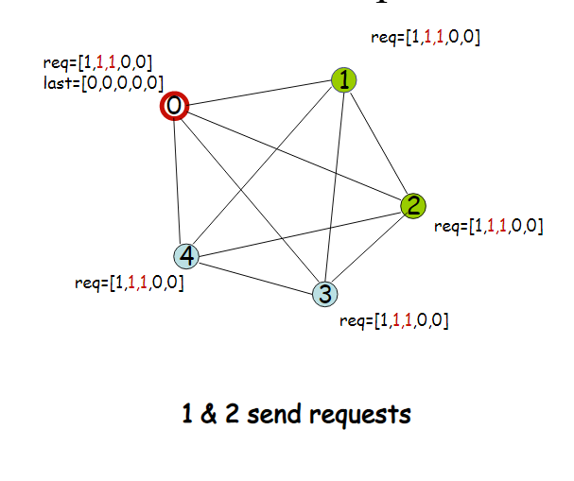
Suzuki-Kasami’s Broadcast Algorithm
Mutual exclusion is a concurrency control property which is introduced to prevent race conditions.
It is the requirement that a process can not enter its critical section while another concurrent process is currently present or executing in its critical section i.e only one process is allowed to execute the critical section at any given instance of time.

Slide 44
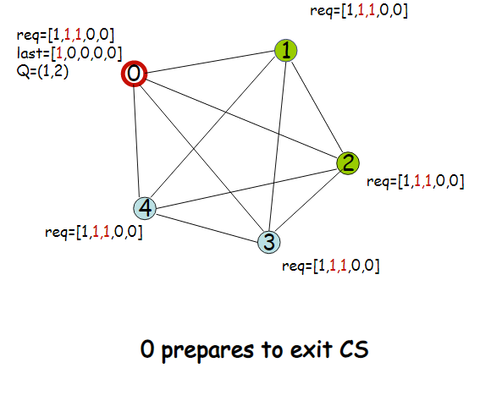
Suzuki-Kasami’s Broadcast Algorithm
Mutual exclusion is a concurrency control property which is introduced to prevent race conditions.
It is the requirement that a process can not enter its critical section while another concurrent process is currently present or executing in its critical section i.e only one process is allowed to execute the critical section at any given instance of time.

Slide 45
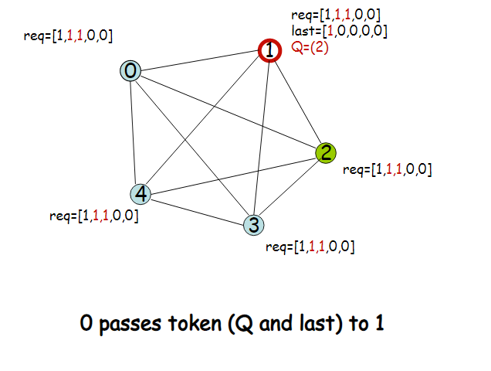
Suzuki-Kasami’s Broadcast Algorithm
Mutual exclusion is a concurrency control property which is introduced to prevent race conditions.
It is the requirement that a process can not enter its critical section while another concurrent process is currently present or executing in its critical section i.e only one process is allowed to execute the critical section at any given instance of time.

Slide 46
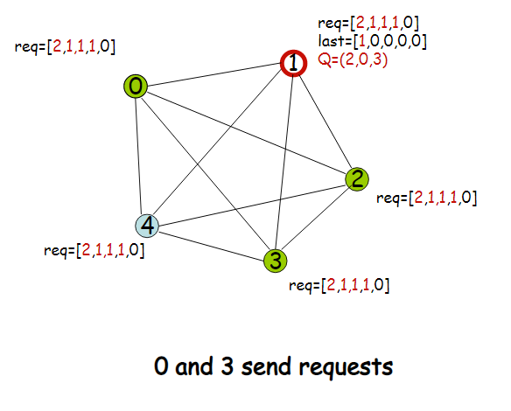
Suzuki-Kasami’s Broadcast Algorithm
Mutual exclusion is a concurrency control property which is introduced to prevent race conditions.
It is the requirement that a process can not enter its critical section while another concurrent process is currently present or executing in its critical section i.e only one process is allowed to execute the critical section at any given instance of time.

Slide 47
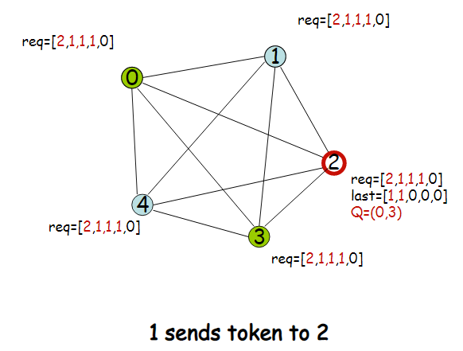
Suzuki-Kasami’s Broadcast Algorithm
Mutual exclusion is a concurrency control property which is introduced to prevent race conditions.
It is the requirement that a process can not enter its critical section while another concurrent process is currently present or executing in its critical section i.e only one process is allowed to execute the critical section at any given instance of time.

Slide 48
NON-TOKEN BASED ALGORITHM
NON-TOKEN BASED APPROACH:
A site communicates with other sites in order to determine which sites should execute critical section next. This requires exchange of two or more successive round of messages among sites.
This approach use timestamps instead of sequence number to order requests for the critical section.
When ever a site make request for critical section, it gets a timestamp. Timestamp is also used to resolve any conflict between critical section requests.
All algorithm which follows non-token based approach maintains a logical clock. Logical clocks get updated according to Lamport’s scheme
Mutual exclusion is a concurrency control property which is introduced to prevent race conditions.
It is the requirement that a process can not enter its critical section while another concurrent process is currently present or executing in its critical section i.e only one process is allowed to execute the critical section at any given instance of time.

Slide 49
Maekawa’s Distributed Mutual Exclusion Algorithm
It is a permission based algorithm proposed by Lamport as an illustration of his synchronization scheme for distributed systems.
permission based timestamp is used to order critical section requests and to resolve any conflict between requests.
In Lamport’s Algorithm critical section requests are executed in the increasing order of timestamps i.e a request with smaller timestamp will be given permission to execute critical section first than a request with larger timestamp.
Mutual exclusion is a concurrency control property which is introduced to prevent race conditions.
It is the requirement that a process can not enter its critical section while another concurrent process is currently present or executing in its critical section i.e only one process is allowed to execute the critical section at any given instance of time.

Slide 50
Lamport’s Distributed Mutual Exclusion Algorithm
In this algorithm:
Three type of messages ( REQUEST, REPLY and RELEASE) are used and communication channels are assumed to follow FIFO order.
A site send a REQUEST message to all other site to get their permission to enter critical section.
A site send a REPLY message to requesting site to give its permission to enter the critical section.
A site send a RELEASE message to all other site upon exiting the critical section.
Every site S_{i}, keeps a queue to store critical section requests ordered by their timestamps.
request_queue_{i} denotes the queue of site S_{i}
A timestamp is given to each critical section request using Lamport’s logical clock.
Timestamp is used to determine priority of critical section requests. Smaller timestamp gets high priority over larger timestamp. The execution of critical section request is always in the order of their timestamp.
Mutual exclusion is a concurrency control property which is introduced to prevent race conditions.
It is the requirement that a process can not enter its critical section while another concurrent process is currently present or executing in its critical section i.e only one process is allowed to execute the critical section at any given instance of time.

Slide 51
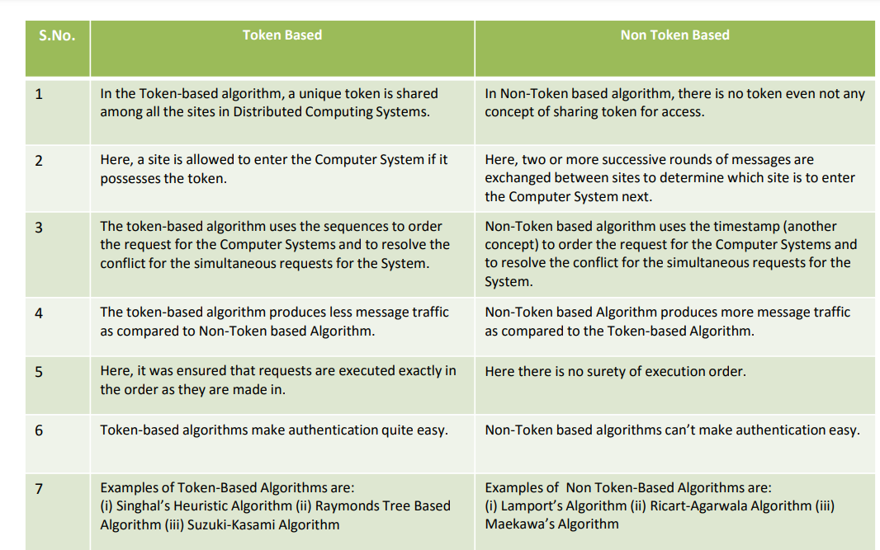

Slide 52
DEADLOCK DETECTION
A deadlock is a condition in a system where a set of processes (or threads) have requests for resources that can never be satisfied.
Essentially, a process cannot proceed because it needs to obtain a resource held by another process but it itself is holding a resource that the other process needs.
Mutual exclusion is a concurrency control property which is introduced to prevent race conditions.
It is the requirement that a process can not enter its critical section while another concurrent process is currently present or executing in its critical section i.e only one process is allowed to execute the critical section at any given instance of time.

Slide 53
Centralized deadlock detection
In the centralized approach, there is only one responsible resource to detect deadlock.
The advantage of this approach is that it is simple and easy to implement, while the drawbacks include excessive workload at one node, single-point failure (that is the whole system is dependent on one node if that node fails the whole system crashes) which in turns makes the system less reliable.
Mutual exclusion is a concurrency control property which is introduced to prevent race conditions.
It is the requirement that a process can not enter its critical section while another concurrent process is currently present or executing in its critical section i.e only one process is allowed to execute the critical section at any given instance of time.

Slide 54
Centralized deadlock detection
Centralized deadlock detection attempts to imitate the non distributed algorithm through a central coordinator.
Each machine is responsible for maintaining a resource graph for its processes and resources.
A central coordinator maintains the resource utilization graph for the entire system: the Global Wait-For Graph.
This graph is the union of the individual Wait-For Graphs. If the coordinator detects a cycle in the global wait-for graph, it aborts one process to break the deadlock.
Mutual exclusion is a concurrency control property which is introduced to prevent race conditions.
It is the requirement that a process can not enter its critical section while another concurrent process is currently present or executing in its critical section i.e only one process is allowed to execute the critical section at any given instance of time.

Slide 55
Centralized deadlock detection
In the non-distributed case, all the information on resource usage lives on one system and the graph may be constructed on that system. In the distributed case, the individual sub graphs have to be propagated to a central coordinator.
A message can be sent each time an arc is added or deleted. If optimization is needed, a list of added or deleted arcs can be sent periodically to reduce the overall number of messages sent.
Mutual exclusion is a concurrency control property which is introduced to prevent race conditions.
It is the requirement that a process can not enter its critical section while another concurrent process is currently present or executing in its critical section i.e only one process is allowed to execute the critical section at any given instance of time.

Slide 56
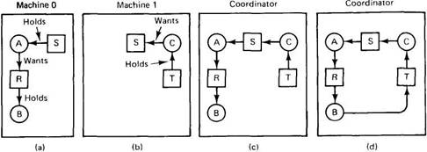
Centralized deadlock detection
Mutual exclusion is a concurrency control property which is introduced to prevent race conditions.
It is the requirement that a process can not enter its critical section while another concurrent process is currently present or executing in its critical section i.e only one process is allowed to execute the critical section at any given instance of time.
(a) Initial resource graph for machine 0. (b) Initial resource graph for machine 1. (c) The coordinator's view of the world. (d) The situation after the delayed message.

Slide 57
Centralized deadlock detection
Consider a system with processes A and B running on machine 0, and process C running on machine 1. Three resources exist: R, S, and T. Initially, the situation is as shown in Fig (a) and (b): A holds S but wants R, which it cannot have because B is using it; C has T and wants S, too. The coordinator's view of the world is shown in Fig. (c). This configuration is safe. As soon as B finishes, A can get R and finish, releasing S for C. After a while, B releases R and asks for T, a perfectly legal and safe swap. Machine 0 sends a message to the coordinator announcing the release of R, and machine 1 sends a message to the coordinator announcing the fact that B is now waiting for its resource, T. Unfortunately, the message from machine 1 arrives first, leading the coordinator to construct the graph of Fig (d). The coordinator incorrectly concludes that a deadlock exists and kills some process. Such a situation is called a false deadlock. Many deadlock algorithms in distributed systems produce false deadlocks like this due to incomplete or delayed information.
Mutual exclusion is a concurrency control property which is introduced to prevent race conditions.
It is the requirement that a process can not enter its critical section while another concurrent process is currently present or executing in its critical section i.e only one process is allowed to execute the critical section at any given instance of time.

Slide 58
Centralized deadlock detection - Solution
One possible way out might be to use Lamport's algorithm to provide global time. Since the message from machine 1 to the coordinator is triggered by the request from machine 0, the message from machine 1 to the coordinator will indeed have a later timestamp than the message from machine 0 to the coordinator. When the coordinator gets the message from machine 1 that leads it to suspect deadlock, it could send a message to every machine in the system saying: "I just received a message with timestamp T which leads to deadlock. If anyone has a message for me with an earlier timestamp, please send it immediately." When every machine has replied, positively or negatively, the coordinator will see that the arc from R to B has vanished, so the system is still safe. Although this method eliminates the false deadlock, it requires global time and is expensive. Furthermore, other situations exist where eliminating false deadlock is much harder.
Mutual exclusion is a concurrency control property which is introduced to prevent race conditions.
It is the requirement that a process can not enter its critical section while another concurrent process is currently present or executing in its critical section i.e only one process is allowed to execute the critical section at any given instance of time.

Slide 59
Distributed deadlock detection
Processes are allowed to request multiple resources at once, instead of one at a time.
By allowing multiple requests simultaneously, the growing phase of a transaction can be speeded up considerably.
The consequence of this change to the model is that a process may now wait for two or more resources simultaneously.
Example: a modified resource graph, where only the processes are shown. Each arc passes through a resource. For simplicity the resources have been omitted from the figure. Process 3 on machine 1 is waiting for two resources, one held by process 4 and one held by process 5.
Mutual exclusion is a concurrency control property which is introduced to prevent race conditions.
It is the requirement that a process can not enter its critical section while another concurrent process is currently present or executing in its critical section i.e only one process is allowed to execute the critical section at any given instance of time.

Slide 60
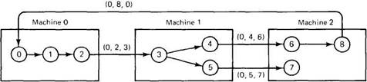
Distributed deadlock detection
Mutual exclusion is a concurrency control property which is introduced to prevent race conditions.
It is the requirement that a process can not enter its critical section while another concurrent process is currently present or executing in its critical section i.e only one process is allowed to execute the critical section at any given instance of time.

Slide 61
Distributed deadlock detection
Some of the processes are waiting for local resources, such as process 1, but others, such are process 2, are waiting for resources that are located on a different machine.
It is precisely these cross-machine arcs that make looking for cycles difficult. The Chandy-Misra-Haas algorithm is invoked when a process has to wait for some resource, for example, process 0 blocking on process 1.
At that point a special probe message is generated and sent to the process (or processes) holding the needed resources. The message consists of three numbers: the process that just blocked, the process sending the message, and the process to whom it is being sent. The initial message from 0 to 1 contains the triple (0, 0, 1).
Mutual exclusion is a concurrency control property which is introduced to prevent race conditions.
It is the requirement that a process can not enter its critical section while another concurrent process is currently present or executing in its critical section i.e only one process is allowed to execute the critical section at any given instance of time.

Slide 62
Distributed deadlock detection
When the message arrives, the recipient checks to see if it itself is waiting for any processes. If so, the message is updated, keeping the first field but replacing the second field by its own process number and the third one by the number of the process it is waiting for.
The message is then sent to the process on which it is blocked. If it is blocked on multiple processes, all of them are sent (different) messages. This algorithm is followed whether the resource is local or remote.
In Fig. we see the remote messages labeled (0, 2, 3), (0, 4, 6), (0, 5, 7), and (0, 8, 0). If a message goes all the way around and comes back to the original sender, that is, the process listed in the first field, a cycle exists and the system is deadlocked.
Mutual exclusion is a concurrency control property which is introduced to prevent race conditions.
It is the requirement that a process can not enter its critical section while another concurrent process is currently present or executing in its critical section i.e only one process is allowed to execute the critical section at any given instance of time.

Slide 63
Distributed deadlock prevention
Deadlock prevention consists of carefully designing the system so that deadlocks are structurally impossible.
Various techniques include allowing processes to hold only one resource at a time, requiring processes to request all their resources initially, and making processes release all resources when asking for a new one. All of these are cumbersome in practice.
A method that sometimes works is to order all the resources and require processes to acquire them in strictly increasing order. This approach means that a process can never hold a high resource and ask for a low one, thus making cycles impossible.
Mutual exclusion is a concurrency control property which is introduced to prevent race conditions.
It is the requirement that a process can not enter its critical section while another concurrent process is currently present or executing in its critical section i.e only one process is allowed to execute the critical section at any given instance of time.

Slide 64
Distributed deadlock prevention
The idea behind the algorithm is that when one process is about to block waiting for a resource that another process is using, a check is made to see which has a larger timestamp (i.e., is younger). We can then allow the wait only if the waiting process has a lower timestamp (is older) than the process waited for. In this manner, following any chain of waiting processes, the timestamps always increase, so cycles are impossible. Alternatively, we can allow processes to wait only if the waiting process has a higher timestamp (is younger) than the process waited for, in which case the timestamps decrease along the chain. Although both methods prevent deadlocks, it is wiser to give priority to older processes. They have run longer, so the system has a larger investment in them, and they are likely to hold more resources. Also, a young process that is killed off will eventually age until it is the oldest one in the system, so this choice eliminates starvation. As we have pointed out before, killing a transaction is relatively harmless, since by definition it can be restarted safely later.
Mutual exclusion is a concurrency control property which is introduced to prevent race conditions.
It is the requirement that a process can not enter its critical section while another concurrent process is currently present or executing in its critical section i.e only one process is allowed to execute the critical section at any given instance of time.

Slide 65
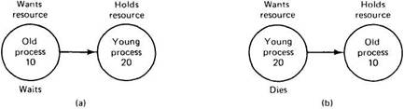
Distributed deadlock prevention
To make this algorithm clearer, consider the situation of Fig. 3-25. In (a), an old process wants a resource held by a young process. In (b), a young process wants a resource held by an old process. In one case we should allow the process to wait; in the other we should kill it. Suppose that we label (a) dies and (b) wait. Then we are killing off an old process trying to use a resource held by a young process, which is inefficient. Thus we must label it the other way, as shown in the figure. Under these conditions, the arrows always point in the direction of increasing transaction numbers, making cycles impossible. This algorithm is called wait-die.
Mutual exclusion is a concurrency control property which is introduced to prevent race conditions.
It is the requirement that a process can not enter its critical section while another concurrent process is currently present or executing in its critical section i.e only one process is allowed to execute the critical section at any given instance of time.

Slide 66
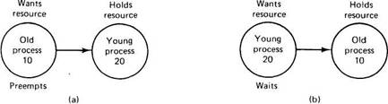
Distributed deadlock prevention
Now consider the situation of Fig. 3-26, where we are going to allow preemption. Given that our system believes in ancestor worship, as we discussed above, we do not want a young whippersnapper preempting a venerable old sage, so Fig. 3-26(a) and not Fig. 3-26(b) is labeled preempt. We can now safely label Fig. 3-26(b) wait. This algorithm is known as wound-wait, because one transaction is supposedly wounded (it is actually killed) and the other waits
Mutual exclusion is a concurrency control property which is introduced to prevent race conditions.
It is the requirement that a process can not enter its critical section while another concurrent process is currently present or executing in its critical section i.e only one process is allowed to execute the critical section at any given instance of time.

Slide 67
Distributed deadlock prevention
If an old process wants a resource held by a young one, the old process preempts the young one, whose transaction is then killed, as depicted in Fig.
The young one probably starts up again immediately, and tries to acquire the resource, leading to Fig. 3-26(b), forcing it to wait. Contrast this algorithm with wait-die.
There, if an oldtimer wants a resource held by a young squirt, the oldtimer waits politely. However, if the young one wants a resource held by the old one, the young one is killed. It will undoubtedly start up again and be killed again.
Mutual exclusion is a concurrency control property which is introduced to prevent race conditions.
It is the requirement that a process can not enter its critical section while another concurrent process is currently present or executing in its critical section i.e only one process is allowed to execute the critical section at any given instance of time.

Slide 68
DISTRIBUTED DEADLOCK DETECTION
A deadlock is a condition in a system where a set of processes (or threads) have requests for resources that can never be satisfied.
Essentially, a process cannot proceed because it needs to obtain a resource held by another process but it itself is holding a resource that the other process needs.
Mutual exclusion is a concurrency control property which is introduced to prevent race conditions.
It is the requirement that a process can not enter its critical section while another concurrent process is currently present or executing in its critical section i.e only one process is allowed to execute the critical section at any given instance of time.

Slide 69
DISTRIBUTED DEADLOCK DETECTION
A directed graph model used to record the resource allocation state of a system. This state consists of n processes, P₁ … P_{n}, and m resources, R₁ … $_{m}.
In such a graph:
P₁ → R₁ means that resource R₁ is allocated to process P₁.
P₁ ← R₁ means that resource R₁ is requested by process P₁.
Deadlock is present when the graph has a directed cycles.
Mutual exclusion is a concurrency control property which is introduced to prevent race conditions.
It is the requirement that a process can not enter its critical section while another concurrent process is currently present or executing in its critical section i.e only one process is allowed to execute the critical section at any given instance of time.

Slide 70
Centralized deadlock detection
In the centralized approach, there is only one responsible resource to detect deadlock.
The advantage of this approach is that it is simple and easy to implement, while the drawbacks include excessive workload at one node, single-point failure (that is the whole system is dependent on one node if that node fails the whole system crashes) which in turns makes the system less reliable.
Mutual exclusion is a concurrency control property which is introduced to prevent race conditions.
It is the requirement that a process can not enter its critical section while another concurrent process is currently present or executing in its critical section i.e only one process is allowed to execute the critical section at any given instance of time.

Slide 71
Centralized deadlock detection
Centralized deadlock detection attempts to imitate the non distributed algorithm through a central coordinator.
Each machine is responsible for maintaining a resource graph for its processes and resources.
A central coordinator maintains the resource utilization graph for the entire system: the Global Wait-For Graph.
This graph is the union of the individual Wait-For Graphs. If the coordinator detects a cycle in the global wait-for graph, it aborts one process to break the deadlock.
Mutual exclusion is a concurrency control property which is introduced to prevent race conditions.
It is the requirement that a process can not enter its critical section while another concurrent process is currently present or executing in its critical section i.e only one process is allowed to execute the critical section at any given instance of time.

Slide 72
Centralized deadlock detection
In the non-distributed case, all the information on resource usage lives on one system and the graph may be constructed on that system. In the distributed case, the individual sub graphs have to be propagated to a central coordinator.
A message can be sent each time an arc is added or deleted. If optimization is needed, a list of added or deleted arcs can be sent periodically to reduce the overall number of messages sent.
Mutual exclusion is a concurrency control property which is introduced to prevent race conditions.
It is the requirement that a process can not enter its critical section while another concurrent process is currently present or executing in its critical section i.e only one process is allowed to execute the critical section at any given instance of time.

Slide 73
Centralized deadlock detection
Mutual exclusion is a concurrency control property which is introduced to prevent race conditions.
It is the requirement that a process can not enter its critical section while another concurrent process is currently present or executing in its critical section i.e only one process is allowed to execute the critical section at any given instance of time.
(a) Initial resource graph for machine 0. (b) Initial resource graph for machine 1. (c) The coordinator's view of the world. (d) The situation after the delayed message.

Slide 74
Centralized deadlock detection
Consider a system with processes A and B running on machine 0, and process C running on machine 1. Three resources exist: R, S, and T. Initially, the situation is as shown in Fig (a) and (b): A holds S but wants R, which it cannot have because B is using it; C has T and wants S, too. The coordinator's view of the world is shown in Fig. (c). This configuration is safe. As soon as B finishes, A can get R and finish, releasing S for C. After a while, B releases R and asks for T, a perfectly legal and safe swap. Machine 0 sends a message to the coordinator announcing the release of R, and machine 1 sends a message to the coordinator announcing the fact that B is now waiting for its resource, T. Unfortunately, the message from machine 1 arrives first, leading the coordinator to construct the graph of Fig (d). The coordinator incorrectly concludes that a deadlock exists and kills some process. Such a situation is called a false deadlock. Many deadlock algorithms in distributed systems produce false deadlocks like this due to incomplete or delayed information.
Mutual exclusion is a concurrency control property which is introduced to prevent race conditions.
It is the requirement that a process can not enter its critical section while another concurrent process is currently present or executing in its critical section i.e only one process is allowed to execute the critical section at any given instance of time.

Slide 75
Centralized deadlock detection - Solution
One possible way out might be to use Lamport's algorithm to provide global time. Since the message from machine 1 to the coordinator is triggered by the request from machine 0, the message from machine 1 to the coordinator will indeed have a later timestamp than the message from machine 0 to the coordinator. When the coordinator gets the message from machine 1 that leads it to suspect deadlock, it could send a message to every machine in the system saying: "I just received a message with timestamp T which leads to deadlock. If anyone has a message for me with an earlier timestamp, please send it immediately." When every machine has replied, positively or negatively, the coordinator will see that the arc from R to B has vanished, so the system is still safe. Although this method eliminates the false deadlock, it requires global time and is expensive. Furthermore, other situations exist where eliminating false deadlock is much harder.
Mutual exclusion is a concurrency control property which is introduced to prevent race conditions.
It is the requirement that a process can not enter its critical section while another concurrent process is currently present or executing in its critical section i.e only one process is allowed to execute the critical section at any given instance of time.

Slide 76
Distributed deadlock detection
Processes are allowed to request multiple resources at once, instead of one at a time.
By allowing multiple requests simultaneously, the growing phase of a transaction can be speeded up considerably.
The consequence of this change to the model is that a process may now wait for two or more resources simultaneously.
Example: a modified resource graph, where only the processes are shown. Each arc passes through a resource. For simplicity the resources have been omitted from the figure. Process 3 on machine 1 is waiting for two resources, one held by process 4 and one held by process 5.
Mutual exclusion is a concurrency control property which is introduced to prevent race conditions.
It is the requirement that a process can not enter its critical section while another concurrent process is currently present or executing in its critical section i.e only one process is allowed to execute the critical section at any given instance of time.

Slide 77
Distributed deadlock detection
Mutual exclusion is a concurrency control property which is introduced to prevent race conditions.
It is the requirement that a process can not enter its critical section while another concurrent process is currently present or executing in its critical section i.e only one process is allowed to execute the critical section at any given instance of time.

Slide 78
Distributed deadlock detection
Some of the processes are waiting for local resources, such as process 1, but others, such are process 2, are waiting for resources that are located on a different machine.
It is precisely these cross-machine arcs that make looking for cycles difficult. The Chandy-Misra-Haas algorithm is invoked when a process has to wait for some resource, for example, process 0 blocking on process 1.
At that point a special probe message is generated and sent to the process (or processes) holding the needed resources. The message consists of three numbers: the process that just blocked, the process sending the message, and the process to whom it is being sent. The initial message from 0 to 1 contains the triple (0, 0, 1).
Mutual exclusion is a concurrency control property which is introduced to prevent race conditions.
It is the requirement that a process can not enter its critical section while another concurrent process is currently present or executing in its critical section i.e only one process is allowed to execute the critical section at any given instance of time.

Slide 79
Distributed deadlock detection
When the message arrives, the recipient checks to see if it itself is waiting for any processes. If so, the message is updated, keeping the first field but replacing the second field by its own process number and the third one by the number of the process it is waiting for.
The message is then sent to the process on which it is blocked. If it is blocked on multiple processes, all of them are sent (different) messages. This algorithm is followed whether the resource is local or remote.
In Fig. we see the remote messages labeled (0, 2, 3), (0, 4, 6), (0, 5, 7), and (0, 8, 0). If a message goes all the way around and comes back to the original sender, that is, the process listed in the first field, a cycle exists and the system is deadlocked.
Mutual exclusion is a concurrency control property which is introduced to prevent race conditions.
It is the requirement that a process can not enter its critical section while another concurrent process is currently present or executing in its critical section i.e only one process is allowed to execute the critical section at any given instance of time.

Slide 80
Distributed deadlock prevention
Deadlock prevention consists of carefully designing the system so that deadlocks are structurally impossible.
Various techniques include allowing processes to hold only one resource at a time, requiring processes to request all their resources initially, and making processes release all resources when asking for a new one. All of these are cumbersome in practice.
A method that sometimes works is to order all the resources and require processes to acquire them in strictly increasing order. This approach means that a process can never hold a high resource and ask for a low one, thus making cycles impossible.
Mutual exclusion is a concurrency control property which is introduced to prevent race conditions.
It is the requirement that a process can not enter its critical section while another concurrent process is currently present or executing in its critical section i.e only one process is allowed to execute the critical section at any given instance of time.

Slide 81
Distributed deadlock prevention
The idea behind the algorithm is that when one process is about to block waiting for a resource that another process is using, a check is made to see which has a larger timestamp (i.e., is younger). We can then allow the wait only if the waiting process has a lower timestamp (is older) than the process waited for. In this manner, following any chain of waiting processes, the timestamps always increase, so cycles are impossible. Alternatively, we can allow processes to wait only if the waiting process has a higher timestamp (is younger) than the process waited for, in which case the timestamps decrease along the chain. Although both methods prevent deadlocks, it is wiser to give priority to older processes. They have run longer, so the system has a larger investment in them, and they are likely to hold more resources. Also, a young process that is killed off will eventually age until it is the oldest one in the system, so this choice eliminates starvation. As we have pointed out before, killing a transaction is relatively harmless, since by definition it can be restarted safely later.
Mutual exclusion is a concurrency control property which is introduced to prevent race conditions.
It is the requirement that a process can not enter its critical section while another concurrent process is currently present or executing in its critical section i.e only one process is allowed to execute the critical section at any given instance of time.

Slide 82
Distributed deadlock prevention
To make this algorithm clearer, consider the situation of Fig. 3-25. In (a), an old process wants a resource held by a young process. In (b), a young process wants a resource held by an old process. In one case we should allow the process to wait; in the other we should kill it. Suppose that we label (a) dies and (b) wait. Then we are killing off an old process trying to use a resource held by a young process, which is inefficient. Thus we must label it the other way, as shown in the figure. Under these conditions, the arrows always point in the direction of increasing transaction numbers, making cycles impossible. This algorithm is called wait-die.
Mutual exclusion is a concurrency control property which is introduced to prevent race conditions.
It is the requirement that a process can not enter its critical section while another concurrent process is currently present or executing in its critical section i.e only one process is allowed to execute the critical section at any given instance of time.

Slide 83
Distributed deadlock prevention
Now consider the situation of Fig. 3-26, where we are going to allow preemption. Given that our system believes in ancestor worship, as we discussed above, we do not want a young whippersnapper preempting a venerable old sage, so Fig. 3-26(a) and not Fig. 3-26(b) is labeled preempt. We can now safely label Fig. 3-26(b) wait. This algorithm is known as wound-wait, because one transaction is supposedly wounded (it is actually killed) and the other waits
Mutual exclusion is a concurrency control property which is introduced to prevent race conditions.
It is the requirement that a process can not enter its critical section while another concurrent process is currently present or executing in its critical section i.e only one process is allowed to execute the critical section at any given instance of time.

Slide 84
Distributed deadlock prevention
If an old process wants a resource held by a young one, the old process preempts the young one, whose transaction is then killed, as depicted in Fig.
The young one probably starts up again immediately, and tries to acquire the resource, leading to Fig. 3-26(b), forcing it to wait. Contrast this algorithm with wait-die.
There, if an oldtimer wants a resource held by a young squirt, the oldtimer waits politely. However, if the young one wants a resource held by the old one, the young one is killed. It will undoubtedly start up again and be killed again.
Mutual exclusion is a concurrency control property which is introduced to prevent race conditions.
It is the requirement that a process can not enter its critical section while another concurrent process is currently present or executing in its critical section i.e only one process is allowed to execute the critical section at any given instance of time.

