Slide 1
t

Slide 2
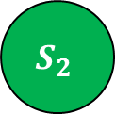
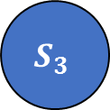
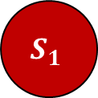
$$S_{1}$$
$$S_{2}$$
$$S_{3}$$

Slide 3
ID
Variable1
Variable2
ID
Variable1
A
B
C
1
2
3
X
Y
Z
A=2 B=1 C=5
A=4 B=2 C=8
A=1 C=6
1
2
3
X
Y
Z
2
4
1
1
2
0
5
8
6
.
.
.
.
.
.
.
.
.
.
.
.
.
.
.
.
.
.
.
.
.
.
.
.

Slide 4
Software package_1
Software package_2
CPU utilization
CPU utilization_1
CPU utilization_2
Software package
update

Slide 5
Software release
Test case
CPU utilization
Software package
update

Slide 6
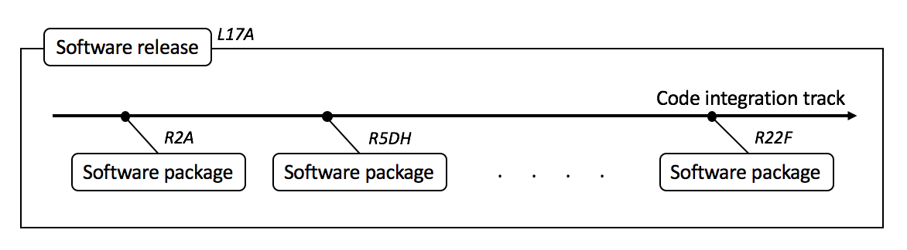
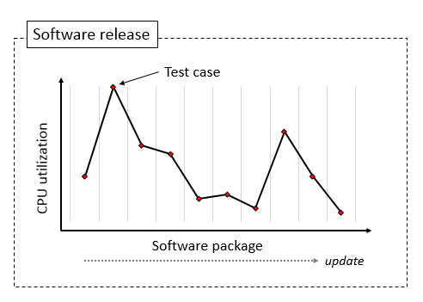

Slide 7
Software release
L17A
Code integration track
R2A
R5DH
R22F
Software package
Software package
. . . .
Software package

Slide 8


Software package
R2A
QA Capacity
Automated test suites
Post-processing
Test suite
Logging loop
Test suite
Logging loop
.
.
.

Slide 9
Software package
R2A
QA Capacity
Automated test suites
Logging loop
Post-processing
Test case
Test suite
Test case
.
.
.
Logging loop
Post-processing
Test case
Test suite
Test case
.
.
.

Slide 10



MME
MME
eNB
Cell
0
eNB
eNB
UE
E-UTRAN

Slide 11
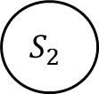

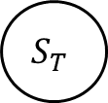
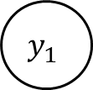
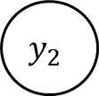
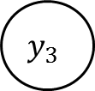
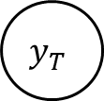

Latent
states
$$S_{1}$$
$$S_{2}$$
$$S_{3}$$
$$S_{T}$$
. . .
Observable
$$y_{1}$$
$$y_{2}$$
$$y_{3}$$
. . .
$$y_{T}$$

Slide 12




Expansion $(S_{1})$
Recession $(S_{2})$
$$S_{1}$$
$$S_{2}$$

Slide 13
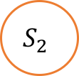




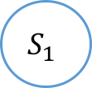
$$p_{12}$$
$$p_{11}$$
$$S_{1}$$
$$S_{2}$$
$$p_{22}$$
$$p_{21}$$

Slide 14




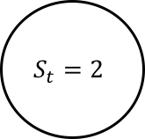
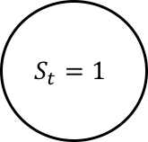
$$p_{12}$$
$$S_{t}=1$$
$$S_{t}=2$$
$$p_{11}$$
$$p_{22}$$
$$p_{21}$$

Slide 15
Start
Initial value
E-step
1 to T
Filtering
T to 1
Smoothing
M-step
Converged
End

Slide 16
Converged
Start
E-step
M-step
End
Initial
values
Filtering
Smoothing
from 1 to T
from T-1 to 1

Slide 17
E-step
False
Initial
values
Converged
Start
Filtering
Smoothing
M-step
True
End
from 1 to T
from T-1 to 1

Slide 18
[A, B, C, D, E]
[A, B, D]
[C, E]
[A, D]
A
D
B
C
E

