Slide 1
t

Slide 2
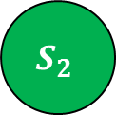

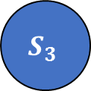
$$S_{1}$$
$$S_{2}$$
$$S_{3}$$

Slide 3
ID
Variable1
Variable2
ID
Variable1
A
B
C
1
2
3
X
Y
Z
A=2 B=1 C=5
A=4 B=2 C=8
A=1 C=6
1
2
3
X
Y
Z
2
4
1
1
2
0
5
8
6
.
.
.
.
.
.
.
.
.
.
.
.
.
.
.
.
.
.
.
.
.
.
.
.

Slide 4
Software package_1
Software package_2
CPU utilization
CPU utilization_1
CPU utilization_2
Software package
update

