Slide 1




Title: Animal Substitution
I have a lot of animals in my house! Their numbers add up to 15. What could I have?
= 5
= 3
= 2
= 10

Slide 2
Title: Animal Substitution
Bronze – substitute values into algebraic addition and subtractions (L4)
Silver – substitute values into a range of algebraic expressions (L5)
Gold – write your own algebraic puzzle (L5)

Slide 3
4 min
a = 3 b = 6 c = 5
Bronze
a + 2
b – 3
c + a
a + b + c
b – c
3a
Silver
3c
b/a
4a
ab
bc
2a + b
Gold
3c – b
2b – 2a
2ac
2b/a
2c -3a
2a + b + 2c

Slide 4
4 min
a = 3 b = 6 c = 5
Bronze
5
3
8
14
1
9
Silver
15
2
12
18
30
12
Gold
9
6
30
4
1
22

Slide 5

Well done – you are now a zoo keeper! ☺

Slide 6
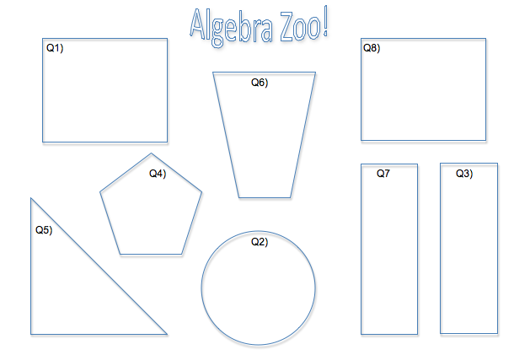
…but your zoo is currently empty ☹ You need to know what animals to put in!

Slide 7
Break the code then scramble the letters to find out what animal goes in which enclosure. Then, draw it in!
e.g. 2C D – W 2G

Slide 8
Break the code then scramble the letters to find out what animal goes in which enclosure. Then, draw it in!
e.g. 2C D – W 2G
A
C
T

Slide 9
8 min Q1-3
Break the code then scramble the letters to find out what animal goes in which enclosure. Then, draw it in!
e.g. 2C D – W 2G
A
C
T
C
A
T

Slide 10
8 min Q4-6
Break the code then scramble the letters to find out what animal goes in which enclosure. Then, draw it in!
Q1) Lion
Q2) Bears
Q3) Snakes

Slide 11
6 min Q7&8
Break the code then scramble the letters to find out what animal goes in which enclosure. Then, draw it in!
Q1) Lion
Q2) Bears
Q3) Snakes
Q4) Penguin
Q5) Hippo
Q6) Meerkat

Slide 12
6 min puzzle
Q1) Lion
Q2) Bears
Q3) Snakes
Q4) Penguin
Q5) Hippo
Q6) Meerkat
Q7) Giraffe
Q8) Elephant
Challenge: Can you make up your own puzzle?
Pick an animal and write out all the letters
2) Write a puzzle that gives each lesson as an answer,
e.g. S = 40 = 2T
3) Jumble up your questions, and swap with a friend ☺

Slide 13
a = 5 b = 10 c = 8
Bronze:
a + b =
b – c =
Silver:
2b =
b/a =
Gold:
2c + a =
2b/a =
Pick the hardest question you can to see which level you reached today! ☺

