Slide 1
From content to search:
Speed-dating Apache Solr
Alexandre Rafalovitch
Apache Solr Committer
Apache Solr Popularizer
@arafalov

Slide 2
Apache Solr search engine features
Advanced full-text search – very very advanced!
Facets and aggregations
SolrCloud for scale
Extremely configurable
  Config files
  Extension points
  Plugins
Near Real-Time indexing
Multiple input formats: XML, JSON, CSV, GeoJSON
Multiple output formats: XML, JSON, CSV, GeoJSON, PHP, Ruby, Python, XLSX…
Multiple client options: SolrJ, JavaScript, Python, PHP, R, Ruby…..
Integrates Apache Lucene, Tika, Log4J, Xerces, ZooKeeper, Velocity, OpenNLP
Integrates IBM ICU4J (Unicode), Carrot (document clustering)
Has web-based Admin UI based on public APIs
Can also do Graphs, Machine Learning, SQL, Linear Algebra…
The little Search engine that could!

Slide 3
Learning Solr
Solr Reference Guide
  1250! pages of goodness
  Important! Solr WIKI is no longer primary source
Ships with many examples (with explanations in comments):
  techproducts
  cloud
  schemaless
  dih (DataImportHandler – 5 examples)
  films
  files
Solr Users mailing list, IRC channel, StackOverflow,
Videos on YouTube from Lucene/Solr Revolution (Activate, as of 2018)
http://www.solr-start.com/ - My reference website

Slide 4
Can be a bit too much
Solr Reference Guide is feature-organized
  Some powerful features are hard to locate
Examples are a bit of a kitchen-sink
Printed books cannot keep up
Many examples use artificial, tuned datasets
Several ways to do similar things

Slide 5
Today – we start to solve that
Use the smallest learning configuration
Latest cool features
End-to-end
Evolve from the queries backwards
Real life example(s)
  Use “Data is plural” - Newsletter of useful/curious real-life datasets
  https://tinyletter.com/data-is-plural
  Sent by Jeremy Singer-Vine (https://www.jsvine.com/)
Just a taste – but a good one
  Enough for you to understand how to keep learning by yourself
  Repo: https://github.com/arafalov/solr-apachecon2018-presentation

Slide 6
Learning setup
Minimal setup
  1 Server
  1 Collection/Core (per example)
  Minimal schema (no extra types)
  Minimal configuration (all defaults, no caches, etc.)
Larger production setup
  Multiple servers and Zookeepers (SolrCloud)
  Multiple collections with shards, replicas
  Full configuration (see Reference Guide)

Slide 7
Rapid (Search) Application Development
10 Get the Solr server running
20 Create new core with custom config
30 Index some data
40 Run some queries/facets/aggregation/graph analysis/...
50 IF NOT HAPPY
60 Identify improvement
70 Evolve schema/configuration
80 Re/Index data
90 GOTO 40
100 ENDIF

Slide 8
Setting up our own server
Shipped examples are preconfigured
  Magic location
  Magic config files (in server/solr/configsets/<templatedir>/conf)
  Hard to do multiple examples
  Confusing to grow to production, later
For clarity, let’s setup our own server
  Create server root directory (e.g. sroot )
  Copy solr.xml to sroot (from <solr install>/server/solr)
  bin/solr -s <path to sroot>
    All bin commands are in <solr install>/bin/
    Default Solr port is 8983, other ports offset from that

Slide 9
Minimal learning config
Absolute minimum – 2 files
  managed-schema (an XML file)
    Definition of fields, field types, unique keys
    Can be managed by API directly (removes comments on use)
  solrconfig.xml (also an XML file)
    Endpoints, Default parameters, Caches, Pre-processing pipelines, ...
    A lot of system-admin and production config
    Cannot be modified by API directly, but there are overlays and request parameters APIs
We will also use:
  params.json
    supplements solrconfig.xml
    helps to manage request parameter defaults with API
Get them: https://github.com/arafalov/solr-apachecon2018-presentation/tree/master/configsets/minimal

Slide 10
Create Collection/Core
bin/solr create -c dip
-d .../minimal
  Collection/core name: dip
  Our 3 config files are in .../minimal
  Uses API to talk to the server
Creates full structure under sroot/dip
  Exception: logs (by default) <solr install>/server/logs
For SolrCloud, configs are in ZooKeeper!

Slide 11
Dataset - “Data is Plural” itself
Google sheet linked from https://tinyletter.com/data-is-plural
Save as .tsv (tab-separated values)
  Mine goes until 12 Sept 2018
Solr can index .csv, also .tsv with help
  https://lucene.apache.org/solr/guide/7_4/post-tool.html#indexing-csv
  https://lucene.apache.org/solr/guide/7_4/uploading-data-with-index-handlers.html#csv-formatted-index-updates

Slide 12
Index the content
bin/post -c dip
-params "separator=%09"
-type "text/csv"
.../dip-data.tsv
Fails as mandatory uniqueKey id field is missing
Let’s use rowid as unique id
bin/post -c dip
-params "separator=%09&rowid=id"
-type "text/csv"
.../dip-data.tsv
AND BOOM – We are ready for SEARCH

Slide 13
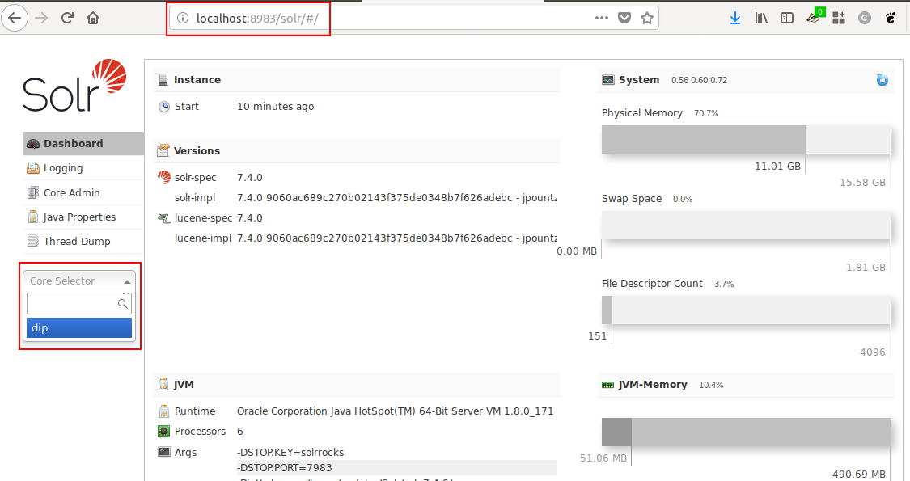
Admin UI
Start searching with Admin UI
http://localhost:8983/ - redirects to UI

Slide 14
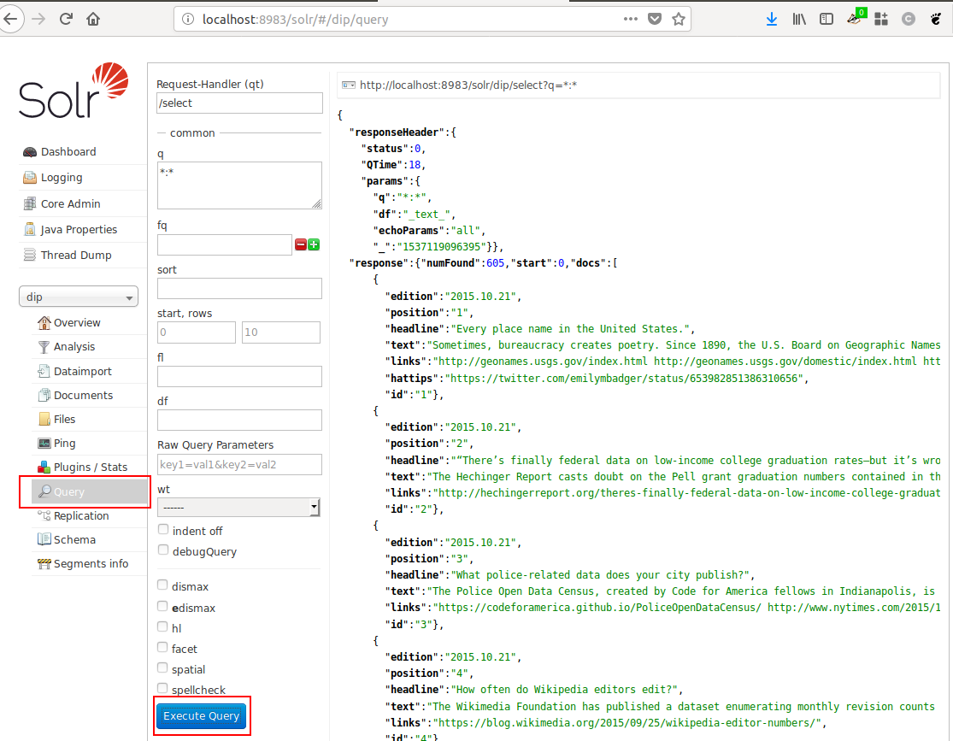
Default search

Slide 15
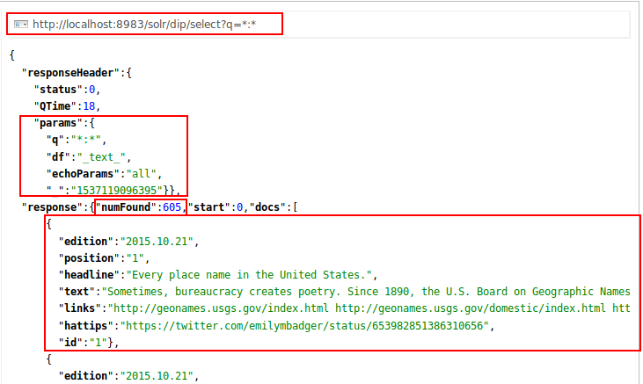
Default search – result details

Slide 16
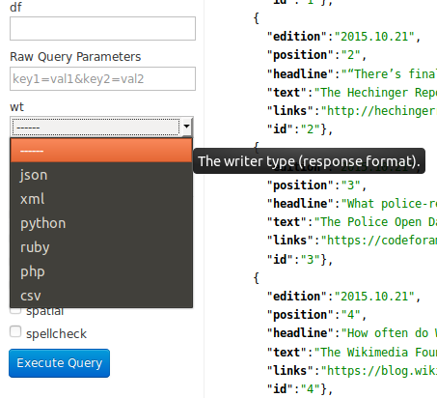
Output formats (wt)
JSON by default:
http://localhost:8983/solr/dip/select?q=*:*
http://localhost:8983/solr/dip/select?q=*:*&wt=ruby

Slide 17
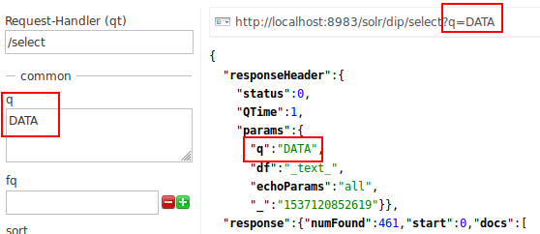
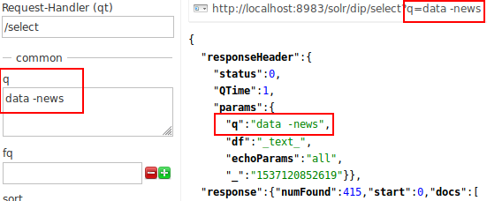
Basic searches
Case-insensitive search (why?)
  Search for ‘data’ in the q input box
  Search for ‘DATA’ instead
  Same 461 results
  What defines case sensitivity?
Inclusion and exclusion
  ‘data news’ - 469 results
  ‘+data +news’ - 46 results
  ‘+data -news’ - 415 results
What defines search syntax?

Slide 18
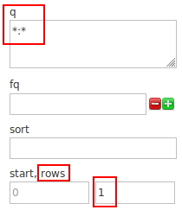
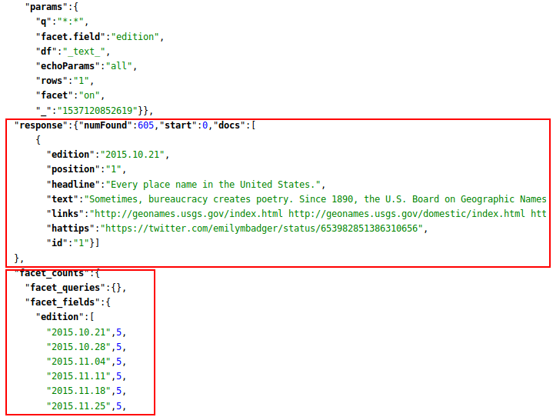
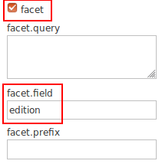
Beyond search - Facets
http://localhost:8983/solr/dip/select?facet.field=edition&facet=on&q=*:*&rows=1

Slide 19
Facets – Group by year - GET
What about grouping by year
http://localhost:8983/solr/dip/select
?facet=on&q=*:*&rows=0
&facet.query={!prefix f=edition}2014
&facet.query={!prefix f=edition}2015
&facet.query={!prefix f=edition}2016
&facet.query={!prefix f=edition}2017
&facet.query={!prefix f=edition}2018
A bit beyond what Admin UI can allow you enter right now
A bit painful as a GET
Can be also be done as a POST

Slide 20
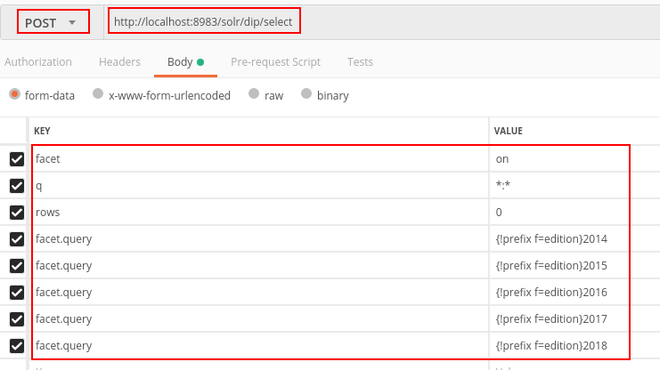
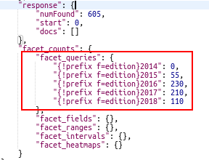
Facet – Group by year - POST
Easier with Postman (https://www.getpostman.com/)
Can save requests, create collections, publish

Slide 21
Quick review
We did basic index of a real dataset
We did some simple searches
  Case-insensitive
  Basic facets
  Less-basic facets
Already useful – and just the tip of Solr
Next: let’s understand WHY this works

Slide 22
Minimal learning config
Absolute minimum – 2 files
  managed-schema (an XML file)
    Definition of fields, field types, unique keys
    Can be managed by API directly (removes comments on use)
  solrconfig.xml (also an XML file)
    Endpoints, Default parameters, Caches, Pre-processing pipelines, ...
    A lot of system-admin and production config
    Cannot be modified by API directly, but there are overlays and request parameters APIs
We will also use:
  params.json
    supplements solrconfig.xml
    helps to manage request parameter defaults with API
Get them: https://github.com/arafalov/solr-apachecon2018-presentation/tree/master/configsets/minimal

Slide 23
Minimal config and params
Minimal solrconfig.xml
<?xml version="1.0" encoding="UTF-8" ?>
<config>
<luceneMatchVersion>7.4.0</luceneMatchVersion>
<requestHandler name="/select"
class="solr.SearchHandler" useParams="SELECT" />
</config>
Minimal matching params.json
{"params":{
"SELECT":{
"df":"_text_",
"echoParams":"all"
}}}
Relies on a lot of defaults, check them with config API:
http://localhost:8983/solr/<corename>/config?expandParams=true
https://lucene.apache.org/solr/guide/7_4/config-api.html

Slide 24
Minimal managed-schema
<?xml version="1.0" encoding="UTF-8"?>
<schema name="smallest-config" version="1.6">
<field name="id" type="string" required="true" indexed="true" stored="true" />
<field name="_text_" type="text_basic"
multiValued="true" indexed="true" stored="false" docValues="false"/>
<dynamicField name="*" type="text_basic" indexed="true" stored="true"/>
<copyField source="*" dest="_text_"/>
<uniqueKey>id</uniqueKey>
<fieldType name="string" class="solr.StrField" sortMissingLast="true" docValues="true"/>
<fieldType name="text_basic" class="solr.SortableTextField" positionIncrementGap="100">
<analyzer>
<tokenizer class="solr.StandardTokenizerFactory"/>
<filter class="solr.LowerCaseFilterFactory"/>
</analyzer>
</fieldType>
</schema>

Slide 25
Schema definition hierarchy
Field type CLASS
  Underlying representation
Field Type
  No built-in types
  Configuration
  Defaults
  Analyzers (if supported)
Field definition
  Concrete configuration
Popular field type classes
  StrField
  TextField
  SortableTextField
  IntPointField
  DatePointField
Other classes
  BinaryField
  BoolField
  CollationField
  CurrencyFieldType
  DateRangeField
  DoublePointField
  ExternalFileField
  EnumFieldType
  FloatPointField
  ICUCollationField
  LongPointField
  PointType
  PreAnalyzedField
  RandomSortField
  SpatialRecursivePrefixTreeFieldType
  UUIDField

Slide 26
managed-schema – field types
<fieldType name="string" class="solr.StrField" sortMissingLast="true" docValues="true"/>
Name: string – convention, not complusory
Class: solr.StrField - keep string as is, no processing
sortMissingLast – what to do with missing values
docValues – enable column store, useful for faceting, sorting, grouping
Additional configuration will be done on field using this type, can also override values here (not name/class)
No analyzers magic for this (solr.StrField) type

Slide 27
managed-schema – field types
<fieldType name="text_basic" class="solr.SortableTextField" positionIncrementGap="100">
<analyzer>
<tokenizer class="solr.StandardTokenizerFactory"/>
<filter class="solr.LowerCaseFilterFactory"/>
</analyzer>
</fieldType>
Name: text_basic – whatever you want
Class: solr.SortableTextField – new type useful for search and faceting both. Implicitly uses docValues
positionIncrementGap – just keep this, a bit of an internal thing
Basic combined index/query analyzer chain
  Tokenizer: StandardTokenizerFactory – generic, split on whitespace and punctuation
  (Token) Filter: LowerCaseFilterFactory - lowercase every token during index and search => case-insensitive match
Many more interesting analyzer chains are in examples
You can (and should) craft your own for specialty use-cases

Slide 28
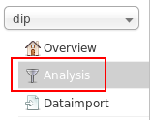
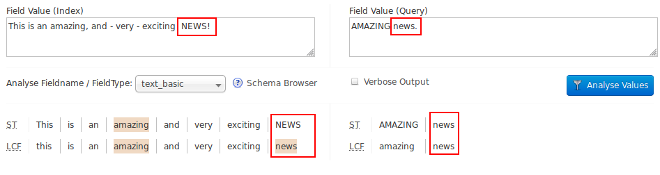
Understanding analyzer chains
...
<analyzer>
<tokenizer class="solr.StandardTokenizerFactory"/>
<filter class="solr.LowerCaseFilterFactory"/>
</analyzer>
...

Slide 29
managed-schema - fields
<field name="id" type="string" required="true"
indexed="true" stored="true" />
  Field name is id – we refer to this later, in uniqueKey
  Its type is string – as we defined
  It is required – that’s quite rare actually
  It is indexed – means we can search on it
  It is stored
    Means we will return it to the user
    Important for ID, a decision point for the rest
<uniqueKey>id</uniqueKey>

Slide 30
managed-schema - fields
<field name="_text_" type="text_basic"
multiValued="true" indexed="true"
stored="false" docValues="false"/>
Name: _text_ - underscores to show special usage in our config
Type: text_basic – defined later
multiValued – can take multiple values
indexed – we can search against it, using text_basic rules
(Not) stored – will not show up in the result
(Disabled) docValues – overrides type definition

Slide 31
Dynamic fields
<dynamicField name="*" type="text_basic"
indexed="true" stored="true"/>
  Dynamic Field – match incoming field name that is not matched explicitly by other definitions – a magic fallback
  Name: ”*” - pattern, means any left-over field name
    - could also be *_str, random_*
  stored – means the user will see the fields
  indexed – means we can search against it
  Type: text_basic – means we do the tokenization
  and analysis

Slide 32
copyField
<copyField source="*" dest="_text_"/>
Duplicates fields for different treatment
Here:
  copy ALL (*) fields (all dynamic fields AND id field)
  To field _text_
Remember: _text_
  is searchable (we even disabled docValues)
  not stored (so user does not see this duplicated content)
  multiValued (as it gets each field’s content as separate value)
Important! Copied content is searched by rules of the destination field…. (e.g. dates copied to text field)
Why do we need this duplication?

Slide 33
Query path
What happens when we search “+data -news”
Enable debugQuery flag to find out
  http://localhost:8983/solr/dip/select?debugQuery=on&q=+data -news
  "parsedquery":"+_text_:data -_text_:news"
Solr has a query parser, which has parameters
  In solrconfig.xml, we defined /select endpoint
  It declared useParams=SELECT
  In params.json, we set a df parameter to _text_
  For default (lucene) Query Parser, df is Default Field parameter
Other Query Parsers have very different expectations
  eDisMax is popular and has much greater searched-fields control
  Also: https://lucene.apache.org/solr/guide/7_4/other-parsers.html

Slide 34
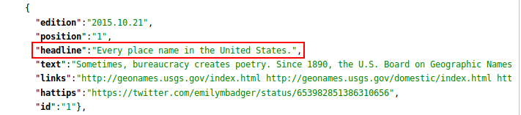
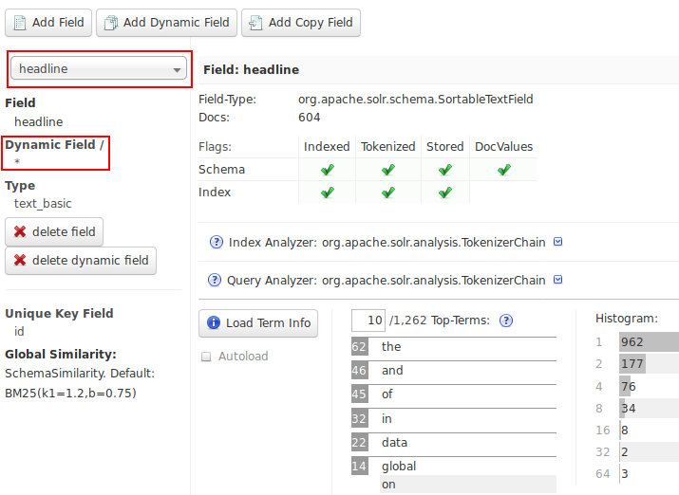

Record details

Slide 35
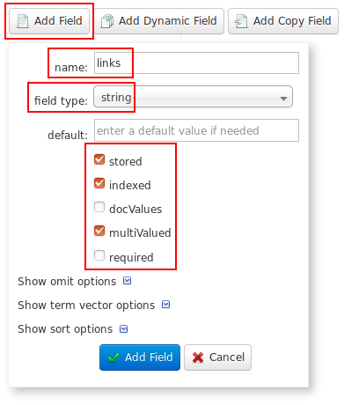
Evolving the schema
Let’s make links multi-valued strings, split while injesting on white-space
In managed-schema, we still just have id, _text_ as explicit fields
Can do it in Admin UI
  Delete links (not strictly needed for dynamic field)
  Create explicit definition: stored, indexed, multiValued, using string field type
  This will rewrite managed-schema
Need to reindex, sometimes delete/reindex
  Usually docValues require delete/reindex
  Remember! Have a primary source

Slide 36
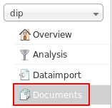
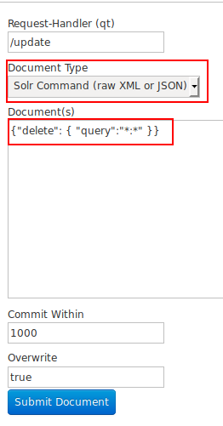
Deleting content
bin/post -c dip -d $"<delete><query>*:*</query></delete>"
Can also do it in Admin UI/Documents
Can use (Solr-specific) XML or JSON, delete by ID or specific query
https://lucene.apache.org/solr/guide/7_4/uploading-data-with-index-handlers.html

Slide 37
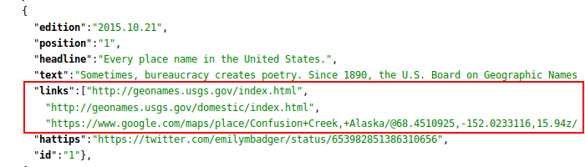
Reindexing
bin/post -c dip -params "separator=%09&rowid=id&f.links.split=true&f.links.separator=%20"
-type "text/csv" .../dip-data.tsv
New parameters
  f.links.split=true
  f.links.separator=20

Slide 38
Next challenge – links count
Let’s find records with 3+ links
Quite hard because we search from index (dictionary) of tokens
Correct Solr reasoning:
  Shape the data for search
  Solr is not a (storage-oriented) database
  Duplicate and index in multiple ways
  Pre-calculate what you will search
  De-normalize if needed

Slide 39
Update Request Processors
Update Request Processor (URP)
  Runs after format (XML, JSON, etc) parser
  Runs before schema is involved
  Can run multiple in a chain
Many (legacy and new) ways to configure
  Documentation (rather hard to discover): https://lucene.apache.org/solr/guide/7_4/update-request-processors.html
  Also: http://www.solr-start.com/info/update-request-processors/
Example complex chain: Solr “schemaless” type-guessing mode

Slide 40
Counting links
To count links
  Copy to another field (not yet involving schema) - CloneFieldUpdateProcessorFactory
  Replace links themselves with their count – CountFieldValuesUpdateProcessorFactory
Defining URPs
  Some are implicit, but not ours
  Can define in solrconfig.xml (edit, reload core)
  Can use Config API to define an overlay (in configoverlay.json)
    https://lucene.apache.org/solr/guide/7_4/config-api.html
Can use curl, Postman, or hack an Admin UI/Documents

Slide 41
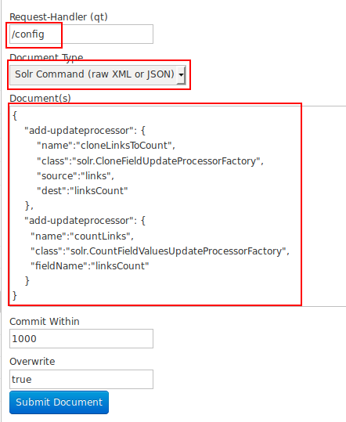
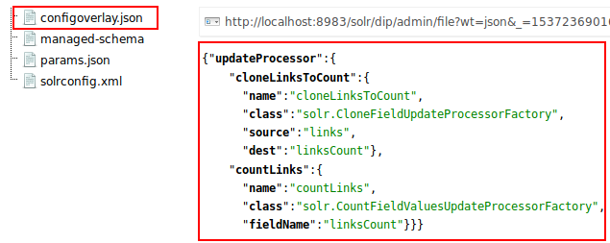
Hacking Admin UI for Config API
Define two URPs
Cannot define a chain via Config API
Notice: We changed request handler
Notice: JSON has duplicate
keys-names (Ugh!)
Once submitted, we have new configoverlay.json file in core’s config directory
Can check on Admin UI Files screen

Slide 42
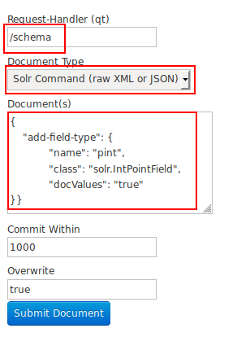
Evolving schema for linksCount
URP will generate linksCount field
By default, it would be a text_basic
Let’s make it an Integer – better search
Need to add a field type, no UI for that
Can edit file manually and reload core
Or can use Schema API
https://lucene.apache.org/solr/guide/7_4/schema-api.html
Again, we can use an Admin UI hack (/schema)
Once field type (pint) is defined, use Admin UI to define linksCount as pint with default of 0
As it is a new field, no need to delete index, can just reindex

Slide 43
Reindex with URPs
bin/post -c dip -params "separator=%09&rowid=id&f.links.split=true&f.links.separator=%20&processor=cloneLinksToCount,countLinks" -type "text/csv" .../dip-data.tsv
New parameter
  processor=cloneLinksToCount,countLinks
But that’s getting too long
Can we do something about it?
  Hint: params.json

Slide 44
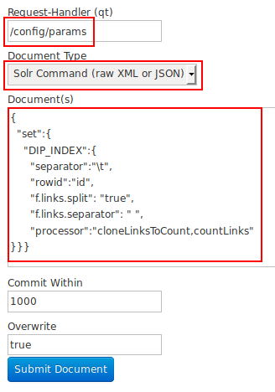
Dealing with solrconfig.xml
Can modify solrconfig.xml by hand and reload core (legacy method)
Can use Config API to create new entries – useful, but overkill for changing parameters
Can use Request Parameters API with predefined or explicit useParams
  https://lucene.apache.org/solr/guide/7_4/request-parameters-api.html
  /config/params endpoint
    Takes JSON with set/unset/delete keys
    Notice different escape for tab, space
Once done, we can refer to it:
  bin/post -c dip -params "useParams=DIP_INDEX"
  -type "text/csv" .../dip-data.tsv

Slide 45
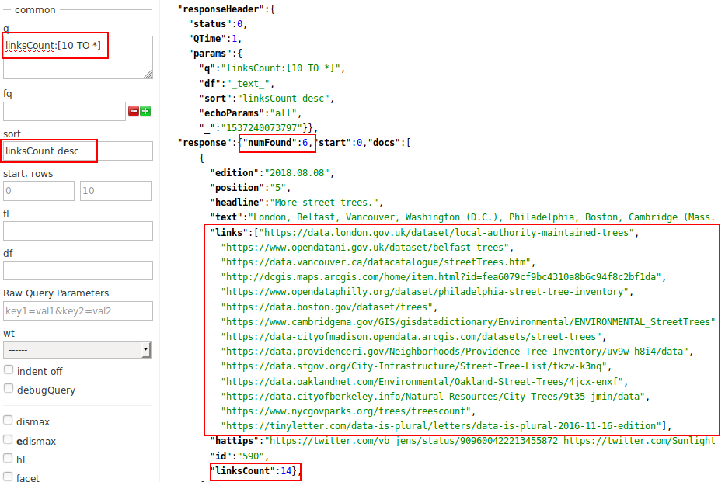
Search for many links
http://localhost:8983/solr/dip/select?q=linksCount:[10 TO *]&sort=linksCount desc

Slide 46
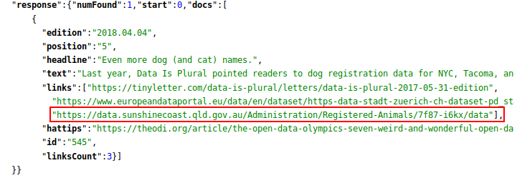
Everybody likes dogs and cats
Now that we have the basics
Let’s choose another dataset
How about: +dogs +australia
Export the Sunshine Coast dataset as XML

Slide 47
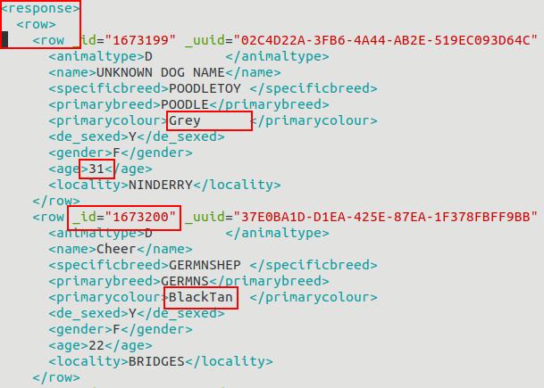
Reviewing the dataset format
Original XML is hard to read
Best to reformat (I use XMLStarlet)
Definitely not Solr format
Can preprocess with XSLT (outside or inside Solr)
Can import with Data Import Handler (DIH)
  Custom field mapping
  Can do data merge, nested requests
  Has Admin UI screen
  Good for quick analysis
  Not production quality

Slide 48
Analyzing the data needs
Records are at response/row/row
_id is an attribute, the rest are elements
animaltype can be “d” and “Cat” - normalize to dog/cat
Some elements have extra space – trim
age should be a number
primarycolour can have mixed colours – make it possible to search on sub-colour?
Lowercase everything

Slide 49
Defining the pipeline
Data Import Handler (DIH)
  Parse XML and map to field name
  Rename _id to id and de_sexed to desexed
Update Request Processors
  Trim extra space on everything
  Normalize D to Dog
Schema definition
  Default dynamic field – as before (lowercase!)
  Explicit int field for age
  Copy primarycolour into secondary field and split
Can evolve one step at a time, starting from DIH
  We are totally out of time for that today!
  Home work (hint – enable DIH in solrconfig.xml first, then iterate)
Copy minimal directory to pets-final to start new configset

Slide 50
Pets managed-schema (age)
Modify managed-schema
Keep all definitions there from minimal configset
Add new parts anywhere in the file
field type int and field definition for age
<fieldType name="pint" class="solr.IntPointField"
docValues="true"/>
<field name="age" type="pint" default="0"
indexed="true" stored="true"/>

Slide 51
Pets managed-schema (splitcolour type)
Define new field type to extract partial colour names (e.g. BlackWhite => Black, White)
<fieldType name="splitcolour_type" class="solr.TextField"
positionIncrementGap="100">
<analyzer type="index">
<tokenizer class="solr.KeywordTokenizerFactory"/>
<filter class="solr.WordDelimiterFilterFactory"
splitOnCaseChange="1" preserveOriginal="1"/>
<filter class="solr.LowerCaseFilterFactory"/>
</analyzer>
<analyzer type="query">
<tokenizer class="solr.KeywordTokenizerFactory"/>
<filter class="solr.LowerCaseFilterFactory"/>
</analyzer>
</fieldType>

Slide 52
Pets managed-schema (splitcolour field)
Define new field splitcolour and copy from primarycolour to it
<field name="splitcolour" type="splitcolour_type"
indexed="true" stored="false"/>
<copyField source="primarycolour"
dest="splitcolour"/>
Notice:
  we have to search against splitcolour explicitly
  it is not returned to user (stored=false)

Slide 53
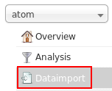
Reference DIH example
Use DIH/atom example for reference (one of 5)
bin/solr start -e dih -p 9999 (avoid port conflict)
  http://localhost:9999/solr/#/atom/dataimport//dataimport
bin/solr stop -p 9999 (when done)
<solr_install>/example/example-DIH/solr/atom/conf/solrconfig.xml
  Order of elements is important for solrconfig.xml
  Notice library requirement
  Request Handler definition for /dataimport
  config => atom-data-config.xml (DIH configuration)
  Both params and Trim URP are right in solrconfig.xml (instead of params.json and configoverlay.json) – less flexible, though can still be overriden
atom-data-config.xml
  https://lucene.apache.org/solr/guide/7_4/uploading-structured-data-store-data-with-the-data-import-handler.html
  Loads XML from URL Feed, not File (both are valid for URLDataSource)
  Shows Transformers (we will stick to URPs)

Slide 54
Pets solrconfig.xml
<lib dir="${solr.install.dir:../../../..}/dist/"
regex="solr-dataimporthandler-.*\.jar"/>
…
<requestHandler name="/dataimport" class="solr.DataImportHandler">
<lst name="defaults">
<str name="config">pets-data-config.xml</str>
<str name="processor">trim_text,fix_dog</str>
</lst>
</requestHandler>
<updateProcessor class="solr.processor.TrimFieldUpdateProcessorFactory"
name="trim_text" />
<updateProcessor class="solr.processor.RegexReplaceProcessorFactory"
name="fix_dog">
<str name="fieldName">animaltype</str>
<str name="pattern">D</str>
<str name="replacement">Dog</str>
<bool name="literalReplacement">true</bool>
</updateProcessor>

Slide 55
pets-data-config.xml
<dataConfig>
<dataSource type="URLDataSource"/>
<document>
<entity name="pets"
url="file://${solr.core.instanceDir}/../../pets/pets.xml"
processor="XPathEntityProcessor"
forEach="/response/row/row">
<field column="id" xpath="/response/row/row/@_id" />
<field column="animaltype" xpath="/response/row/row/animaltype" />
<field column="name" xpath="/response/row/row/name" />
<field column="specificbreed" xpath="/response/row/row/specificbreed" />
<field column="primarybreed" xpath="/response/row/row/primarybreed" />
<field column="primarycolour" xpath="/response/row/row/primarycolour" />
<field column="desexed" xpath="/response/row/row/de_sexed" />
<field column="gender" xpath="/response/row/row/gender" />
<field column="age" xpath="/response/row/row/age" />
<field column="locality" xpath="/response/row/row/locality" />
</entity>
</document>
</dataConfig>

Slide 56
Pets – create core
bin/solr create -c pets -d …/pets-final
  Create core in the running server with our custom configset
  Active config files are now in sroot/pets/conf
  Hack: you can edit these files and reload core
  For more options: bin/solr create_core -h
bin/solr delete -c pets
  If you want to update configset and recreate core
  Will delete modifications made while running

Slide 57
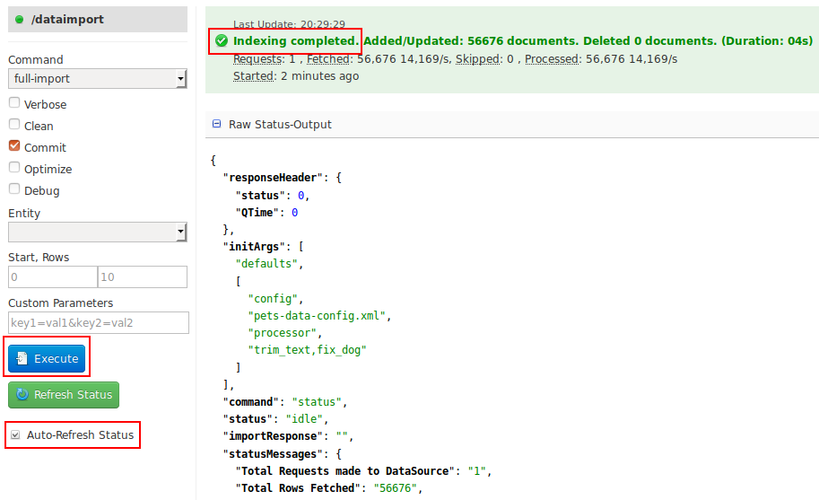
Import pets records with DIH

Slide 58
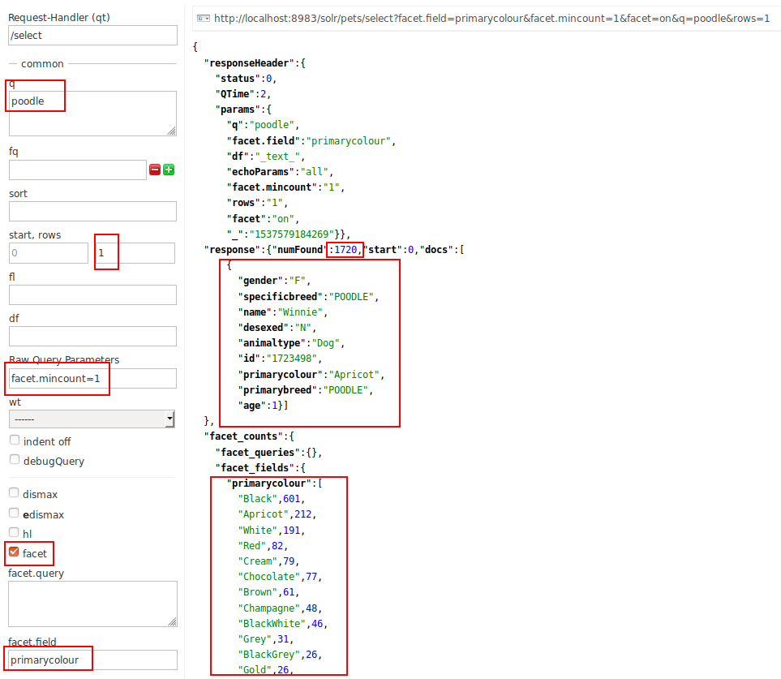
Basic search
http://localhost:8983/solr/pets/select?facet.field=primarycolour&facet.mincount=1&facet=on&q=poodle&rows=1
Case-insensitive search (poodle)
Return only first record of 1720 found (of 56676 total)
Show facets on primarycolour field
Do not return facets with 0 matched documents

Slide 59
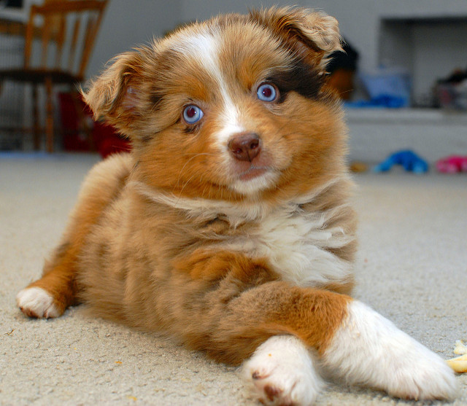

Merle puppy
Merle – is a color
There are several types of Merle
Can we figure out types and popularity using splitcolour field?
  q=splitcolour:merle
  rows=0
  facet=on
  facet.field=primarycolour
  facet.mincount=1
By Ted Van Pelt (Flickr, CC BY 2.0):
https://www.flickr.com/photos/bantam10/5580029980/

Slide 60
Advanced analytics
Basic queries and facets are good to start
Recent Solr supports:
  JSON Request API:
    https://lucene.apache.org/solr/guide/7_4/json-request-api.html
  JSON Query DSL:
    https://lucene.apache.org/solr/guide/7_4/json-query-dsl.html
  JSON Facets:
    https://lucene.apache.org/solr/guide/7_4/json-facet-api.html
  Allows multi-leveled facets, analytics, (start of) semantic knowledge graph
Can do very complex queries

Slide 61
Complex JSON query
{
query: "splitcolour:gray",
filter: "age:[0 TO 20]"
limit: 2,
facet: {
type: {
type: terms,
field: animaltype,
facet : {
avg_age: "avg(age)",
breed: {
type: terms,
field: specificbreed,
limit: 3,
facet: {
avg_age: "avg(age)",
ages: {
type: range,
field : age,
start : 0,
end : 20,
gap : 5
}}}}}}}
For all animals with a variation of gray colour
Limited to those of age between 0 and 20 (to avoid dirty data docs)
Show first two records and facets
Facet them by animal type (Cat/Dog)
  Then by the breed (top 3 only)
    Then show counts for 5-year brackets
On all levels, show bucket counts
On bottom 2 levels, show average age

Slide 62
JSON Facets results
"facets":{
"count":3168,
"type":{
"buckets":[{
"val":"Cat",
"count":1891,
"avg_age":6.687...,
"breed":{
"buckets":[{
"val":"DOMSH",
"count":951,
"avg_age":6.270241850683491,
"ages":{
"buckets":[
{"val":0, "count":387},
{"val":5, "count":358},
{"val":10, "count":164},
{"val":15, "count":41}]}},
{
"val":"Dog",
"count":1277,
"avg_age":7.372748629600626,
"breed":{
"buckets":[{
"val":"MALTESEX",
"count":131,
"avg_age":8.587786259541986,
"ages":{
"buckets":[{
"val":0,
"count":17},
{
"val":5,
"count":62},
{
"val":10,
"count":45},
{
"val":15,
"count":7}]}},

Slide 63
THANK YOU
Alexandre Rafalovitch
@arafalov
arafalov@apache.org

