Slide 1
Small Business Management System
Presented By:
Arafat Bin Reza
SEID: 257088
Shamsul Hasan Siam
SEID: 259222
Mohammad Fagle Karim
SEID: 263353
Rezwana Binte Reza
SEID: 257090

Slide 2
Introduction
Business Management System (BMS) is designed to convert day-to-day business activities on automated level.
BMS allows user to help and keep the track of all the suppliers and customers.
This system also allows user to keep track of purchased product details and sales product details.
By BMS, user can generate reports on sales and purchase details easily.

Slide 3
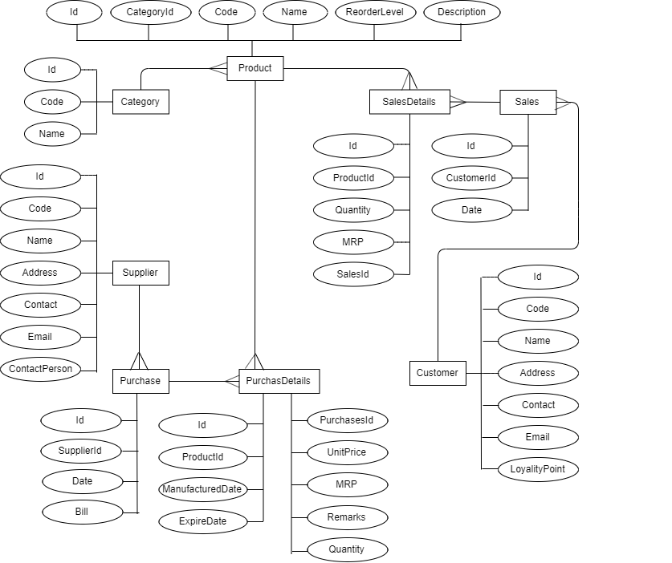
ER Diagram

Slide 4
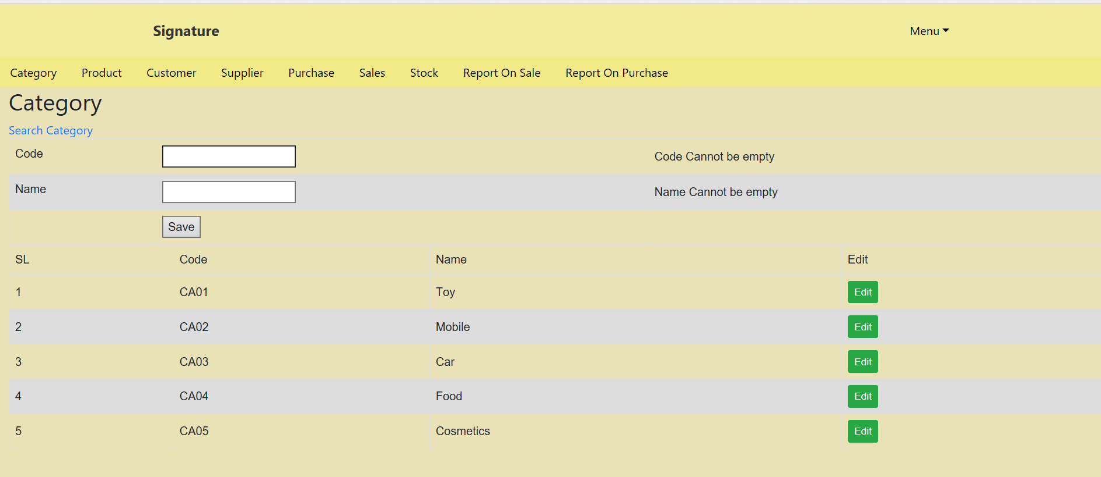
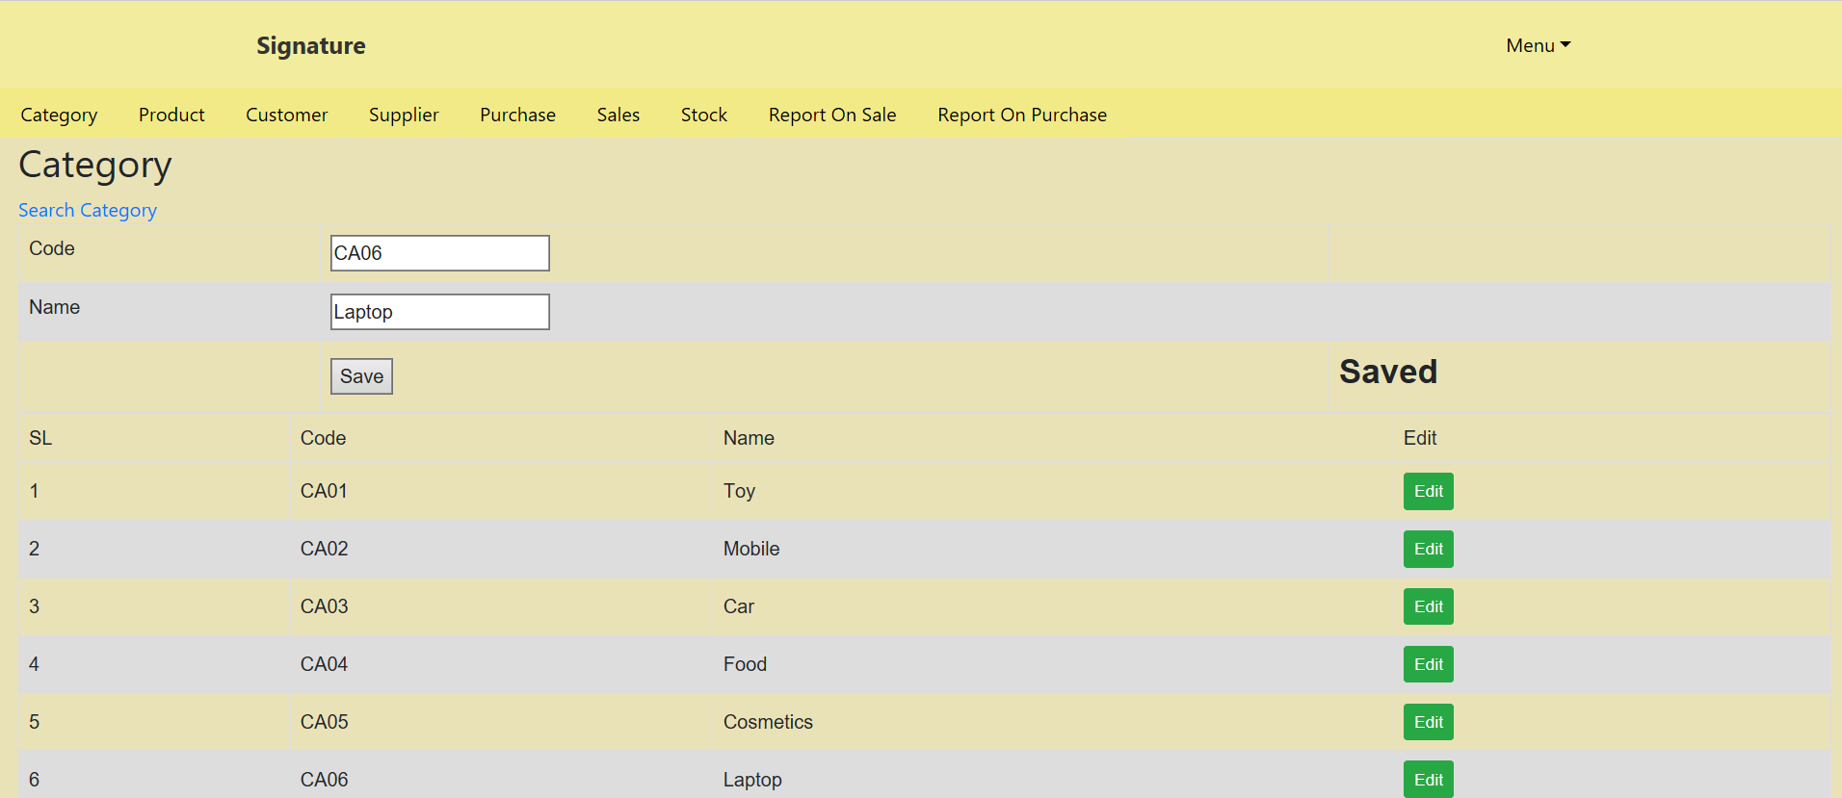
Screen Shot of Category Module Output
Empty Check
Unique Check

Slide 5
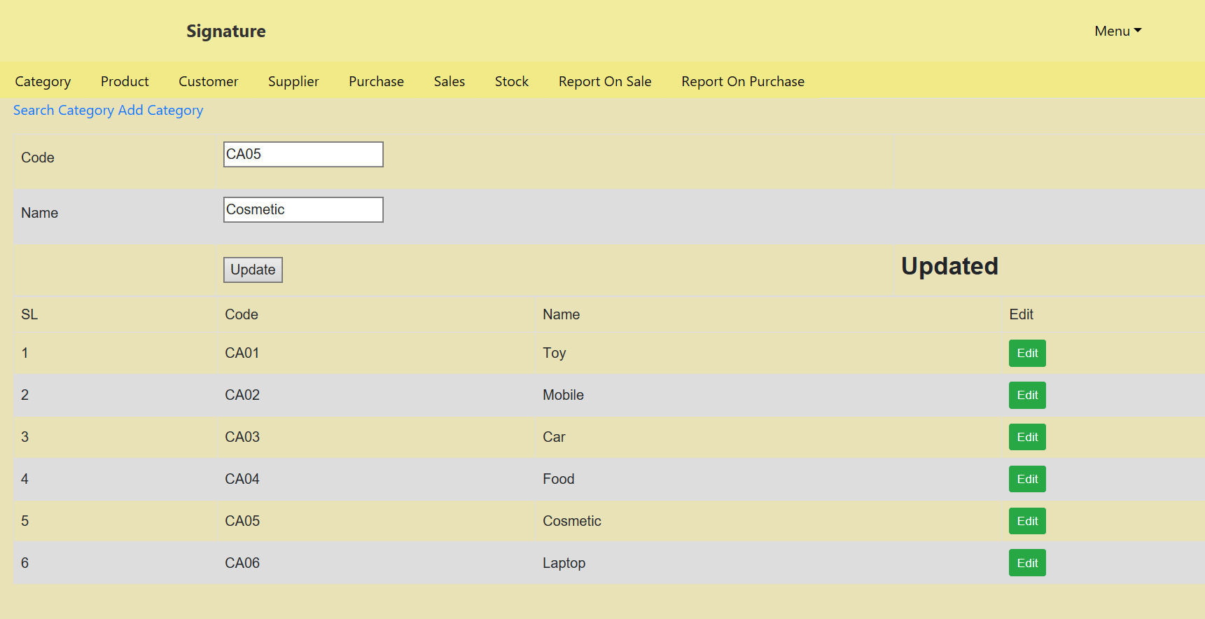
Screen Shot of Category Module Output
Save Check
Update Check

Slide 6
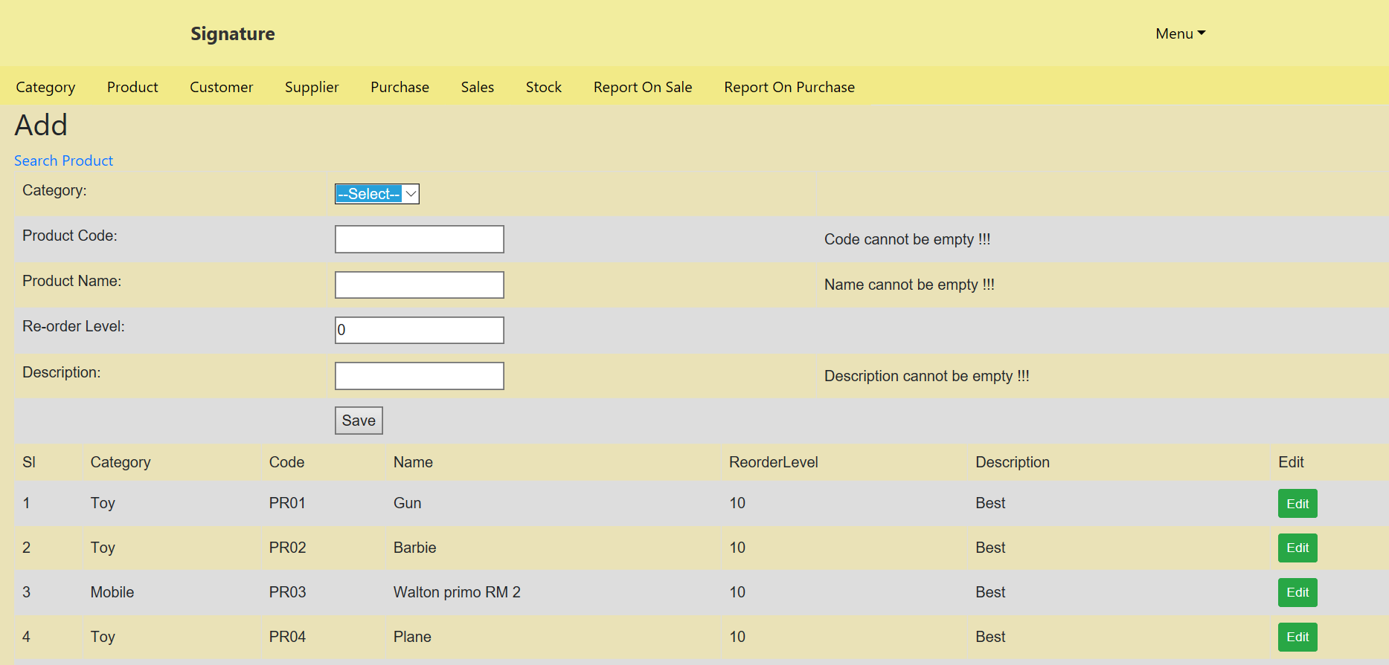
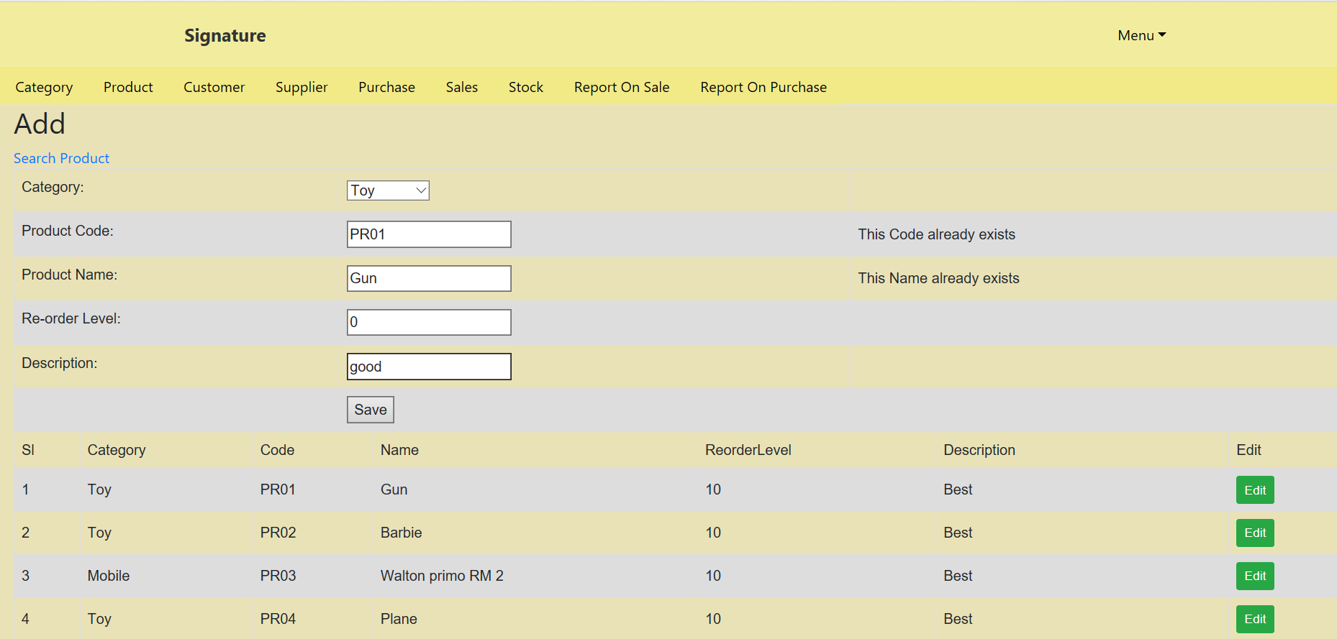
Screen Shot of Product Module Output
Empty Check
Unique Check

Slide 7
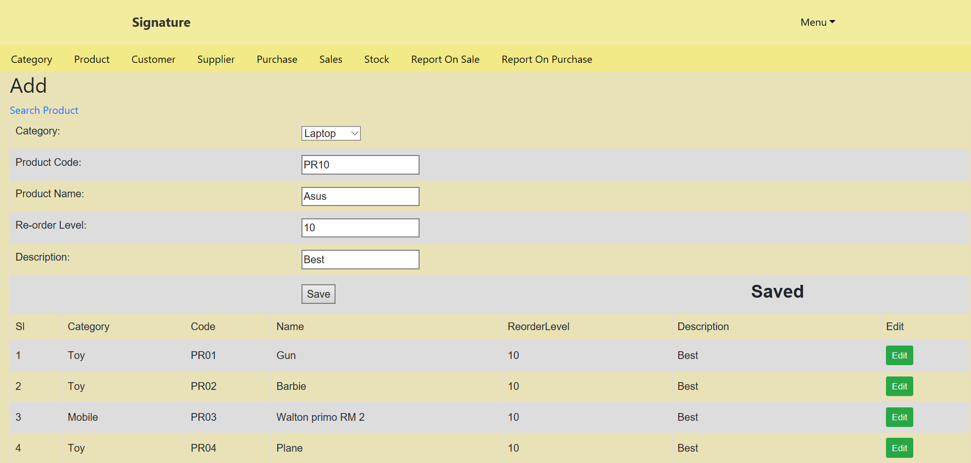
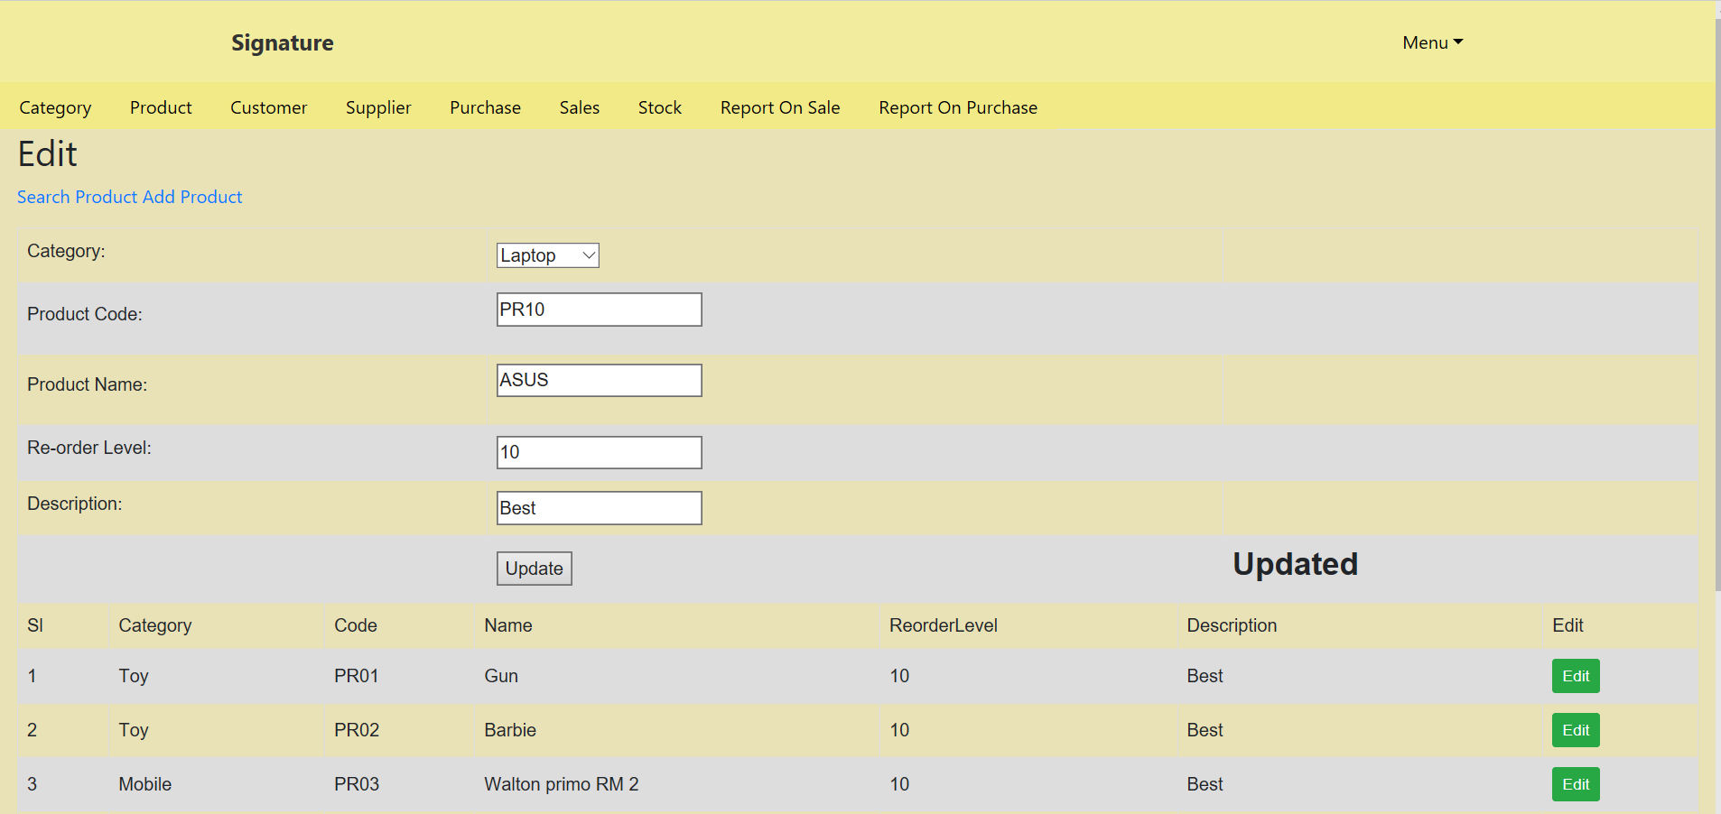
Screen Shot of Product Module Output
Save Check
Update Check

Slide 8
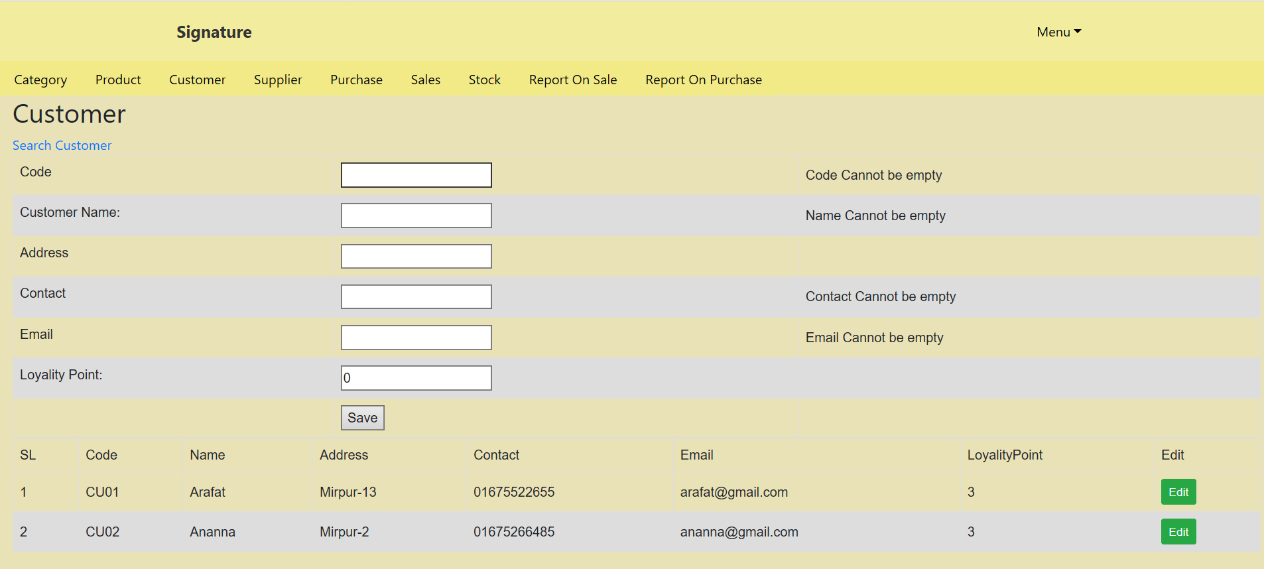
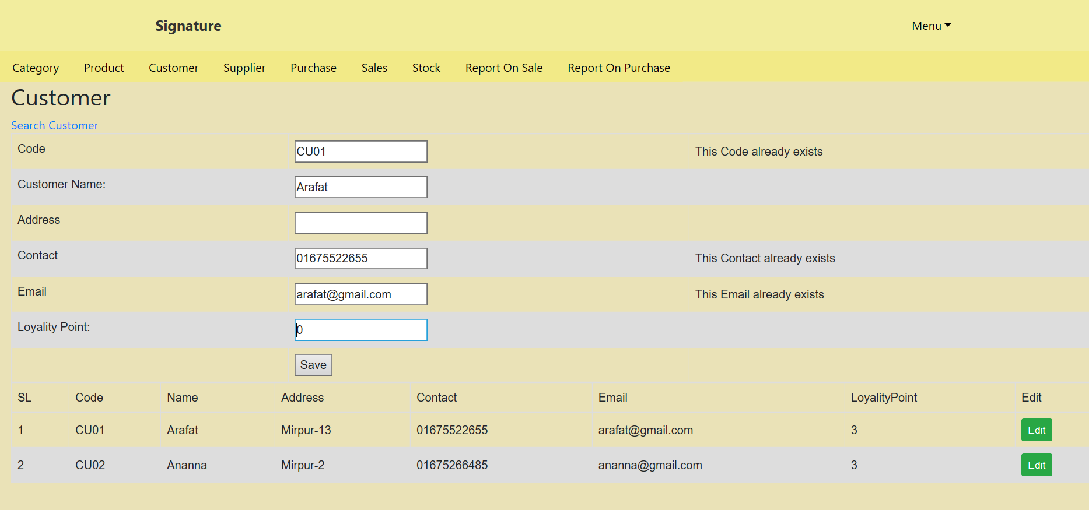
Screen Shot of Customer Module Output
Empty Check
Unique Check

Slide 9
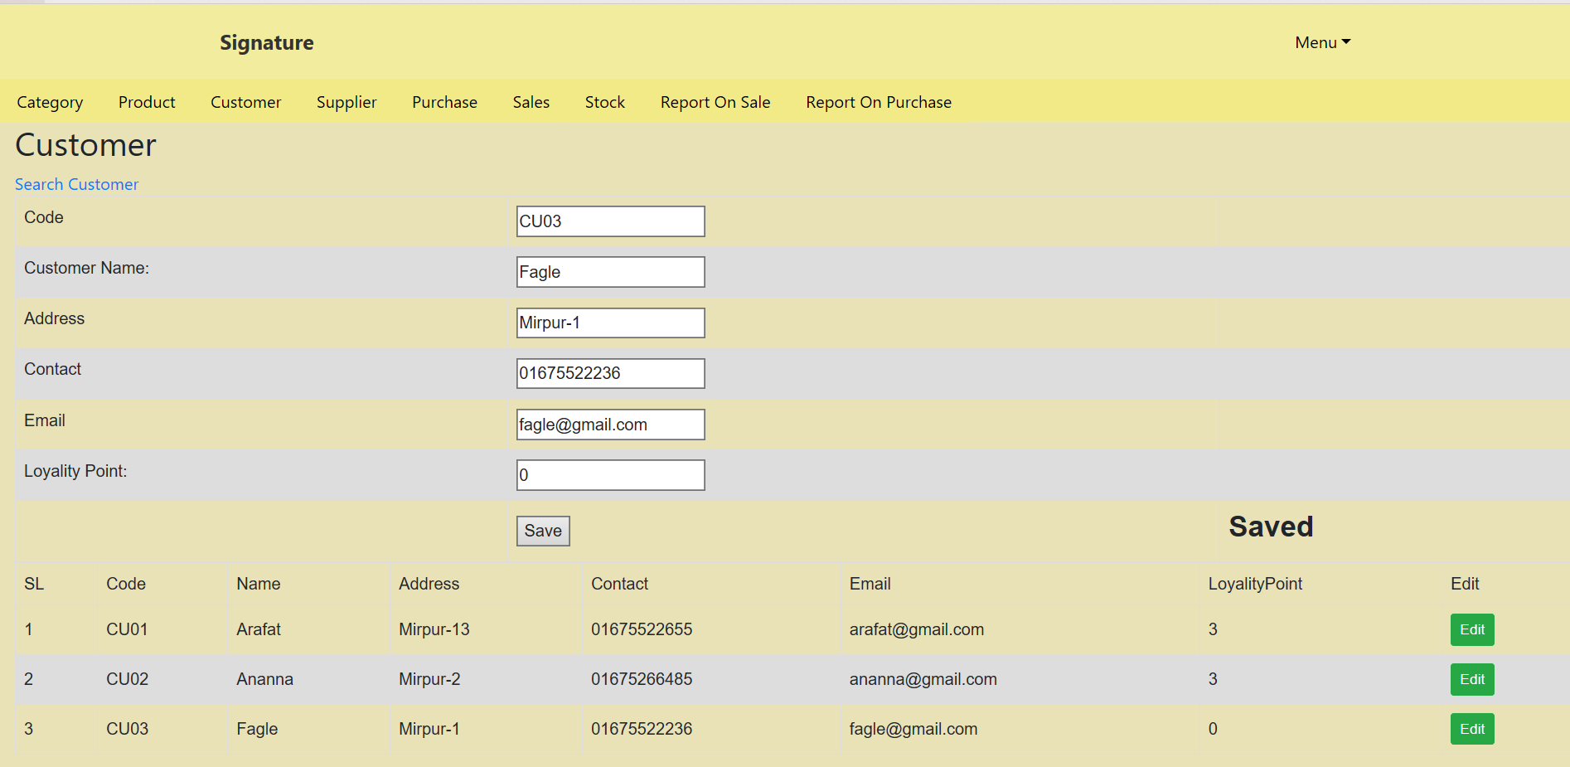
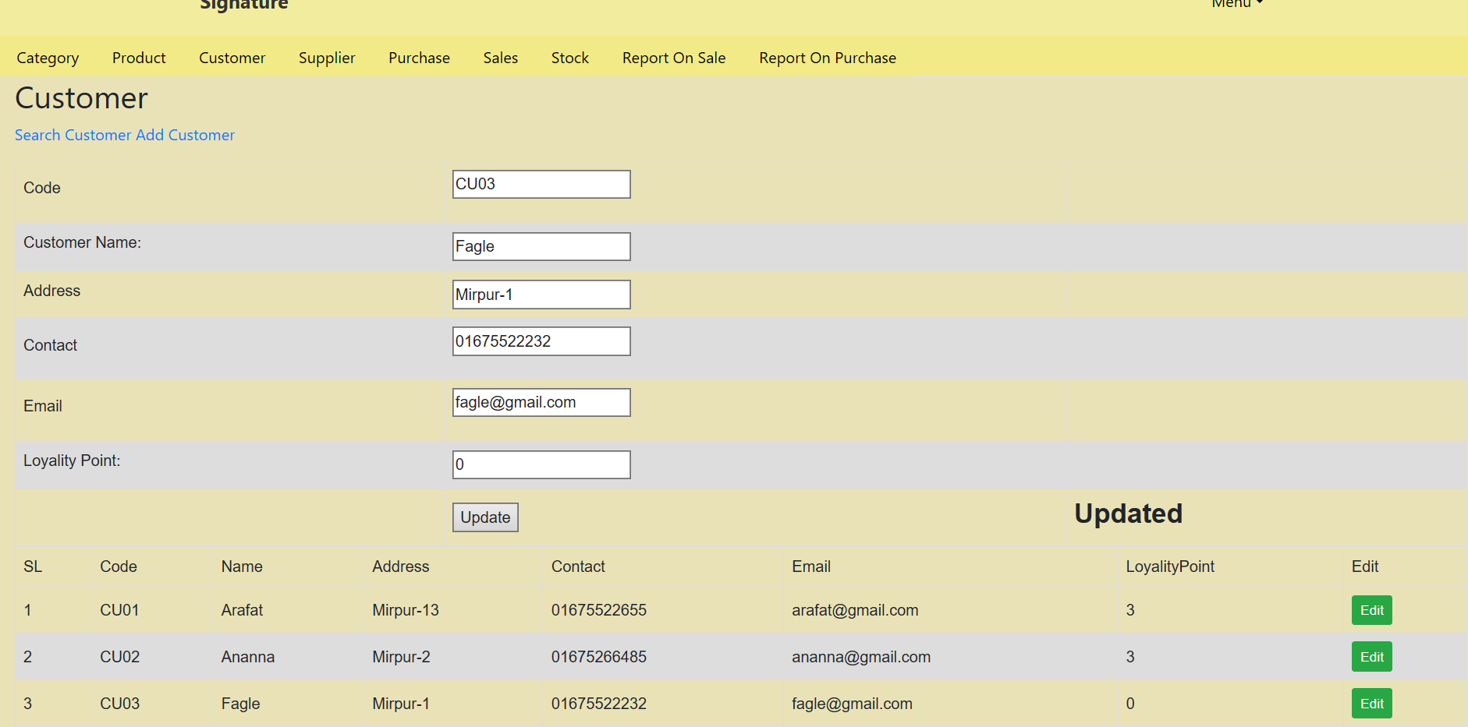
Screen Shot of Customer Module Output
Save Check
Update Check

Slide 10
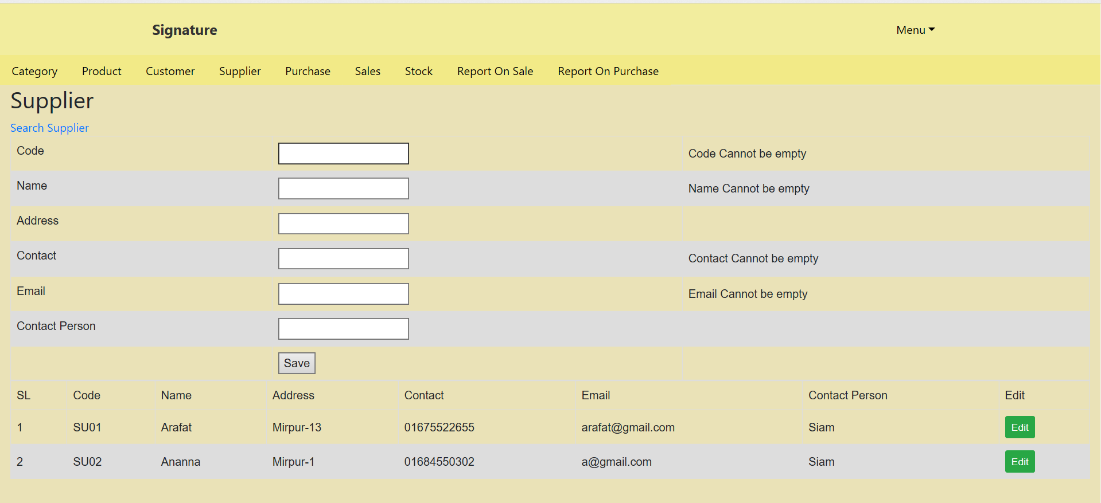
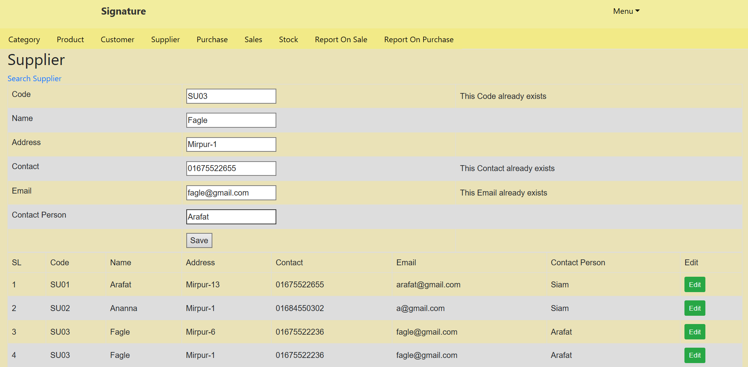
Screen Shot of Supplier Module Output
Empty Check
Unique Check

Slide 11
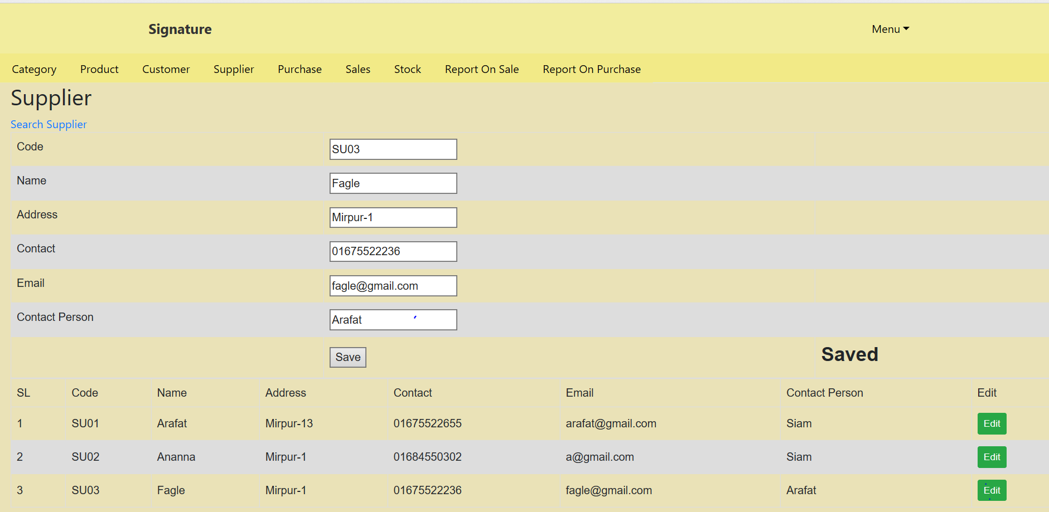
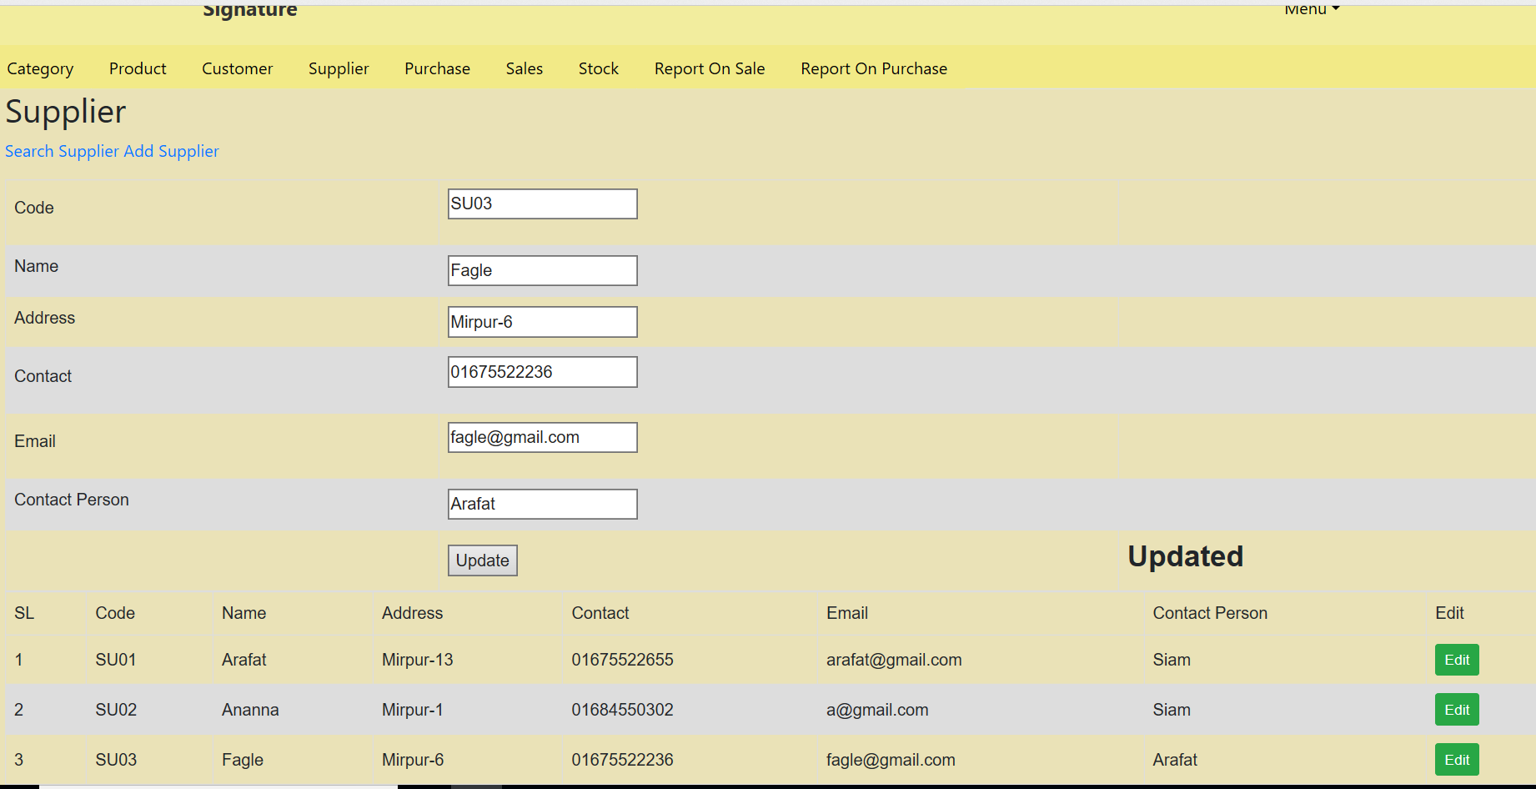
Screen Shot of Supplier Module Output
Save Check
Update Check

Slide 12
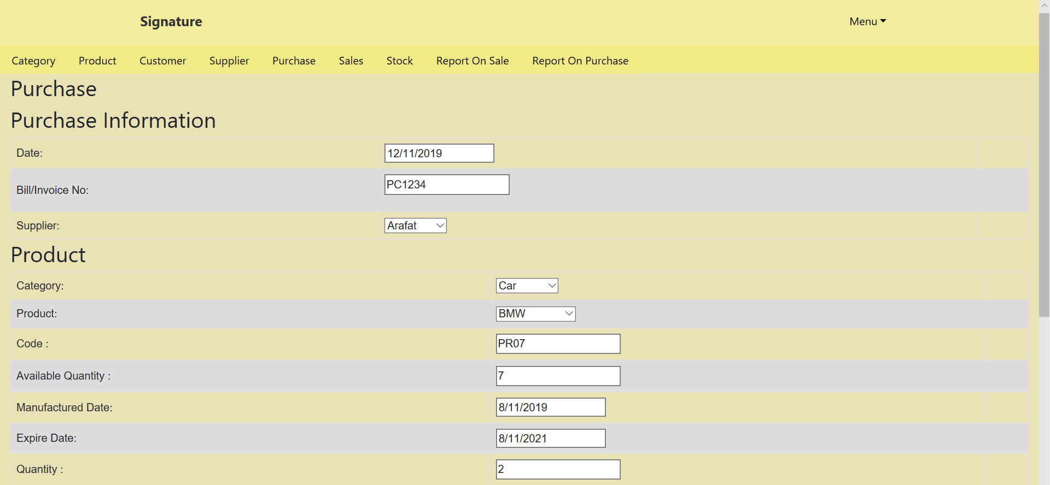
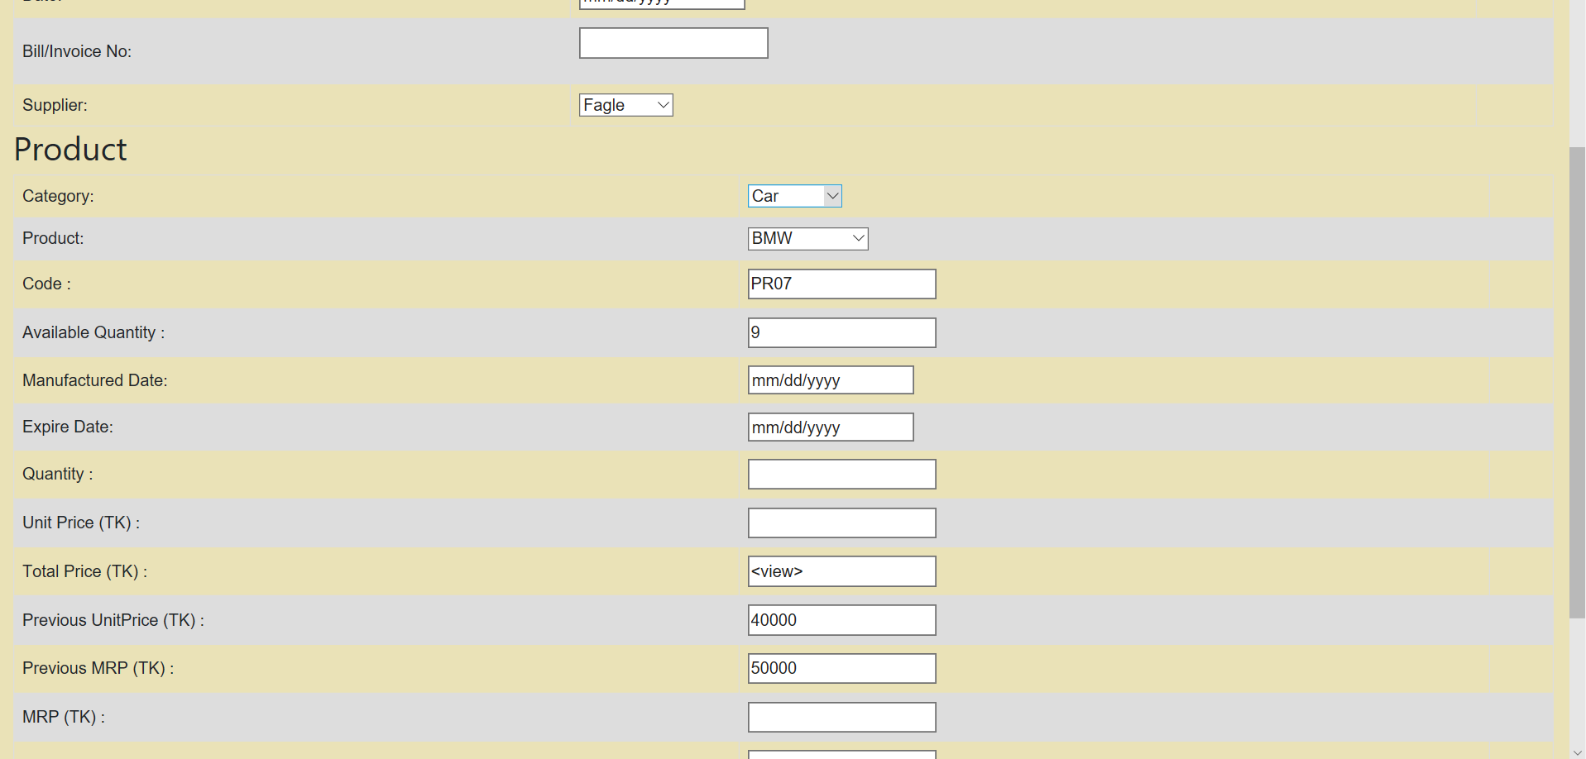
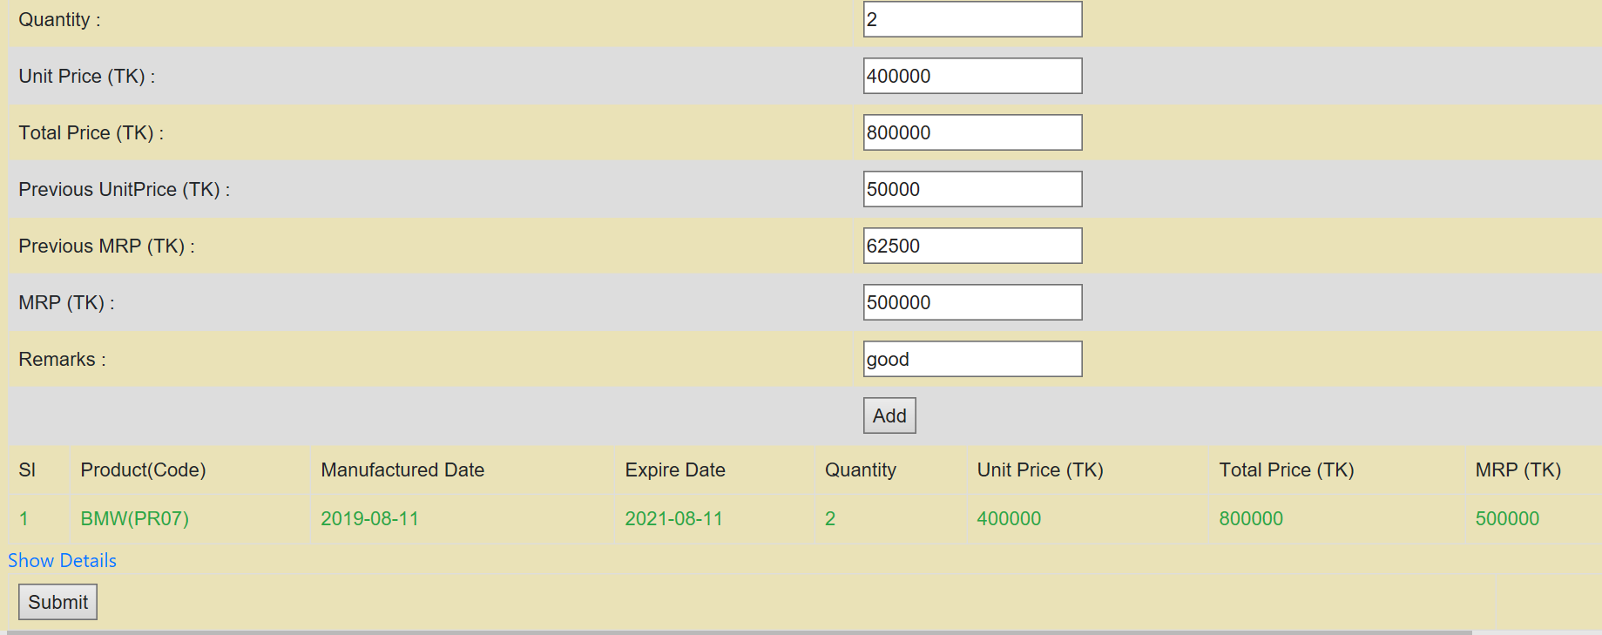
Screen Shot of Purchase Module output
Save Check
Available Quantity Changes

Slide 13
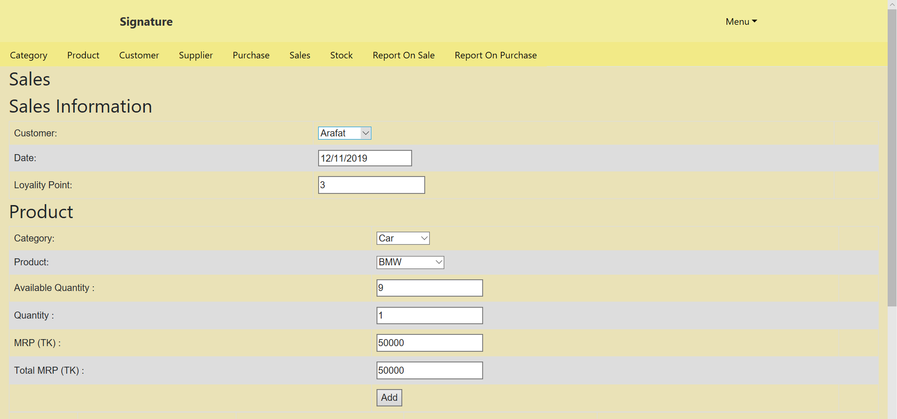
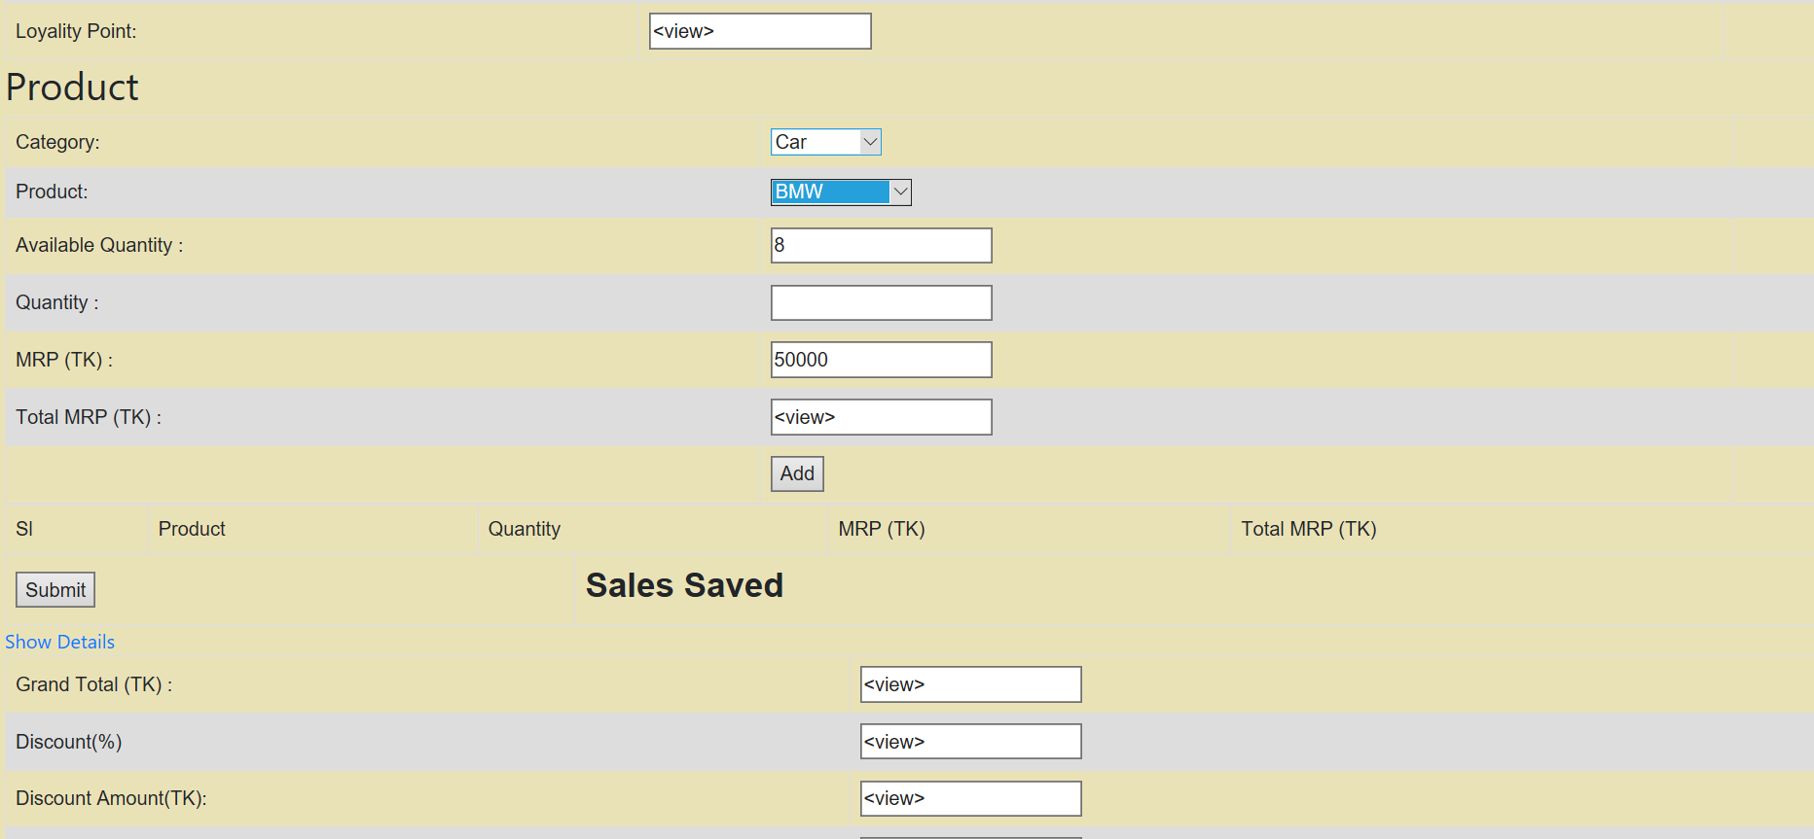
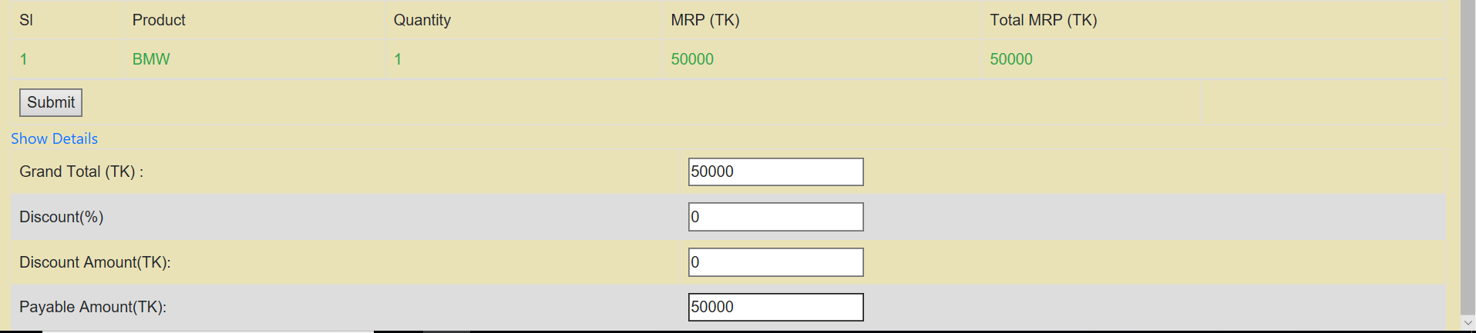
Screen Shot of Sales Module Output
Save Check
Available Quantity Changes

Slide 14
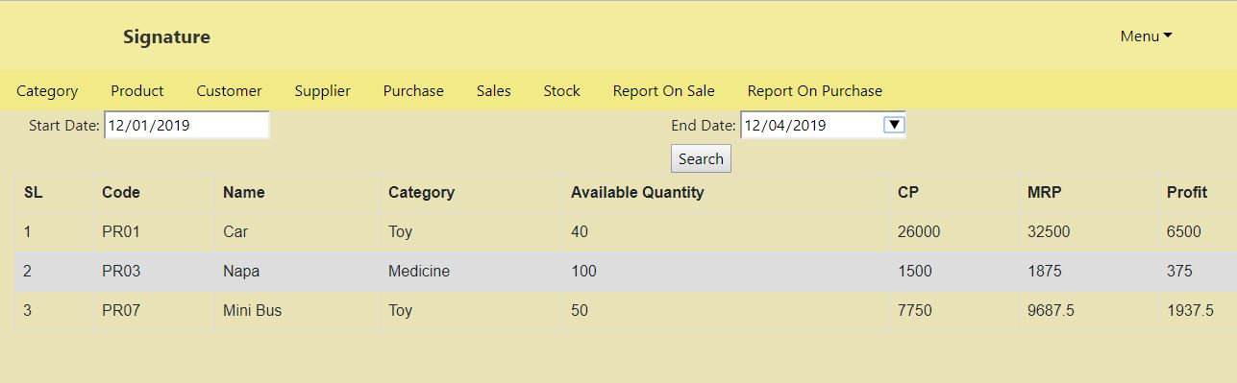
Screen Shot of Purchase REPORT Module Output
Purchase Details Check

Slide 15
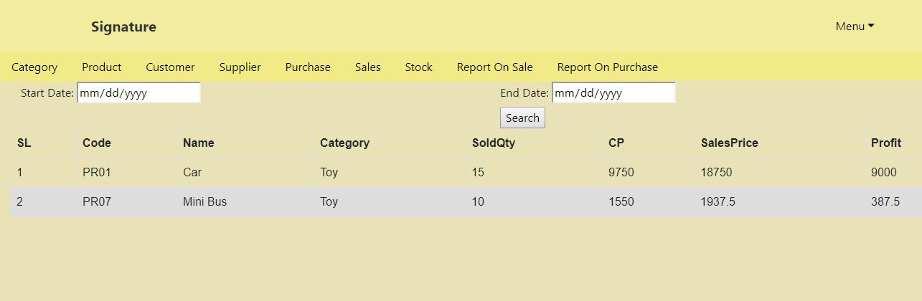
Screen Shot of SALES REPORT Module Output
Sav Purchase Details e Check

