Slide 1

DBMS LABORATORY (06123228) • SUMMER 2026
ORCUS
Organized Crime Understanding System
A 3NF-compliant relational database platform engineered to modernize criminal complaint intake, statutory FIR registration, multi-officer case management, and tamper-proof evidence chain-of-custody for Bangladesh Police.
Academic Project Team & Module Ownership:
• Md. Arafat Hossain Faisal (ID: 241400060) [Team Lead - Module 1: Architecture, Security, RBAC & Audit]
• A.K. Md. Shakil Hossain (ID: 241400043) [Investigation Lead - Module 2: Intake, GD, FIR & Cases]
• Ayshee Islam Liza (ID: 241400045) [Forensic Lead - Module 3: Participants, Geocoding & Custody]
Presented to: Course Faculty Evaluator ("Mam") | Department of CSE

Slide 2
PROBLEM CONTEXT & ANALYSIS
The Crisis of Manual Investigation Management
Challenges in paper-based Police Stations (Thanas) across Bangladesh
1. Evidence Tampering in Trials
Physical and digital evidence seized at crime scenes lacks verifiable provenance. Without unbroken timestamps and seal registries, defense attorneys routinely secure dismissals under Section 9 of the Evidence Act.
2. Citizen Complaint Black Hole
Citizens filing grievances receive handwritten slips with no tracking. Complainants cannot determine if their inquiry was converted to a GD, elevated to an FIR, or dropped without repeated station visits.
3. Trans-Regional Crime Silos
Criminal syndicates operate across Dhaka, Chattogram Port, Sylhet, and Rajshahi border corridors. Paper files prevent inter-branch intelligence sharing and suspect recidivism tracking.
4. The ORCUS Relational Solution
A unified 3NF relational database connecting 5 regional commands, enforcing atomic tracking sequences (CMP, GD, FIR, CAS), SHA-256 evidence hashing, and an immutable audit trail.

Slide 3
SYSTEM ARCHITECTURE
3-Tier Decoupled Enterprise Architecture
Strict separation of concerns guaranteeing security, scale, and data integrity
TIER 1 • PRESENTATION
Next.js 14 App Router
✔ React 18 & TypeScript strict types
✔ Bilingual Interface (English & Bengali)
✔ Citizen Public Complaint & Tracking Portal
✔ Officer Command Center & Global Search
✔ ZERO token storage in localStorage (XSS-safe)
TIER 2 • BUSINESS LOGIC
Go (Golang) Microservice
✔ High-performance Gin web framework
✔ Bcrypt password hashing (Cost = 10)
✔ Stateless JWT in secure HttpOnly cookies
✔ Role-Based Access Control (RBAC) middleware
✔ Immutable security & change audit logging
TIER 3 • STORAGE ENGINE
MySQL 8.0+ / InnoDB
✔ 28 Tables normalized to strict 3NF
✔ Strict Foreign Key Referential Integrity
✔ ON DELETE RESTRICT on core investigation assets
✔ Stored procedures & operational views
✔ ACID transaction isolation guaranteeing consistency

Slide 4
DATABASE NORMALIZATION
Relational Schema Design & 3NF Proof
Zero data redundancy and complete elimination of operational anomalies
Mathematical Normalization Proof
1. First Normal Form (1NF)
All attributes contain atomic values. Multi-valued contacts (phone, email) extracted into dedicated child entity complainant_contact. Every table possesses an unambiguous primary key.
2. Second Normal Form (2NF)
Meets 1NF. All non-key attributes are fully functionally dependent on the entire primary key. In composite bridge tables (case_suspect, case_victim), operational roles depend strictly on the composite key pair.
3. Third Normal Form (3NF)
Meets 2NF. No transitive dependencies exist (X -> Y -> Z). Officer badge numbers, branch details, and user credentials reside in distinct entities, preventing cascading corruption upon profile edits.
Referential Integrity & Constraints
• ON DELETE RESTRICT: Applied to master operational records. A case cannot be deleted if active evidence exists; a branch cannot be dropped if assigned to officers.
• ON DELETE CASCADE: Applied strictly to transient bridge associations (e.g. dropping a case cascades to its case_suspect and case_witness junctions).
• Atomic Sequence Generator: A dedicated system_sequence table atomically increments reference counters, generating gapless statutory IDs:
CMP-2026-0801 Citizen Complaint Tracking Code
GD-DHK-2026-0012 Metropolitan General Diary Number
FIR-2026-0101 Statutory First Information Report
CAS-2026-0001 Master Police Investigation File

Slide 5
TEAM CONTRIBUTION & SCOPE
Academic Division of Responsibilities
3 Independent functional modules harmoniously bound via relational integrity
MODULE 1 • LEAD ARCHITECT
Md. Arafat Hossain Faisal
ID: 241400060
• Core Relational Schema Design & 3NF Normalization
• User Authentication (JWT HttpOnly, Bcrypt)
• Role-Based Access Control (RBAC) Engine
• Agency Branches & Regional Commands
• Security Audit Logging (`audit_log`)
• Root Admin Protection (`user_id = 1`)
MODULE 2 • INVESTIGATION LEAD
A.K. Md. Shakil Hossain
ID: 241400043
• Citizen Complaint Intake & Public Tracking
• Duty Officer Review & GD Escalations
• Statutory First Information Report (FIR)
• Penal Code & Cyber Security Act Sections
• Case Master Dossier & Lead IO Assignments
• Status Transition Timelines & Histories
MODULE 3 • FORENSIC LEAD
Ayshee Islam Liza
ID: 241400045
• Criminal Participants Profiling (Suspects)
• Victim Trauma Notes & Witness Statements
• GIS Location Geocoding (`location`)
• Physical & Digital Evidence Ingestion
• Tamper-Evident Seals & SHA-256 Hashes
• Multi-Hop Chain of Custody Audit Trail

Slide 6
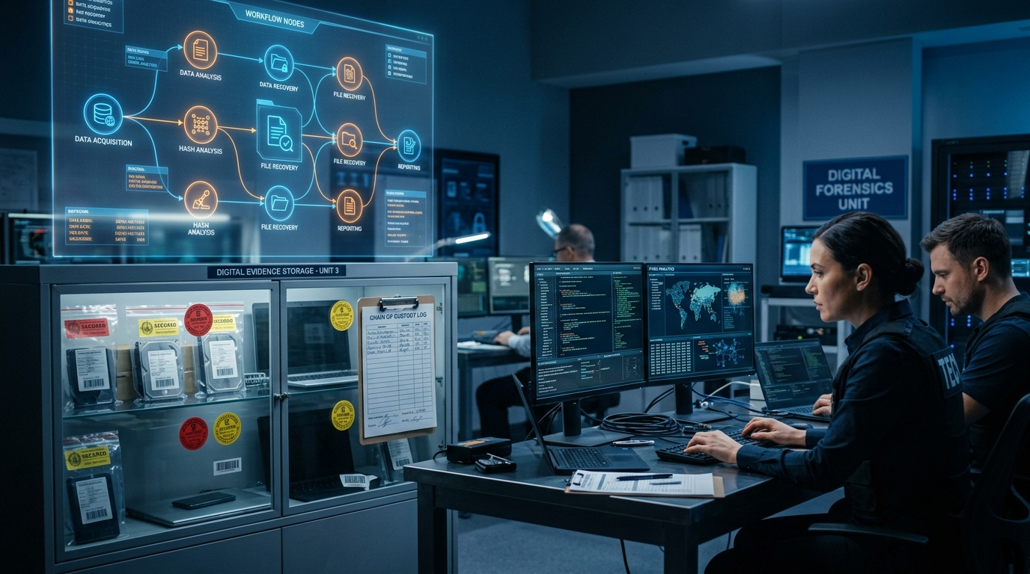
OPERATIONAL LIFECYCLE
The Complete Investigation Workflow Pipeline
From public citizen complaint intake to judicial trial exhibit
Step 1: Citizen Complaint Intake
Complainant submits incident report; system allocates atomic tracking code (CMP-2026-0801). Complainant tracks progress publicly without exposing officer notes.
Step 2: General Diary (GD) Logging
Duty officer conducts preliminary inquiry under Police Regulations Bengal; formal station GD approved (GD-DHK-2026-0012) with geographical jurisdiction.
Step 3: Statutory FIR Registration
Cognizable elements substantiated under CrPC Sec 154. First Information Report registered (FIR-2026-0101) with Bangladesh Penal Code Sections (Sec 420, 120B).
Step 4: Case Dossier & IO Delegation
Master case opened (CAS-2026-0001); elite detective assigned as Lead Investigating Officer. Mandatory status updates recorded in case_status_history.
Step 5: Suspects & Evidence Seizure
Suspects and witnesses mapped with operational roles. Physical & digital items seized with tamper seal numbers (SEAL-DHK-0091) and bitstream SHA-256 hashes.
Step 6: Multi-Hop Chain of Custody
Every movement logged (Scene -> Lab -> Vault -> Court). Formally admitted as physical Exhibit P-1 leading to judicial conviction decree.

Slide 7
FORENSIC INTEGRITY
Chain of Custody & Evidence Act Compliance
Cryptographic hashes and sealed provenance guaranteeing court admissibility
Legal Due Process & Verification
1. Evidence Act Section 9 Admissibility:
Criminal courts require uninterrupted proof that evidence has not been altered or substituted from the moment of seizure to trial exhibit admission.
2. SHA-256 Digital Checksums:
Every digital artifact (flash drive, disk image, VoIP audio) receives an immediate SHA-256 hash. If even 1 bit changes, the cryptographic hash mismatches.
3. Numbered Tamper-Evident Seals:
Physical evidence containers receive barcode-numbered tamper seals (e.g. SEAL-DHK-0091) recorded in the database.
4. Custodian Sign-Over Contract:
Both the releasing officer and receiving officer must sign off on transfer reason, destination facility, and seal condition.
Actual Audit Trail: EV-2026-0001-01
Item Description: Encrypted 128GB SanDisk USB Flash Drive
Seizure Location: Banani Suspect Workstation Safehouse
Cryptographic Hash: e3b0c44298fc1c149afbf4c8996fb92427ae41e4649...
Seal Reference: SEAL-DHK-0091 (Condition: Intact)
Hop 1 (Initial Collection): Seized by Lead Insp. Faisal -> HQ Reception Desk
Hop 2 (Lab Analysis): Transferred to Forensic Lead Liza -> Lab Locker D1
Hop 3 (Court Exhibition): Formally admitted in Dhaka Metropolitan Sessions Court as Exhibit P-1
Result: Zero provenance gaps; unanimous judicial admission decree.

Slide 8
DEMONSTRATION DATASET
Real-World Criminal Investigation Scenarios
5 Fully-fleshed Bangladesh Police operations ready for live demonstration
CAS-2026-0001 • Central HQ (Dhaka)
Operation Shadow Wire
45M BDT SWIFT cyber fraud exfiltration targeting corporate bank accounts. Evidence: Encrypted USB Drive & forged bank authorizations. Penal Code 420, 120B, CSA 17.
CAS-2026-0002 • Port Zone (Chattogram)
Operation Kraken
Tampered maritime shipping container #MSKU-998241 at Berth 9 concealing military night-optics and satellite phones. Customs Act 156.
CAS-2026-0003 • Central HQ (Dhaka)
Operation Iron Shield
Armed cartel extortion demanding 20M BDT with vehicle gunfire in Gulshan. Evidence: 9mm Beretta pistol & intercepted VoIP audio. Penal Code 384, 395.
CAS-2026-0004 • Northern Regional (Rajshahi)
Operation Silver Mint
Clandestine press printing 42.5M counterfeit BDT. Precision steel intaglio plates seized. Status: Successfully closed with unanimous conviction.
CAS-2026-0005 • Northern Regional (Rajshahi)
Operation Black Grid
SCADA RTU intrusion at Regional Substation 4 triggering 4-hour blackout. Evidence: Forensic RAM bitstream memory image. CSA Sec 17.

Slide 9
QUALITY ASSURANCE
Automated Test Harness & Verification Proof
100% Pass rate across authentication, RBAC boundaries, and route integrity
87 / 87
Tests Passing
5
Automated Suites
28
HTTP Routes Verified
0
Security Breaches
Comprehensive Automated Test Suites Summary:
1. Strict Authentication & Authorization (15 tests): HttpOnly session cookie validation, expired session revoking, role separation, and XSS client storage audit (Zero tokens in localStorage).
2. Record Deletion Capabilities (6 tests): Root admin (user_id = 1) unbypassable 403 Forbidden protection; verified transactional cascade deletion of complaints, GDs, FIRs, evidence, and cases.
3. Deterministic Core Workflow (11 tests): End-to-end simulated operational journey from citizen complaint submission to GD elevation, FIR filing, IO delegation, custody handover, and case closure.
4. Strict Route Verification (42 tests): Guarantees 200 OK across all authenticated operational portals and mandatory 307 Redirect to /login for unauthenticated visitors.

Slide 10
ACADEMIC EVALUATION
Conclusion & Live Demonstration Readiness
Thank you for your guidance throughout the Summer 2026 DBMS semester
Key Project Achievements
✔ Mathematically Sound: 28 tables fully normalized to 3NF eliminating all operational anomalies.
✔ Judicial Admissibility: Tamper-proof evidence custody with SHA-256 hashes and seal tracking under Evidence Act Sec 9.
✔ Citizen Transparency: Public complaint filing and tracking portal with bilingual English/Bengali support.
✔ Production Security: Stateless JWT in HttpOnly cookies, Bcrypt password hashing, and immutable audit logs.
✔ Real Law Enforcement Dataset: 5 complex multi-district criminal cases with legal Penal Code sections.
Ready for Faculty Evaluation
Live Demonstration Credentials:
Use 1-Click Instant Logins on Portal Login Screen:
• Admin (Faisal)
• Lead Det. (Shakil)
• Forensic (Liza)
• Duty Off. (Nusrat)
• Inspector (Tariq)
We welcome questions on Relational Theory, Normalization Proofs, SQL Triggers, Views & System Workflows.

