Slide 1

Design Optimization and Assessment of Floating Solar PV with Wind Turbine Systems at KEPZ
2023 5th International Conference on Sustainable Technologies for Industry 5.0 (STI)
Presented by A.I. Ikram Authors A.I. Ikram*, A.W. Erfan, T. Khandaker, M.A.R. Reyad, S.E.A. Himu, M.M. Alam, M.S. Islam | Submitted to Paper ID 1075 International Conference on Sustainable Technologies for Industry 5.0 (STI)

Slide 2
PRESENTATION OUTLINE
Introduction
Literature reviews
Aims and objective
Methodology
Analysis Conditions
Results and simulations
Conclusions
References

Slide 3
INTRODUCTION
Bangladesh is heavily relied on natural gas and coal to meet its power generation demand.
Renewable technology proved its viability as an alternative solution for energy crisis that is yet to come due to limited natural gas resources and environmental concern.
We find the urge to test the economic feasibility of grid-integrated hybrid renewable system for an industrial zone name KEPZ (Korean Export Processing Zone).

Slide 4
LITERATURE REVIEW
Title | Author | Contribution | Limitation
Floating Solar Photovoltaic System: An Overview and their Feasibility at Kaptai in Rangamati. | Raihan Chowdhury, Md. Abdul Aowal, Sk. Md. Golam Mostafa | Floating solar viability and performance tested | No economic feasibility tested.
Feasibility study of an islanded microgrid in rural area consisting of pv, wind, biomass and battery energy storage system | S. Singh, M. Singh, and S. C. Kaushik | Economic feasibility with hybrid distributed generator | No optimization regarding operating cost.
Design and techno-economical optimization for hybrid pv/wind system under various meteorological conditions | S. Diaf, G. Notton, M. Belhamel, M. Haddadi, and A. Louche | Economic feasibility and optimization | No floating solar considered

Slide 5
AIMS AND OBJECTIVES
To design of model comprised of grid-connected floating solar PV, and WT that can calculate hourly generation from given resource data.
To use GWO algorithm to minimize the upfront cost of that system and levelized cost of energy.
To do an economical analysis of the system and a comparison with similar studies.

Slide 6
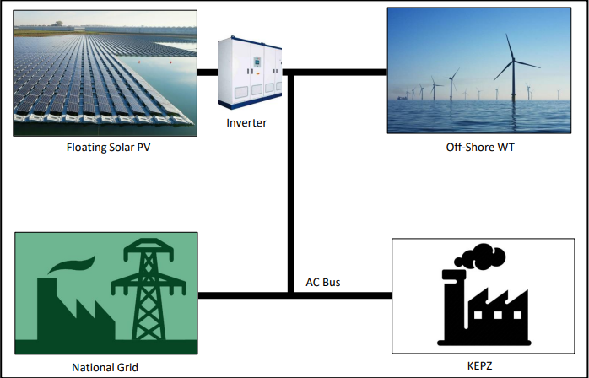
METHODOLOGY (CONT.)
Input
Hourly metrological data
Load demand data collected
Model
Floating PV and WT mathematical model
GWO algorithm model
Output
Economically feasible system
Optimal operating cost
Fig 1 – Proposed Model

Slide 7
METHODOLOGY
Design Model
Project Specification
GWO Algorithm
Economic Analysis
Simulation
Result
Technical Model
Economical Model
Location Coordinate
Hourly Metrological Data
Initialize Wolf
Evaluate Fitness
Assign and update α, β, and δ
Run till Termination critera met
Investment cost, Maintenance cost, Repacement cost
NPC and CRF
Calculate LCoE
Annual hourly generation & consumption
1000 iteration cycle on GWO operation

Slide 8
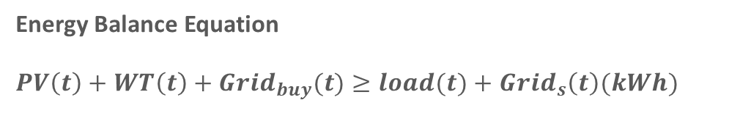
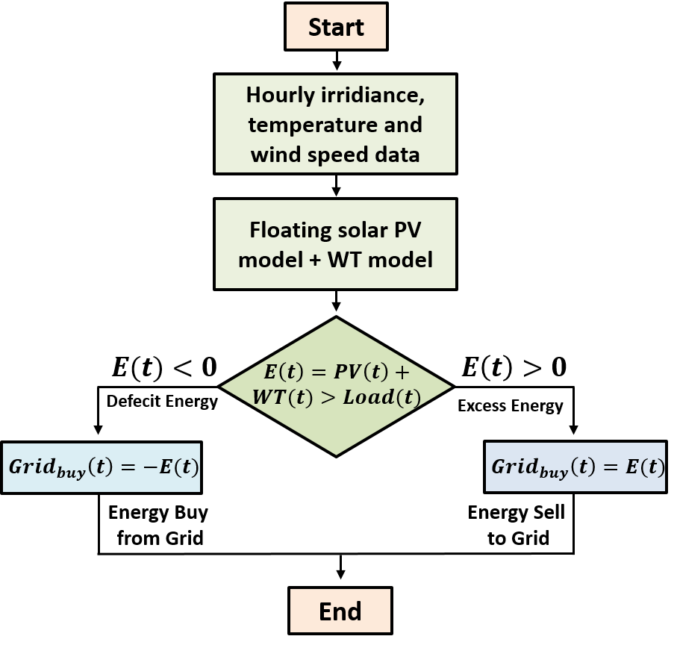
METHODOLOGY (CONT.)
The hour is denoted by ‘t’.
The mathematical model of floating solar PV and WT calculate the hourly energy generation using the hourly value. If the energy is short, defecit energy is bougt from grid to satisfy load demand, and when energy generation higher, the excess energy is sold to grid.
<
Fig 2 – Energy estimation flowchart

Slide 9
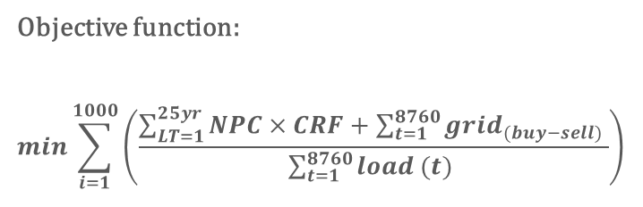
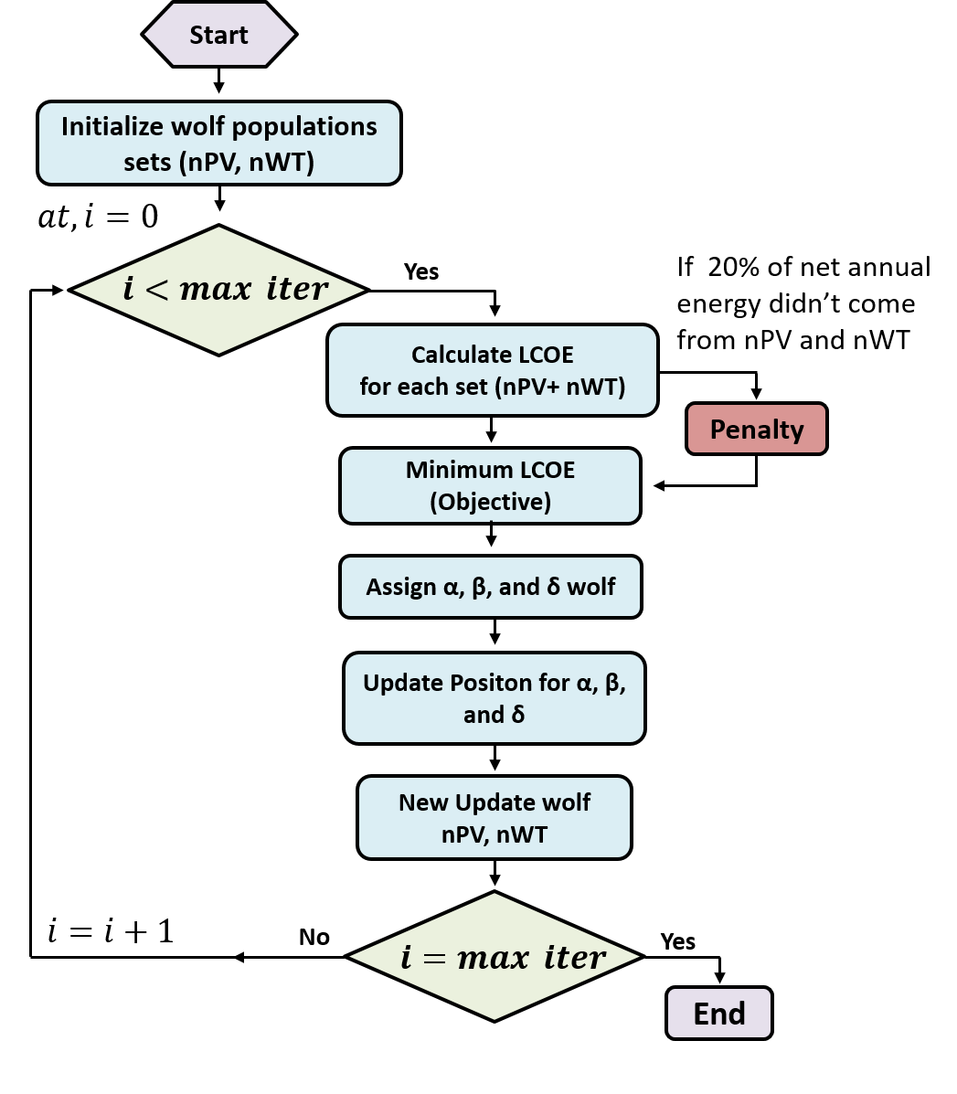

METHODOLOGY (CONT.)
Here, NPC is the net present cost, CRF is the capital recovery factor of the system, and $\sum_{t=1}^{8760}{grid_{(buy−sell)} }$is the annual net revenue from selling energy to the grid.
GWO algorithm produce the value of nPV, nWT after each iteration. Thus determining the NPC and optimal capacity required for the system.
Parameters | Value
Population size | 10
Upper bound | 10000
Lower bound | 0
Iteration | 100
Fig 6 – GWO algorithm flowchart

Slide 10
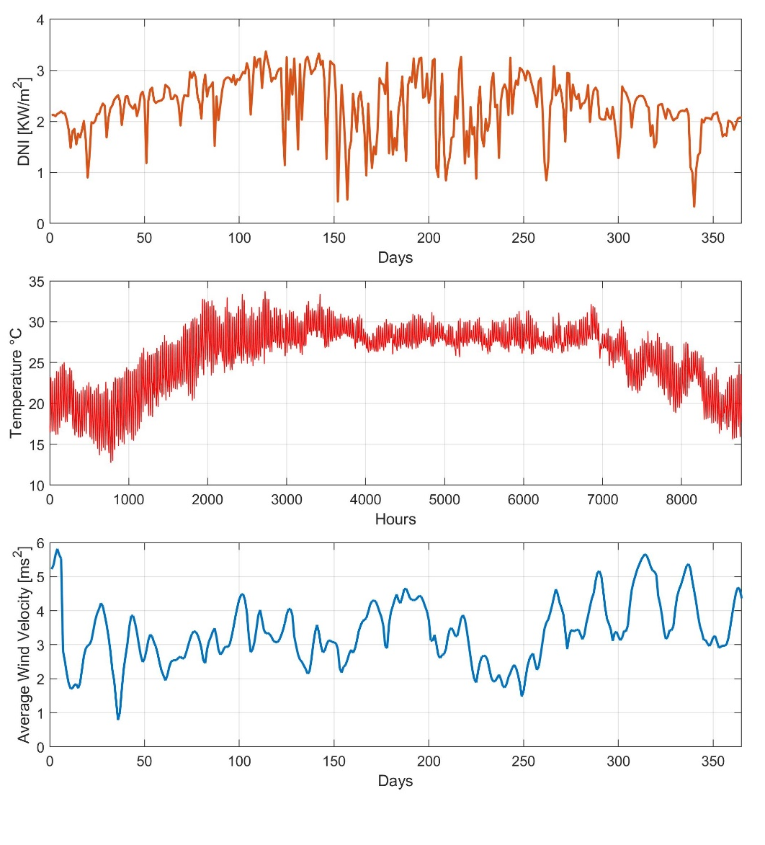
ANALYSIS CONDITIONS
Location specific solar Insolation and wind speed data was collected from NREL in order to test the model.
Daily average DNI is noticed around 2.3 (kW/m2), which is very potential for solar generation, and the average hourly wind speed is perceived around 4.26 (m/s)
Fig. Input Meteorological Data Point

Slide 11
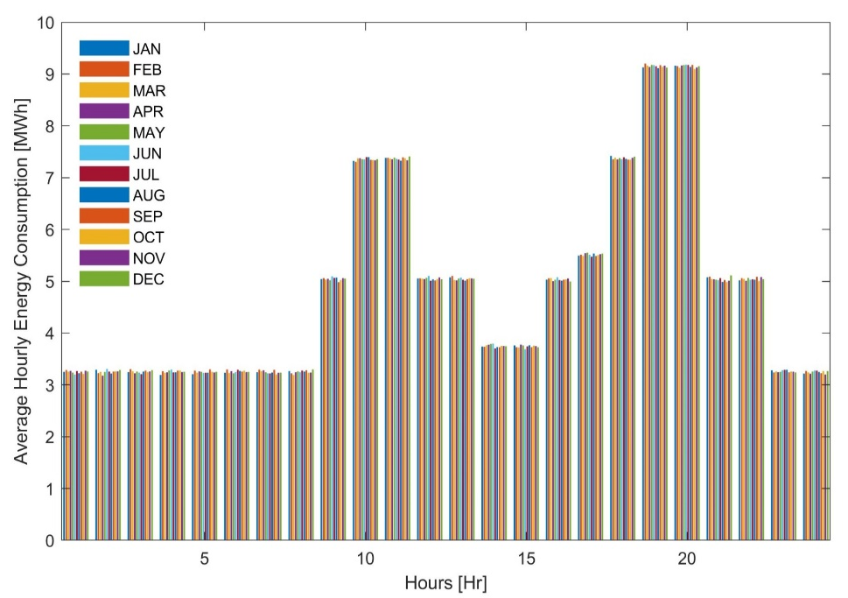
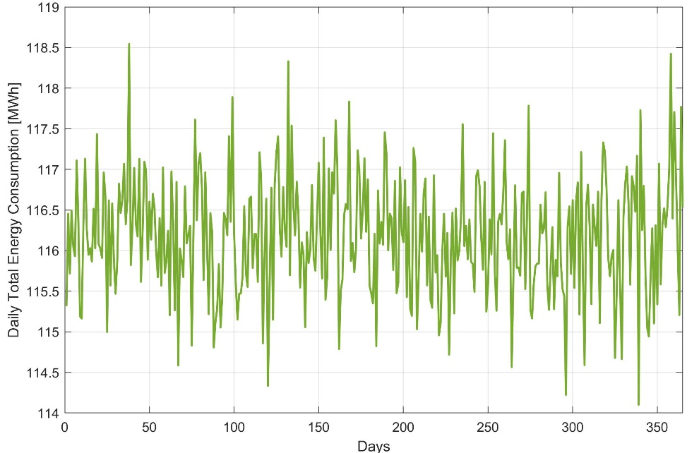
ANALYSIS CONDITIONS (CONT.)
Hourly load data of 1 day was collected from KEPZ office. Around 2% uniformly distributed randomness was added to simulate annual hourly data.
Fig 9 – KEPZ Load (MWh)

Slide 12
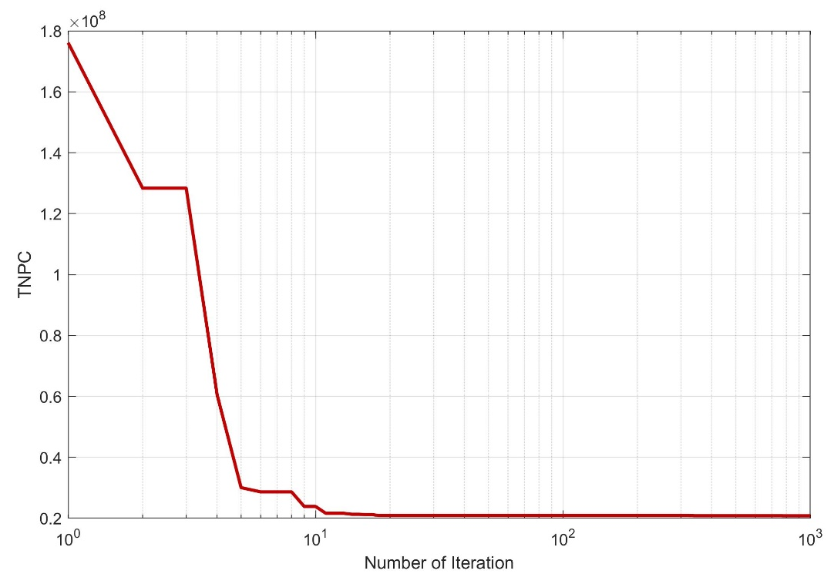
RESULTS AND SIMULATIONS
Convergence Curve:
Optimization algorithm was run for 100 iteration with population size of 10.
Convergence curve shows the objective function is achieving lowest possible value over every iteration.
GWO is gradually achieving the lowest TNPC value possible with every iteration.
After 40-iteration, TNPC remains constant. Because GWO is designed to optimize the system so that 20% of net annual load demand comes renewable.

Slide 13
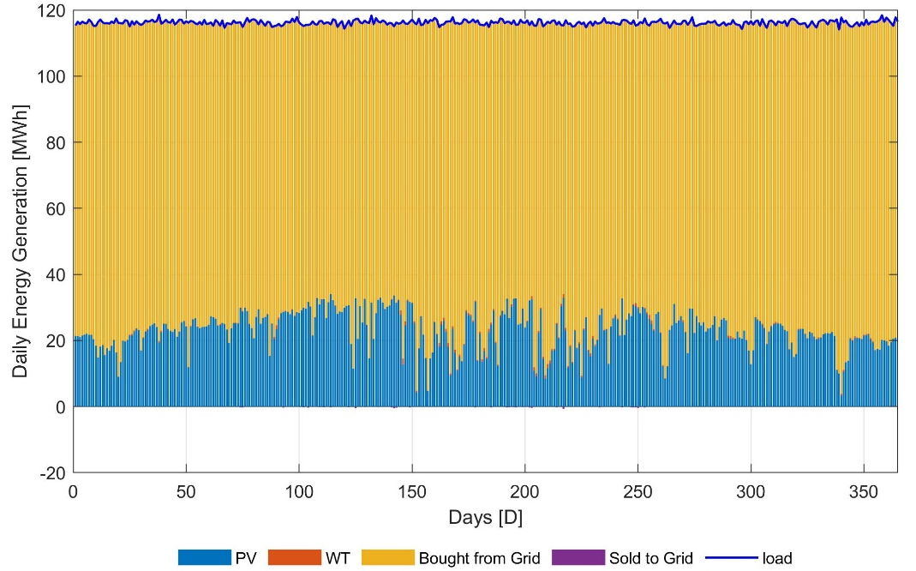
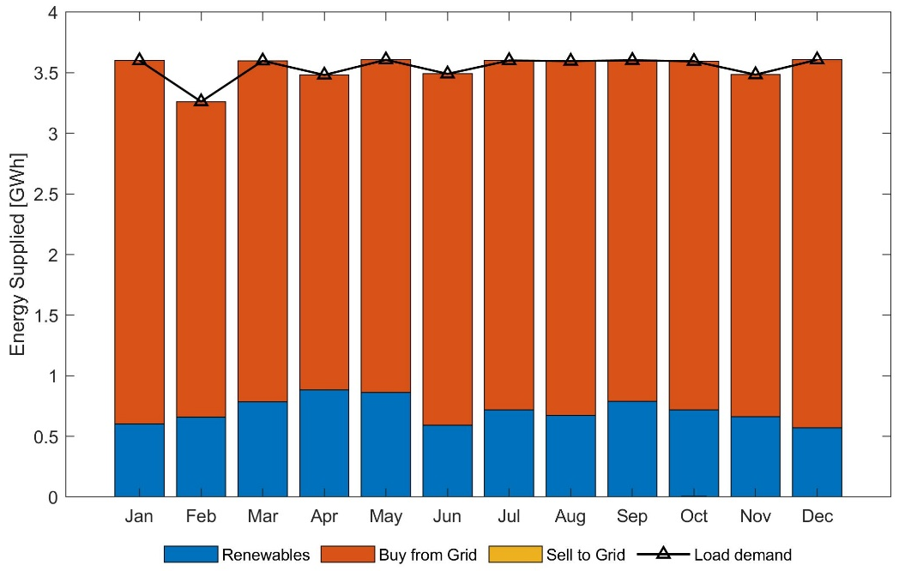
RESULTS AND SIMULATIONS (CONT.)
Annual Generation and Consumption: Fig 9 shows the daily energy consumption and generation by renewable sources and gird for 365 days.
Fig 9 – Daily energy scenario
Fig 10 – Monthly total energy scenario

Slide 14
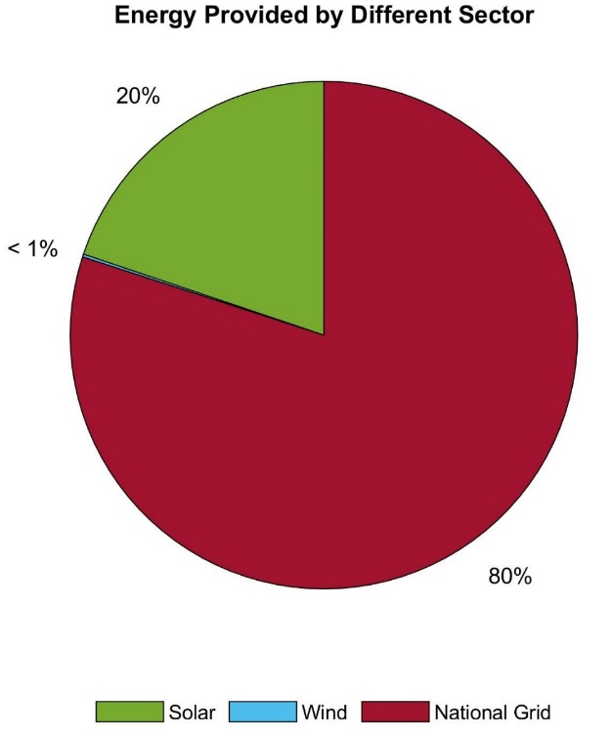
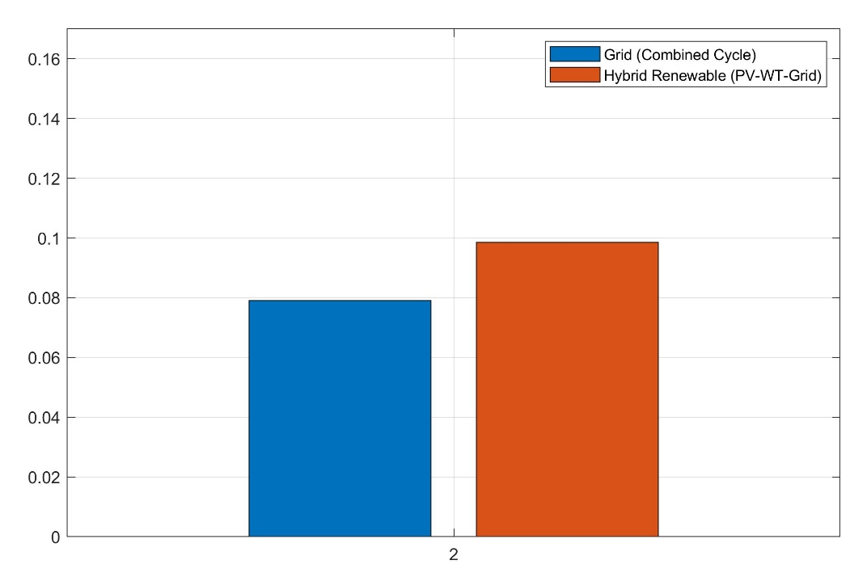
RESULTS AND SIMULATIONS (CONT.)
GWO algorithm calculated the optimal size for the system.
LCoE was found lowest as 0.106 ($/KWh) after GWO optimization
Higher LCoE of 0.160 ($/KWh) was observed for non-GWO optimized approach.
Fig 10 – Energy generation share
Fig 11 – Daily total generation and consumption

Slide 15
RESULTS AND SIMULATIONS (CONT.)
Total capacity of 887 kW of PV and 80kW of WT need to be installed in the system to operate economically feasible to provide 20% of total annual load demand at KEPZ industrial zone.
Rest of the 80% of energy was provided by. Very negligible amount of wind energy was produce as it was tested with low wind potential site.
Renewable |  |  |  | Grid
Name | Rated Capacity (KW) | Annual Generation (MWh/yr.) |  | Annual Energy Status (MWh/yr.)
PV | 886.53 | 8410.67 |  | Sold | 10.07
WT | 80 | 78.25 |  | Bought | 33927.78

Slide 16
RESULTS AND SIMULATIONS (CONT.)
$9,31,149 needed to be invested as capital cost. $1,98,78,395 of operation and maintenance cost will be spend over project life time of 25 years.
Total net present cost of the system was found $2,08,28,456. Levelized cost of electricity was found 0.106 ($/KWh) for the proposed system.
Renewable |  |  |  |  |  | Grid
Item | Capital Cost ($) | O&M Cost ($) | Net Preset Cost ($) | LCoE ($/kWh) |  | Tariff rate CoE ($/kWh)
PV | 7,13,300 | 1,64,07,726 | 1,71,71,976 |  |  | Retail | 0.079
Pontoon | 50,950 | 0 | 0 |  |  | Sell | 50% of retail price
WT | 88,000 | 3,373,709 | 3,461,709 | 0.106
Inverter | 9,31,149 | 96,960 | 1,94,772
Total | 9,31,149 | 1,98,78,395 | 2,08,28,456

Slide 17
CONCLUSIONS
An economic model for RES was proposed to calculate the annual cost and cost of energy (CoE) considering profit margin, lifetime of component.
GWO algorithm determine economic and technical feasibility of floating solar PV panels, wind turbine for Korean Export Processing Zone (KEPZ), and LCoE was found 0.106 $/kWh.
It can be concluded that 20% of total annual energy demand of KEPZ, Chattagram can be provided by renewable distributed generator.

Slide 18
REFERENCES
A. Sahu, N. Yadav, and K. Sudhakar, “Floating photovoltaic power plant: A review,” Renewable and sustainable energy reviews, vol. 66, pp. 815–824, 2016.
S. Mirjalili, S. M. Mirjalili, and A. Lewis, “Grey wolf optimizer,” Advances in engineering software, vol. 69, pp. 46–61, 2014.
S. Diaf, G. Notton, M. Belhamel, M. Haddadi, and A. Louche, “Design and techno-economical optimization for hybrid pv/wind system under various meteorological conditions,” Applied Energy, vol. 85, no. 10, pp. 968–987, 2008
NREL, “Solar resource data and tools,” 2022. [Online]. Available: https://www.nrel.gov/grid/solar-resource/renewable-resource-data.html
S. Singh, M. Singh, and S. C. Kaushik, “Feasibility study of an islanded microgrid in rural area consisting of pv, wind, biomass and battery energy storage system,” Energy Conversion and Management, vol. 128, pp. 178–190, 2016

Slide 19
THANK YOU

