Slide 1

2023 5th International Conference on Sustainable Technologies for Industry 5.0 (STI)
Feasibility Study and Performance Analysis of Rooftop Solar Panels and Airdolphin Wind Turbines
Paper ID 6260
Presented By
Arafat Ibne Ikram
Author
Samiul Hoque Kashfi, Md Abdulla Al Noman, Arafat Ibne Ikram*, Sheik Erfan Ahmed Himu, Fahim Abrar, Minhazur Rahman and Md Imtiaz Uddin

Slide 2

Introduction
Hybrid systems have gained in significance since they seemed to be the best option for a distributed, renewable energy system.
Analysis and modelling must receive special attention in emerging hybrid system implementations.
Utilizing the renewable energy sources present in Dhaka city would help to narrow the enormous gap between supply and demand.

Slide 3
Objectives
The over all objectives is to design and analysis hybrid energy
system for Dhaka. The key objective will be specified as:
To design and analysis for Rooftop Solar System by using HelioScope tools.
To make telecommunication tower self energizing by using wind Airdolphin Turbine.

Slide 4
LITERATURE REVIEW
Title | Author | Result
Potential rooftop distribution mapping using Geographic Information Systems (GIS) for Solar PV Installation: A case study for Dhaka, Bangladesh | Jamal, Taskin & Ongsakul, Weerakorn & Singh, Jai Govind & Salehin, Sayedus & Ferdous, S.M. | They only calculate Dharmondi area total proposed PV system power using HOMER. The power supplied from the PV system could be 15% of the total electricity supply of the Dhanmondi grid.
A Hypothetical Design Of Small Hydro Power Plant Using Sewage Water In The Perspective Of Dhaka City | Mia, Nasim & Hossain, Moazzam & Islam, A.K.M Shoriful & Rahman, Sheikh & Ahmed, Nadim & Khan, Sadia & Yasmin, Farjana | If the average head of Dhaka city is 2.65m and the total water is 1,239,573,600 cubic meter water per annum, then the approximate available power in the generator is 0.828 MW
Wind Turbines to Power Telecommunication Systems: A Case Study in Sicily | Antonio Messineo, Vincenzo Franzitta and Marco Trapanese | The finding of the study was that all the horizontal axis turbines can supply the energy needs of the radio broadcasting station, that amounts to approximately 10,926 kWh/year

Slide 5
Methodology
Designing rooftop PV solar system using HelioScope
To reduce the telecommunication towers power consumption by using Airdolphin Turbine.
Dividing whole Dhaka city by govt. & private section.
To utilize the wind energy of Dhaka city by using telecommunication towers.

Slide 6
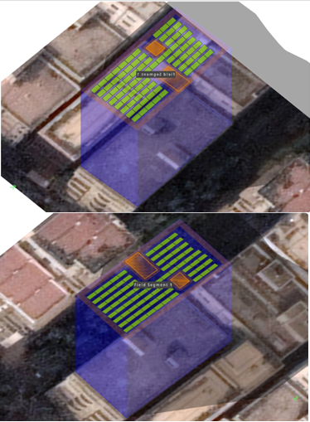
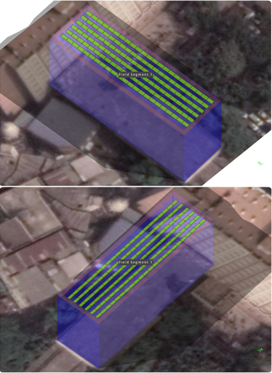
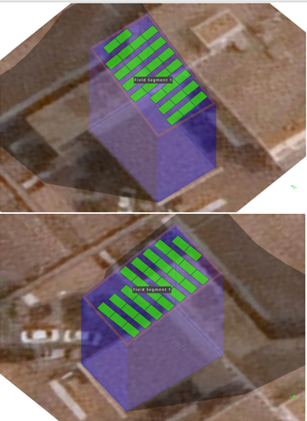
Design for Rooftop Solar System
Fig-1: Top view of District of suggested location for PV panel.
(Total of 77kWp Installed cap., tilt angle is 30°, azimuth is 176.73°, 9886.25 sq.ft.)

Slide 7
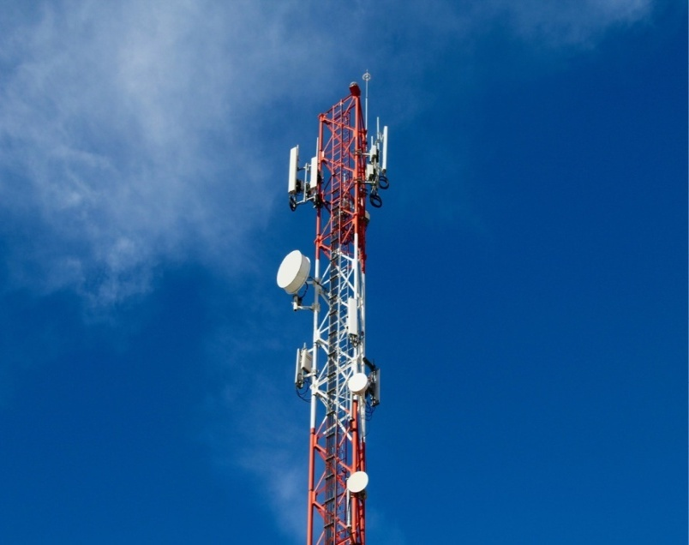
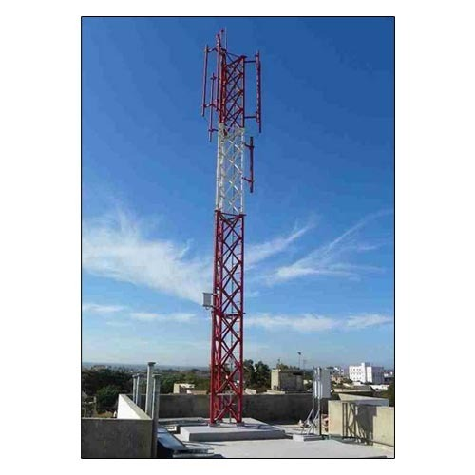
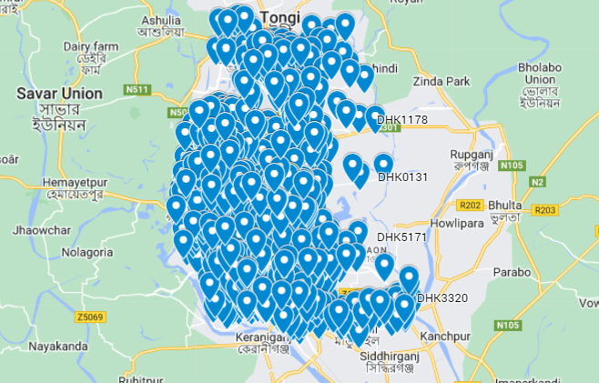
Design for Wind Turbine (CONTD.)
Fig. Banglalink core in Dhaka (1805 sites)
Fig. Roof top telecommunication tower

Slide 8
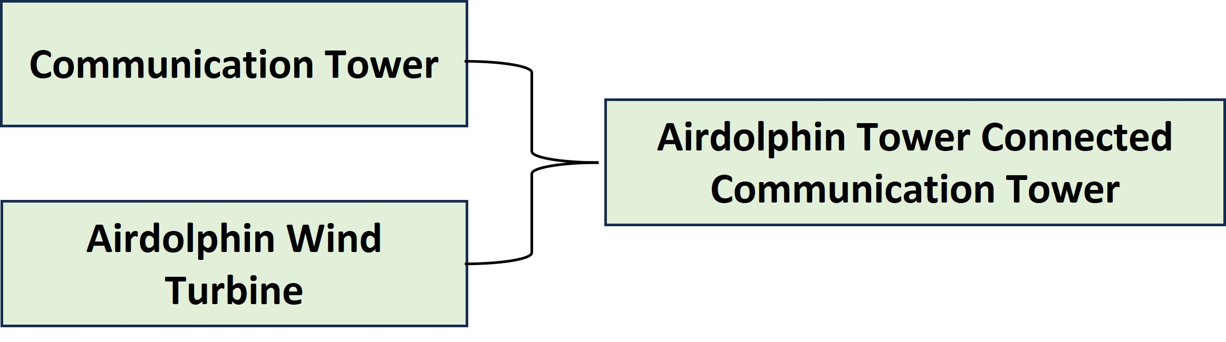
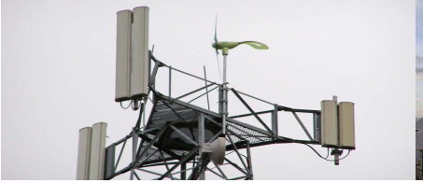
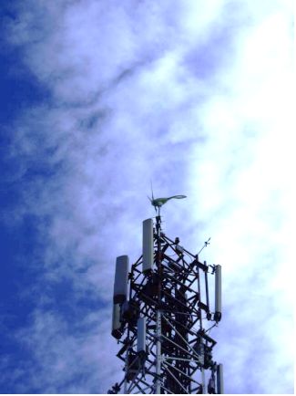
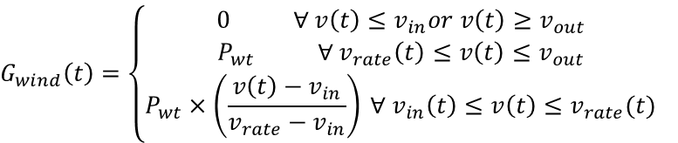
Design for Wind Turbine (CONTD.)
Hourly energy generated by Airdolphin Wind turbine can be achieved using –
$$G_{wind}\left(t\right)=\left\{\begin{aligned}0 ∀ v\left(t\right)≤v_{in}or v\left(t\right)≥v_{out} \\ P_{wt} ∀ v_{rate}\left(t\right)≤v\left(t\right)≤v_{out} \\ P_{wt}×\left(\frac{v\left(t\right)−v_{in}}{v_{rate}−v_{in}}\right) ∀ v_{in}\left(t\right)≤v\left(t\right)≤v_{rate}(t)\end{aligned}\right.$$
‘t’ is denoted as the hourly variable.
Operation is carried out in MATLAB software environment
Fig-19: Turbine connected with tower

Slide 9
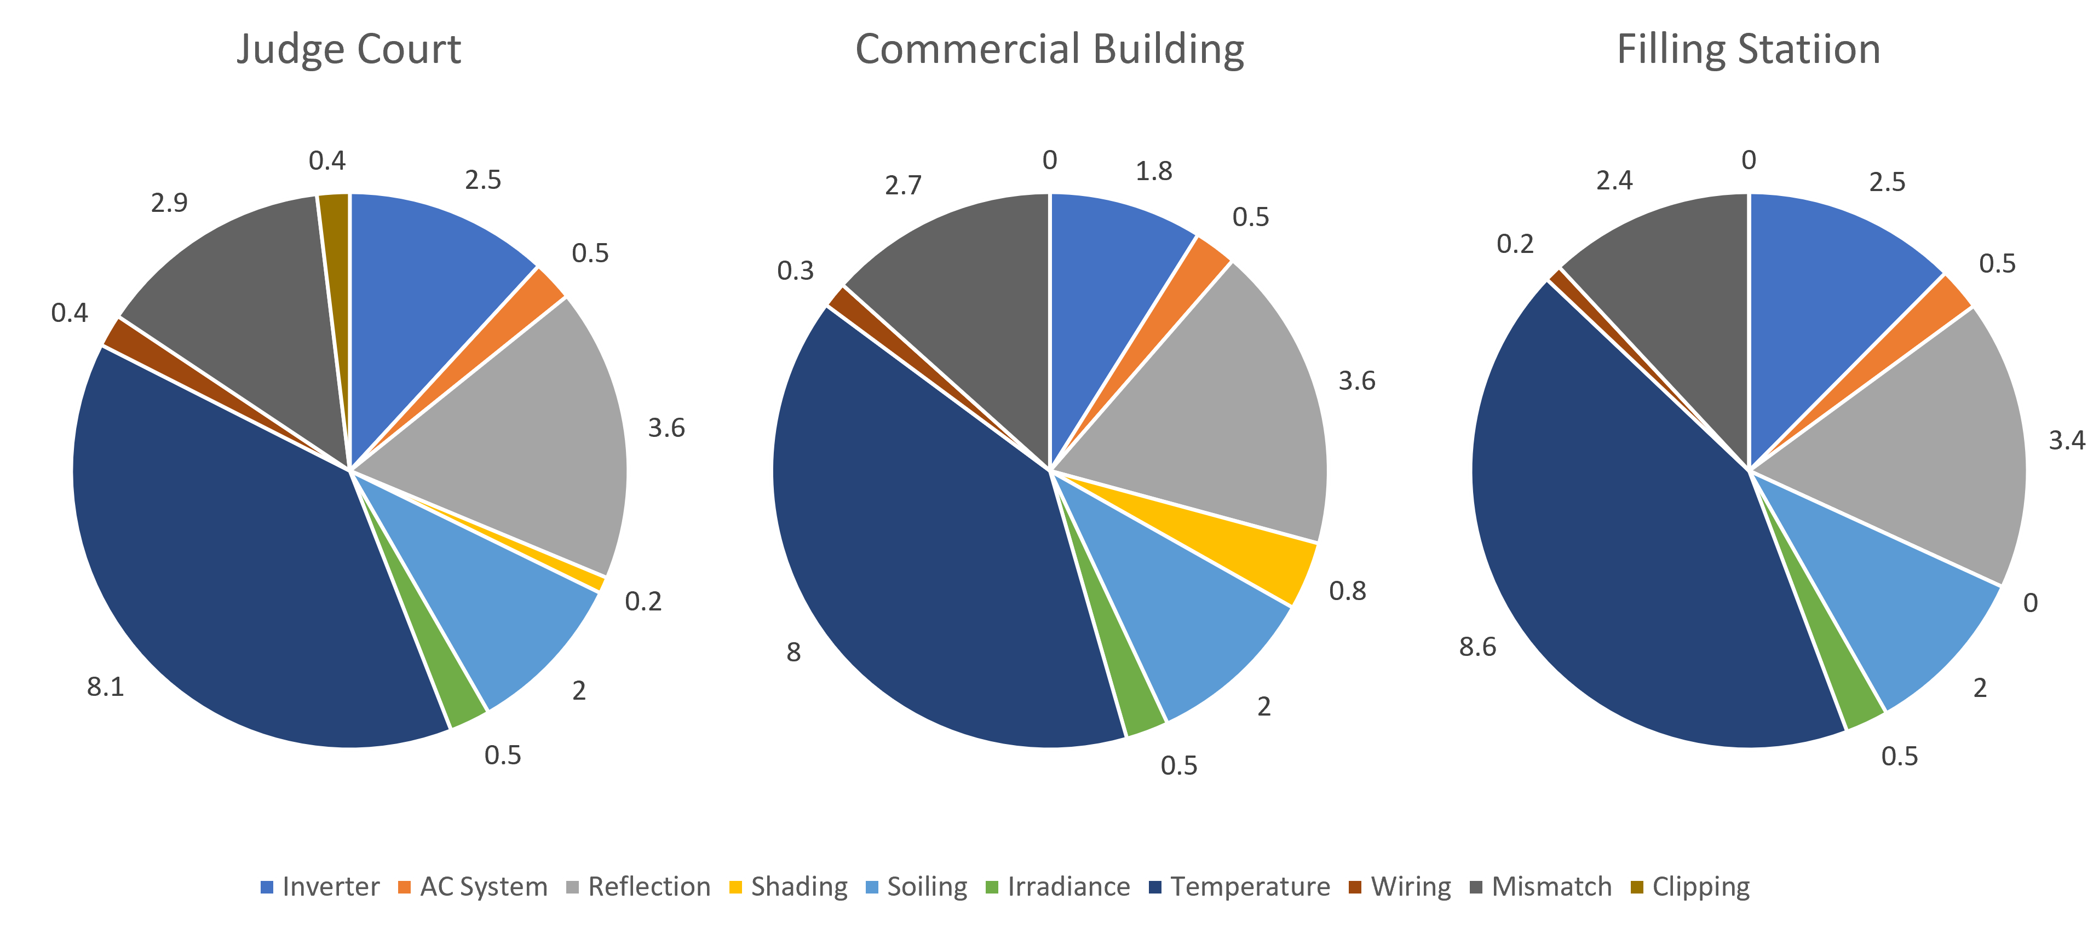
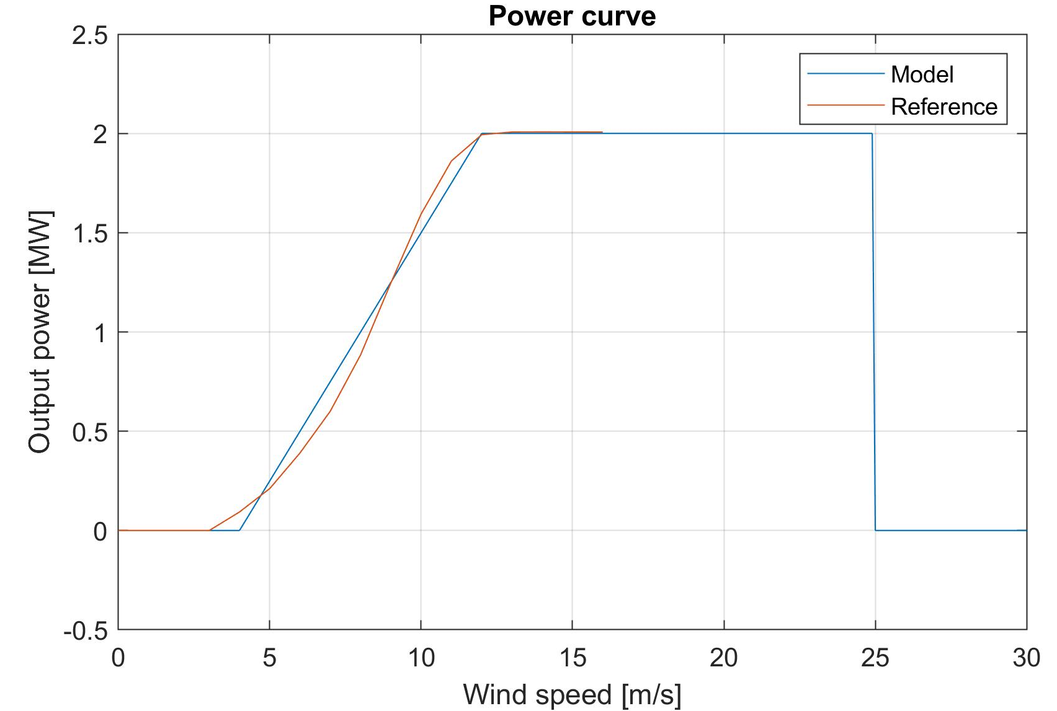
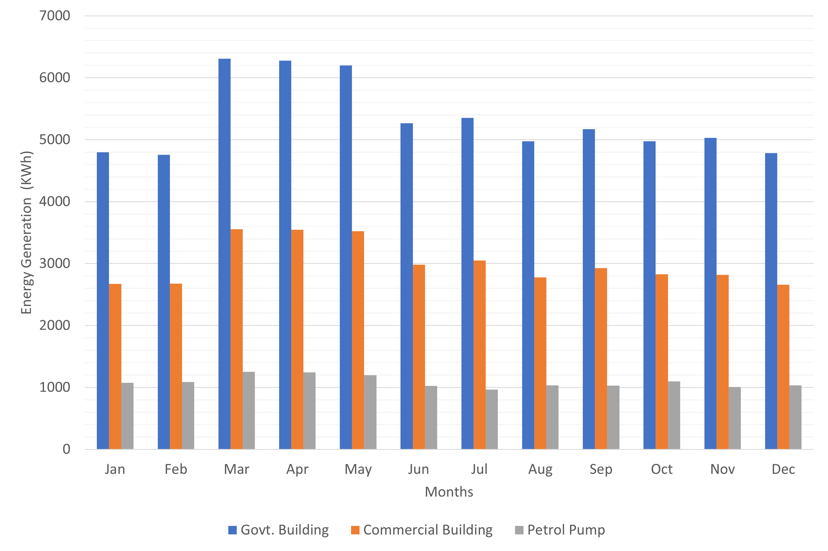
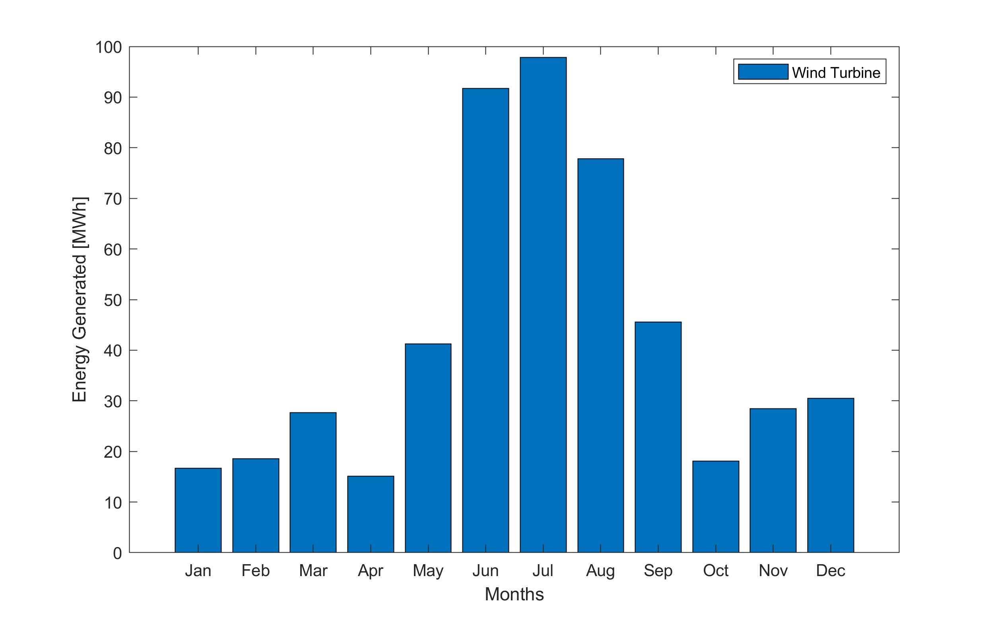
Result and Analysis
Fig. Source of System Loss.
Fig. Wind Turbine Power Curve
Fig. Monthly PV Generation
Fig. Monthly Production of energy

Slide 10
Result and Analysis (CONTD.)
Months | Rooftop Solar PV Gen. (kWh) |  |  |  | Wind Gen. (MWh)
 | Judge Court (Govt. Building) | Commercial Building, Banani | Petrol & CNG Filling Station |  | AirDolphin Telecommunication Wind turbine
Jan | 4799.8 | 2673.7 | 1076.6 |  | 16.59
Feb | 4756 | 2674.8 | 1088.2 |  | 17.98
Mar | 6309.9 | 3554.9 | 1253.8 |  | 28.05
Apr | 6277.8 | 3544.6 | 1242.3 |  | 14.77
May | 6199.5 | 3522.9 | 1196.7 |  | 41.02
Jun | 5268.4 | 2982.6 | 1024.2 |  | 91.53
Jul | 5355.1 | 3050.2 | 967.4 |  | 98.12
Aug | 4973.4 | 2775.4 | 1033.2 |  | 77.65
Sep | 5169.5 | 2925.7 | 1028.2 |  | 45.65
Oct | 4975.3 | 2826.2 | 1097.9 |  | 19.56
Nov | 5032 | 2819.9 | 1005.9 |  | 27.65
Dec | 4783.2 | 2658.9 | 1034.4 |  | 29.36

Slide 11

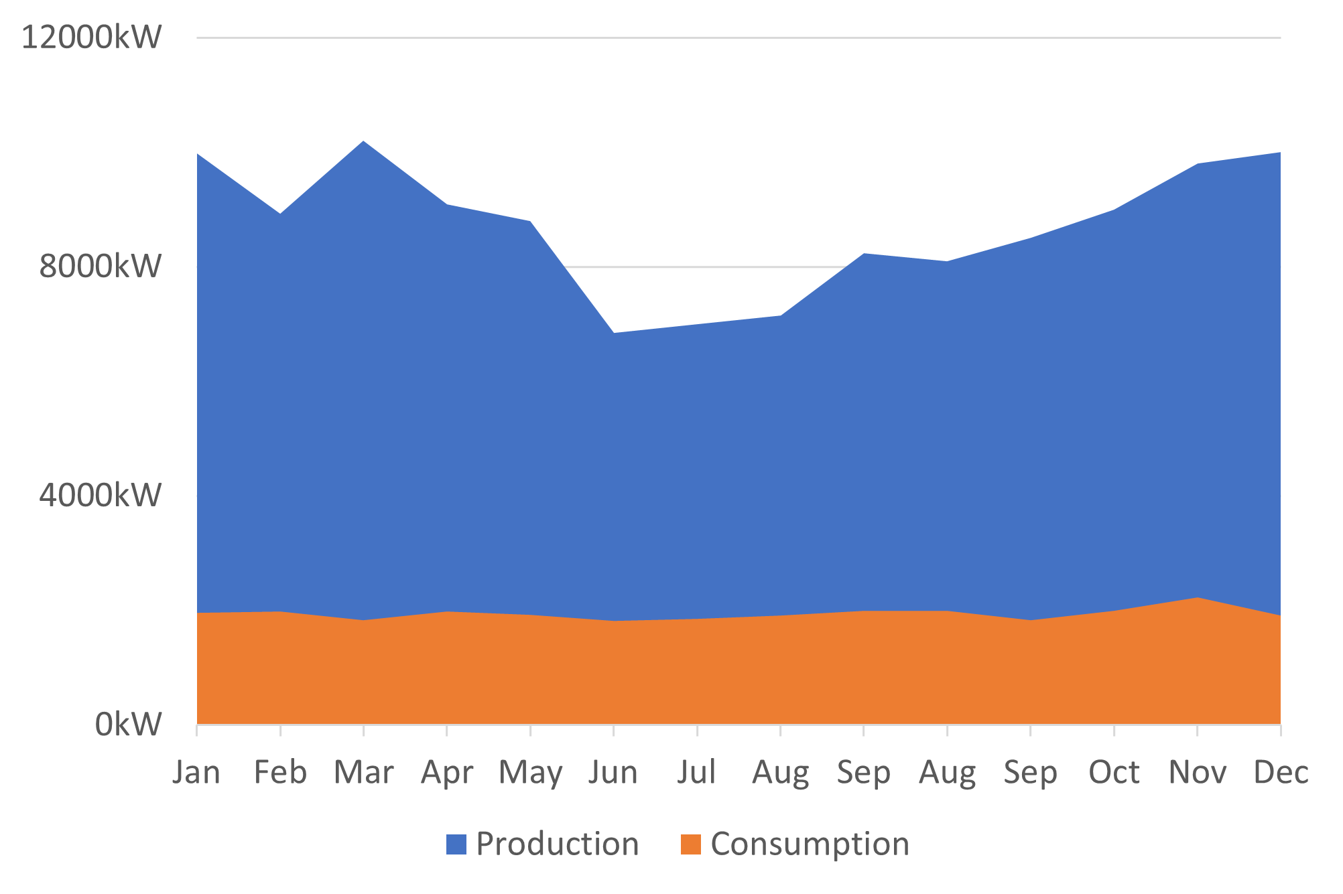
Result and Analysis
Fig. Financial Analysis.
Fig. Consumption vs Generation Comparison

Slide 12
Result and Analysis(CONTD.)
We have said earlier that the Dhaka city offers 10.554 km2. And our sample area is around 9886.25Sqft = 0.0009184km2.
Annually we are generating almost 103.2MWh in our sample design.
We are getting 103.2MWh against 0.0009184km2 area.
We will get approximately 1185945.99MWh = 1185.946 GWh power against 10.554km2 area.

Slide 13
Total Energy Calculation
Hybrid Energy System
Annually Energy Produce (Estimated)
Section | Amount Produce | Unit
Total Energy Produce from RSS | 1185.946 | GWh
Total Energy Produce from Wind | 5.04 | GWh
Total Energy Produce Annually | 1190.986 | GWh

Slide 14
Conclusion
A hybrid Rooftop PV and Air Dolphin Wind turbine comprising energy system model is constructed in this study.
We have also noticed that this model is more trustworthy and effective than the previous models.
The hybrid model of PV/WIND/small hydro delivers power at a considerably higher and more cost-effective rate than the present system.

Slide 15
Future Work
In the future, if we modify our filling station model to become a hybrid solar system, we can easily use this model as an EV charging station.
The vortex hydro turbine system can be implemented in the Dasherkandi Sewage Treatment Plant, which is the largest sewage treatment plant in South Asia. In that case, we can get huge power because of its daily sewage treatment capacity of 500000m3.
The wind turbine proposed model can be implemented in the transmission tower. In that case, we can produce a large amount of electricity to cover up both the telecommunication tower and the transmission tower.

Slide 16
References
Amit Kumer Podder, Anik Kumar Das, Eklas Hossain, Nallapaneni Manoj Kumar, Naruttam Kumar Roy, Hassan Haes Alhelou, Alagar Karthick, Amer Al-Hinai, Integrated modeling and feasibility analysis of a rooftop photovoltaic systems for an academic building in Bangladesh, International Journal of Low-Carbon Technologies, Volume 16, Issue 4, December 2021, Pages 1317–1327, https://doi.org/10.1093/ijlct/ctab056.
Mia, Nasim & Hossain, Moazzam & Islam, A.K.M Shoriful & Rahman, Sheikh & Ahmed, Nadim & Khan, Sadia & Yasmin, Farjana. (2021). A Hypothetical Design Of Small Hydro Power Plant Using Sewage Water In The Perspective Of Dhaka City. 1-5. 10.1109/ICCCNT51525.2021.9579747.
Antonio Messineo1, Vincenzo Franzitta2 and Marco Trapanese, Wind Turbines to Power Telecommunication Systems: A Case Study in Sicily, 2011.

Slide 17
THANK YOU

