Slide 1
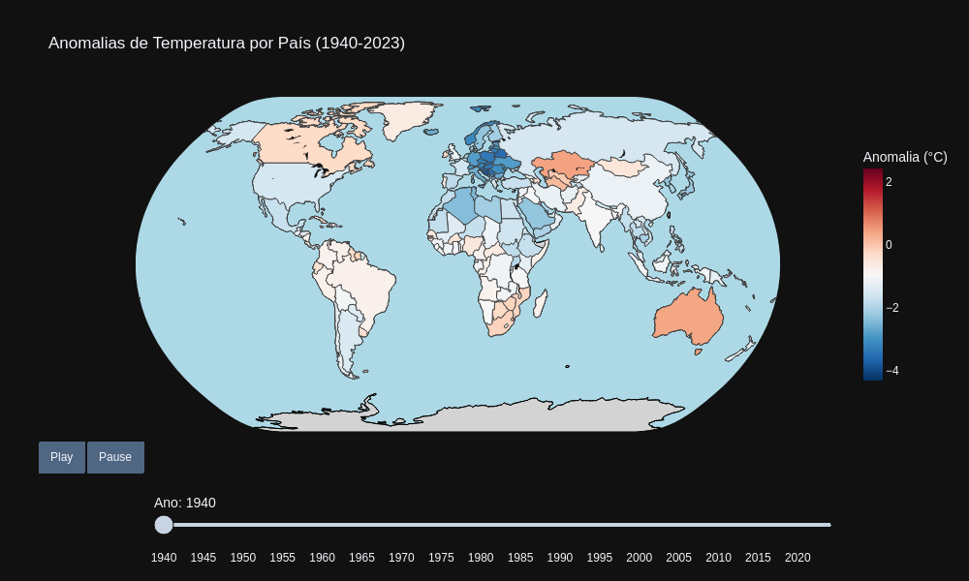
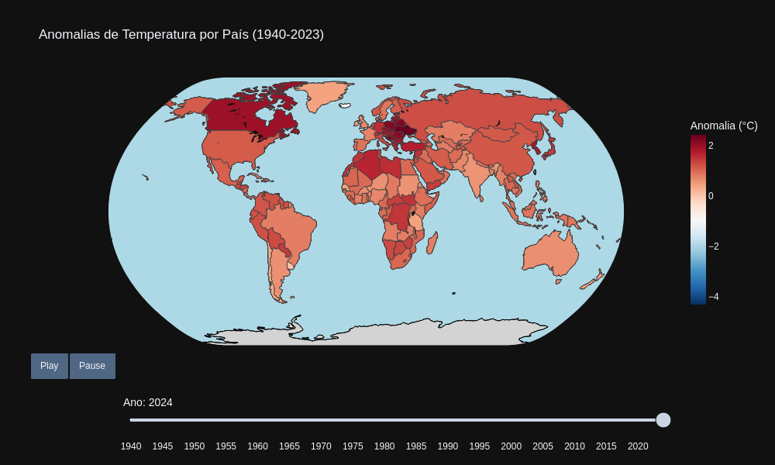
Anomalias de temperatura anuais*
*Contains modified Copernicus Climate Change Service information (2025) – with major processing by Our World in Data. “Annual temperature anomalies” [dataset]. Contains modified Copernicus Climate Change Service information, “ERA5 monthly averaged data on single levels from 1940 to present 2” [original data]. Retrieved June 27, 2025 from https://archive.ourworldindata.org/20250624-125417/grapher/annual-temperature-anomalies.html (archived on June 24, 2025).

Slide 2
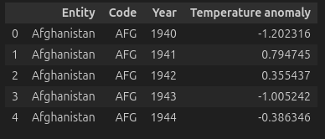
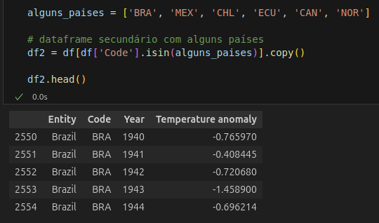
Aparência inicial do dataframe
Dataframe secundário com países de interesse

Slide 3
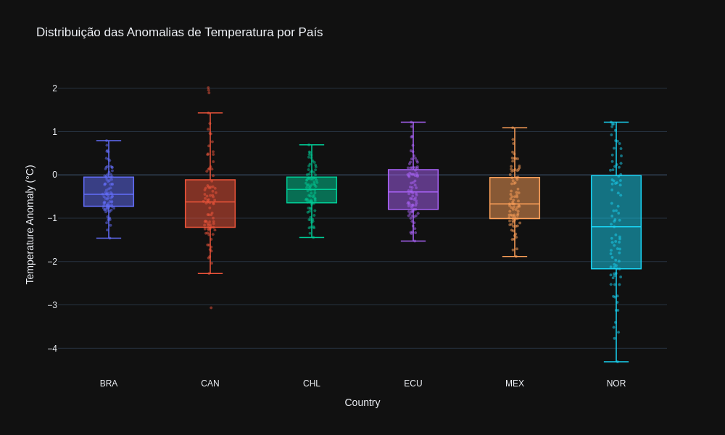
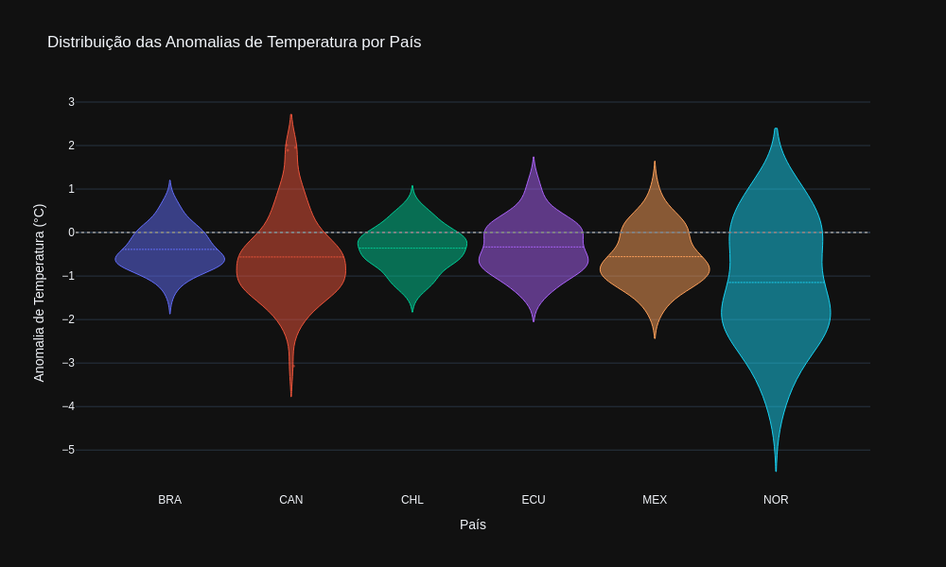
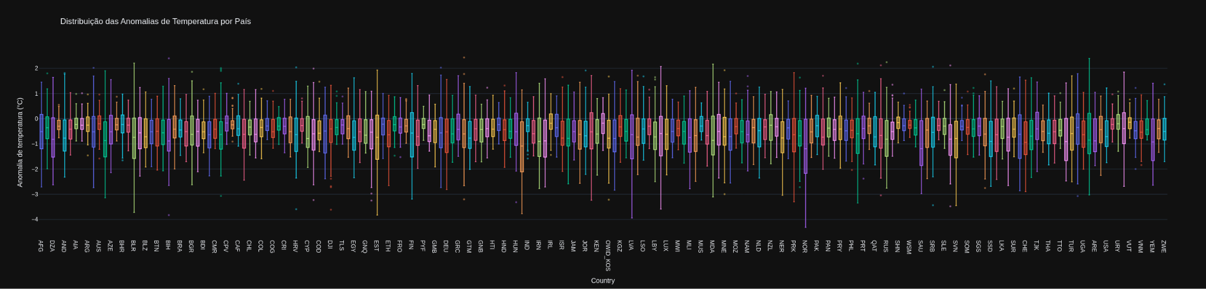

Slide 4
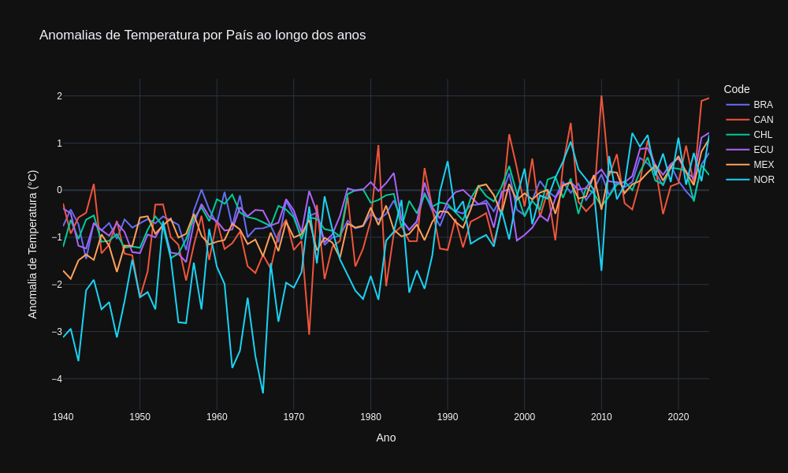
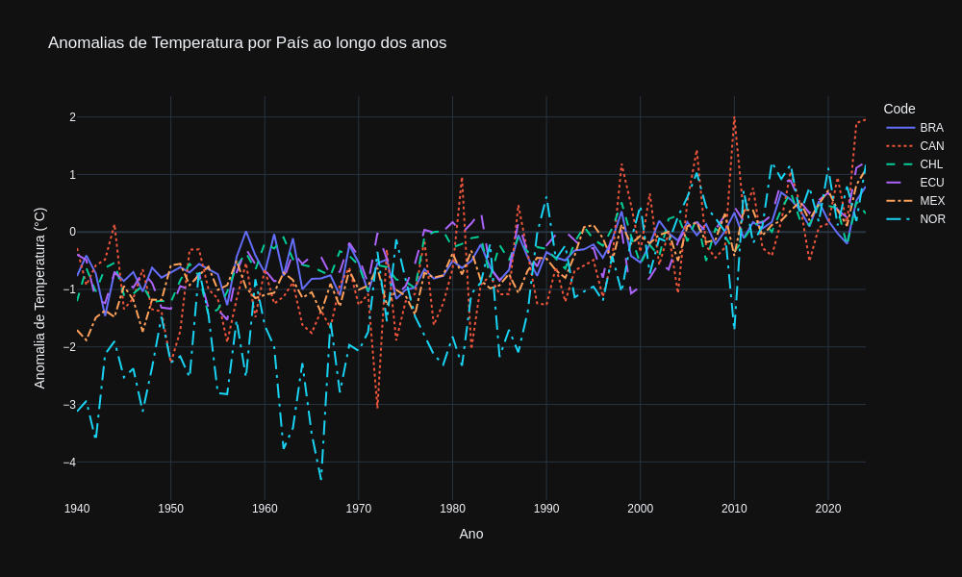
Ruim para daltônicos :(
Ruim para todos :)

Slide 5
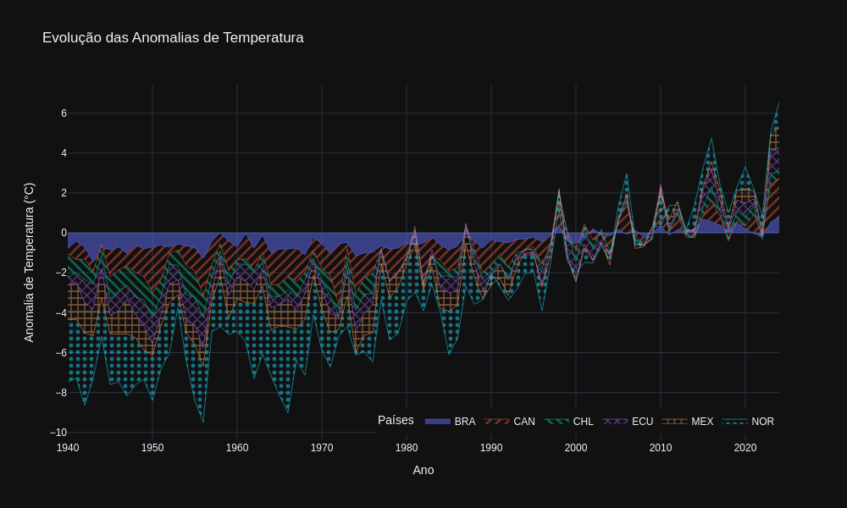

Slide 6
