Slide 1
Identifying the neighborhood of Brooklyn to understand new business openings.

Slide 2
Introduction
To open a new business a variety of insights are requires such as :
Where can a business be opened?
What kind of business can be opened in a particular area?
What is the success rate of the business?
To answer the questions we need to identify the business already present in an area and study them.

Slide 3
Business Problem
A business can grow and develop when there are not much of a competition and when the product produced is of great quality. In any particular area there can be a lot of people with same business and products.

Slide 4
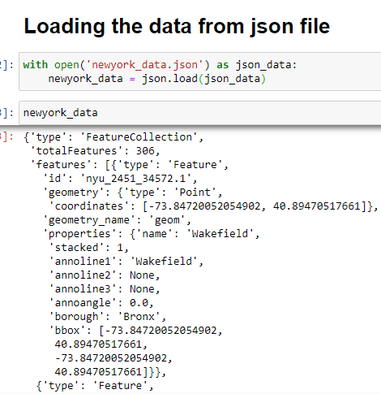
Data

Slide 5
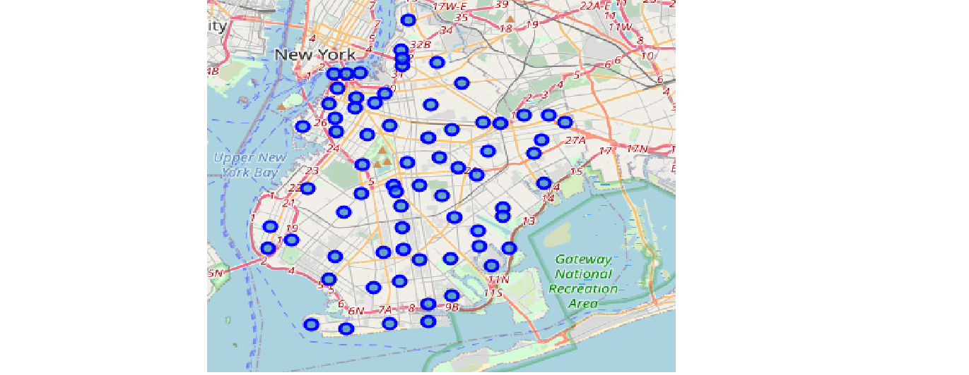
Visualization
Here is a map of Brooklyn which will be clustered.

Slide 6
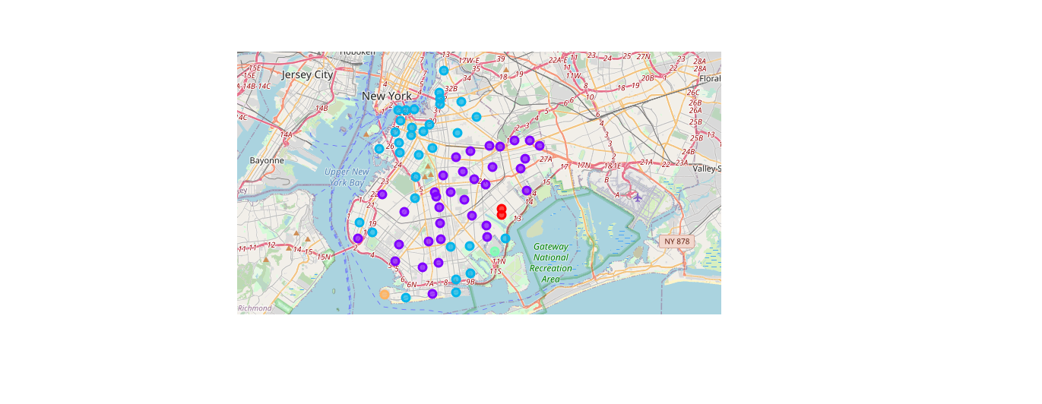
Clustering
Brooklyn after clustering

Slide 7
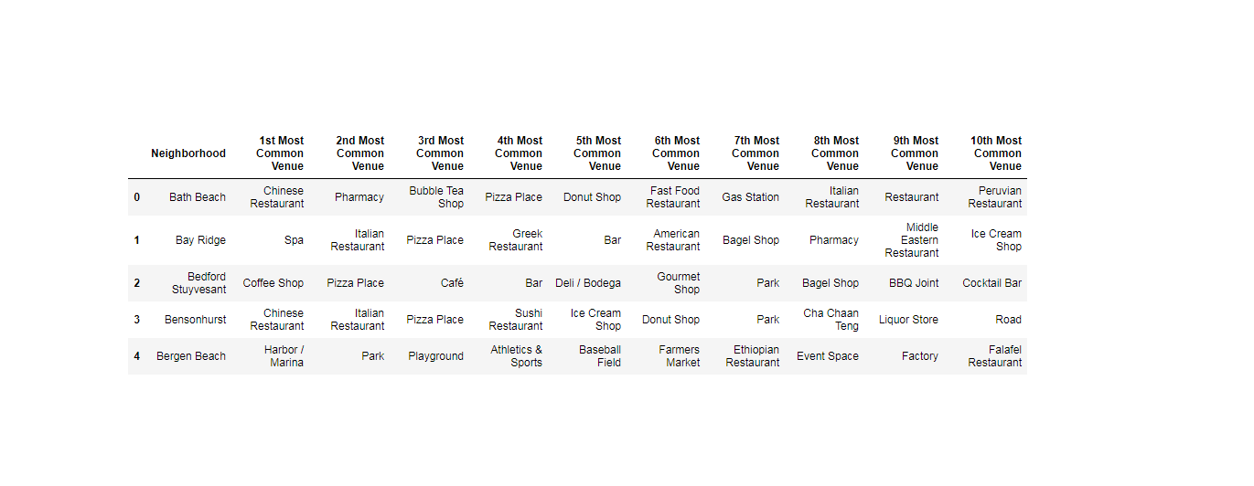
Identifying common venues

Slide 8
Methodology
Brooklyn data is given to K mean for clustering with a cluster of 5.
It creates 5 clusters and identifies the cluster with maximum number of businesses.
We can visualize and see what can be opened in any cluster.

Slide 9
Result and Conclusion
Cluster 1,4 and 5 are ideal to open any new well established businesses such as Dairy, Bakery, Flower shop, Clothing store etc, whereas any new idea or innovation can be tested in cluster 2 and 3 as the amount of well established businesses are already present and the success rate of new business is high (if any new idea) as the population is high in that region.

