Slide 1
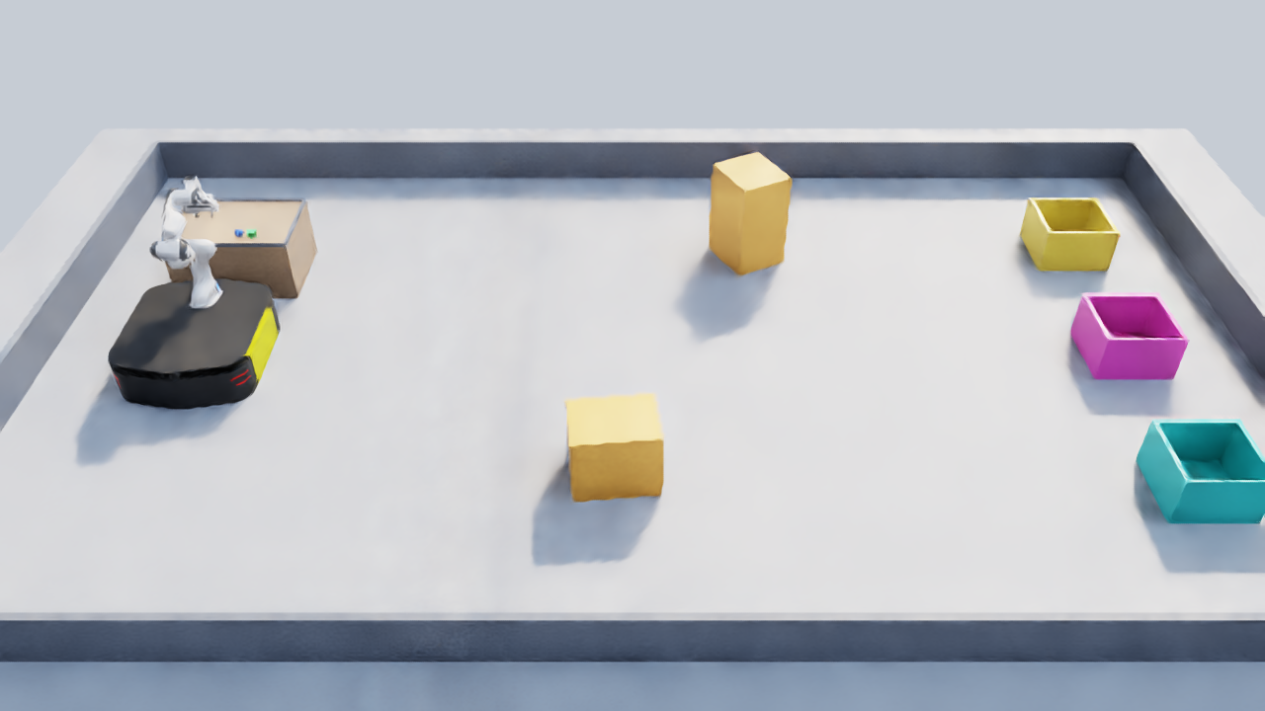
How Small Can a Robot's Eyes Be?
Compact latent visual policies and a vision-language programmer for camera-only mobile manipulation
Author Name · Machine Vision
Notes:
Question of the talk: how much visual information does a robot policy need if everything it sees is squeezed into 16 numbers?

Slide 2
Everything the policy sees fits in 16 numbers
16
255k
1.5 ms
2
dimensional latent vector: the policy's entire view of the world
parameters in the whole network
per decision for six arms (CUDA graph, idle GPU)
low-resolution RGB cameras: head 96×96, wrist 64×64
Research questions
What task structure survives a 16-D visual bottleneck?
Which skills can such a policy perform on its own, and which need a slower, smarter layer above it?
Can a vision-language model program and verify those skills from camera images?

Slide 3
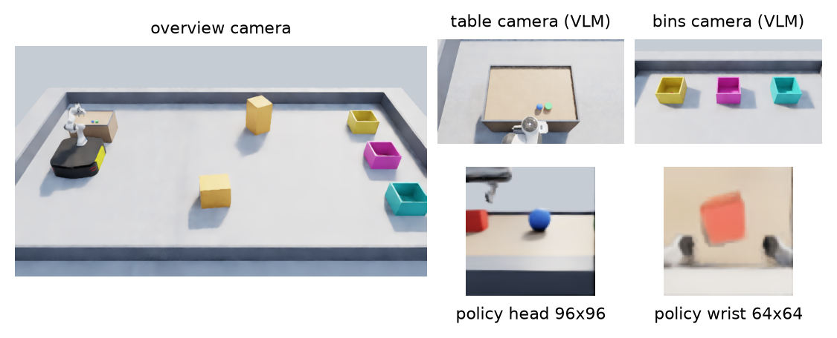
Simulated cell: pick, drive, drop
Isaac Sim 5.1, PhysX 120 Hz, control 15 Hz
Ridgeback + Franka Panda; holonomic base model
Red cube, blue ball, green puck; three bins
Friction grasps only: no welds, no teleporting
Privileged teacher (training data only)
Reads true poses from the simulator: grid path planning for driving, a descent funnel for grasping. Its decisions depend only on the current state, so it can relabel any state the student reaches. It never drives a reported student run.

Slide 4
Two speeds: a VLM writes programs, a tiny policy moves
Claude Opus 5.5 programmer
~10 s per call
reads 4 camera views + execution log, writes face / goto / pick / drop programs, verifies outcomes
Learned latent skills
15 Hz, 1.5–15 ms
pick(color), drop(): gripper x/y/z velocity + grip from two RGB cameras
Fixed controllers
15 Hz
face(): heading control · goto(): grid planner · wrist angle hold · inverse kinematics

Slide 5
Three roles: teacher, student, operator
Teacher
Student
Operator
scripted controller
16-D latent policy
Claude Opus 5.5
Reads exact object poses from the simulator. Demonstrates the task and labels the student's mistakes. Used only to make training data.
Learns to copy the teacher from two camera images alone, without the poses. Becomes the pick and drop skills.
Calls the trained skills, looks at the cameras, checks the outcome and retries. Never sees the teacher or the training data.
→
→
training only
learned
run time
Teacher → student is imitation learning; student → operator is a function call. The teacher can cheat because the simulator knows where everything is. The student has to learn the same behaviour from pixels, which is what a real robot would have.

Slide 6
Latent mixture-of-experts policy
head RGB
96×96 ×2 frames
depthwise CNN +
spatial softmax
gate
z ∈ ℝ¹⁶
latent
4 experts
action chunk K=4
base v · gripper v · grip
wrist RGB
64×64 ×2 frames
depthwise CNN +
spatial softmax
joints · gripper width · base velocity · skill command
phase head (from z)
255,249 parameters · two-thirds in the experts
Rotation is never an output: heading and wrist angle are held by fixed controllers
Whole forward pass captured as one CUDA graph: 7.2 ms → 1.5 ms per decision
Not PCA: z is trained with the action, so it keeps what the robot needs to act, not what varies most in the pixels

Slide 7
Training: imitation, then let the student make mistakes
1
2
3
4
Teacher episodes
Behaviour cloning
DAgger rounds
Specialists
scripted controller with true poses; Gaussian action noise (DART) so recoveries appear
smooth-L1 on action chunks, BCE on grip, phase CE, gate balance; ±4 px shift + colour jitter
student executes each step with probability 1−β; teacher labels every visited state
pick-focused and drive-focused rounds; the executor routes each skill to its checkpoint
Action space mattered more than architecture
With joint-angle deltas, a 5 mm grasp correction is ~0.005 rad, the size of the network's own error, so the student never closed on objects. Gripper velocity in the arm frame turns the same correction into a learnable signal.

Slide 8
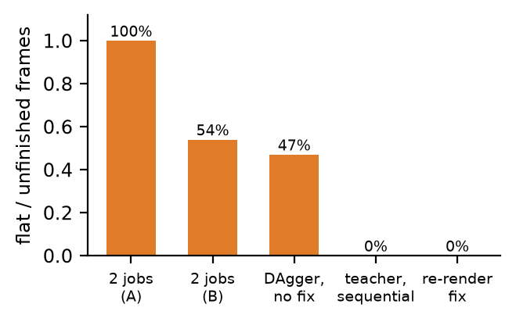
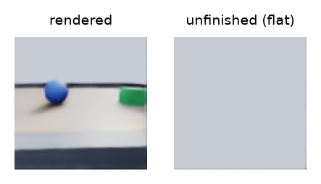
The cameras lied before the model did
~1 m near clip
default camera clipping hid the table, floor and arm right in front of the robot
Unfinished frames
two renderers on one GPU: 100% / 54% sky-only frames; 47% in one DAgger round
Black cameras
120 pick episodes with a black wrist camera, silently dropped by the training filter

Slide 9
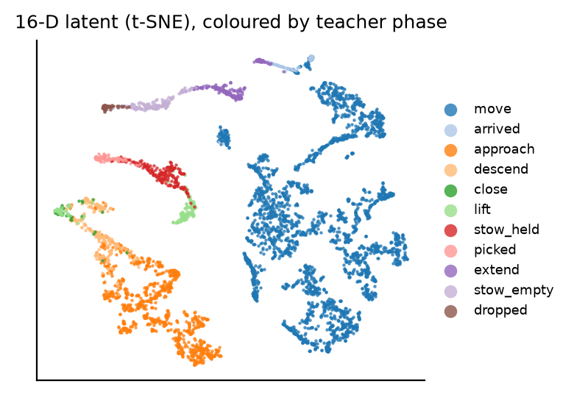
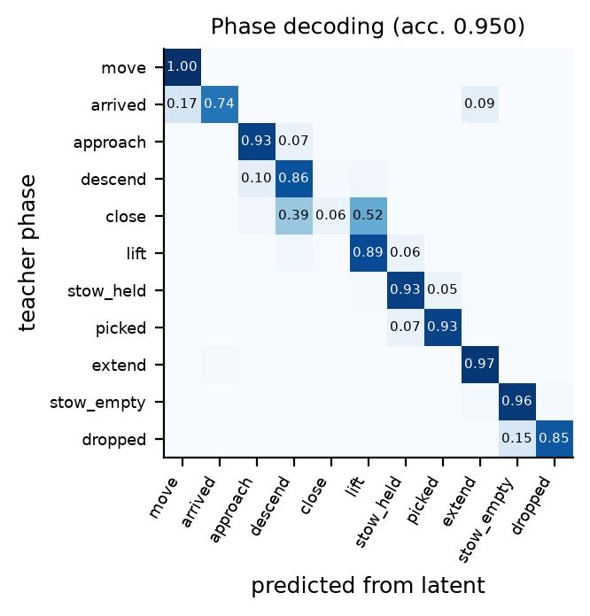
The 16-D latent organises the task
Driving and manipulation separate; pick phases form an ordered curve. A linear head on z recovers the teacher's phase on 95% of frames, confusing only neighbouring phases.

Slide 10
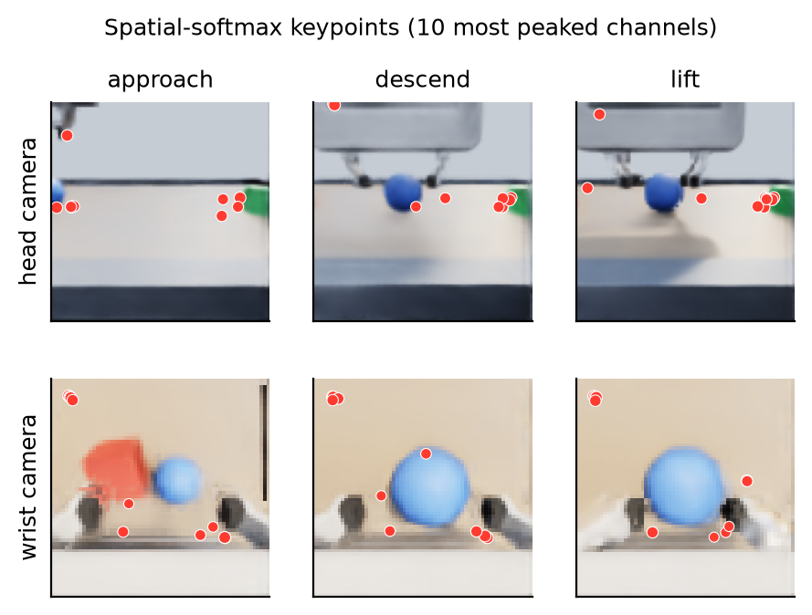
Where the policy looks
Spatial-softmax keypoints
Wrist view: object, fingertips, table edge
Head view: table edge and objects on it
Dot size = how peaked the channel is

Slide 11
Experts specialise by skill without being told
62%
of pick routed to expert 1
66%
of drop routed to expert 3
The skill command is an input, so the gate could route on it; it does, while the latent stays shared across skills.

Slide 12
Ablations: wrist camera and latent size
What it says
The wrist camera carries most of the task information; head-only loses the most
4-D is too small; 64-D helps a little offline
Offline numbers only: they do not predict closed-loop success

Slide 13
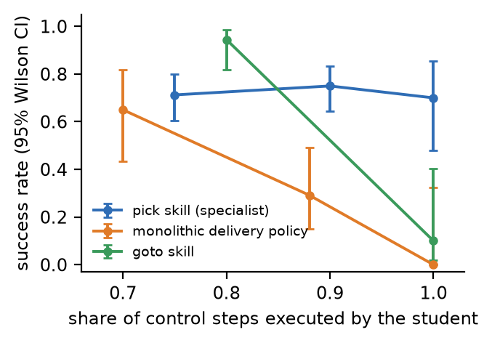
Closed loop: skills work alone, the monolith never did
14/20
camera-only pick, no teacher at all
4/8
full deliveries: learned pick + drop, planner goto
0
solo successes of the end-to-end delivery policy
Success vs share of steps executed by the student (95% Wilson intervals). Points at 1.0 are pure student control.

Slide 14
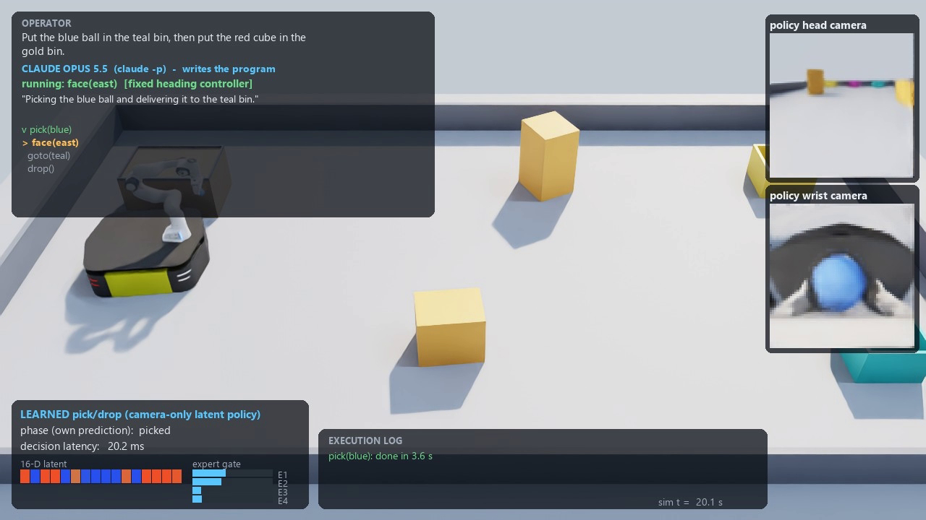
Opus as programmer and verifier
Recorded run
pick(blue) face(east) goto(teal) drop()
Verified from images that the ball left the table
face(west) goto(table) face(north) pick(red)
Retried pick(red) after a timeout
Then stopped, wrongly concluding the cube had left the table: its table and bin cameras had rendered black
Views given | Accuracy | Table | In bin | Floor
table + bins + overview | 83% | 31/31 | 19/31 | 10/10
overview only | 53% | 26/31 | 2/31 | 10/10
Object locations from rendered images vs PhysX ground truth: 24 scenes × 3 objects. Errors are almost all "not visible" abstentions for objects inside bins; only one answer named a wrong location.
Disclosure: the table/bin layout and the pick → face → goto → drop recipe are written in Opus's prompt; it chooses objects, order, checks and retries.

Slide 15
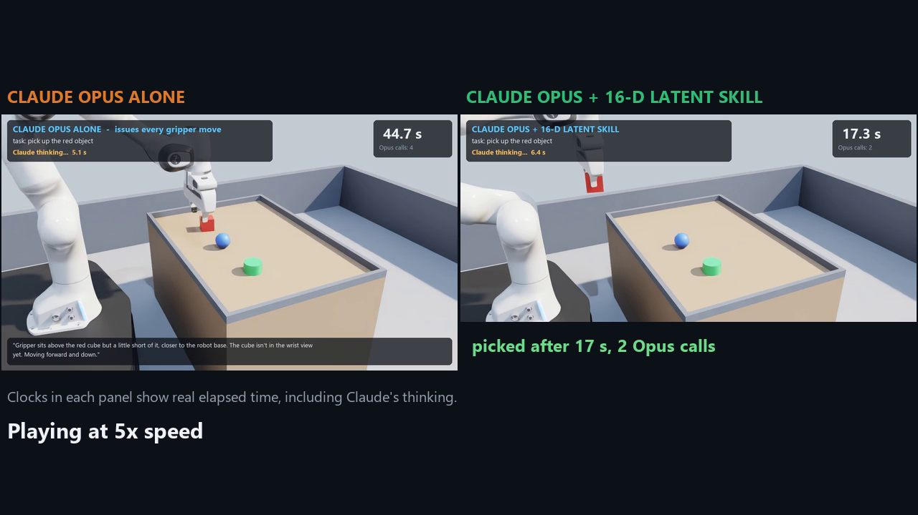
Deployment test: Opus alone vs Opus + 16-D skill
Same robot, same two cameras, same instruction ("pick up the <colour> object"), same Opus model and prompt budget. Success is read from PhysX: the commanded object held 5 cm above the table. Clocks are wall time, including Opus thinking.
Opus alone
Opus + 16-D skill
each call moves the gripper ≤ 8 cm and sets open/close
Opus calls pick(colour); the latent policy closes the loop at 15 Hz
0/6
4/6
successful picks
successful picks
Comparison video (under 60 s), real time then labelled speed-up
never
18 s
A language model reasons well but sees and acts once every ~10 s; contact-rich grasping needs feedback every ~70 ms.
mean time when successful
mean time when successful
13.0 Opus calls per attempt
2.2 Opus calls per attempt

Slide 16
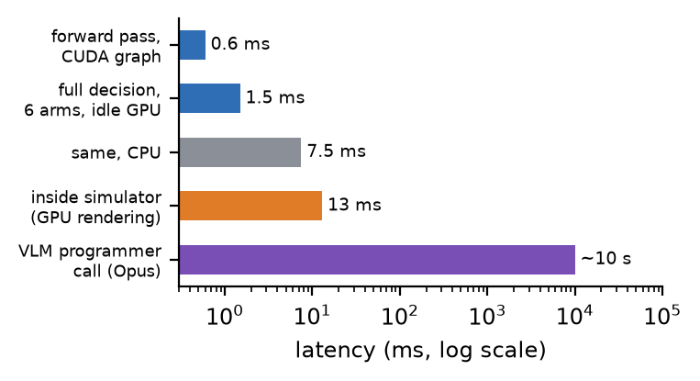
Four orders of magnitude between the two layers
Inside the running simulator a decision takes 6–15 ms, well under the 67 ms control period
A VLM call takes 6–13 s, so it can only act on programs, never on motor commands
The robot holds still while Opus thinks

Slide 17
Where it fits, and the next step
Fits now: fixed, structured cells
Factory stations, warehouses, lab automation: one setting, known parts
A skill takes a few hours, mostly simulator time; training itself is minutes
1.5 ms decisions; 7.5 ms even on a CPU
Needs work: the open world
Varied scenes and objects; learned navigation (1/10 alone here)
Memory and world models: the policy sees only the current frame
Sim-to-real transfer; larger latents (64-D already beat 16-D)
Next: one Opus that builds its own skills, then uses them
describe task
Opus writes the teacher
collect demos
train 16-D student
verify in physics
add to toolbox, operate
→
→
→
→
→
Today these are two separate Opus roles: an engineer (a coding assistant that wrote the teacher, simulator and training code with the author) and an operator (calls skills at run time). The deployed system does not write its own teachers yet; merging the two roles is the next step, with a human still checking each new skill.

Slide 18
Limitations
Simulation only
Small evaluations
holonomic base model, one fixed arena, nearly fixed object positions
8–20 closed-loop trials per condition; wide confidence intervals
Navigation not learned
Offline ablations
learned goto: 34/36 with help, 1/10 alone; replaced by a planner
single training budget, three seeds; no closed-loop ablation

Slide 19
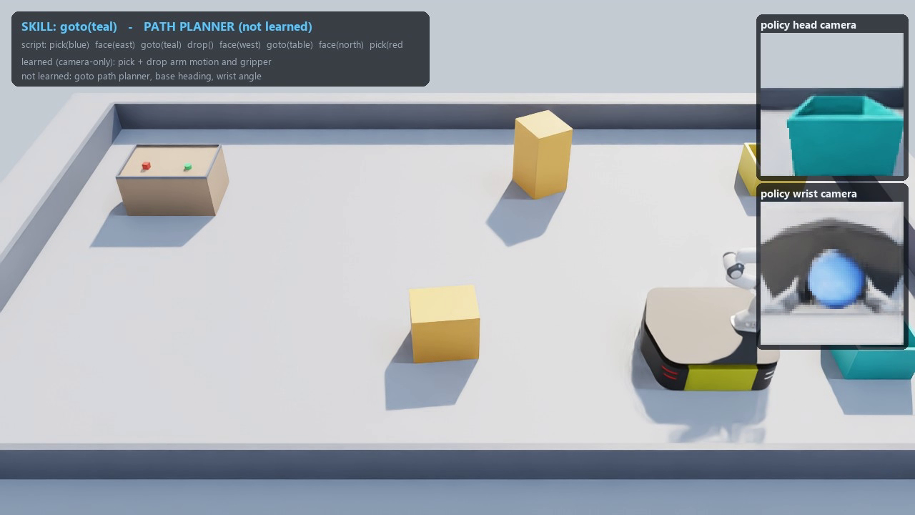
Small eyes, big planner
16 numbers capture the task's structure and drive a camera-only pick 14/20 times
Experts specialise by skill on their own
Complete tasks need a hierarchy at this size: a VLM that programs, verifies and retries
Deployment test: Opus alone picks 0/6, with the 16-D skill 4/6
Check the cameras before blaming the model
Best recorded run: two deliveries by the learned pick and drop skills (real time)

