Slide 1
Rethinking Health Technology
Health-related issues are typically identified by specialists using diagnostic methods. However, real progress requires moving backward to prevention and prediction, and forward to recovery monitoring. By combining behavioral, physiological, and environmental data, we can build systems that monitor, predict, and prevent health issues.

Slide 2
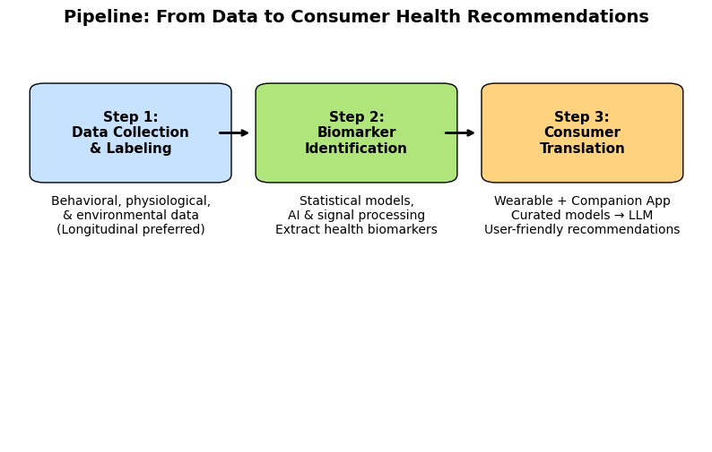
Development Pipeline
Step 1: Data Collection & Labeling → Behavioral, physiological, and environmental inputs; longitudinal data preferred.
Step 2: Biomarker Identification → Statistical models and AI extract meaningful health indicators.
Step 3: Consumer Translation → From research prototype to wearable + companion app feeding curated models into LLM for recommendations.

Slide 3
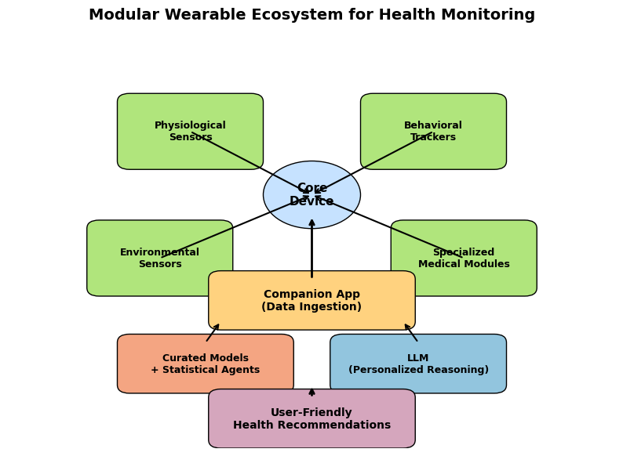
Modular Wearable Ecosystem
A user-friendly core device can be customized with modules (physiological, behavioral, environmental, and specialized medical). Data flows into a companion app, passes through curated models and an LLM, and generates personalized, user-friendly health recommendations.

